Slide 1
Quantization of light, charge and energy
Chapter 2-Class4
Light carries energy :sun
How does light travel and in what form this energy is carried?
Energy can be carried by particles and waves: So does light travel as a stream of particles or as waves?

Slide 2
Energy, Mass, and Momentum of a Photon
Example 11: Photosynthesis.
In photosynthesis, pigments such as chlorophyll in plants capture the energy of sunlight to change CO₂ to useful carbohydrate. About nine photons are needed to transform one molecule of CO₂ to carbohydrate and O₂. Assuming light of wavelength λ = 670 nm (chlorophyll absorbs most strongly in the range 650 nm to 700 nm), how efficient is the photosynthetic process? The reverse chemical reaction releases an energy of 4.9 eV/molecule of CO₂.
Notes:
Solution: The energy of nine photons of wavelength 670 nm is 17 eV; this means the process is 29% efficient.

Slide 3
The photoelectric effect
Problem 22: A certain type of film is sensitive only to light whose wavelength is less than 630 nm. What is the energy (eV and Kcal ) needed for the chemical reaction to occur which causes the film to change?

Slide 4
The Photoelectric Effect
Photoelectric effect demonstrates that light also behaves like a particle.
Energy comes in particle-like chunks, the basics of quantum physics.
(energy of one chunk depends on frequency, a beam of light has
MANY chunks & the energy of the beam is the sum)
Notes:
Can only be explained by introducing some radical
ideas of quantum physics. (light is both wave and particle)
Also, basic physics of all sensitive light detectors, digital
cameras, etc.

Slide 5
Summary of what we know so far:
If light can kick out electron, then even smallest intensities of that light will continue to kick out electrons. Kinetic Energy (KE) of the electrons does not depend on intensity.
2. Lower frequencies of light means lower initial KE of electrons
& KE changes linearly with frequency.
3. There is minimum frequency below which light won’t kick out electrons.
(Einstein) Need “photon” picture of light to explain observations:
- Light comes in chunks (“particle-like”) of energy (“photon”)
- a photon interacts only with single electron
- Photon energy depends on frequency of light, …
for lower frequencies, photon energy not enough to free an electron

Slide 6
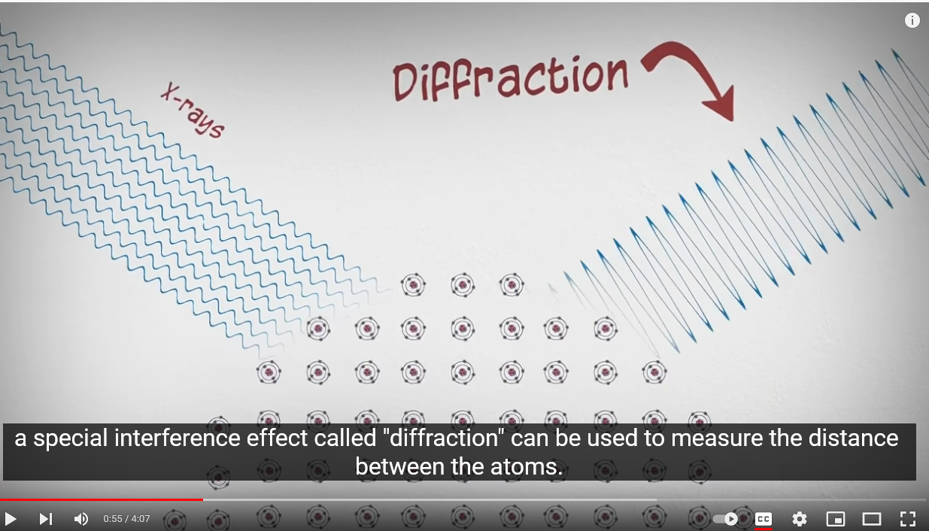
What are x-rays?
https://www.youtube.com/watch?v=QHMzFUo0NL8

Slide 7
The production of X-rays
X-rays were discovered by the Dutch physicist Wilhelm K. Roentgen (1845-1923), who performed much of his work in Germany.
Roentgen’s discovery turned out to be the first significant development in quantum physics.
He found that “rays” originating from the point where the cathode rays (electrons) hit the glass tube, or a target within the tube, could pass through materials opaque to light and activate a fluorescent screen or photographic film.
He investigated this phenomenon extensively and found that all materials are transparent to these rays to some degree and that the transparency decreases with increasing density. This fact led to the medical use of x rays within months after the publication of Roentgen’s first paper.
Roentgen was unable to deflect these rays magnetic field, nor he was able to observe refraction or interference phenomena associated with waves, so he gave the rays the name x-rays.

Slide 8
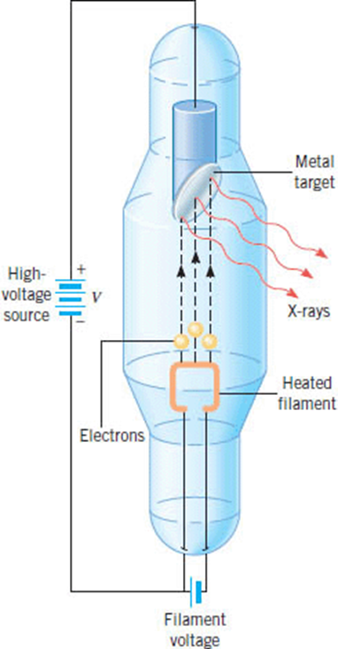
Production of X-rays
X-rays can be produced when electrons, accelerated through a large potential difference, collide with a metal target made, for example, from molybdenum or copper.
The target is contained within an evacuated glass tube.
In an X-ray tube, electrons are emitted by a heated filament, accelerate through a large potential difference, and strike the metal target. The X-rays originate when the electrons interact with the target.

Slide 9
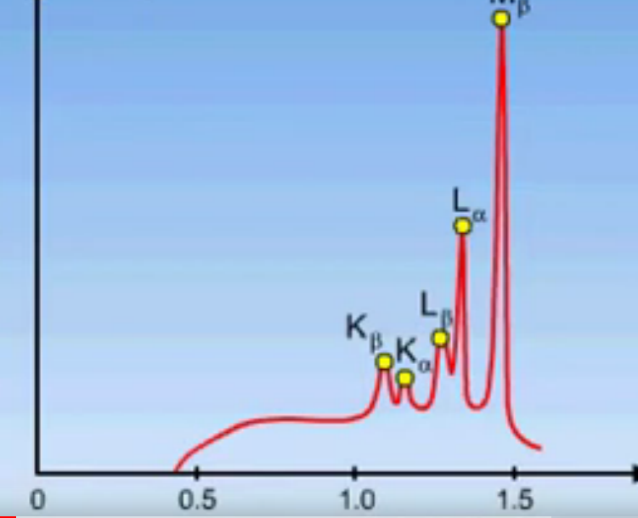
Characteristic Radiation
https://www.youtube.com/watch?v=GRaTKjK6rZI

Slide 10
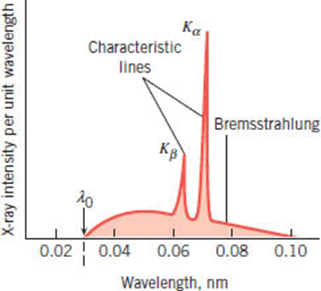
X-ray Spectra
X-rays are electromagnetic waves produced by the acceleration of the electrons when they are deflected and stopped by the atoms of a target.
Such radiation is called Bremsstrahlung, German for “braking radiation.”
The slight diffraction broadening of an x-ray beam after passing through slits a few thousandths of a millimeter wide indicated the wavelength of x rays to be of the order of 10-10 m = 0.1 nm.
The sharp peaks are called characteristic lines or characteristic X-rays because they are characteristic of the target material. The broad continuous spectrum is referred to as Bremsstrahlung and is emitted when the electrons decelerate or “brake” upon hitting the target.
Molybdenum target is bombarded with electrons that have
been accelerated from rest through a potential difference of 45,000 V.
Inner electrons can be ejected by high-energy electrons. The resulting X-ray spectrum is characteristic of the element.

Slide 11
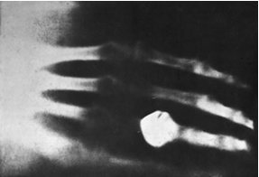
X-ray Tubes
(c)
(a)
(b)
(a) Early x-ray tube[Courtesy of Cavendish Laboratory.] (b) X-ray tubes became more compact over time. This tube was a design typical of the mid-twentieth century. [Courtesy of Schenectady Museum, Hall of Electrical History, Schenectady,
NY.]
(c )An x ray of Mrs. Roentgen’s hand taken by Roentgen shortly after his discovery.

Slide 12
Laue experiment
In 1912 Max von Laue suggested that since the wavelengths of x- rays were of the same order of magnitude as the spacing of atoms in a crystal, the regular array of atoms in a crystal might act as a three- dimensional grating for the diffraction of x-rays.
Experiments (Figures on the left) soon confirmed that x- rays are a form of electromagnetic radiation with wavelengths in the range of about 0.01 to 0.10 nm and that atoms in crystals are arranged in regular arrays.
(b) Photographic plate with Laue spots
Schematic sketch of a Laue experiment. The crystal acts as a three- dimensional grating, which diffracts the x-ray beam and produces a regular array of spots, called a Laue pattern, on photographic film or an x-ray-sensitive charge- coupled device (CCD) detector.
Laue x-ray diffraction pattern using a niobium boride crystal and 20-keV molybdenum x rays. [General Electric Company.]

Slide 13
Bragg Analysis
W. L. Bragg, in 1912, proposed a simple and convenient way of analyzing the diffraction of x-rays by crystals.
He examined the interference of x rays due to scattering from various sets of parallel planes of atoms, now called Bragg planes.
A crystal of NaCl showing two sets of Bragg planes
This is cubic structure called face-centered cubic

Slide 14
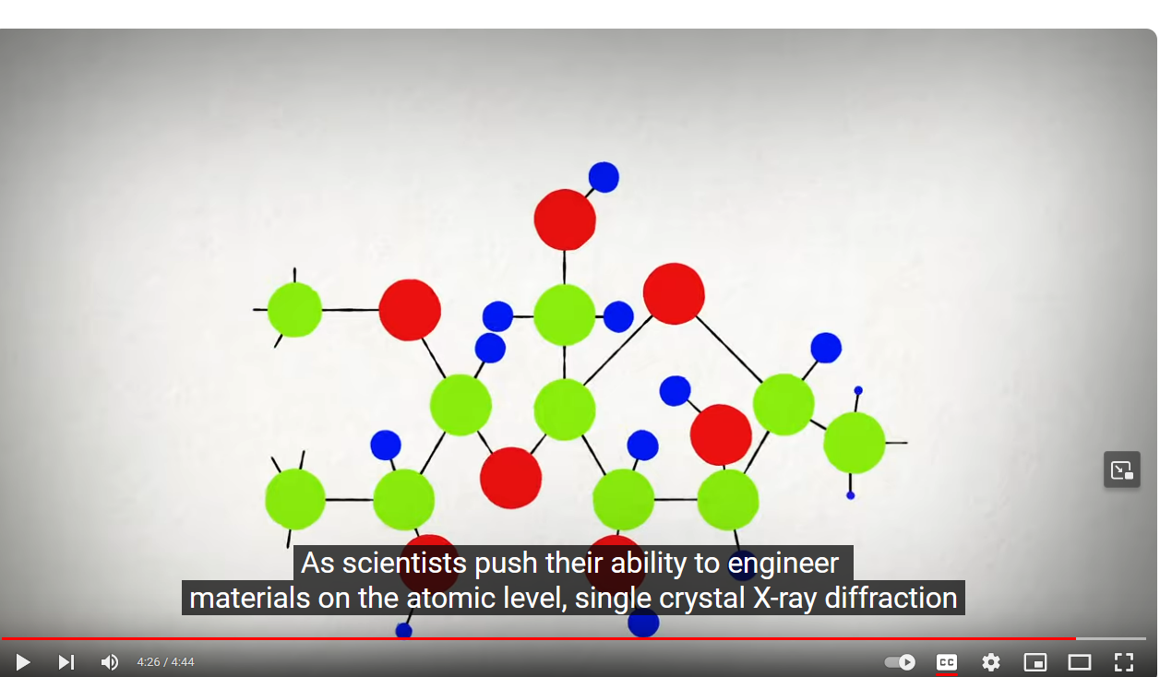
X-ray diffraction by a single crystal
https://www.youtube.com/watch?v=xBA09PXPPR4

Slide 15
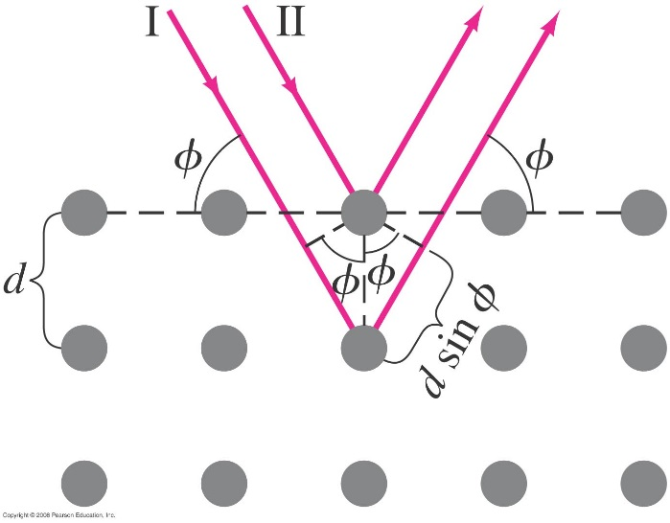
X-Rays and X-Ray Diffraction
The wavelengths of X-rays are very short. Diffraction experiments are impossible to do with conventional diffraction gratings.
Crystals have spacing between their layers that is ideal for diffracting X-rays.
Waves scattered at equal angles from atoms in two different planes will be in phase (constructive interference) only if the difference in path length is an integral number of wavelengths. From Figure below we see that this condition is satisfied if
2d sin Ф= mλ where m = an integer, and is called the Bragg condition
Ф Ф angle between plane and wave
Bragg scattering happens from two successive planes.
The waves from the two atoms shown have a path length difference of 2d sin Ф.
They will be in phase if the Bragg condition 2d sin Ф = mλ is met.
Notes:
Figure 35-28. X-ray diffraction by a crystal.

