Slide 1
Wave & particle: Quantization of light, charge and energy Chapter 2
Light carries energy :sun
How does light travel and in what form this energy is carried?
Energy can be carried by particles and waves: So does light travel as a stream of particles or as waves?

Slide 2
Doppler Effect (sound)
https://www.youtube.com/watch?v=h4OnBYrbCjY

Slide 3
Doppler Effect (light)
https://www.youtube.com/watch?v=3mJTRXCMU6o

Slide 4
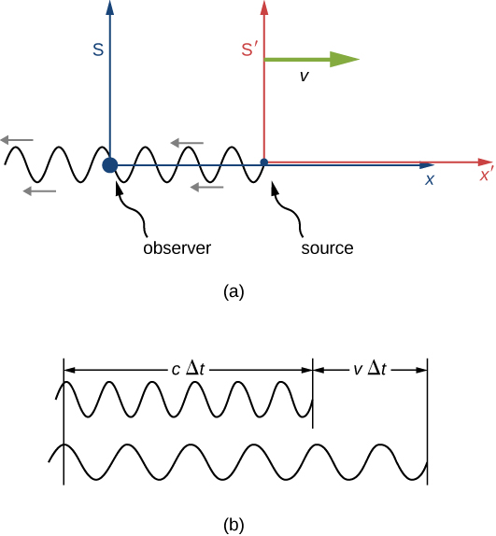
The Doppler effect for Light
Suppose an observer in S sees light from a source in S‘, S′ moving away at velocity v. The wavelength of the light could be measured within S‘.
But because of the motion of S' relative to S, considered solely within S, the observer sees the wave pattern, and therefore the wavelength, stretched out.
Light from moving objects will appear to have different wavelengths depending on the relative motion of the source and the observer.
Notes:
Figure 36-14. Doppler shift for light. (a) Source and observer at rest. (b) Source moving toward stationary observer.

Slide 5
Doppler Shift for Light
Hence, one can derive the observed frequency and wavelength:
f₀ is the frequency of the light as seen in the source’s reference frame, f is measured by an observer moving towards the source.
If the source and observer are moving away from each other, v changes sign.

Slide 6
Red Shift and Blue Shift
The observed wavelength λ of electromagnetic radiation is longer (called a “red shift”) than that emitted by the source λ₀ when the source moves away from the observer. Similarly, the wavelength is shorter (called a “blue shift”) when the source moves toward the observer. The amount of change is determined by:
$λ=λ_{0}\sqrt{\frac{c+v}{c−v}}$
Visible light will have its wavelength lengthened toward the red end of the visible spectrum (red shift).
Visible light will have its wavelength shortened toward the blue end of the visible spectrum (blue shift).

Slide 7
Doppler Shift for Light
Example 13: Speeding through a red light.
A driver claims that he did not go through a red light because the light was Doppler shifted and appeared green. Calculate the speed of a driver in order for a red light to appear green.
Notes:
Applying the Doppler shift, with red light at 650 nm and green at 500 nm, gives v = 0.26c.

Slide 8
Doppler Shift for Light
Example 14: A certain galaxy has a Doppler shift given by f₀-f= 0.0987f₀ . How fast is it moving away from us?

Slide 9
Doppler Shift for Light
Example 15 :A spaceship moving toward Earth at 0.70c transmits radio signals at 95.0 MHz. At what frequency should Earth receivers be tuned?

Slide 10
The Impact of Special Relativity
The predictions of special relativity have been tested thoroughly, and verified to great accuracy.
The correspondence principle says that a more general theory must agree with a more restricted theory where their realms of validity overlap. This is why the effects of special relativity are not obvious in everyday life.

Slide 11
Summary of Chapter 1
Inertial reference frame: one in which Newton’s first law holds.
Principles of relativity: the laws of physics are the same in all inertial reference frames; the speed of light in vacuum is constant regardless of speed of source or observer.
Time dilation:
.

Slide 12
Summary of Chapter 1
Length contraction:
Gamma:

Slide 13
Summary of Chapter 1
Lorentz transformations:
.
Relativistic momentum:

Slide 14
Summary of Chapter 1
Mass–energy relation:
Kinetic energy:
Total energy:
Relationship between energy and momentum:

Slide 15
Quantization of light, charge and energy Chapter 2
Light carries energy :sun
How does light travel and in what form this energy is carried?
Energy can be carried by particles and waves: So does light travel as a stream of particles or as waves?

Slide 16
Light Is a Particle! (Sir Isaac Newton)
Known for his Law of Universal Gravitation, English physicist Sir Isaac Newton (1643 to 1727) realized that light had frequency-like properties when he used a prism to split sunlight into its component colors. Nevertheless, he thought that light was a particle because the periphery of the shadows it created was extremely sharp and clear.

Slide 17
Light Is a Wave! (Grimaldi and Huygens)
The wave theory, which maintains that light is a wave, was proposed around the same time as Newton's theory. In 1665, Italian physicist Francesco Maria Grimaldi (1618 to 1663) discovered the phenomenon of light diffraction and pointed out that it resembles the behavior of waves. Then, in 1678, Dutch physicist Christian Huygens (1629 to 1695) established the wave theory of light and announced the Huygens' principle.

Slide 18
Light Is Unequivocally a Wave! (Fresnel and Young)
Some 100 years after the time of Newton, French physicist Augustin-Jean Fresnel (1788 to 1827) asserted that light waves have an extremely short wavelength and mathematically proved light interference. In 1815, he developed physical laws for light reflection and refraction, as well. In 1817, English physicist Thomas Young (1773 to 1829) calculated light's wavelength from an interference pattern, thereby not only figuring out that the wavelength is 1 μm ( 1 μm = one millionth of a meter ) or less, but also that light is a transverse wave. At that point, the particle theory of light fell out of favor and was replaced by the wave theory.

Slide 19
Light Is a Wave - an Electromagnetic Wave! (Maxwell)
The next theory was provided by the brilliant Scottish physicist James Clerk Maxwell (1831 to 1879). In 1864, he predicted the existence of electromagnetic waves, the existence of which had not been confirmed before that time, and out of his prediction came the concept of light being a wave, or more specifically, a type of electromagnetic wave.

Slide 20
Light Is Also a Particle! (Einstein)
The theory of light being a particle completely vanished until the end of the 19th century when Albert Einstein revived it. Now that the dual nature of light as "both a particle and a wave" has been proved, its essential theory was further evolved from electromagnetics into quantum mechanics. Einstein believed light is a particle (photon) and the flow of photons is a wave. The main point of Einstein's light quantum theory is that light's energy is related to its oscillation frequency. He maintained that photons have energy equal to "Planck's constant times oscillation frequency," and this photon energy is the height of the oscillation frequency while the intensity of light is the quantity of photons. The various properties of light, which is a type of electromagnetic wave, are due to the behavior of extremely small particles called photons that are invisible to the naked eye.

Slide 21
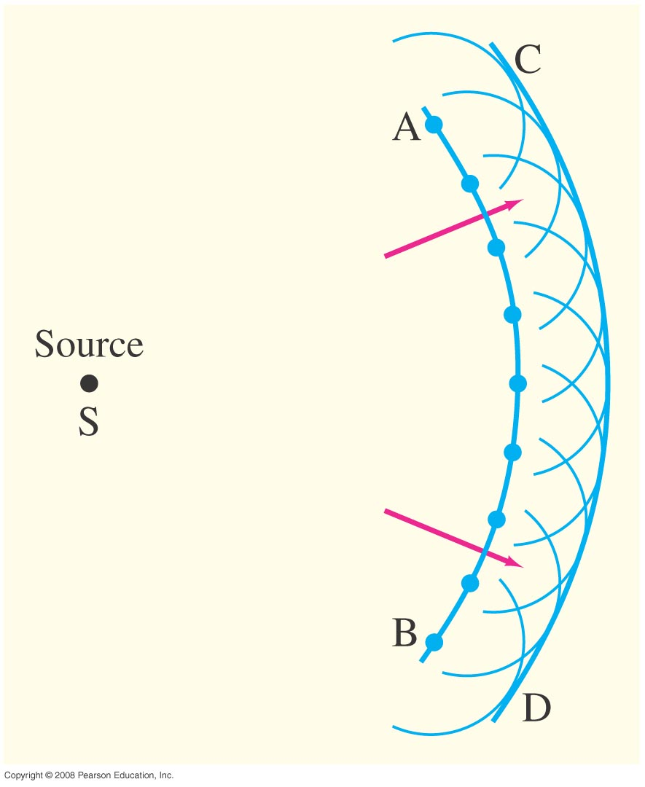
Waves versus Particles; Huygens’ Principle and Diffraction
Huygens proposed the wave theory of light, he developed a technique that predict the future position of a wave front when an earlier position is known.
Huygens’ principle: every point on a wave front acts as a point source; the wave front as it develops is tangent to all the wavelets.
Notes:
Figure 34-1. Huygens’ principle, used to determine wave front CD when wave front AB is given.

Slide 22
Waves versus Particles; Huygens’ Principle and Diffraction
Huygens’ principle is consistent with diffraction:
When a wave impinge on an obstacle, the wave front is interrupted.
Huygens predicted that waves bend behind an obstacle: Diffraction
Notes:
Figure 34-2. Huygens’ principle is consistent with diffraction (a) around the edge of an obstacle, (b) through a large hole, (c) through a small hole whose size is on the order of the wavelength of the wave.

Slide 23
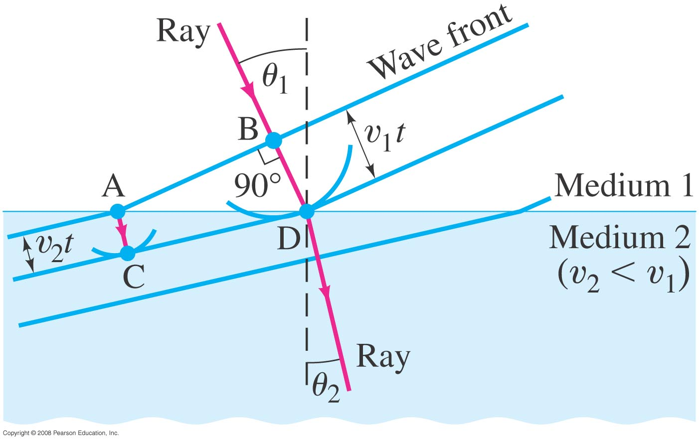
Huygens’ Principle and the Law of Refraction
Huygens’ principle can also explain the law of refraction.
As the wavelets propagate from each point, they propagate more slowly in the medium of higher index of refraction.
This leads to a bend in the wave front and therefore in the ray.
Notes:
Figure 34-3. Refraction explained, using Huygens’ principle. Wave fronts are perpendicular to the rays.

Slide 24
Huygens’ Principle and the Law of Refraction
The frequency of the light does not change, but the wavelength does as it travels into a new medium:

Slide 25
Huygens’ Principle and the Law of Refraction
Highway mirages are due to a gradually changing index of refraction in heated air.
In hot days car drivers see mirages of water due to a layer of hot air in the air. Hot air is less dense than cold air, so the index of refraction is slightly lower for the van heading towards the observer in the truck.
Ray A goes directly to the observer, Ray B bends slightly as it moves through a different index of refraction. The wavefront moves faster in air, the wave bends but seems to be coming from below (dashed lines) for the observer
Notes:
Figure 34-4. (a) A highway mirage. (b) Drawing (greatly exaggerated) showing wave fronts and rays to explain highway mirages. Note how sections of the wave fronts near the ground move faster and so are farther apart.

Slide 26
Interference – Young’s Double-Slit Experiment
If light is a wave, interference effects will be seen, where one part of a wave front can interact with another part.
One way to study this is to do a double-slit experiment:
Notes:
Figure 34-5. (a) Young’s double-slit experiment. (b) If light consists of particles, we would expect to see two bright lines on the screen behind the slits. (c) In fact, many lines are observed. The slits and their separation need to be very thin.

Slide 27
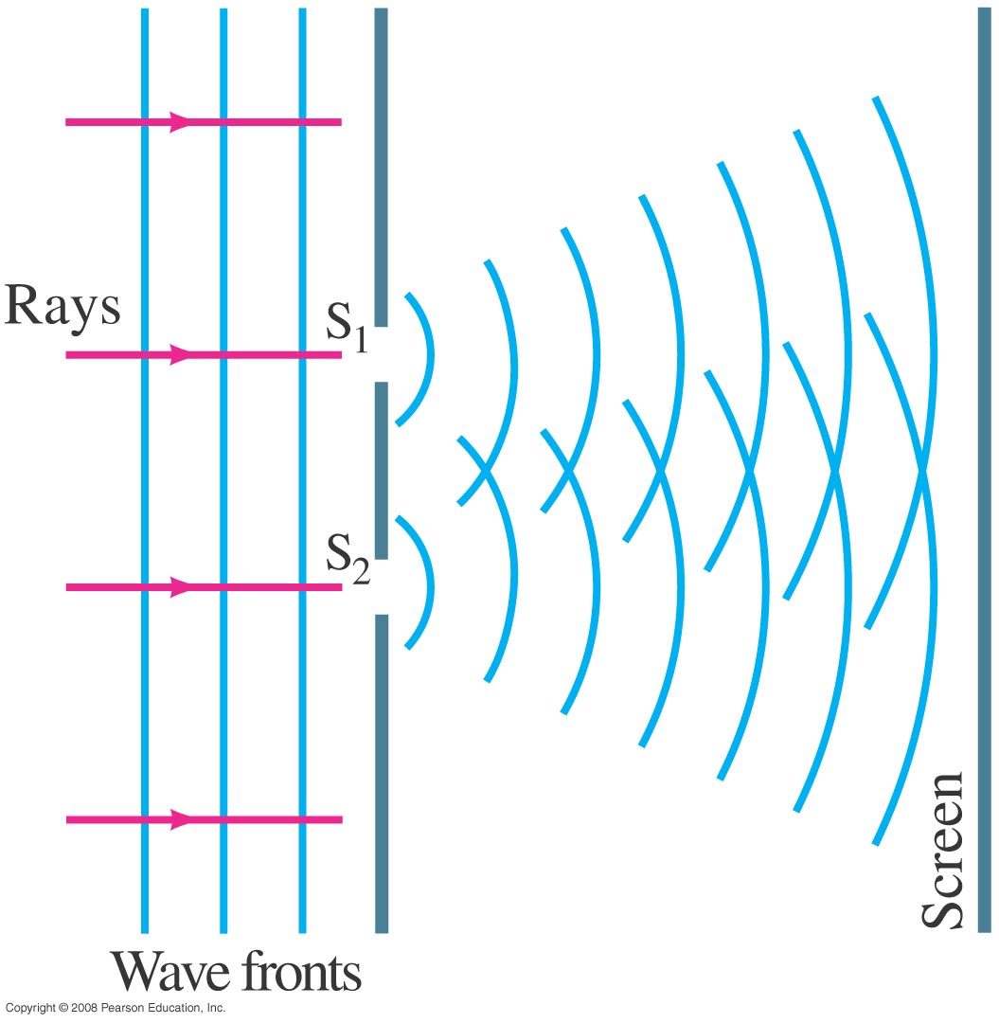
Interference – Young’s Double-Slit Experiment
Monochromatic wavelength (single wavelength) through two slits.
If light is a wave, there should be an interference pattern.
Notes:
Figure 34-6. If light is a wave, light passing through one of two slits should interfere with light passing through the other slit.

Slide 28
Interference – Young’s Double-Slit Experiment
The interference occurs because each point on the screen is not the same distance from both slits. Depending on the path length difference, the wave can interfere constructively (bright spot) or destructively (dark spot).
Notes:
Figure 34-7. How the wave theory explains the pattern of lines seen in the double-slit experiment. (a) At the center of the screen the waves from each slit travel the same distance and are in phase. (b) At this angle θ, the lower wave travels an extra distance of one whole wavelength, and the waves are in phase; note from the shaded triangle that the path difference equals d sin θ. (c) For this angle θ, the lower wave travels an extra distance equal to one-half wavelength, so the two waves arrive at the screen fully out of phase. (d) A more detailed diagram showing the geometry for parts (b) and (c).

Slide 29
Interference – Young’s Double-Slit Experiment
We can use geometry to find the conditions for constructive and destructive interference:
and

Slide 30
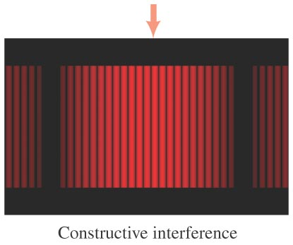
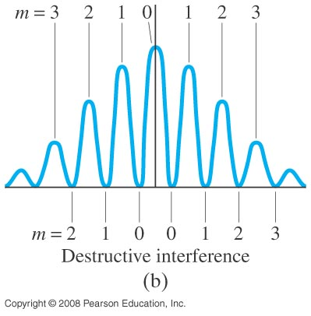
Interference – Young’s Double-Slit Experiment
Between the maxima and the minima, the interference varies smoothly.
Notes:
Figure 34-9. (a) Interference fringes produced by a double-slit experiment and detected by photographic film placed on the viewing screen. The arrow marks the central fringe. (b) Graph of the intensity of light in the interference pattern. Also shown are values of m for Eq. 34–2a (constructive interference) and Eq. 34–2b (destructive interference).

Slide 31
Interference – Young’s Double-Slit Experiment
Conceptual Example 1: Interference pattern lines.
(a) Will there be an infinite number of points on the viewing screen where constructive and destructive interference occur, or only a finite number of points? (b) Are neighboring points of constructive interference uniformly spaced, or is the spacing between neighboring points of constructive interference not uniform?
Notes:
Solution. a. Due to the fact that sin θ cannot be greater than 1, the maximum value of m is equal to the (truncated) value of d/λ.
b. The spacing increases with θ, although for small θ it is close to being uniform.

Slide 32
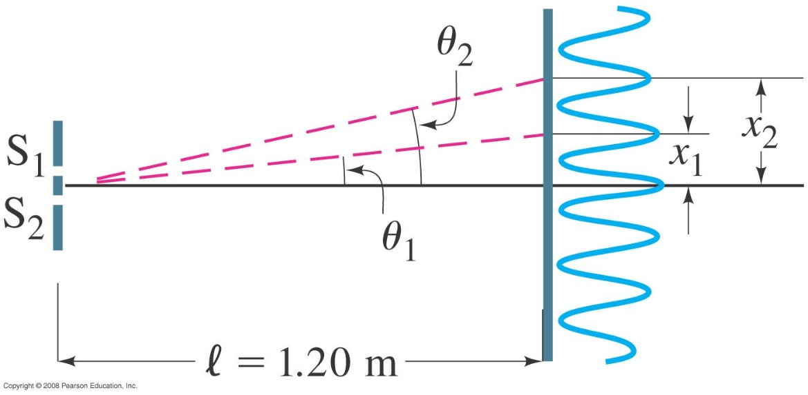
Interference – Young’s Double-Slit Experiment
Example 2: Line spacing for double-slit interference.
A screen containing two slits 0.100 mm apart is 1.20 m from the viewing screen. Light of wavelength λ = 500 nm falls on the slits from a distant source. Approximately how far apart will adjacent bright interference fringes be on the screen?
Notes:
Figure 34-10. Examples 34–2 and 34–3. For small angles θ (give θ in radians), the interference fringes occur at distance x = θl above the center fringe (m = 0); θ₁ and x₁ are for the first-order fringe (m = 1), θ₂ and x₂ are for m = 2.
Solution: Using the geometry in the figure, x ≈ lθ for small θ, so the spacing is 6.0 mm.

