Slide 1
Special Relativity
Chapter 1-Class3

Slide 2
Relative Simultaneity
Two Events at different locations that are simultaneous in one frame of reference will not be simultaneous in a frame of reference moving relative to the first

Slide 3
Time Dilation
Calculating the difference between clock “ticks,” we find that the interval in the moving frame is related to the interval in the clock’s rest frame:
Δt is the time measured by the observer on earth
between sending and receiving the light
Δt₀ is the time measured by the observer on the spaceship.

Slide 4
Time Dilation
The factor multiplying Δt₀ occurs so often in relativity that it is given its own symbol, γ:
We can then write
Δt>Δt₀ this is a result of the theory of relativity, and is called time dilation
Δt₀ is called proper time
.

Slide 5
Proper Time
…refers to the time measured by a clock in an inertial frame where it is at rest.
Example: Any given clock never moves with respect to itself. It keeps proper time for itself in its own rest frame.
Any observer moving with respect to this clock sees it run slow (i.e., time intervals are longer). This is time dilation.
Mathematically: Event 1: (x₁,y₁,z₁,t₁)
Event 2: (x₁,y₁,z₁,t₂)
Proper time is the shortest time that can be recorded between two events.
Δt₀=t₂-t₁
Same location

Slide 6
Time Dilation
Two events occurring at the same location in one frame will be separated by a longer time interval in a frame moving relative to the first

Slide 7
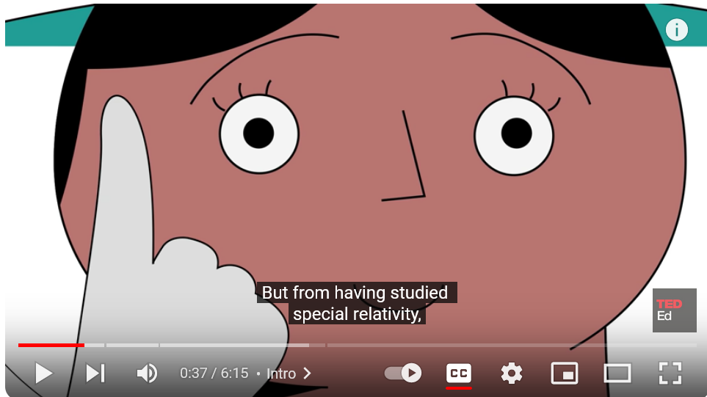
Twin Paradox
https://www.youtube.com/watch?v=h8GqaAp3cGs

Slide 8
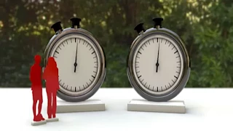
GPS and relativity
https://www.youtube.com/watch?v=x7mWlAauLPs

Slide 9
Important conclusion
Where something is, depends on when you check on it (and on the movement of your own reference frame).
Time and space are not independent quantities; they are related by relative velocity.

Slide 10
Length Contraction
If time intervals are different in different reference frames, lengths must be different as well. Length contraction is given by
or
Length contraction occurs only along the direction of motion.

Slide 11
Length Contraction
The length of an object in a frame through which the object moves is smaller than its length in the frame in which it is at rest

Slide 12
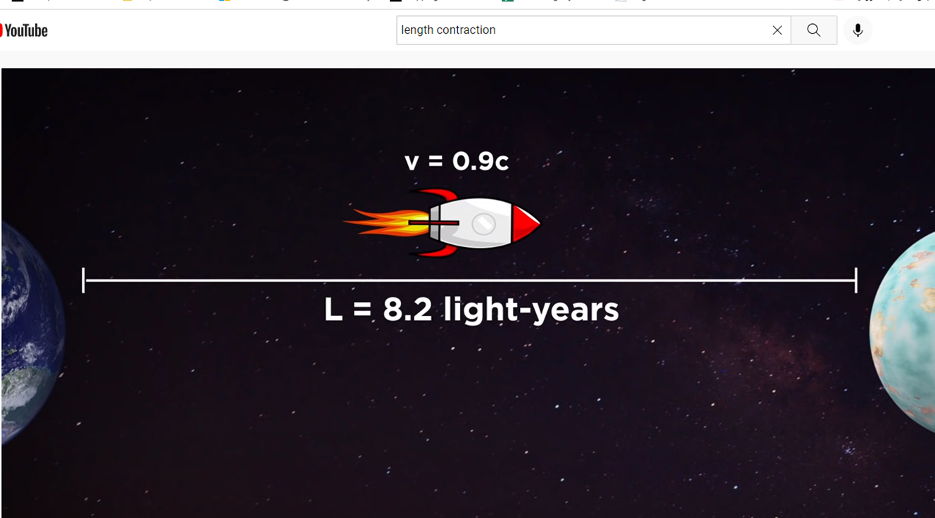
Length Contraction
https://www.youtube.com/watch?v=FPzGAksFCbs

Slide 13
Length of an object
This stick is 3m long. I measure both ends at the same time in my frame of reference.
“Same time” or not doesn’t actually matter here, because the stick isn’t going anywhere.
... -3 -2 -1 0 1 2 3 ...
This length, measured in the stick’s rest frame, is its proper length.

Slide 14
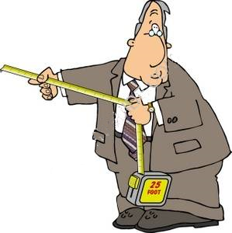
‘Proper length’
Proper length: Length of object measured in the frame where it is at rest (use a ruler)
... -3 -2 -1 0 1 2 3 ...

Slide 15
Remember ‘proper time’
Proper time: Time interval Δt₀=t₂-t₁ between two events measured in the frame where the two events occur at the same spatial coordinate, i.e. a time interval that can be measured with one clock.
v

Slide 16
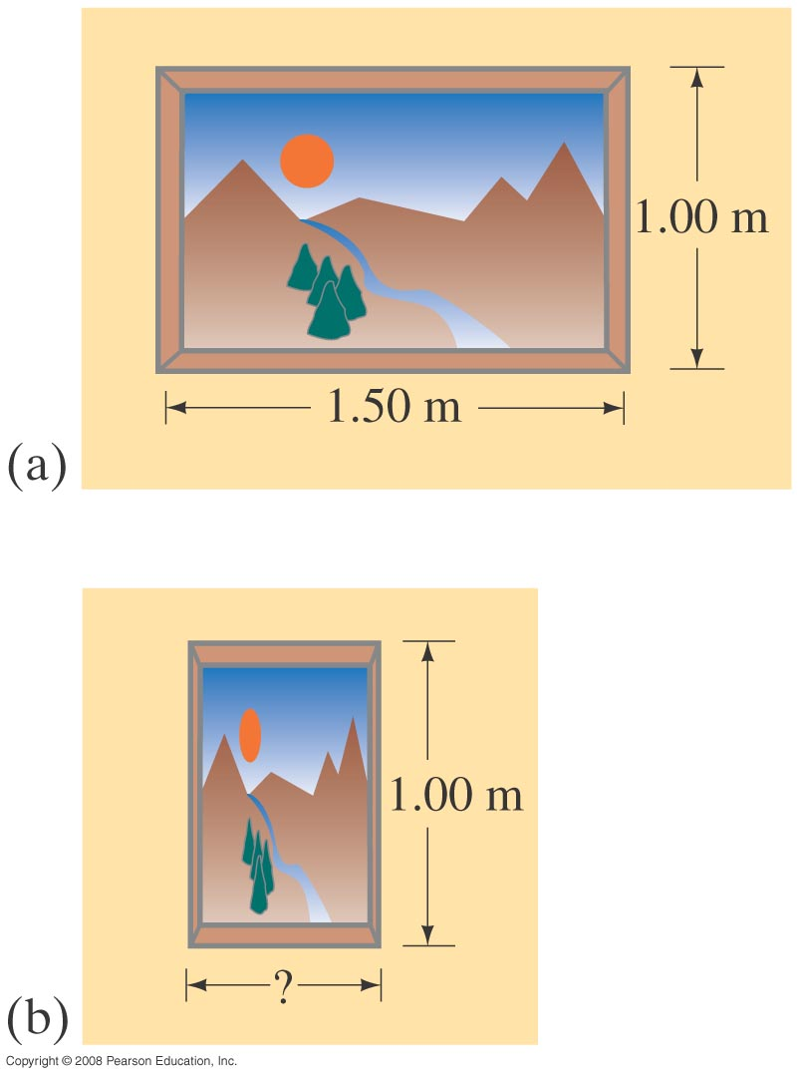
Length Contraction
Example 5: Painting’s contraction.
A rectangular painting measures 1.00 m tall and 1.50 m wide. It is hung on the side wall of a spaceship which is moving past the Earth at a speed of 0.90c. (a) What are the dimensions of the picture according to the captain of the spaceship? (b) What are the dimensions as seen by an observer on the Earth?
Notes:
Solution: a. The captain is in the rest frame of the painting, and sees it as 1.00 m tall and 1.50 m wide.
b. The height is unchanged; the length is shortened to 0.65 m.

Slide 17
Length Contraction
Example 6: A fantasy supertrain.
A very fast train with a proper length of 500 m is passing through a 200-m-long tunnel. Let us imagine the train’s speed to be so great that the train fits completely within the tunnel as seen by an observer at rest on the Earth. That is, the engine is just about to emerge from one end of the tunnel at the time the last car disappears into the other end. What is the train’s speed?
Notes:
Solution: The speed needs to be fast enough that the 500-m length of the train is contracted to 200 m. Substituting in the length contraction equation and solving for v gives v = 0.92c. (This is where the fantasy comes in).

Slide 18
Length Contraction
Conceptual Example 7: Resolving the train and tunnel length.
Observers at rest on the Earth see a very fast 200-m-long train pass through a 200-m-long tunnel (as in Example 6) so that the train momentarily disappears from view inside the tunnel. Observers on the train measure the train’s length to be 500 m and the tunnel’s length to be only 78 m. Clearly a 500-m-long train cannot fit inside a 78-m-long tunnel. How is this apparent inconsistency explained?
Notes:
Solution: The observers on the train see the front end of the train exit the tunnel before the back end enters it. This is due to the lack of agreement on simultaneity between different inertial reference frames.

