Slide 1
Special Relativity
Chapter 1-Class2

Slide 2
Postulates of the Special Theory of Relativity
The laws of physics have the same form in all inertial reference frames.
Light propagates through empty space with speed c independent of the speed of source or observer.
This solves the ether problem – the speed of light is in fact the same in all inertial reference frames.

Slide 3
Einstein’s Postulates
Einstein looked at the EM waves as being a magnetic field and an electric field moving and changing amplitudes in space not in time, so it was not reasonable to get a c reduced or equal to 0.
He concluded there was no ether
The First Postulate:
Postulate 1: is an extension of the Newtonian principle of relativity to include all types of physical measurements (not just measurements in mechanics).
The laws of physics are the same for observers in all inertial reference frames. No one frame is preferred over any other.
It is impossible to prove that any one frame is truly in motion or is truly at rest. No motion is absolute-all is relative
Galileo assumed that the laws of mechanics were the same in all inertial reference frames. Einstein extended that idea to include all the laws of physics, especially those of electromagnetism and optics.
It is the laws of physics, which relate these measurements of physical quantities to one another, that are the same.

Slide 4
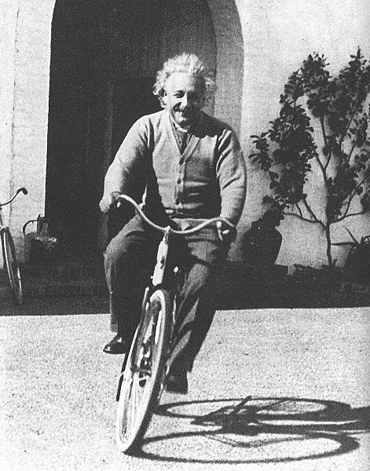
Einstein’s Postulate of Relativity
The laws of physics are the same in all inertial frames of reference.

Slide 5
Einstein’s Postulates
Second Postulate:
Postulate 2 describes a common property of all waves:
For example: the speed of sound waves does not depend on the motion of the sound source. When an approaching car sounds its horn, the frequency heard increases according to the Doppler effect, but the speed of the waves traveling through the air does not depend on the speed of the car
The speed of light in vacuum has the same value c in all directions and in all inertial reference frames.
Light moves at the same speed relative to all observers.
Light travel at an ultimate speed.

Slide 6
Conclusion
The speed of light is the same in all inertial frames of reference.
Einstein, 1905
This was still new in 1905 when Einstein proposed it. Now it has been tested experimentally many times.

Slide 7
Special relativity
https://www.youtube.com/watch?v=AInCqm5nCzw

Slide 8
Special Relativity
https://www.youtube.com/watch?v=yuD34tEpRFw

Slide 9
Simultaneity-Events
Both postulates have been exhaustively tested, and no exceptions have ever been found.
A physical event is something that happens, like the closing of a door, a lightning strike, the collision of two particles, your birth, or the explosion of a star.
Every event occurs at some point in space and at some instant in time.
It is very important to recognize that events are independent of the particular inertial reference frame that we might use to describe them
Definition: An event is a measurement of where something is and when it is there.

Slide 10
Observers
Events are described by observers who do belong to particular inertial frames of reference.
Observers could be people, electronic instruments, or other suitable recorders, but for our discussions in special relativity we are going to be very specific.
Strictly speaking, the observer will be an array of recording clocks located throughout the inertial reference system.
you can think of the observer as a person who goes around reading out the memories of the recording clocks or receives records that have been transmitted from distant clocks, but always keep in mind that in reporting events, such a person is strictly limited to summarizing the data collected from the clock memories.

Slide 11
Simultaneity
One of the implications of relativity theory is that time is not absolute. Distant observers do not necessarily agree on time intervals between events, or on whether they are simultaneous or not.
Why not?
In relativity, an “event” is defined as occurring at a specific place and time. Let’s see how different observers would describe a specific event.

Slide 12
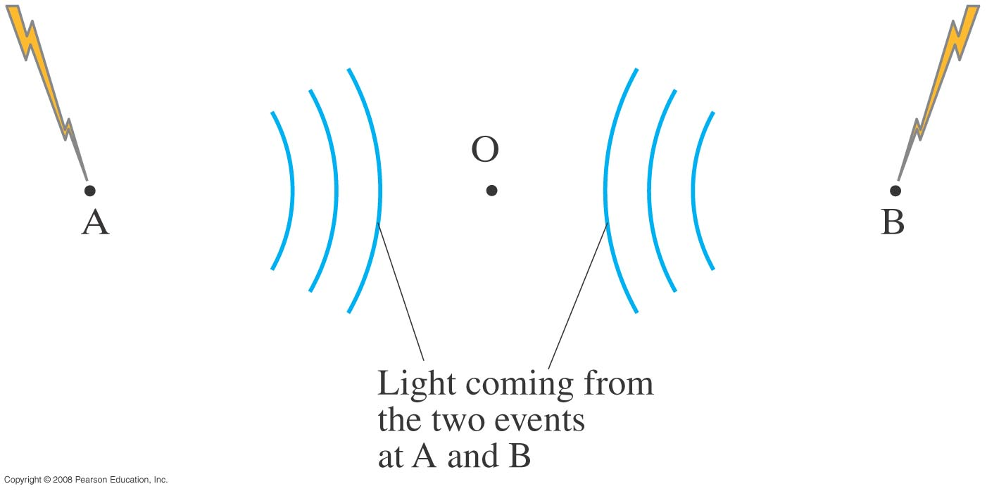
Simultaneity
Thought experiment: lightning strikes at two separate places. One observer believes the events are simultaneous – the light has taken the same time to reach her – but another, moving with respect to the first, does not.
Notes:
Figure 36-4. A moment after lightning strikes at points A and B, the pulses of light are traveling toward the observer O, but O “sees” the lightning only when the light reaches O.

Slide 13
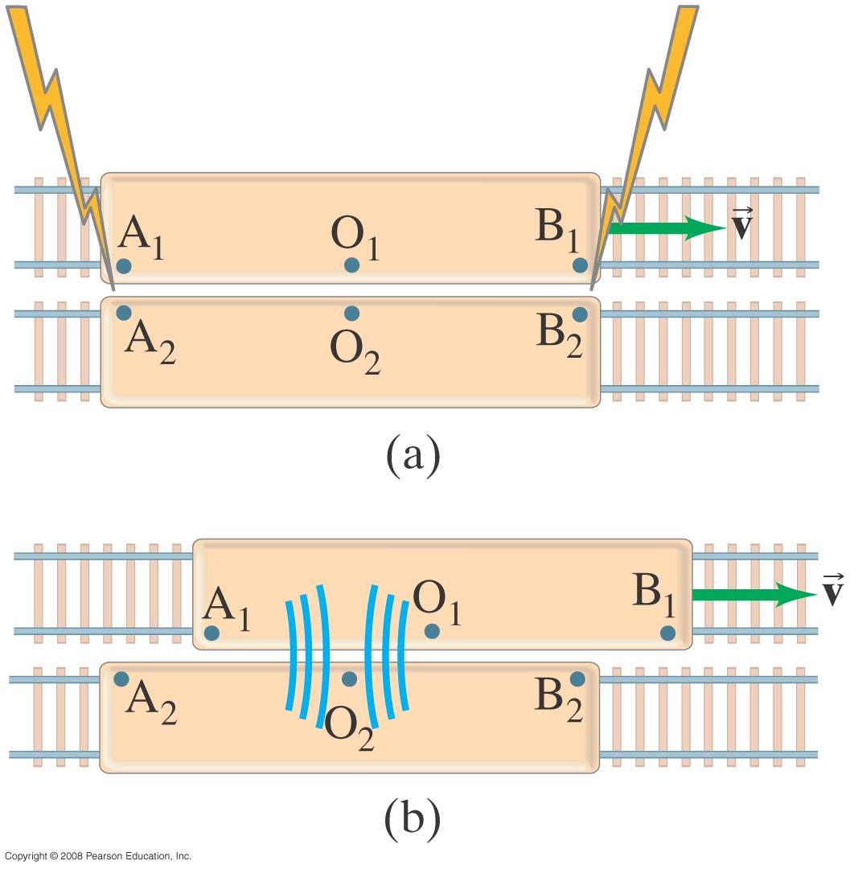
Simultaneity
Are these 2 events simultaneous to an observer moving in reference to the first one?
Here, it is clear that if one observer sees the events as simultaneous, the other cannot, given that the speed of light is the same for each.
Simultaneity is not an absolute concept.
Notes:
Figure 36-6. Thought experiment on simultaneity. In both (a) and (b) we are in the reference frame of observer O₂, who sees the reference frame of O₁ moving to the right. In (a), one lightning bolt strikes the two reference frames at A₁ and A₂, and a second lightning bolt strikes at B₁ and B₂. (b) A moment later, the light from the two events reaches O₂ at the same time. So according to observer O₂, the two bolts of lightning strike simultaneously. But in O₁’s reference frame, the light from B₁ has already reached O₁ whereas the light from A₁ has not yet reached O₁. So in O₁’s reference frame, the event at B₁ must have preceded the event at A₁. Simultaneity in time is not absolute.

Slide 14
Another example: Comparing inertial frames
v
... -3 -2 -1 0 1 2 3 ...
... -3 -2 -1 0 1 2 3 ...
At time t = 0, the two frames coincide. A ball is at rest in frame S. Its position is
x = 2 m in S
x’ = 2 m in S’

Slide 15
Another example: Comparing inertial frames
v
... -3 -2 -1 0 1 2 3 ...
... -3 -2 -1 0 1 2 3 ...
Frame S’ is moving to the right (relative to S) at v=1m/s. At time t = 3 sec, the position of the ball is
x = 2 m in S
x’ = -1 m in S’

Slide 16
L
R
v
Lucy
Now Lucy is the middle of a railroad car, and sets off
a firecracker. Light from the explosion travels to both ends of the car. Which end does it reach first according to Lucy?
a) both ends at once
b) the left end, L
c) the right end, R
These events are simultaneous in Lucy’s frame.

Slide 17
L
R
v
Ricky
Now Ricky is standing at rest next to the train tracks, watching the train move to the right. According to Ricky, which end of the train car does the light reach first? (As before the firecracker is still in the middle of the car.)
a) both ends at once
b) the left end, L
c) the right end, R
In Ricky’s frame, these events are not simultaneous.

Slide 18
Relative Simultaneity
Two Events at different locations that are simultaneous in one frame of reference will not be simultaneous in a frame of reference moving relative to the first

Slide 19
Time Dilation and the Twin Paradox
Calculating the difference between clock “ticks,” we find that the interval in the moving frame is related to the interval in the clock’s rest frame:
Clocks moving relative to an observer are measured more slowly as compared to clocks at rest relative to that observer.

Slide 20
Time Dilation and the Twin Paradox
The factor multiplying t₀ occurs so often in relativity that it is given its own symbol, γ:
We can then write
.

Slide 21
Time Dilation and the Twin Paradox
Example 36-1: Lifetime of a moving muon.
(a) What will be the mean lifetime of a muon as measured in the laboratory if it is traveling at v = 0.60c = 1.80 x 10⁸ m/s with respect to the laboratory? Its mean lifetime at rest is 2.20 μs = 2.2 x 10⁻⁶ s. (b) How far does a muon travel in the laboratory, on average, before decaying?
Notes:
Solution: a. The dilated lifetime is 2.8 x 10⁻⁶ s.
b. In that time, the muon will travel 500 m.

Slide 22
Time Dilation and the Twin Paradox
To clarify:
The time interval in the frame where two events occur in the same place is t₀.
The time interval in a frame moving with respect to the first one is Δt.

Slide 23
Time Dilation and the Twin Paradox
Example 36-2: Time dilation at 100 km/h.
Let us check time dilation for everyday speeds. A car traveling covers a certain distance in 10.00 s according to the driver’s watch. What does an observer at rest on Earth measure for the time interval?
Notes:
Solution: In order to find the difference in the measured times, we need to use the binomial expansion: (1 ± x)^{n} ≈ 1 ± nx (for x << 1). This shows that the difference in time is about 4 x 10⁻¹⁴ s, far too small to measure.

Slide 24
Time Dilation and the Twin Paradox
Example 36-3: Reading a magazine on a spaceship.
A passenger on a high-speed spaceship traveling between Earth and Jupiter at a steady speed of 0.75c reads a magazine which takes 10.0 min according to her watch. (a) How long does this take as measured by Earth-based clocks? (b) How much farther is the spaceship from Earth at the end of reading the article than it was at the beginning?
Notes:
Solution: a. The dilated time is 15.1 min.
b. In the frame of the ship, the distance is 0.75c x 10.0 min = 1.35 x 10¹¹ m; in the frame of the Earth it is 0.75c x 15.1 min = 2.04 x 10¹¹ m.

