Slide 1
Special Relativity
Chapter 1

Slide 2
Course Overview
http://chem.winthrop.edu/courses
Webpage
Syllabus
Class notes
This Class is an independent study class
Time meeting is TBA
Office: SIMS, 203
Office Hours: W 1:00 - 3:00, or by appointment.
There is no book for this class, everything will be posted on my page (notes, HW, HW solutions, and study guides)

Slide 3
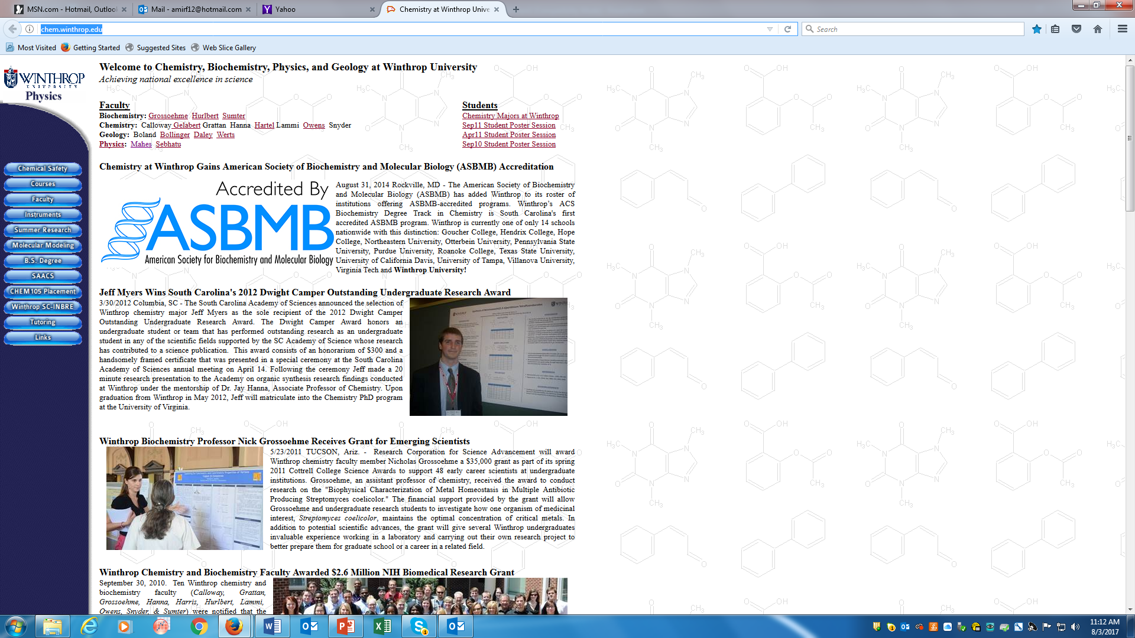
Webpage and Class notes
http://chem.winthrop.edu/

Slide 4
Class Policy
This is an independent study class, I will post the slides on Tuesday or Wednesday in the chemistry page.
You need to go through the slides and the examples.
We will meet on Fridays to go through your questions, and the problems.
If we are behind in class, we will meet another time during the week.

Slide 5
COVID-19 Statement:
Although COVID-19 has reached an endemic phase it is still important to remain vigilant as we face a recent rise in positive cases. As socially responsible members of this community, everyone is expected to engage in daily health self-monitoring, to stay home (residence hall or off-campus housing) from on-campus class, work, or activities if they begin experiencing any COVID-related symptoms.
When experiencing any COVID-related symptoms, students are expected to contact Health Services by completing the QI form in the Patient Portal and respond to the nurse who will contact them with instructions. COVID positive residential students are required to follow their QI plan for 5 days of isolation off campus, so be prepared with a back-up plan as well.
By acknowledgement, you agree to Winthrop’s expectations of you regarding health monitoring and reporting.

Slide 6
CAS diversity and inclusion statement:
At Winthrop University in the College of Arts and Sciences, diversity, equity, and inclusion are essential to our academic mission and institutional identity. We value and see others as whole people. Our faculty, staff, and students work together to create a community where people of all races, ethnicities, genders and gender identities, sexualities, socioeconomic classes, cultural backgrounds, nations of origin, ages, religions, political perspectives, abilities, and body types can truly thrive.

Slide 7
Course Communication
Be sure to check your Winthrop email account daily, as I may send out course related announcements that will come *only* to Winthrop email addresses.
If you email me, please be sure to use your Winthrop email account I will respond to email within 24 hours except from Saturday morning through Sunday afternoon when my response may be slower.

Slide 8
Homework
Homework problems are due on dates indicated I will be indicating when the homework is assigned. Your work is due on time, with the exception of reasonable documented excuses. Late work will be docked 50% of face value and 100% after solutions have been posted.

Slide 9
Exams
There will be three exams and a final paper.
Grading:
Homework 25%
Three in Class exams 15% each
Final Exam 30 %

Slide 10
Modern Physics
“Modern” physics is based on the two major breakthroughs of the early twentieth century (1900): relativity and quantum mechanics.
Physics based on what was known before then (Newton’s laws, Maxwell’s equations, thermodynamics) is called “classical” physics.

Slide 11
Special Relativity
https://www.youtube.com/watch?v=ttZCKAMpcAo

Slide 12
Newtonian Mechanics
Newton became the first person to generalize the observations of Galileo, Al-Haytham and others into the laws of motion that occupied much of your attention in introductory physics.
The second of Newton’s three laws is the study of that relation, as Newton presented it, is called Newtonian mechanics.
$F=m\frac{dv}{dt}$ with
$\frac{dv}{dt}=a$ (acceleration)
Newton’s Laws of Motion work correctly only in inertial reference frame.

Slide 13
Newtonian mechanics does not apply to all situations. If the speeds of the interacting bodies are very large—an appreciable fraction of the speed of light—we must replace Newtonian mechanics with Einstein’s theory of special relativity, which holds at any speed, including those near the speed of light.
If the interacting bodies are on the scale of atomic structure (for example, they might be electrons in an atom), we must replace Newtonian mechanics with quantum mechanics.
Physicists now view Newtonian mechanics as a special case of these two more comprehensive theories.

Slide 14
Galilean–Newtonian Relativity
This principle works well for mechanical phenomena.
However, Maxwell’s equations yield the velocity of light; it is 3.0 x 10⁸ m/s.
So, which is the reference frame in which light travels at that speed?
Scientists searched for variations in the speed of light depending on the direction of the ray, but found none.

Slide 15
Inertial frame
Definition of an inertial reference frame:
One in which Newton’s 3 laws are valid.
Earth is rotating and therefore not an inertial reference frame, but we can treat it as one for many purposes.
A frame moving with a constant velocity with respect to an inertial reference frame is itself inertial.

Slide 16
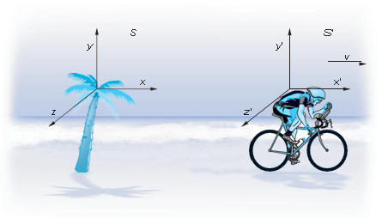
Newton’s Laws of Motion work correctly only in inertial reference frame.
They also have the remarkable property that they are invariant, or unchanged, in any reference frame that moves with constant velocity relative to an inertial frame. All inertial frames are equivalent.
Lets look a at frame that is non inertial!!!
S’ is moving with a velocity v in reference to S, the axes in S and S' are parallel and S' moves in the +x direction at velocity v for an observer in S
Transformation of the position coordinates and the velocity
components of S into those of S' is the Galilean transformation
s’ is moving in the x direction
$x^{′}= x − vt y^{′}= y { z}^{′}= z t′ = t$ 1-2
${u′}_{x}=u_{x}−v{ u′}_{y}=u_{y}$ ${ u′}_{z}=u_{z}$ 1-3

Slide 17
Example
Relativity principle:
The basic laws of physics are the same in all inertial reference frames.
Notes:
Figure 36-2. A coin is dropped by a person in a moving car. The upper views show the moment of the coin’s release, the lower views are a short time later. (a) In the reference frame of the car, the coin falls straight down (and the tree moves to the left). (b) In a reference frame fixed on the Earth, the coin has an initial velocity (= to car’s) and follows a curved (parabolic) path.

Slide 18
Basics Ideas: Inertial reference frames
V
Imagine a train car (it’s always a train!) moving on a straight track with constant velocity with respect to the ground. The train runs smoothly, so that you can’t tell it’s moving by feeling the bumps on the track.
Would you expect the laws of Physics to be different inside this train compared to the labs ?

Slide 19
Example
V
Now, you’re playing pool on the train. The balls roll in straight lines on the table. In other words, the usual Newtonian law of inertia still holds. The frame as a whole is not accelerating.

Slide 20
Example
V
As I’m lining up my shot, the train slows and approaches the station. I have not touched the cue ball. What does it do?
Rolls to the front of the train
Rolls to the back of the train
Remains motionless
(Is this still an inertial reference frame?)

Slide 21
Inertial reference frames
V
As I’m lining up my shot, the train slows and approaches the station. I have not touched the cue ball. What does it do?
Rolls to the front of the train
Rolls to the back of the train
Remains motionless
This frame is no longer inertial! (Accelerated frame)
(Is this still an inertial reference frame?)

Slide 22
Basics Ideas
Inertial Reference Frames:
We define a reference frame as “inertial” if Newton’s three laws of motion hold. In contrast, reference frames in which Newton’s law are not obeyed are labeled “non-inertial.”
Newton believed that at least one such inertial reference frame R exists. Any other inertial frame R' that moves with constant velocity with respect to R is also an inertial reference frame. In contrast, a reference frame R" that accelerates with respect to R is a non-inertial reference frame.

Slide 23
To cut a long story short:
An inertial reference frame is one that is not accelerating.
Relativity principle:
The basic laws of physics are the same in all inertial reference frames.

Slide 24
Michelson and Morley…
https://www.youtube.com/watch?v=F2m_VZJM0Zc

Slide 25
Speed of Light
In about 1860 James Clerk Maxwell summarized the experimental observations of electricity and magnetism in a consistent set of four concise equations.
Maxwell’s equations are not invariant under a Galilean transformation between inertial reference frames.
Maxwell equations predict the existence of electromagnetic waves whose speed would be
The excellent agreement between this number and the measured value of the speed of light and between the predicted polarization properties of electromagnetic waves and those observed for light provided strong confirmation of the assumption that light was an electromagnetic wave and, therefore, traveled at speed c

Slide 26
But, now there’s a problem!
Maxwell told us that EM waves propagate in a medium
where the speed of light is:
Speed c relative to what?
Galileo just told us that c’ = c – v
v speed of the earth relative to “another medium”, c’ speed of light relative to earth
It was postulated that the light travel in a medium called Ether, and the speed of light in reference to the medium is c
If the laws of physics are the same in all inertial frames, then ε₀ and µ₀ have to be the same in all inertial frames.

Slide 27
Michelson and Morley Experiments: Peculiar light-waves
A sound wave propagates through air, with a velocity relative to the air (~330 m / sec)
A water wave propagates through water, with a velocity relative to the water (1..100 m / sec)
The speed of waves depends on the properties of the medium and derived relative to the medium.
So it was natural that any electromagnetic wave (or LIGHT) propagates through...
v
Answer: (19th century physics) The “luminiferous ether.”

Slide 28
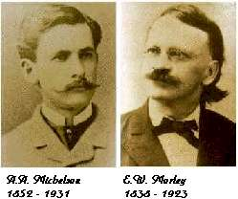
Michelson and Morley…
…performed a famous* experiment that effectively measured the speed of light in different directions with respect to the “ether wind.”
*some say, the most successful failure…

Slide 29
The Michelson–Morley Experiment
This experiment was designed to measure the speed of the Earth with respect to the ether.
The Earth’s motion around the Sun should produce small changes in the speed of light, which would be detectable through interference when the split beam is recombined.

Slide 30
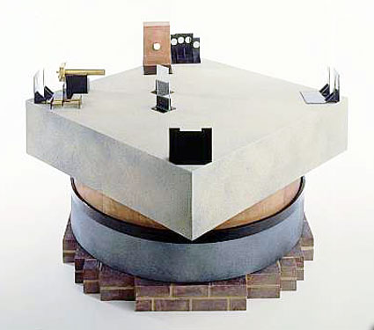
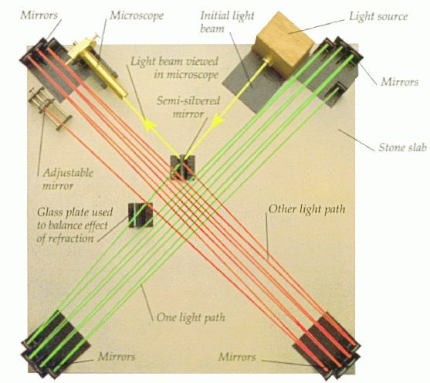
The historic setup (~1887)

Slide 31
The Michelson–Morley Experiment
This interferometer was able to measure interference shifts as small as 0.01 fringe, while the expected shift was 0.4 fringe.
However, no shift was ever observed, no matter how the apparatus was rotated or what time of day or night the measurements were made.
The possibility that the arms of the apparatus became slightly shortened when moving against the ether was considered, but a full explanation had to wait until Einstein came into the picture.

Slide 32
Postulates of the Special Theory of Relativity
The laws of physics have the same form in all inertial reference frames.
Light propagates through empty space with speed c independent of the speed of source or observer.
This solves the ether problem – the speed of light is in fact the same in all inertial reference frames.

