Slide 1
Quiz 5
PHYS212

Slide 2
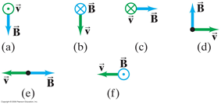
Chapter 27-Problem 16
16. (I) Find the direction of the force on a negative charge for each diagram shown in Fig. 27–42, where v (green) is the velocity of the charge and B (blue) is the direction of the magnetic field. ( means the vector points inward. means it points outward, toward you.)

Slide 3
Chapter 28-Problem 12
12. (II) Two straight parallel wires are separated by 6.0 cm. There is a 2.0-A current flowing in the first wire. If the magnetic field strength is found to be zero between the two wires at a distance of 2.2 cm from the first wire, what is the magnitude and direction of the current in the second wire?

Slide 4
Chapter 29-Problem 10
10. (II) The magnetic field perpendicular to a circular wire loop 8.0 cm in diameter is changed from +0.52 T to $−$0.45 T in 180 ms, where + means the field points away from an observer and $−$toward the observer. Calculate the induced emf.

