Slide 1
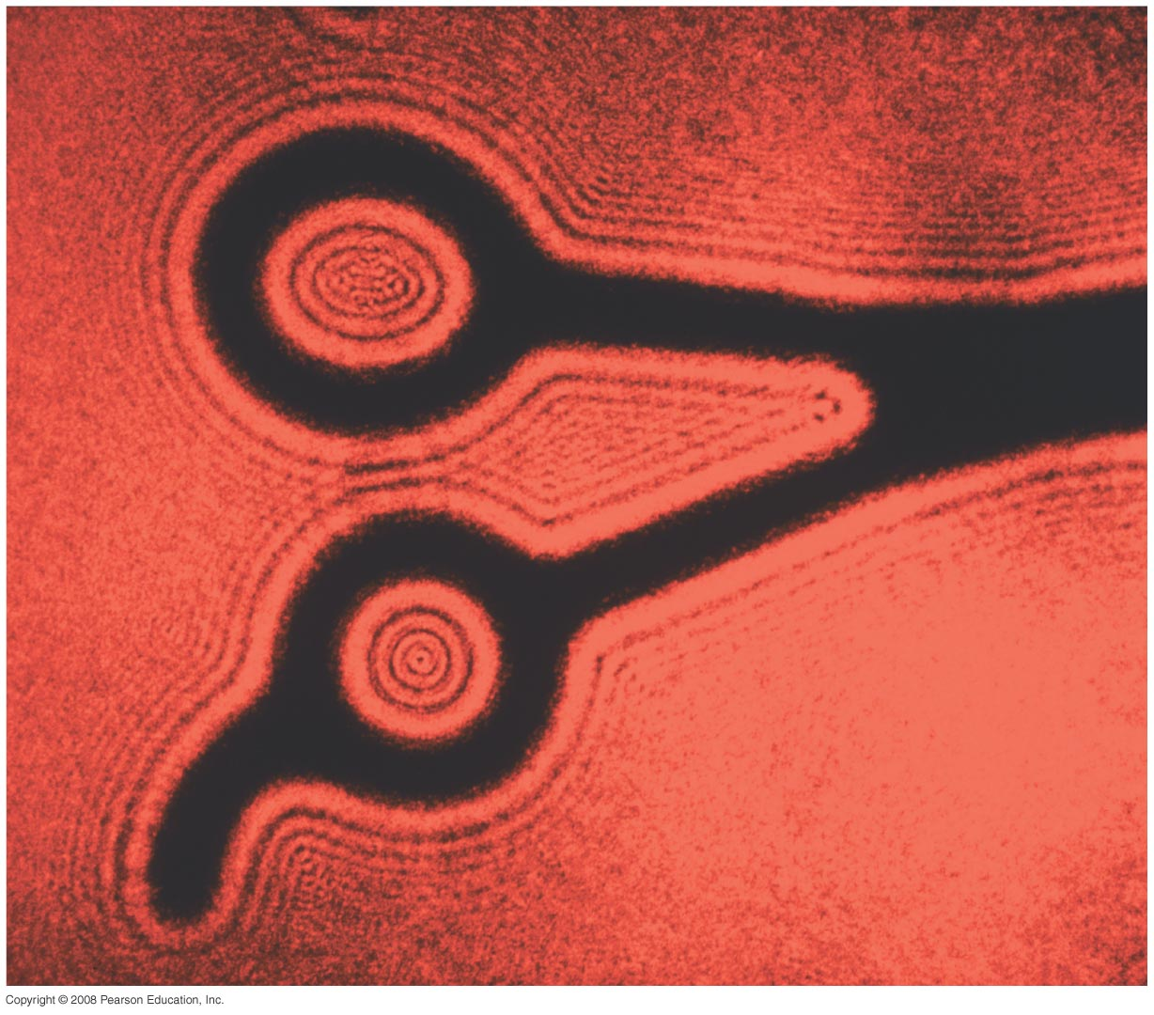
Chapter 35-Diffraction
Notes:
Chapter 35 opener. Parallel coherent light from a laser, which acts as nearly a point source, illuminates these shears. Instead of a clean shadow, there is a dramatic diffraction pattern, which is a strong confirmation of the wave theory of light. Diffraction patterns are washed out when typical extended sources of light are used, and hence are not seen, although a careful examination of shadows will reveal fuzziness. We will examine diffraction by a single slit, and how it affects the double-slit pattern. We also discuss diffraction gratings and diffraction of X-rays by crystals. We will see how diffraction affects the resolution of optical instruments, and that the ultimate resolution can never be greater than the wavelength of the radiation used. Finally we study the polarization of light.

Slide 2
Problem 8
8. (II) (a) For a given wavelength λ, what is the minimum slit width for which there will be no diffraction minima? (b) What is the minimum slit width so that no visible light exhibits a diffraction minimum?

Slide 3
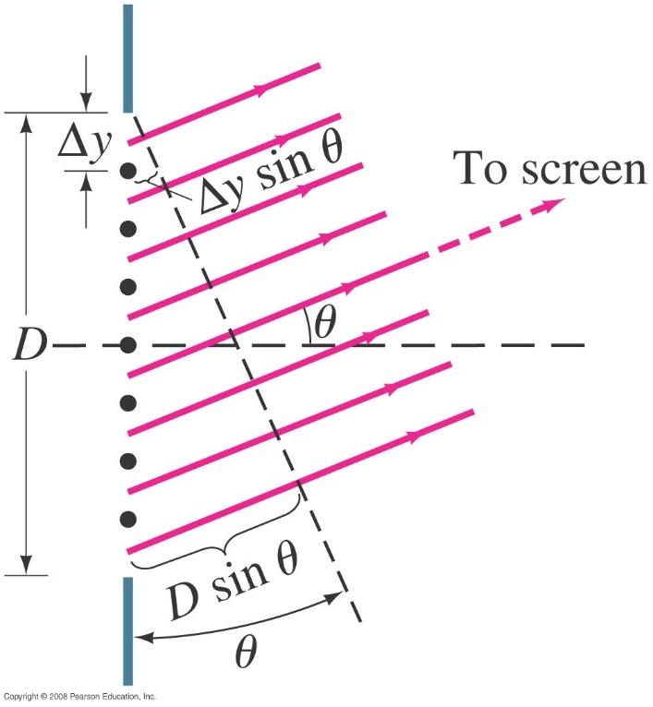
35-2 Intensity in Single-Slit Diffraction Pattern
Light passing through a single slit can be divided into a series of narrower strips; each contributes the same amplitude to the total intensity on the screen, but the phases differ due to the differing path lengths:
.
Phase difference of light from adjacent strips
$$∆y≪λ$$
Notes:
Figure 35-7. Slit of width D divided into N strips of width Δy.

Slide 4
35-2 Intensity in Single-Slit Diffraction Pattern
Finally, we have the phase difference and the intensity as a function of angle:
and
.

Slide 5
35-3 Diffraction in the Double-Slit Experiment
Because the fringes are not all the same heights, to get the intensity of light, we need to get the electric field
The double-slit experiment also exhibits diffraction effects, as the slits have a finite width. This means the amplitude at an angle θ will be modified by the same factor as in the single-slit experiment:
Interference factor
Diffraction factor
The intensity is proportional to the square of the field E_{θ0}.

Slide 6
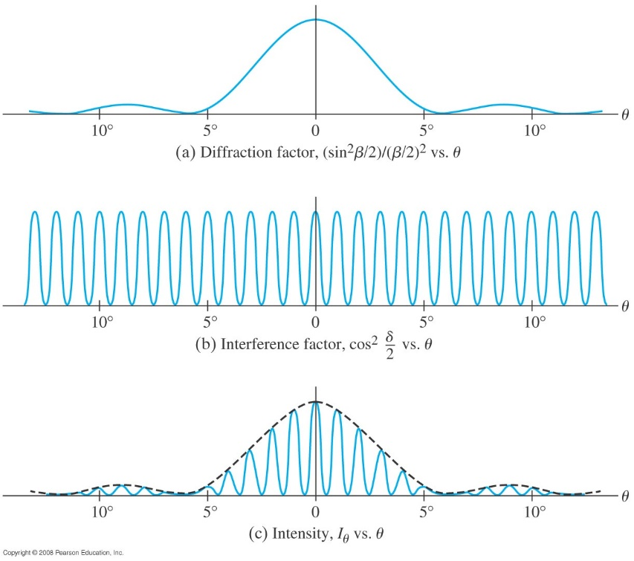
35-3 Diffraction in the Double-Slit Experiment
The diffraction factor (depends on β) appears as an “envelope” modifying the more rapidly varying interference factor (depends on δ).
Notes:
Figure 35-10. (a) Diffraction factor, (b) interference factor, and (c) the resultant intensity plotted as a function of θ for d = 6D = 60λ.

Slide 7
35-4 Limits of Resolution; Circular Apertures
Resolution is the distance at which a lens can barely distinguish two separate objects.
Resolution is limited by aberrations and by diffraction. Aberrations can be minimized, but diffraction is unavoidable; it is due to the size of the lens compared to the wavelength of the light.

Slide 8
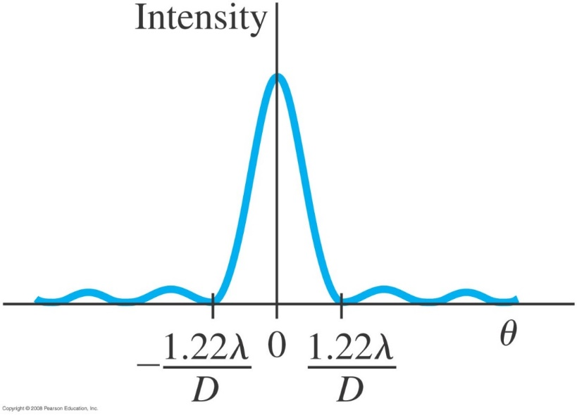
35-4 Limits of Resolution; Circular Apertures
When a lens forms an image of a point object, the image is a tiny diffraction pattern. The image will be blurred even when aberrations are absent
For a lens or any circular aperture of diameter D, the central maximum has an angular width:
When a length is free of aberrations
D is the diameter of the lens or any circular aperture.
Notes:
Figure 35-13. Intensity of light across the diffraction pattern of a circular hole.

Slide 9
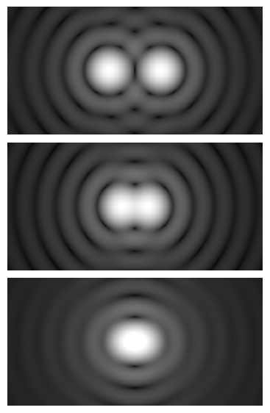
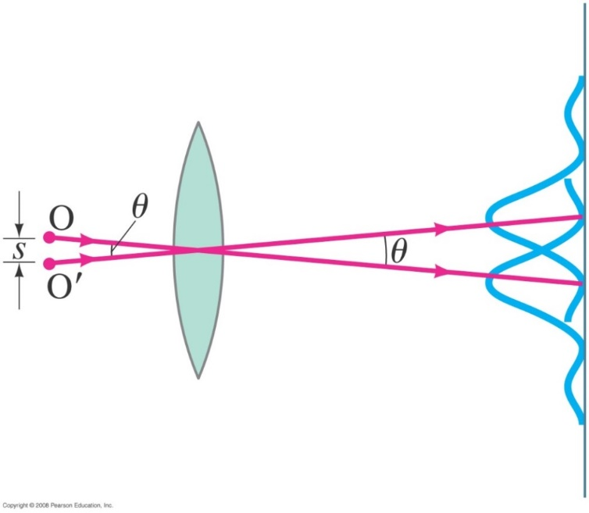
35-4 Limits of Resolution; Circular Apertures
For a circular aperture, lens, or mirror, the Rayleigh criterion states that two images are just resolvable when the center of the diffraction pattern of one is directly over the first minimum of the diffraction pattern of the other.
The two point objects O and O’ subtend an angle θ at the lens; only one ray (it passes through the center of the lens) is drawn for each object, to indicate the center of the diffraction pattern of its image.
Fig.1
D is the diameter of the lens or the mirror
Fig. 1: Airy diffraction patterns generated by light from two point sources passing through a circular aperture, such as the pupil of the eye. Points far apart (top) or meeting the Rayleigh criterion (middle) can be distinguished. Points closer than the Rayleigh criterion (bottom) are difficult to distinguish.
Notes:
Figure 35-14. The Rayleigh criterion. Two images are just resolvable when the center of the diffraction peak of one is directly over the first minimum in the diffraction pattern of the other. The two point objects O and O’ subtend an angle θ at the lens; only one ray (it passes through the center of the lens) is drawn for each object, to indicate the center of the diffraction pattern of its image.

Slide 10
35-5 Resolution of Telescopes and Microscopes; the λ Limit
For telescopes, the resolution limit is as we have defined it:
For microscopes, assuming the object is at the focal point, the resolving power RP is given by
f is the focal distance of the lens

Slide 11
35-5 Resolution of Telescopes and Microscopes; the λ Limit
Typically, the focal length of a microscope lens is half its diameter, which shows that it is not possible to resolve details smaller than the wavelength being used:
Resolving power

Slide 12
Problem 24
24. (I) What is the angular resolution limit (degrees) set by diffraction for the 100-inch (254-cm mirror diameter) Mt. Wilson telescope (λ=560nm) ?

Slide 13
Problem 25
25. (II) Two stars 16 light-years away are barely resolved by a 66-cm (mirror diameter) telescope. How far apart are the stars? Assume λ =550nm and that the resolution is limited by diffraction.

Slide 14
35-6 Resolution of the Human Eye and Useful Magnification
The human eye can resolve objects that are about 1 cm apart at a distance of 20 m, or 0.1 mm apart at the near point.
This limits the useful magnification of a light microscope to about 500x–1000x.

Slide 15
35-7 Diffraction Grating
https://www.youtube.com/watch?v=kga6ofsMj8Y

Slide 16
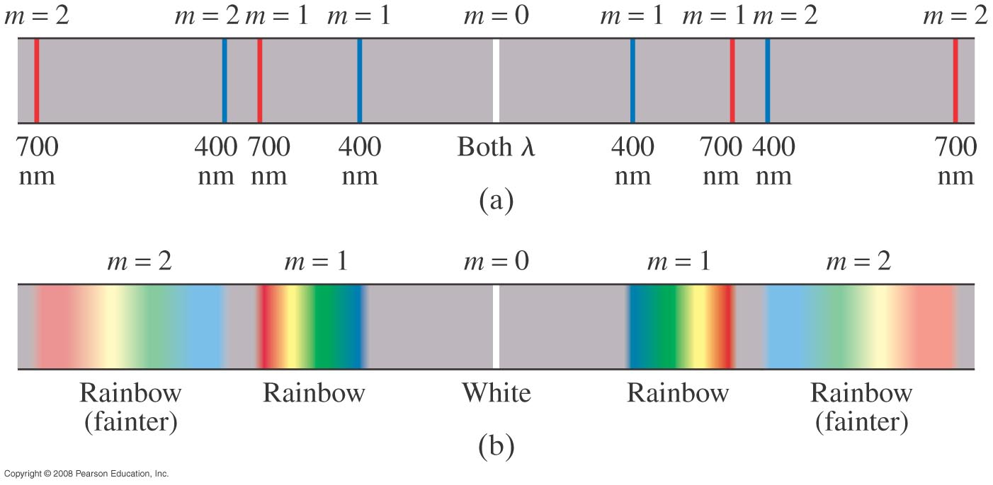
35-7 Diffraction Grating
The maxima of the diffraction pattern are defined by
Spectra by two wavelengths
Spectra by white light
Notes:
Figure 35-19. Spectra produced by a grating: (a) two wavelengths, 400 nm and 700 nm; (b) white light. The second order will normally be dimmer than the first order. (Higher orders are not shown.) If grating spacing is small enough, the second and higher orders will be missing.

Slide 17
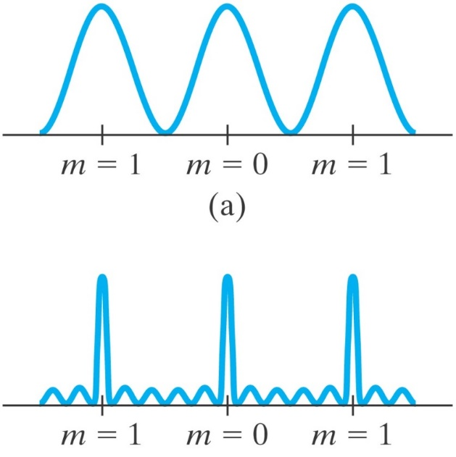
35-7 Diffraction Grating
A diffraction grating consists of a large number of equally spaced narrow slits or lines. A transmission grating has slits that transmit light, while a reflection grating has lines that reflect light.
The more lines or slits there are, the narrower the peaks.
d sinθ = mλ
Figure 35-18. Intensity as a function of viewing angle θ (or position on the screen) for (a) two slits, (b) six slits. For a diffraction grating, the number of slits is very large (500 and more) and the peaks are narrower still.
Notes:
Figure 35-18. Intensity as a function of viewing angle θ (or position on the screen) for (a) two slits, (b) six slits. For a diffraction grating, the number of slits is very large (≈10⁴) and the peaks are narrower still.

Slide 18
35-7 Diffraction Grating
Example 35-8: Diffraction grating: lines.
Determine the angular positions of the first- and second-order maxima for light of wavelength 400 nm and 700 nm incident on a grating containing 10,000 lines/cm.
Notes:
Solution: The distance between the lines is 1.0 μm. For m = 1, the angles are 23.6° and 44.4°. For m = 2, the angle for 400 nm is 53.1°; the equation for sin θ gives a result greater than 1 for 700 nm, so the second order will not appear.

Slide 19
Problem 33
33.(I) A grating has 6800 line/cm. How many spectral orders can be seen (400 to 700 nm) when it is illuminated by white light?

Slide 20
Problem 36
36. (II) White light containing wavelengths from 410 nm to 750 nm falls on a grating with 7800lines/cm. How wide is the first-order spectrum on a screen 2.80 m away?

Slide 21
35-8 The Spectrometer and Spectroscopy
This video shows the spectra of different gases
https://www.youtube.com/watch?v=oae5fa-f0S0

Slide 22
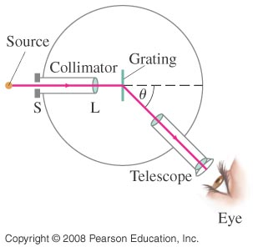
35-8 The Spectrometer and Spectroscopy
A spectrometer makes accurate measurements of wavelengths using a diffraction grating or prism, and help determine elements in a compound.
A gas is heated or a current pass through it, and it will emit certain lines. Only certain discrete wavelength of light are emitted, and these are different for different elements
The wavelength can be determined to high accuracy by measuring the angle at which the light is diffracted:
Grating is in a Prism to separate different wavelength
Figure 35-21. Spectrometer or spectroscope.
Notes:
Figure 35-21. Spectrometer or spectroscope.

Slide 23
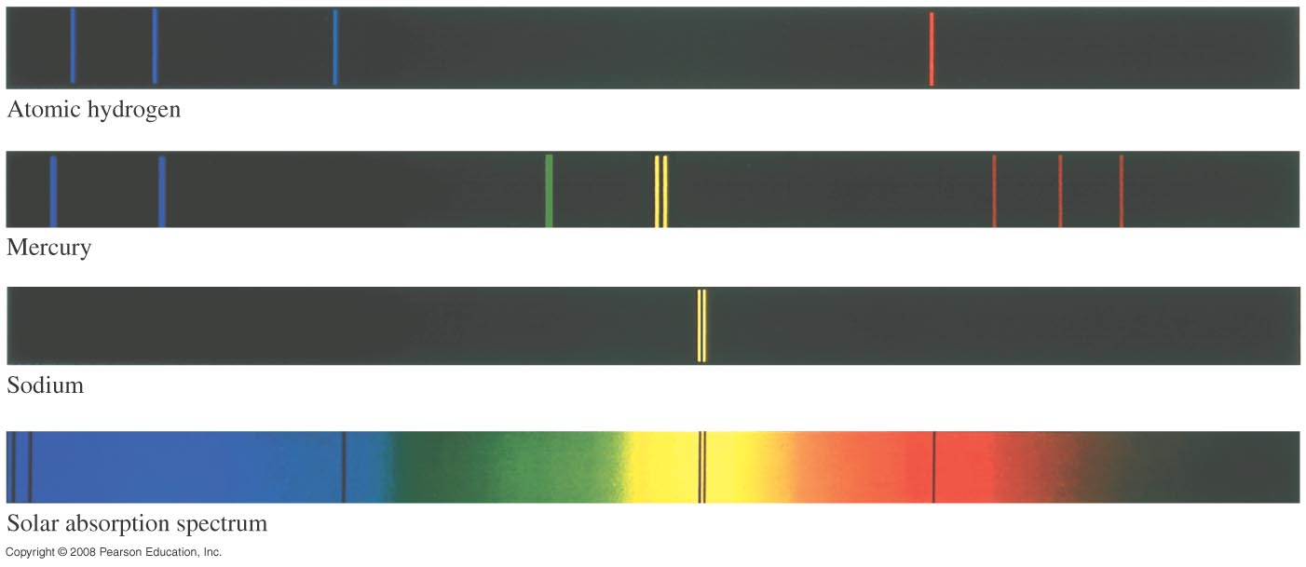
35-8 The Spectrometer and Spectroscopy
Atoms and molecules can be identified when they are in a thin gas through their characteristic emission lines.
Absorption lines are due to atoms or molecules that absorb wavelength of light. They are the same at which they emit light.
Due to dense gaseous object in the sun
Notes:
Figure 35-22. Line spectra for the gases indicated, and the spectrum from the Sun showing absorption lines

Slide 24
35-8 The Spectrometer and Spectroscopy
The wavelength can be determined to high accuracy by measuring the angle at which the light is diffracted:

Slide 25
35-8 The Spectrometer and Spectroscopy
Example 35-11: Hydrogen spectrum.
Light emitted by hot hydrogen gas is observed with a spectroscope using a diffraction grating having 1.00 x 10⁴ lines/cm. The spectral lines nearest to the center (0°) are a violet line at 24.2°, a blue line at 25.7°, a blue-green line at 29.1°, and a red line at 41.0° from the center. What are the wavelengths of these spectral lines of hydrogen?
Notes:
Since these are the lines nearest the center, m = 1. Then the wavelengths are 410 nm, 434 nm, 486 nm, and 656 nm.

Slide 26
Problem 42
42. (II) The first-order line of 589-nm light falling on a diffraction grating is observed at a 16.5° angle. How far apart are the slits? At what angle will the third order be observed?

Slide 27
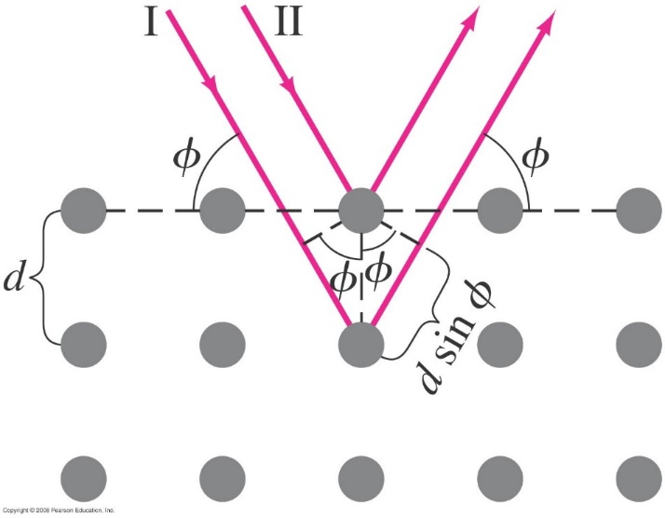
35-10 X-Rays and X-Ray Diffraction
X-ray diffraction has been around since 1895, and was discovered by Wilhelm Conrad Röntgen.
The wavelengths of X-rays are very short. Diffraction experiments are impossible to do with conventional diffraction gratings.
Crystals have spacing between their layers that is ideal for diffracting X-rays.
When electrons are accelerated by a high voltage in a vacuum tube, and are sticking a glass fluorescent mineral , it glows, and a photographic film becomes exposed.
They were called x-ray since they were a new type of unknown radiations.
$$mλ=2dsinφ$$
This is the Bragg equation
X-ray penetrate a crystal , spacing of crystal d that is comparable to λ.
Notes:
Figure 35-28. X-ray diffraction by a crystal.

Slide 28
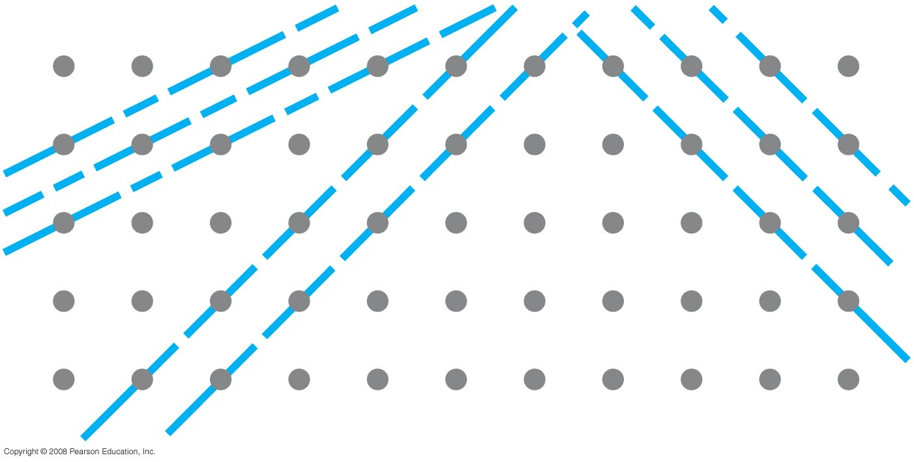
35-10 X-Rays and X-Ray Diffraction
X-ray diffraction is now used to study the internal structure of crystals; this is how the helical structure of DNA was determined.
X-ray diffracted at different angles, you can learn a lot about a substance even if x-ray diffraction analysis is complicated.
Figure 35-29. X-rays can be diffracted from many possible planes within a crystal.
Notes:
Figure 35-29. X-rays can be diffracted from many possible planes within a crystal.

Slide 29
Problem 50
50. (II) First-order Bragg diffraction is observed at 26.8° relative to the crystal surface, with spacing between atoms of 0.24 nm. (a) At what angle will second order be observed? (b) What is the wavelength of the X-rays?

Slide 30
Problem 49
49. (II) X-rays of wavelength 0.138 nm fall on a crystal whose atoms, lying in planes, are spaced 0.285 nm apart. At what angle Φ (relative to the surface, Fig. 35–28) must the X-rays be directed if the first diffraction maximum is to be observed?

Slide 31
Problem 51
51. (II) If X-ray diffraction peaks corresponding to the first three orders ( m= 1, 2, and 3) are measured, can both the X-ray wavelength $λ$ and lattice spacing d be determined? Prove your answer.

