Slide 1
34 Waves versus Particles; Huygens’ Principle and Diffraction
Quiz on Friday-Problems on earlier chapters.
Notes:
Chapter 34 Opener. The beautiful colors from the surface of this soap bubble can be nicely explained by the wave theory of light. A soap bubble is a very thin spherical film filled with air. Light reflected from the outer and inner surfaces of this thin film of soapy water interferes constructively to produce the bright colors. Which colors we see at any point depends on the thickness of the soapy water film at that point and also on the viewing angle. Near the top of the bubble, we see a small black area surrounded by a silver or white area. The bubble’s thickness is smallest at that black spot, perhaps only about 30 nm thick, and is fully transparent (we see the black background). We cover fundamental aspects of the wave nature of light, including two-slit interference and interference in thin films.

Slide 2
Problem 15
15. (II) Light of wavelength 470 nm in air falls on two slits 6.00X10⁻²mm apart. The slits are immersed in water, as is a viewing screen 50.0 cm away. How far apart are the fringes on the screen?

Slide 3
34-3 Interference – Young’s Double-Slit Experiment
https://www.youtube.com/watch?v=vt86k8yoe08&t=1s

Slide 4
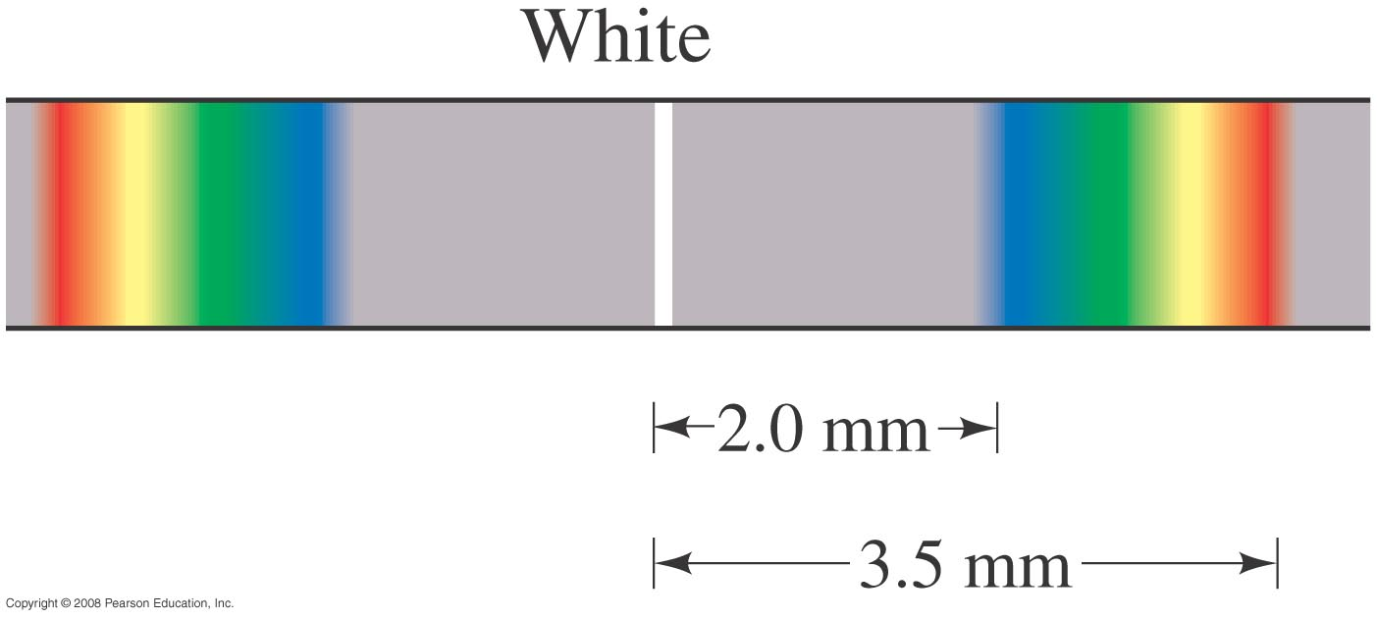
34-3 Interference – Young’s Double-Slit Experiment
When white light falls onto two slits, the central fringe is white, and the position of the maxima (except the central one) depends on wavelength, the first- and higher-order fringes contain a spectrum of colors.
Notes:
Figure 34-11. First-order fringes are a full spectrum, like a rainbow.

Slide 5
34-3 Interference – Young’s Double-Slit Experiment
Example 34-4: Wavelengths from double-slit interference.
White light passes through two slits 0.50 mm apart, and an interference pattern is observed on a screen 2.5 m away. The first-order fringe resembles a rainbow with violet and red light at opposite ends. The violet light is about 2.0 mm and the red 3.5 mm from the center of the central white fringe. Estimate the wavelengths for the violet and red light.
Notes:
Solution: Using the geometry of the previous examples and the small-angle approximation, the wavelength for the first-order fringe is given by d sinθ = mλ, so λ= d sinθ/m$\sim$ d θ/m$\sim$ dx/l = 400 nm for the violet light and 700 nm for the red light.

Slide 6
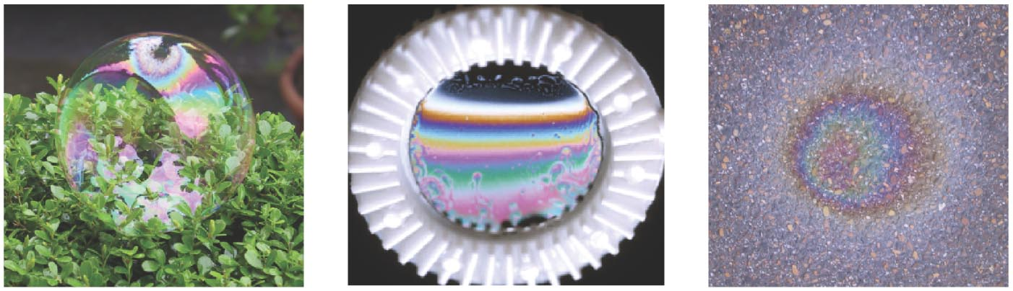
34-5 Interference in Thin Films
Another way path lengths can differ, and waves interfere, is if they travel through different media. If there is a very thin film of material – a few wavelengths thick – light will reflect from both the bottom and the top of the layer, causing interference. This can be seen in soap bubbles and oil slicks.
Soap bubble
Gasoline film
Oil film on wet pavement
Notes:
Figure 34-16. Thin film interference patterns seen in (a) a soap bubble, (b) a thin film of soapy water, and (c) a thin layer of oil on wet pavement.

Slide 7
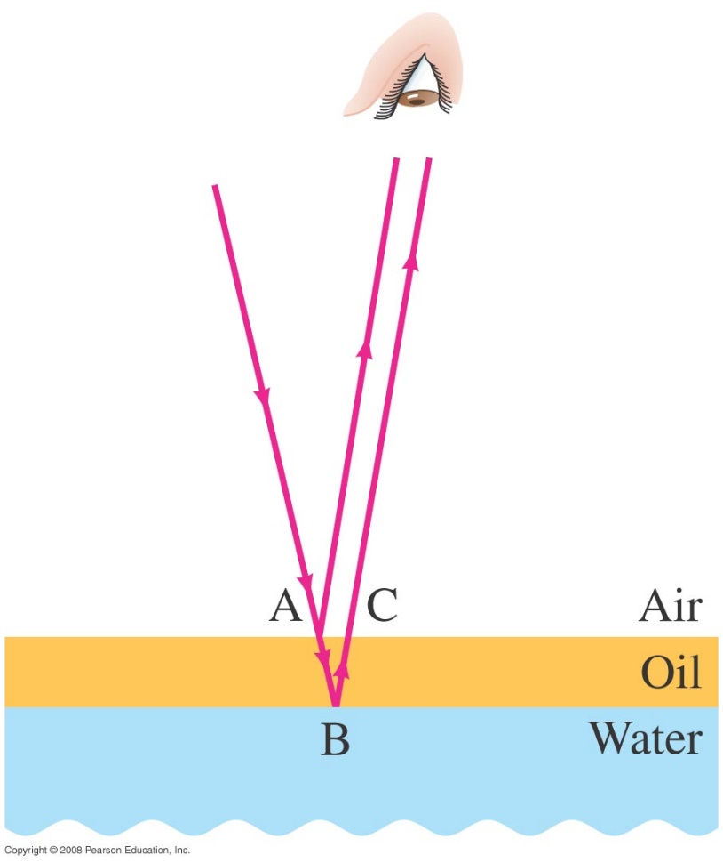
34-5 Interference in Thin Films
The wavelength of the light will be different in the oil and the air, and the reflections at points A and B may or may not involve phase changes.
If the Path difference 2t=ABC= mλ_{n} the two waves reach the eye out of phase, and (m+1/2) λ_{n} if they are in phase
t: thickness
Notes:
Figure 34-17. Light reflected from the upper and lower surfaces of a thin film of oil lying on water. This analysis assumes the light strikes the surface nearly perpendicularly, but is shown here at an angle so we can display each ray.

Slide 8
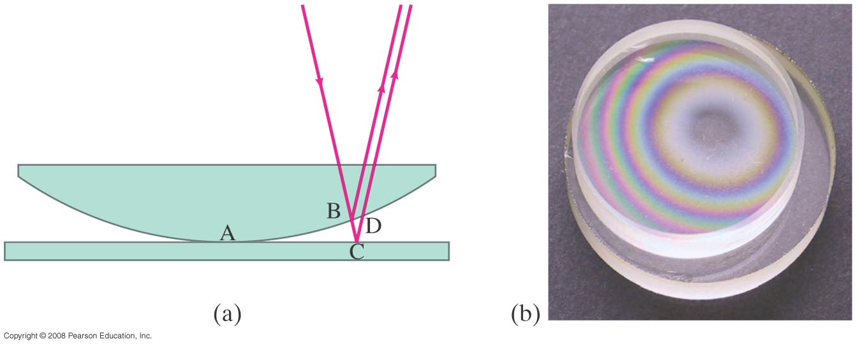
34-5 Interference in Thin Films
A similar effect takes place when a shallowly curved piece of glass is placed on a flat one. When viewed from above, concentric circles appear that are called Newton’s rings.
(a)
(b)
Notes:
Figure 34-18. Newton’s rings. (a) Light rays reflected from upper and lower surfaces of the thin air gap can interfere. (b) Photograph of interference patterns using white light.

Slide 9
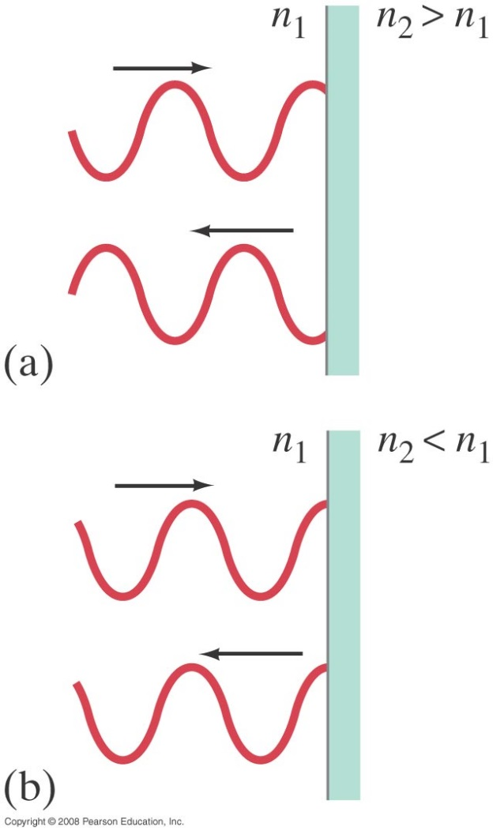
34-5 Interference in Thin Films
A beam of light reflected by a material with index of refraction greater than that of the material in which it is traveling, changes phase by 180°or ½ cycle.
Phase change
ΔΦ=2mπ for bright fringes and at a thickness t: 2t=(m+1/2)λ
ΔΦ=(2m+1)π for dark fringes
and at a thickness t: 2t=mλ
Notes:
Figure 34-19. (a) Reflected ray changes phase by 180° or ½ cycle if n₂ > n₁, but (b) does not if n₂ < n₁.

Slide 10
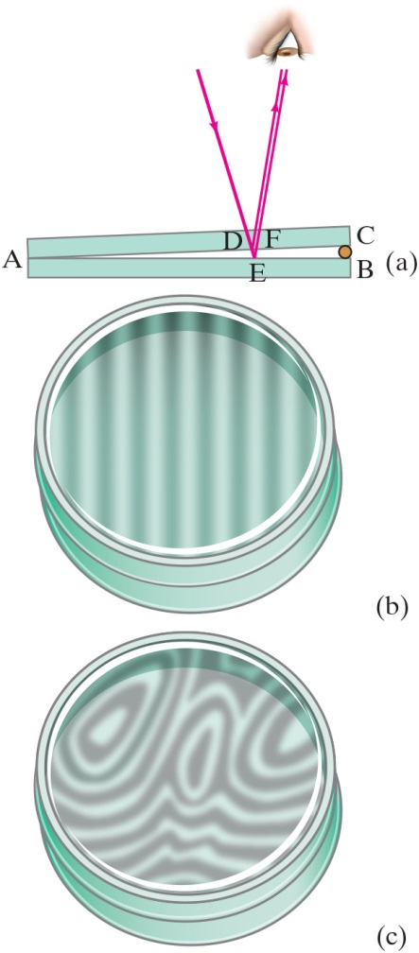
34-5 Interference in Thin Films (5 of 8)
Example 34-6: Thin film of air, wedge-shaped.
A very fine wire
in diameter is placed between two flat glass plates. Light whose wavelength in air is 600 n m falls (and is viewed) perpendicular to the plates and a series of bright and dark bands is seen. How many light and dark bands will there be in this case? Will the area next to the wire be bright or dark?
Notes:
Figure 34-20. (a) Light rays reflected from the upper and lower surfaces of a thin wedge of air (between two glass plates) interfere to produce bright and dark bands. (b) Pattern observed when glass plates are optically flat; (c) pattern when plates are not so flat. See Example 34–6.
LD: In part (“a”), two thin rectangles representing the glass plates are placed one above the other such that the left sides of the plates are in contact while the right sides appear to be separated by a small separator resulting in the formation of a triangular wedge on the right. The left sides of the plates is labeled “A”. The right side of the bottom plate is labeled B, and the right side of the top plate is labeled C. A ray of light from the upper left extends to the lower right, passes through the lower side of the top plate at a point labeled D, and meets the upper side of the lower plate at a point labeled E. From D, the ray gets reflected toward the upper right and meets the eye of an observer. From E, the ray gets reflected parallel to the ray from D toward the upper right, passes through a point labeled F on the lower side of the top plate, and meets the eye of the observer. In part (b), the pattern observed from the top view of two circular glass plates with flat surfaces separated by a small distance is shown. Vertical dark beams separated by thin vertical white stripes are seen. In part (c), the pattern observed from the top view of two circular glass plates with slightly curved surfaces separated by a small distance is shown. An abstract pattern with distorted dark curves alternating with white curves is seen.

Slide 11
34-5 Interference in Thin Films
Problem Solving: Interference
Interference occurs when two or more waves arrive simultaneously at the same point in space.
Constructive interference occurs when the waves are in phase.
Destructive interference occurs when the waves are out of phase.
An extra half-wavelength shift occurs when light reflects from a medium with higher refractive index.

Slide 12
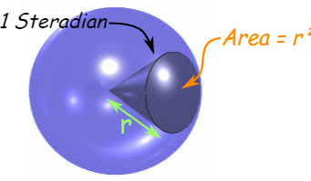
34-7 Luminous Intensity
The intensity of light as perceived depends not only on the actual intensity but also on the sensitivity of the eye at different wavelengths.
Luminous flux: 1 lumen = 1/683 W of 555-nm light (not uniform over all directions)
Luminous intensity: 1 candela = 1 lumen/steradian
Illuminance: luminous flux per unit area
Steradian=(180/π)²

Slide 13
34-7 Polarization
https://www.youtube.com/watch?v=E9qpbt0v5Hw

Slide 14
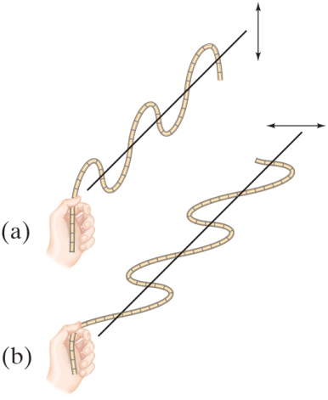
34-7 Polarization
Light is polarized when its electric fields oscillate in a single plane, rather than in any direction perpendicular to the direction of propagation.
Notes:
Figure 34-25. Transverse waves on a rope polarized (a) in a vertical plane and (b) in a horizontal plane.
LD: In part (“a”), a hand appears to be holding the left end of the rope and moving it upward and downward forming a transverse wave along the vertical plane. A vertical double-headed arrow shown on the right of the rope indicates the direction of the motion of the rope. A horizontal line passes the middle of the wave. In part (b), a hand appears to be holding the left end of the rope and moving it sideward forming a transverse wave along the horizontal plane. A horizontal double-headed arrow shown on the right of the rope indicates the direction of motion of the rope. A horizontal line passes the middle of the wave.

Slide 15
34-7 Polarization
Polarized light will not be transmitted through a polarized film whose axis is perpendicular to the polarization direction.
A polarizer has one axis of polarization, and only the direction parallel to the polarizer will go through.
Notes:
Figure 34-26. (a) A vertically polarized wave passes through a vertical slit, but (b) a horizontally polarized wave will not.
LD: In each part, a rectangular screen with a vertical slit is shown on the right. The rope forms a horizontally oriented transverse wave that appears to be traveling from left to right. In part (“a”), the rope forms waves polarized in the vertical plane. A vertical double-headed arrow is shown to the left of the rope. The rope appears to have passed half-way through the slit. In part (b), the rope forms waves polarized in the horizontal plane. A horizontal double-headed arrow is shown to the left of the rope. The rope appears to be stuck near its first peak passing through the slit.

Slide 16
34-7 Polarization
When light passes through a polarizer, only the component parallel to the polarization axis is transmitted. If the incoming light is plane-polarized, the outgoing intensity is:
Notes:
Figure 34-28. Vertical Polaroid transmits only the vertical component of a wave (electric field) incident upon it.
LD: A vertically aligned rectangular screen with parallel vertical lines is labeled Vertical polarizer and is shown toward the right of the figure. The x y coordinate plane tilted to the right is placed parallelly to the left of the polarizer. A vertical dashed arrow labeled E subscript 0 cosine theta from the origin extends upward along the positive y axis. A diagonal arrow labeled E subscript 0 from the origin points to the upper right and is inclined at an angle theta from the y axis. A dashed line connects the tips of E subscript 0 cosine theta and E subscript 0. The coordinate plane with the arrows is labeled Incident beam polarized at angle theta to the vertical; has amplitude E subscript 0. A right-pointing horizontal arrow labeled Light direction is shown on the left of the coordinate plane. The right-pointing arrow extends to the right as a horizontal dashed line with arrowheads pointing to the right, passes through the origin of the coordinate plane, passes through the screen, and extends beyond the screen. The dashed line to the right of the screen is labeled Transmitted wave. A vertical arrow labeled E equals E subscript 0 cosine theta from transmitted wave points upward and has the same magnitude as E subscript 0 cosine theta shown on the coordinate plane.

Slide 17
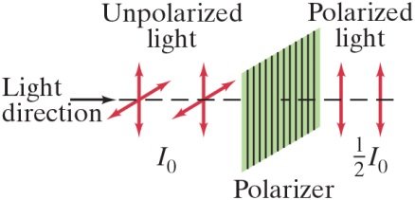
34-7 Polarization
Unpolarized light (light with random directions of polarization) can be thought of as two plane-polarized beams of equal magnitude perpendicular to one another. Passing unpolarized light through a polarizer reduces the intensity by half.
Notes:
Figure 34-29. Unpolarized light has equal intensity vertical and horizontal components. After passing through a polarizer, one of these components is eliminated. The intensity of the light is reduced to half.
LD: Unpolarized light having an intensity of I subscript 0 is shown on the left as two two-dimensional coordinate planes tilted to the right placed side by side and parallel to each other. A vertically aligned rectangular screen with parallel vertical lines is labeled Polarizer and is shown to the right of Unpolarized light. The screen is parallel to Unpolarized light. A right-pointing horizontal arrow labeled Light direction is shown on the left of Unpolarized light. The right-pointing arrow extends to the right as a horizontal dashed line with arrowheads pointing to the right, passes through Unpolarized light, passes through the screen, and extends beyond the screen. Two vertical double-headed arrows labeled Polarized light have the intensity of one half I subscript 0.

Slide 18
34-7 Polarization
This means that if initially unpolarized light passes through crossed polarizers, no light will get through the second one.
Notes:
Figure 34-30. Crossed Polaroids completely eliminate light.
LD: Unpolarized light is shown on the left as two two-dimensional coordinate planes tilted to the right placed side by side and parallel to each other. Two vertically aligned rectangular screens with different patterns representing the polarizers are shown to the right of the unpolarized light. The screens are parallel to each other and Unpolarized light. A right-pointing horizontal arrow labeled Light direction is shown on the left of Unpolarized light. The right-pointing arrow extends to the right as a horizontal dashed line with arrowheads pointing to the right, passes through Unpolarized light, passes through the two screens, and extends beyond the screen on the right. The screen on the left has parallel vertical lines and is labeled Polarizer (axis vertical). The screen on the right has parallel horizontal lines and is labeled Analyzer (axis horizontal). Three parallel vertical double-headed arrows labeled Plane-polarized light are shown between Polarizer and Analyzer. A label No light is shown above the horizontal dashed line to the right of the screen on the right.

Slide 19
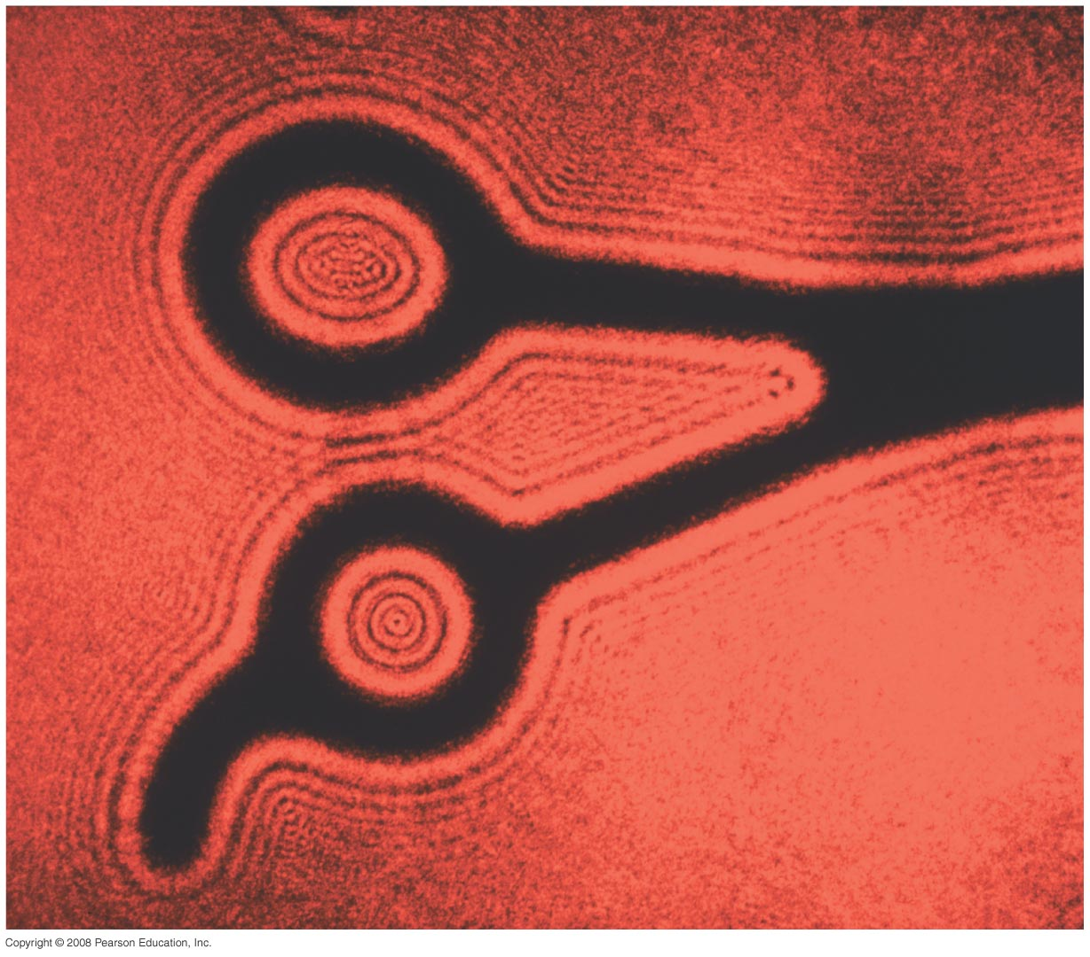
Chapter 35-Diffraction
Notes:
Chapter 35 opener. Parallel coherent light from a laser, which acts as nearly a point source, illuminates these shears. Instead of a clean shadow, there is a dramatic diffraction pattern, which is a strong confirmation of the wave theory of light. Diffraction patterns are washed out when typical extended sources of light are used, and hence are not seen, although a careful examination of shadows will reveal fuzziness. We will examine diffraction by a single slit, and how it affects the double-slit pattern. We also discuss diffraction gratings and diffraction of X-rays by crystals. We will see how diffraction affects the resolution of optical instruments, and that the ultimate resolution can never be greater than the wavelength of the radiation used. Finally we study the polarization of light.

Slide 20
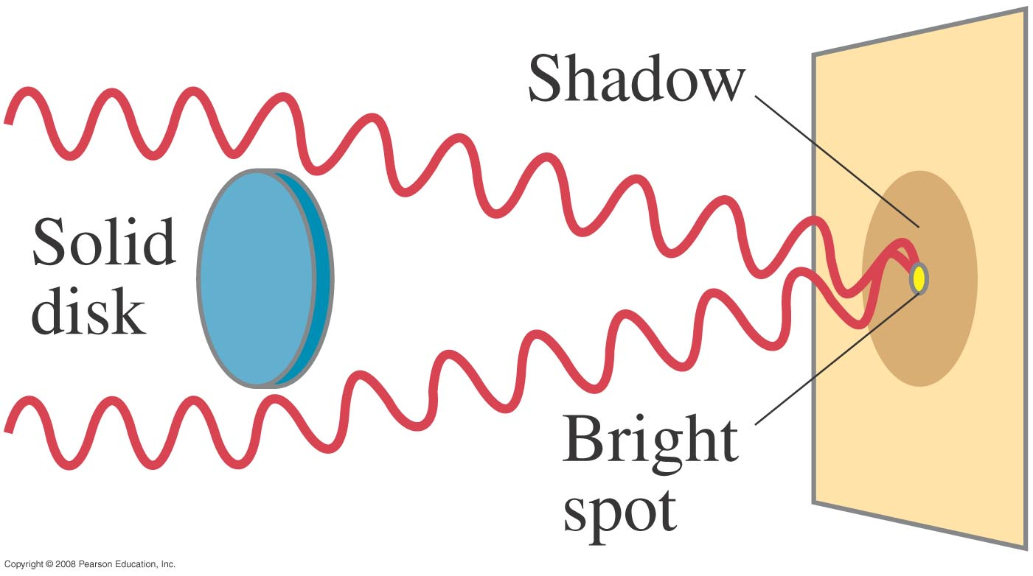
35-1 Diffraction by a Single Slit or Disk
If light is a wave, it will diffract around a single slit or obstacle ( Francois Arago experiment confirming the wave aspect of light).
Constructive interference
Notes:
Figure 35-1. If light is a wave, a bright spot will appear at the center of the shadow of a solid disk illuminated by a point source of monochromatic light.

Slide 21
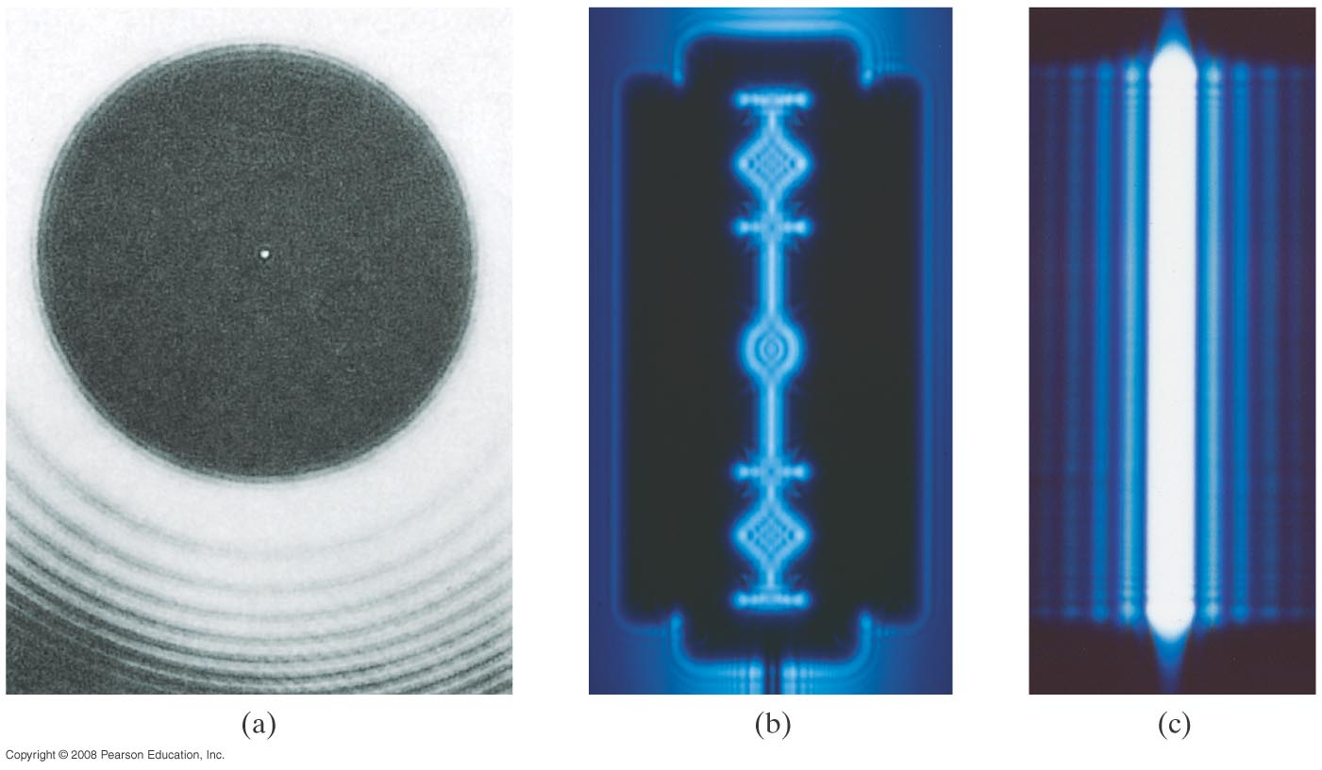
35-1 Diffraction by a Single Slit or Disk
(a) a circular disk
The resulting pattern of light and dark stripes is called a diffraction pattern.
(a) a circular disk
(b) razor
(c) a single slit
Notes:
Figure 35-2. Diffraction pattern of (a) a circular disk (a coin), (b) razor, (c) a single slit, each illuminated by a coherent point source of monochromatic light, such as a laser.

Slide 22
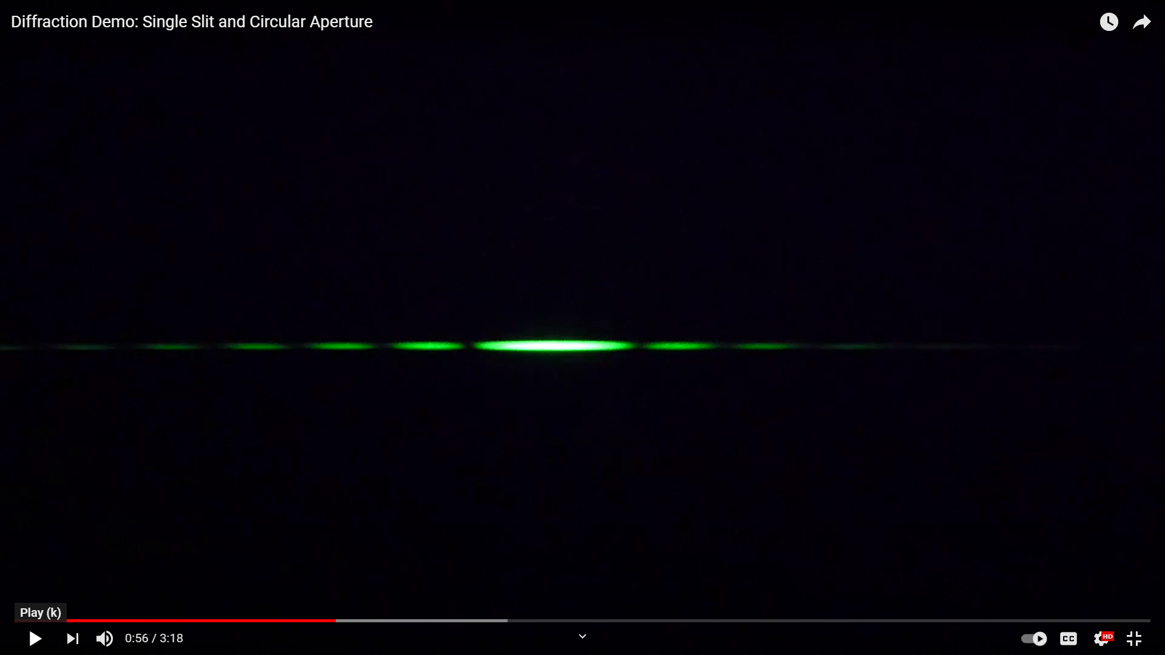
35-1 Diffraction by a Single Slit or Disk
https://www.youtube.com/watch?v=uohd0TtqOaw

Slide 23
35-1 Diffraction by a Single Slit or Disk
This pattern arises because different points along a slit create wavelets that interfere with each other just as a double slit would.
Notes:
Figure 35-3. Analysis of diffraction pattern formed by light passing through a narrow slit of width D.

Slide 24
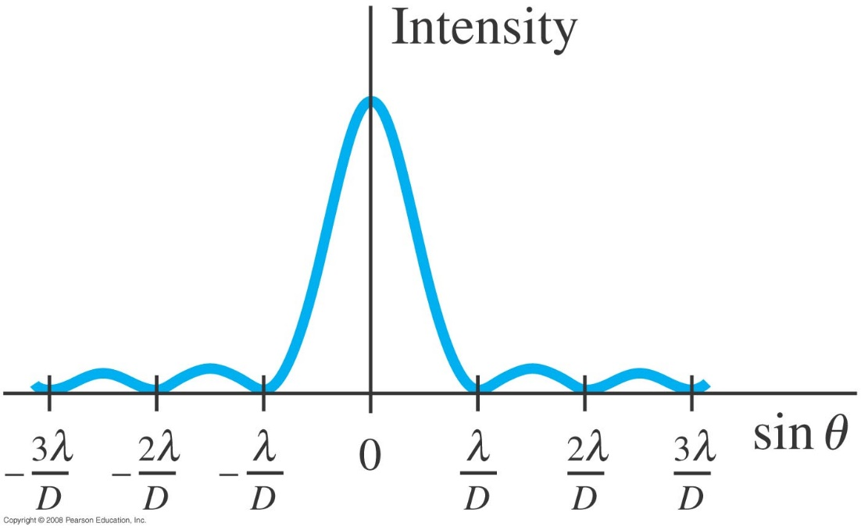
35-1 Diffraction by a Single Slit or Disk
The minima of the single-slit diffraction pattern occur when:
Intensity in the diffraction pattern of a single slit as a function of sin θ. Note that the central maximum is not only much higher than the maxima to each side, but it is also twice as wide (2λ/D wide) as any of the others (only λ/D wide each).
Notes:
Figure 35-4. Intensity in the diffraction pattern of a single slit as a function of sin θ. Note that the central maximum is not only much higher than the maxima to each side, but it is also twice as wide (2λ/D wide) as any of the others (only λ/D wide each).

Slide 25
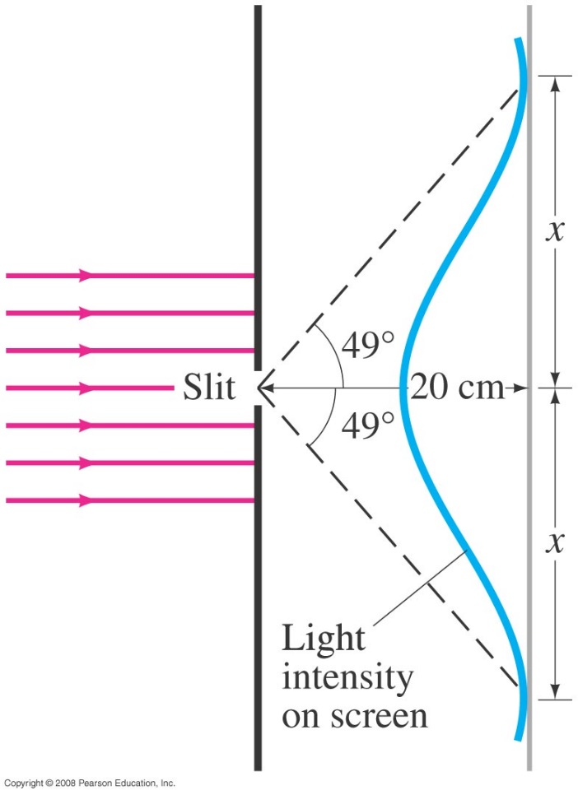
35-1 Diffraction by a Single Slit or Disk
Example 35-1: Single-slit diffraction maximum.
Light of wavelength 750 nm passes through a slit 1.0 x 10⁻³ mm wide. How wide is the central maximum (a) in degrees, and (b) in centimeters, on a screen 20 cm away?
Notes:
Solution: a. The first minimum occurs at sin θ = λ/D = 0.75, or θ = 49°. The full width is twice this, or 98°.
b. The width is 46 cm.

