Slide 1
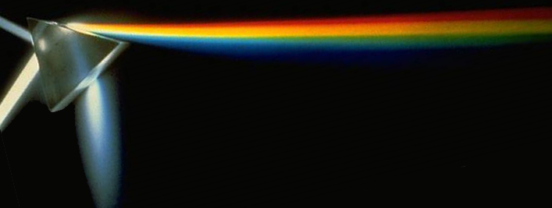
Chapter 31- Electromagnetic waves and Light
Exam on Friday April 5th, study guide posted
Notes:
Chapter 30 Opener. A spark plug in a car receives a high voltage, which produces a high enough electric field in the air across its gap to pull electrons off the atoms in the air–gasoline mixture and form a spark. The high voltage is produced, from the basic 12 V of the car battery, by an induction coil which is basically a transformer or mutual inductance. Any coil of wire has a self-inductance, and a changing current in it causes an emf to be induced. Such inductors are useful in many circuits.

Slide 2
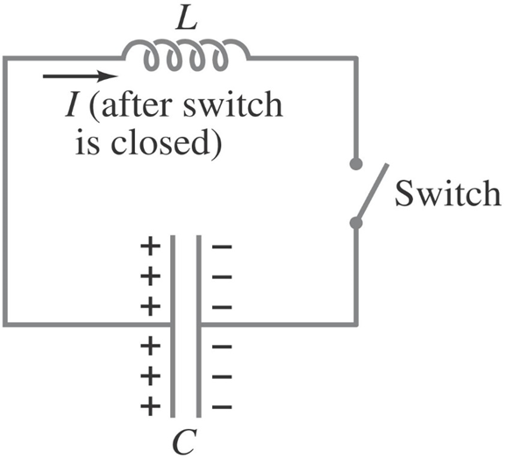
30-5 LC Circuits and Electromagnetic Oscillations
An LC circuit is a charged capacitor shorted through an inductor.
Summing the potential drops around the circuit gives a differential equation for Q:
This is the equation for simple harmonic motion, and has solutions
.

Slide 3
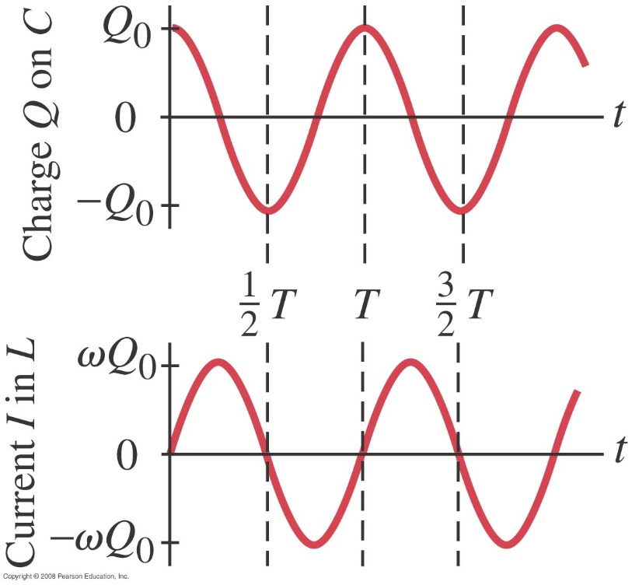
30-5 LC Circuits and Electromagnetic Oscillations
Substituting shows that the equation can only be true for all times if the frequency is given by
The current is sinusoidal as well:
The charge and current are both sinusoidal, but with different phases. The maximum current I₀=ωQ₀

Slide 4
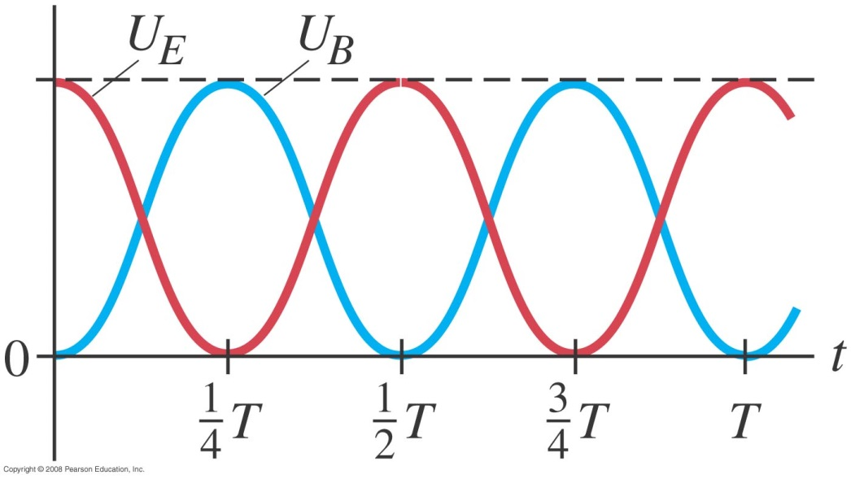
30-5 LC Circuits and Electromagnetic Oscillations
The total energy in the circuit is constant; it oscillates between the capacitor and the inductor:
Notes:
Figure 30-12. Energy U_{E} (red line) and U_{B} (blue line) stored in the capacitor and the inductor as a function of time. Note how the energy oscillates between electric and magnetic. The dashed line at the top is the (constant) total energy U = U_{E} + U_{B}.

Slide 5
Problem 34
34. (II) A 425-pF capacitor is charged to 135 V and then quickly connected to a 175-mH inductor. Determine (a) the frequency of oscillation, (b) the peak value of the current, and (c) the maximum energy stored in the magnetic field of the inductor.

Slide 6
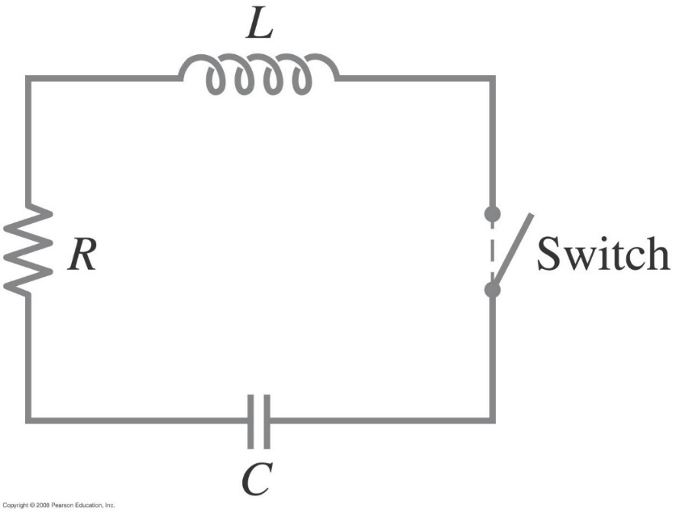
30-6 LC Oscillations with Resistance (LRC Circuit)
Any real circuit will have resistance added to the LC. Now the voltage drops around the circuit give
Notes:
Figure 30-13. An LRC circuit.

Slide 7
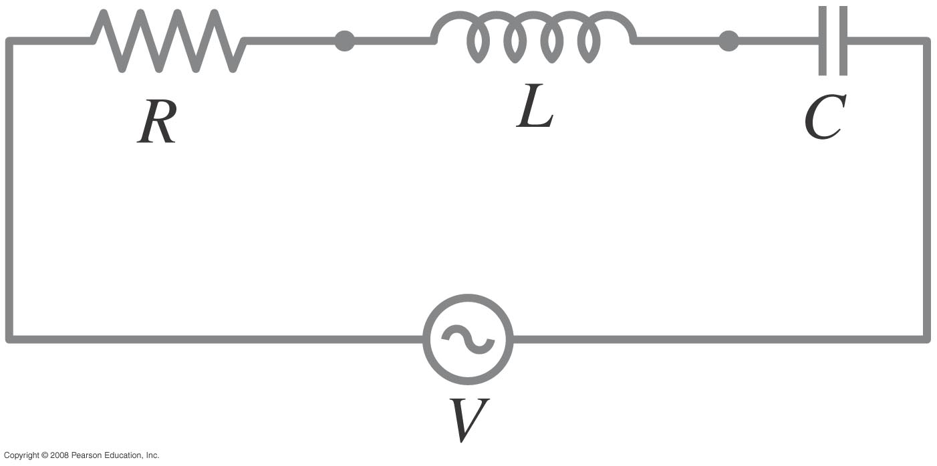
30-8 LRC Series AC Circuit
Analyzing the LRC series AC circuit is complicated, as the voltages are not in phase – this means we cannot simply add them. Furthermore, the reactances depend on the frequency.
Notes:
Figure 30-19. An LRC circuit.

Slide 8
30-8 LRC Series AC Circuit
We find from the ratio of voltage to current that the effective resistance, called the impedance, of the circuit is given by
X_{L}: reactance of the inductor=2πfL
X_{c}: reactance of the capacitor=1/2πfC
Z is in Ohms

Slide 9
Problem 48
48. (I) A 10.0kΩ resistor is in series with a 26.0-mH inductor and an ac source. Calculate the impedance of the circuit if the source frequency is (a) 55.0 Hz; (b) 55,000 Hz.

Slide 10
Problem 49
49.(I) A 75Ω resistor and a 6.8μF capacitor are connected in series to an ac source. Calculate the impedance of the circuit if the source frequency is (a) 60 Hz; (b) 6.0 MHz.

Slide 11
Chapter 31-Chapter 32 Electromagnetic waves
Notes:
Chapter 30 Opener. A spark plug in a car receives a high voltage, which produces a high enough electric field in the air across its gap to pull electrons off the atoms in the air–gasoline mixture and form a spark. The high voltage is produced, from the basic 12 V of the car battery, by an induction coil which is basically a transformer or mutual inductance. Any coil of wire has a self-inductance, and a changing current in it causes an emf to be induced. Such inductors are useful in many circuits.

Slide 12
31-3 Maxwell’s Equations
This set of equations describe electric and magnetic fields, and is called Maxwell’s equations. In the absence of dielectric or magnetic materials, they are:
Gauss’s Law of magnetism
A magnetic field induce a electric field
A electric field induce a magnetic field

Slide 13
31-4 Production of Electromagnetic Waves
Since a changing electric field produces a magnetic field, and a changing magnetic field produces an electric field, once sinusoidal fields are created they can propagate on their own.
These propagating fields are called electromagnetic waves (EM).

Slide 14
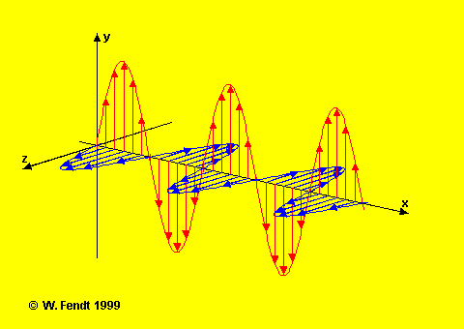
Induced Electric Fields
Electric & Magnetic fields induce each other
Changing B induces emf ⇒ changing E
Changing E ⇒ changing B
⇒ The oscillations (changes) of the electric and magnetic fields create electromagnetic waves

Slide 15
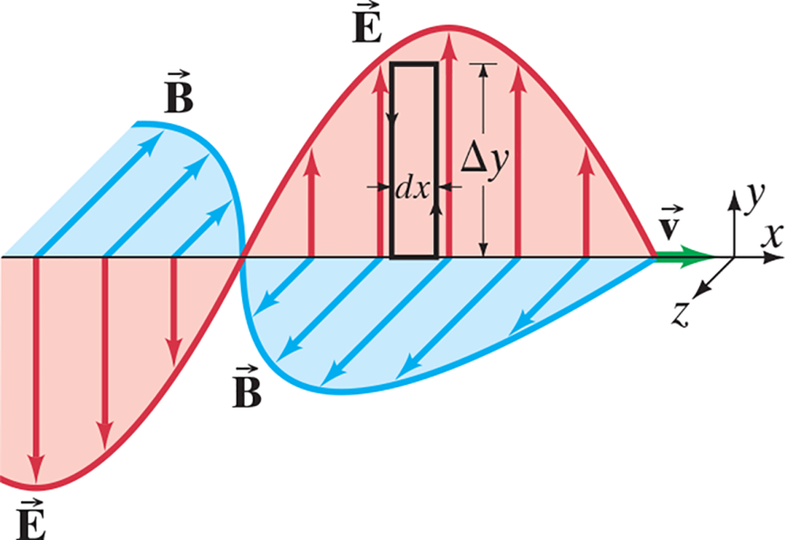
31-5 Electromagnetic Waves, and Their Speed, Derived from Maxwell’s Equations
This figure shows an electromagnetic wave of
wavelength λ
and frequency f. The electric and
magnetic fields are given by
Electromagnetic wave moves in the x direction
Notes:
Figure 31-10. Applying Faraday’s law to the rectangle (Δy)(dx).
LD A horizontal arrow spans across the figure along the horizontal x axis of the x y z plane, where the positive y axis points vertically upward. The waves resemble a sine wave. They are identical but perpendicular to each other and intercept the horizontal arrow at the same points. A portion of the waves for electric field and magnetic field is shown. The wave for electric field is labeled vector E, and the wave for magnetic field is labeled vector B. The wave for electric field is drawn along the x y plane, and the region between the wave and the horizontal arrow is shaded red. The wave for magnetic field is drawn along the x z plane, and the region between the wave and the horizontal arrow is shaded blue. Multiple vertical electric field arrows are drawn from the horizontal arrow to the curve of the wave for electric field. These arrows are perpendicular to the x axis and are on the x y plane. Similarly, multiple magnetic field arrows are drawn from the horizontal arrow to the curve of the wave for magnetic field. These arrows are perpendicular to the x axis and are on the x z plane. A rectangle is drawn on the wave for electric field on the x y plane such that its base lies on the horizontal arrow and its upper left corner is in contact with the curve of the wave. The height of the rectangle is delta y and its width is d x. A velocity vector arrow labeled vector v is drawn toward the right end of the horizontal arrow. It starts from the point where the two waves meet on the horizontal axis and extends to the right in the direction of the positive x axis.

Slide 16
31-5 Electromagnetic Waves, and Their Speed, Derived from Maxwell’s Equations
B and E are related by the following equation Calculated by Maxwell
.
Here, v is the velocity of the wave.
The magnitude of this velocity is around 3.0 x 10⁸ m/s – precisely equal to the measured speed of light.
Based on his calculations, Maxwell’s argue that light is EM wave, nobody believed him until Hertz confirmed Maxwell calculations experimentally 8 years later ( in 1887).

Slide 17
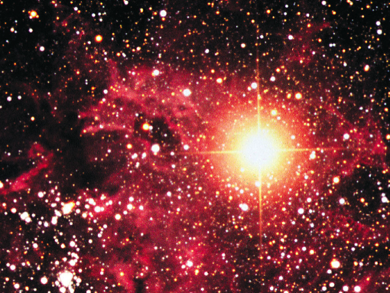
Speed of EM Waves -- vacuum
EM waves do not require a medium to propagate
Permittivity of free space
∈_{ο} = 8.85 x 10⁻¹² C²/N⋅m²
Permeability of free space:
μ_{ο}= 4π x 10⁻⁷ T⋅m/A

Slide 18
31-6 Light as an Electromagnetic Wave and the Electromagnetic Spectrum
The frequency of an electromagnetic wave is related to its wavelength and to the speed of light:
$$c=λf$$
$$ω=2πf$$
$$k=\frac{2π}{λ}$$

Slide 19
31-5 Electromagnetic Waves, and Their Speed, Derived from Maxwell’s Equations
Example 31-2: Determining $\vec{E }$
and
$$\vec{B}$$
in E M waves.
Assume a 60.0-Hz E M wave is a sinusoidal wave
$$\vec{E }$$
pointing in the x
propagating in the z direction with
direction, and
$$\vec{E }$$
and
$$\vec{B}$$
as functions of position and time.
Write vector expressions for

Slide 20
Problem 9
9. (I) If the magnetic field in a traveling EM wave has a peak magnitude of 12.5 nT, what is the peak magnitude of the electric field?

Slide 21
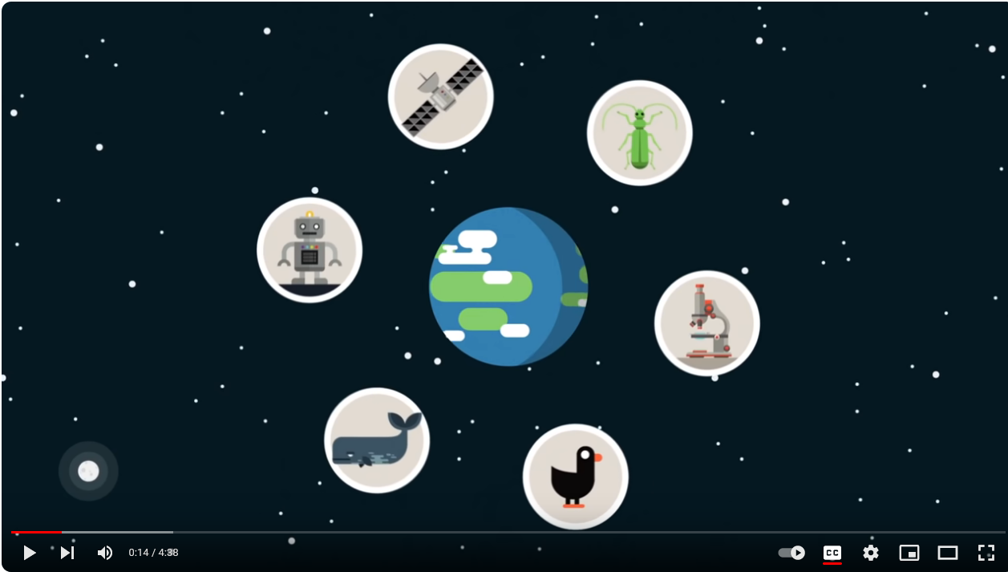
What is light?
https://www.youtube.com/watch?v=IXxZRZxafEQ

Slide 22
Speed of Light in matter
Generally light slows down when it encounters a medium other than vacuum.
n is the index of refraction of the medium n≥1
λ_{ο}
λ
λ_{ο}
c
v
n
Frequency is unchanged

