Slide 1
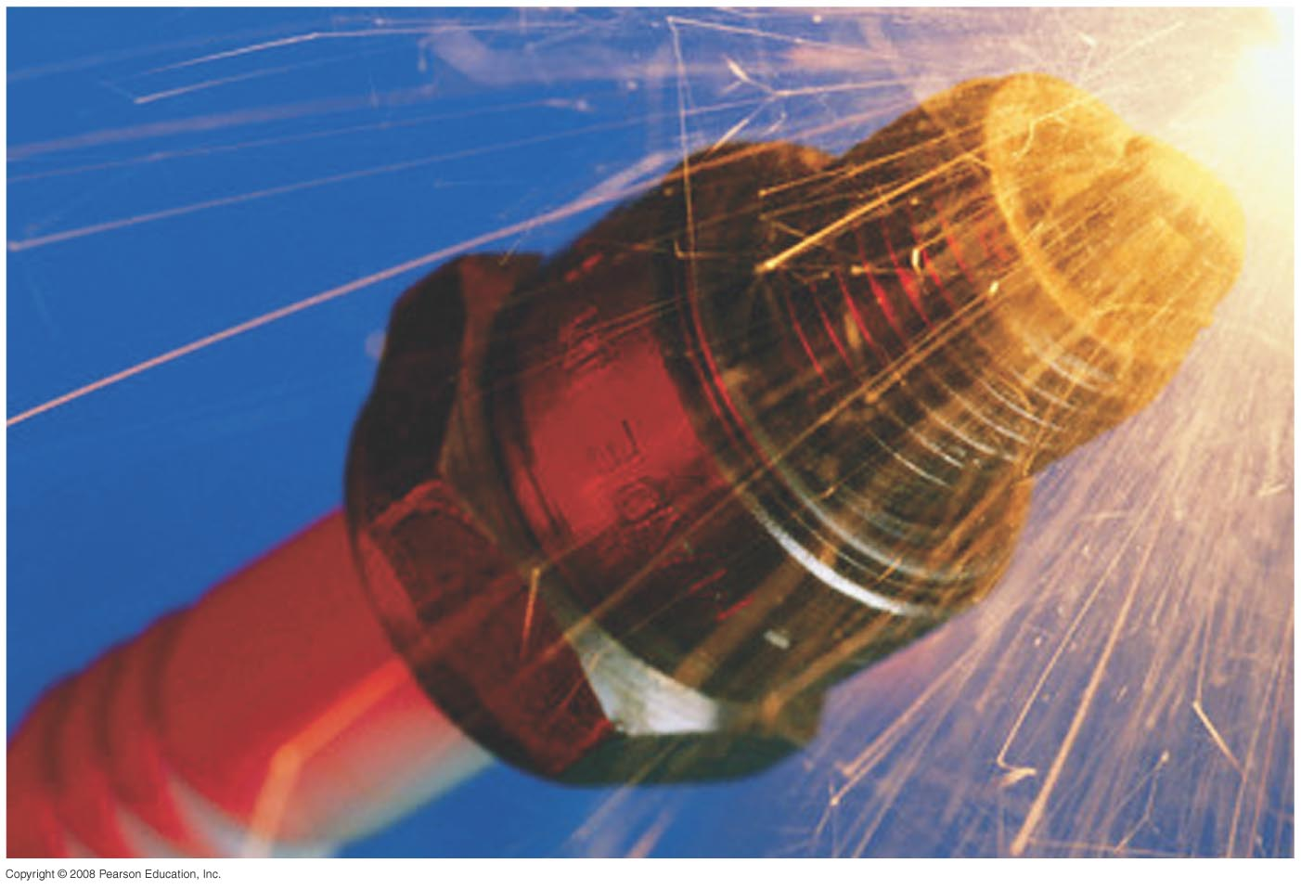
Chapter 30 Inductance, Electromagnetic Oscillations, and AC Circuits
No Homework
Quiz on Friday
Exam on Friday April 5th, study guide posted
Notes:
Chapter 30 Opener. A spark plug in a car receives a high voltage, which produces a high enough electric field in the air across its gap to pull electrons off the atoms in the air–gasoline mixture and form a spark. The high voltage is produced, from the basic 12 V of the car battery, by an induction coil which is basically a transformer or mutual inductance. Any coil of wire has a self-inductance, and a changing current in it causes an emf to be induced. Such inductors are useful in many circuits.

Slide 2
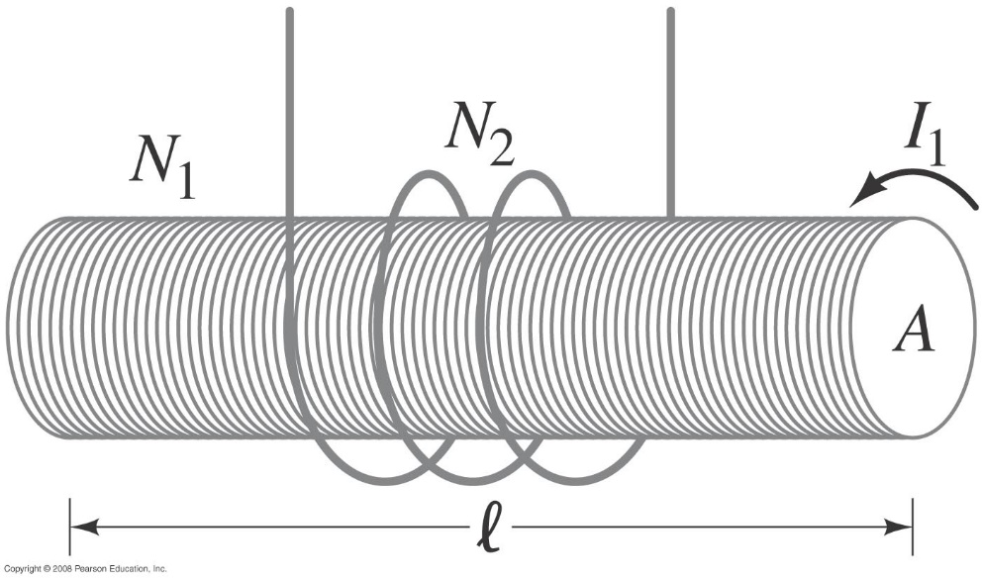
30-1 Mutual Inductance
Example 30-1: Solenoid and coil.
A long thin solenoid of length l and cross-sectional area A contains N₁ closely packed turns of wire. Wrapped around it is an insulated coil of N₂ turns. Assume all the flux from coil 1 (the solenoid) passes through coil 2, and calculate the mutual inductance.
Notes:
Solution$: Assuming all the flux from the solenoid stays within the secondary coil, the flux is BA = μ0 (N1/l) I1A, and M = μ0 (N1N2/l) A.$

Slide 3
30-1 Mutual Inductance
Conceptual Example 30-2: Reversing the coils.
How would Example 30–1 change if the coil with N₂ turns was inside the solenoid rather than outside the solenoid?
Notes:
Solution: The only difference is that the area A would be the area of the coil with turns rather than the area of the solenoid.

Slide 4
30-2 Self-Inductance
A changing current in a coil will also induce an emf in itself:
Here, L is called the self-inductance:
The unit of L is Henry

Slide 5
30-2 Self-Inductance
Example 30-3: Solenoid inductance.
(a) Determine a formula for the self-inductance L of a tightly wrapped and long solenoid containing N turns of wire in its length l and whose cross-sectional area is A.
(b) Calculate the value of L if N = 100, l= 5.0 cm, A = 0.30 cm², and the solenoid is air filled.
Notes:
Solution: a. B = μ₀nI and is constant; the flux is μ₀NIA/l and the self-inductance is μ₀N²A/l.
b. Plugging in the numbers gives L = 7.5 μH.

Slide 6
Problem 6
(I) How many turns of wire would be required to make a 130-mH inductance out of a 30.0-cm-long air-filled coil with a diameter of 4.2 cm?

Slide 7
Problem 8
8.(II) An air-filled cylindrical inductor has 2800 turns, and it is 2.5 cm in diameter and 21.7 cm long. (a) What is its inductance? (b) How many turns would you need to generate the same inductance if the core were filled with iron of magnetic permeability 1200 times that of free space?

Slide 8
Inductors Explained - The basics how inductors work working principle
https://www.youtube.com/watch?v=KSylo01n5FY&t=6s

Slide 9
How inductors work?
https://www.youtube.com/watch?v=VSMGnmQApA0

Slide 10
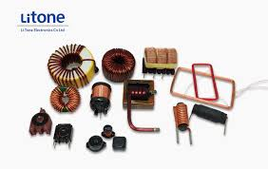
30-3 Energy Stored in a Magnetic Field
Picture of inductors

Slide 11
Problem 15
15. (I) The magnetic field inside an air-filled solenoid 38.0 cm long and 2.10 cm in diameter is 0.600 T. Approximately how much energy is stored in this field?

Slide 12
Problem 18
18. (II) Calculate the magnetic and electric energy densities at the surface of a 3.0-mm-diameter copper wire carrying a 15-A current (ρ_{Cu}=1.68$×{10}^{−8}$Ωm).

Slide 13
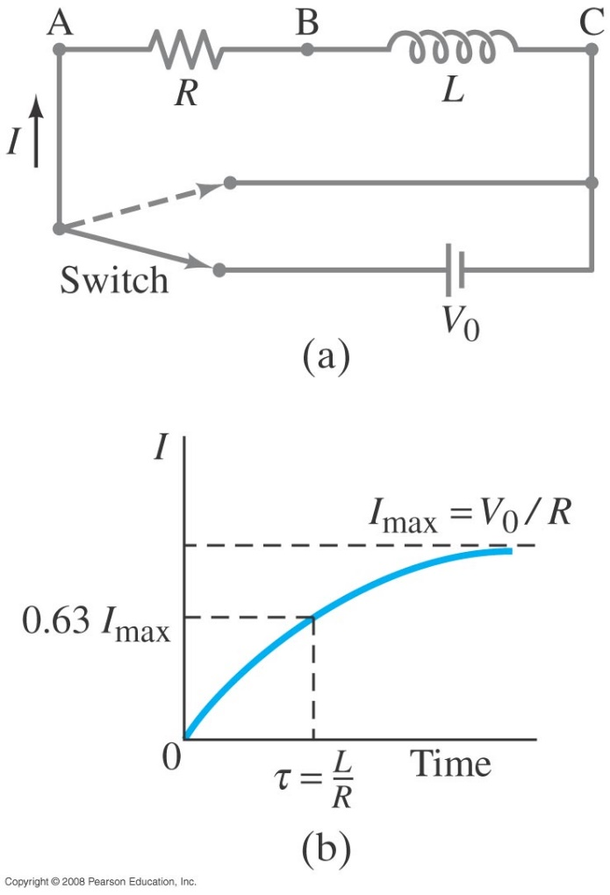
30-4 LR Circuits
A circuit consisting of an inductor and a resistor will begin with most of the voltage drop across the inductor, as the current is changing rapidly. With time, the current will increase less and less, until all the voltage is across the resistor.
An inductor slows down the change in current
Notes:
Figure 30-6. (a) LR circuit; (b) growth of current when connected to battery.

Slide 14
30-4 LR Circuits
The sum of potential differences around the loop gives
Integrating gives the current as a function of time:
.
The time constant of an LR circuit is
.

Slide 15
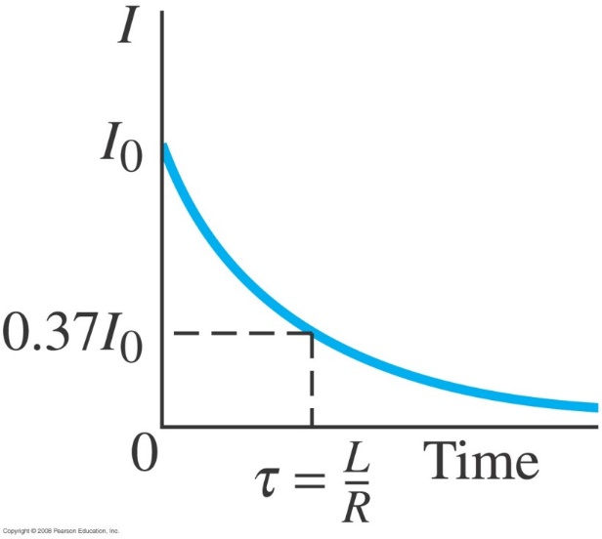
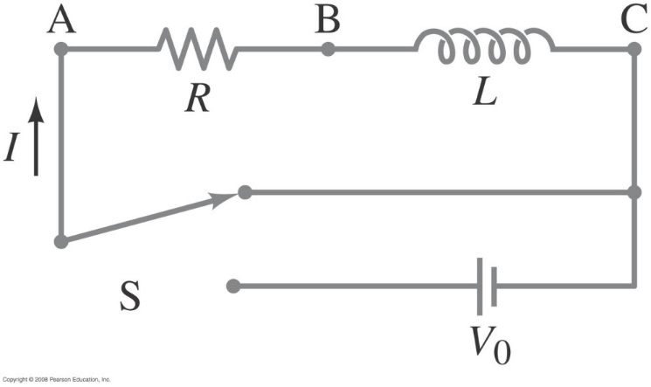
30-4 LR Circuits
If the circuit is then shorted across the battery, the current will gradually decay away:
Notes:
Figure 30-7. The switch is flipped quickly so the battery is removed but we still have a circuit. The current at this moment (call it t = 0) is I₀.
Figure 30-8. Decay of the current in Fig. 30–7 in time after the battery is switched out of the circuit.

Slide 16
Problem 24
24. (II) It takes 2.56 ms for the current in an LR circuit to increase from zero to 0.75 its maximum value. Determine (a) the time constant of the circuit, (b) the resistance of the circuit if L=31mH

