Slide 1
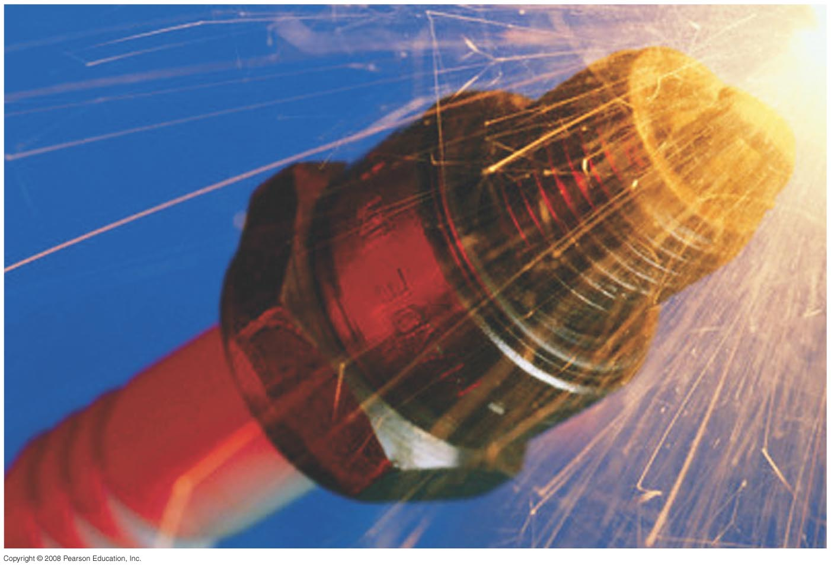
Chapter 30 Inductance, Electromagnetic Oscillations, and AC Circuits
No Homework
Quiz on Friday
Exam on Friday April 5th, study guide posted
Notes:
Chapter 30 Opener. A spark plug in a car receives a high voltage, which produces a high enough electric field in the air across its gap to pull electrons off the atoms in the air–gasoline mixture and form a spark. The high voltage is produced, from the basic 12 V of the car battery, by an induction coil which is basically a transformer or mutual inductance. Any coil of wire has a self-inductance, and a changing current in it causes an emf to be induced. Such inductors are useful in many circuits.

Slide 2
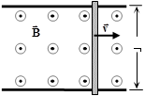
Problem 33
33.(II) A conducting rod rests on two long frictionless parallel rails in a magnetic field B (┴ to the rails and rod) as in Fig. 29–44. (a) If the rails are horizontal and the rod is given an initial push, will the rod travel at constant speed at the beginning of the motion even though a magnetic field is present? (b) Suppose at t=0 when the rod has speed v=v₀ the two rails are connected electrically by a wire from point a to point b. Assuming the rod has resistance R and the rails have negligible resistance, determine the speed of the rod as a function of time. Discuss your answer.
a
b

Slide 3
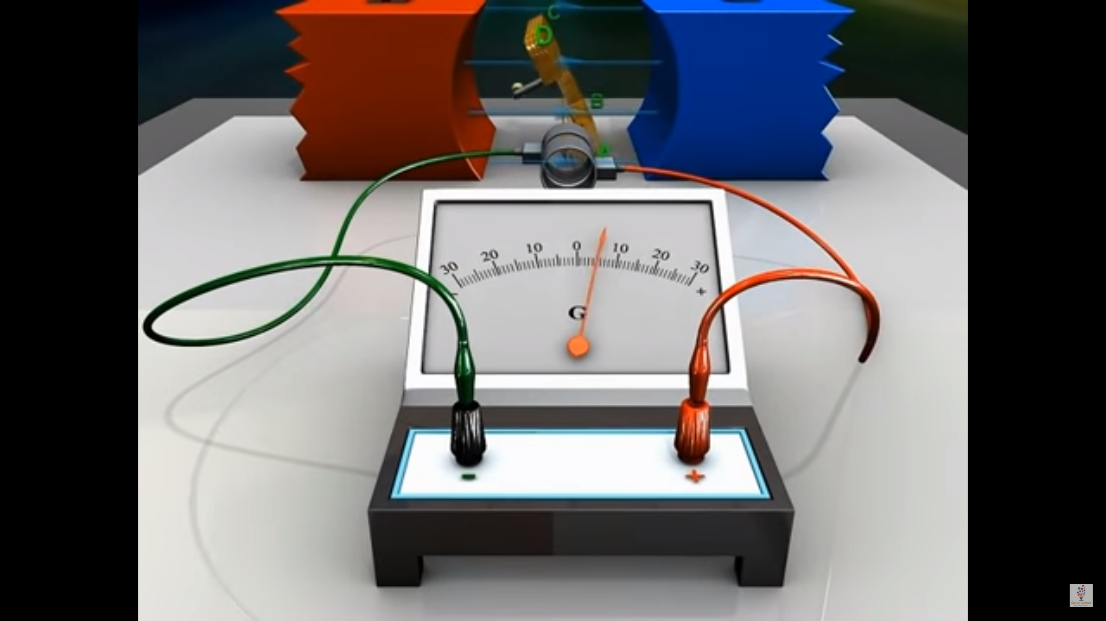
29-4 Electric Generators
https://www.youtube.com/watch?v=gQyamjPrw-U&t=36s

Slide 4
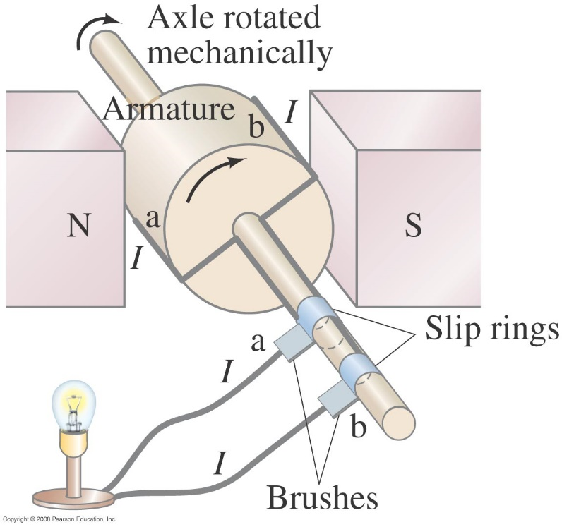
29-4 Electric Generators
One of the application of the induced emf is a generator. A generator is the opposite of a motor – it transforms mechanical energy into electrical energy. This is an ac generator:
The axle is rotated by an external force such as falling water or steam. The brushes are in constant electrical contact with the slip rings.
Notes:
Figure 29-15. An ac generator.

Slide 5
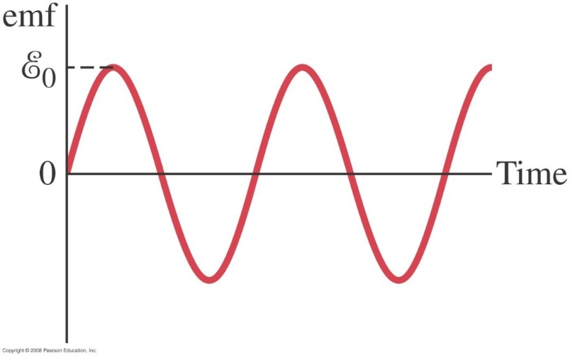
29-4 Electric Generators
If the loop is rotating with constant angular velocity ω, the induced emf is sinusoidal:
For a coil of N loops,
Notes:
Figure 29-16. An ac generator produces an alternating current. The output emf E = E₀ sin ωt, where E₀ = NABω.

Slide 6
29-4 Electric Generators
Example 29-9: An ac generator.
The armature of a 60-Hz ac generator rotates in a 0.15-T magnetic field. If the area of the coil is 2.0 x 10⁻² m², how many loops must the coil contain if the peak output is to be E₀ = 170 V?
Notes:
Solution: N = E₀/BAω = 150 turns. Remember to convert 60 Hz to angular units.

Slide 7
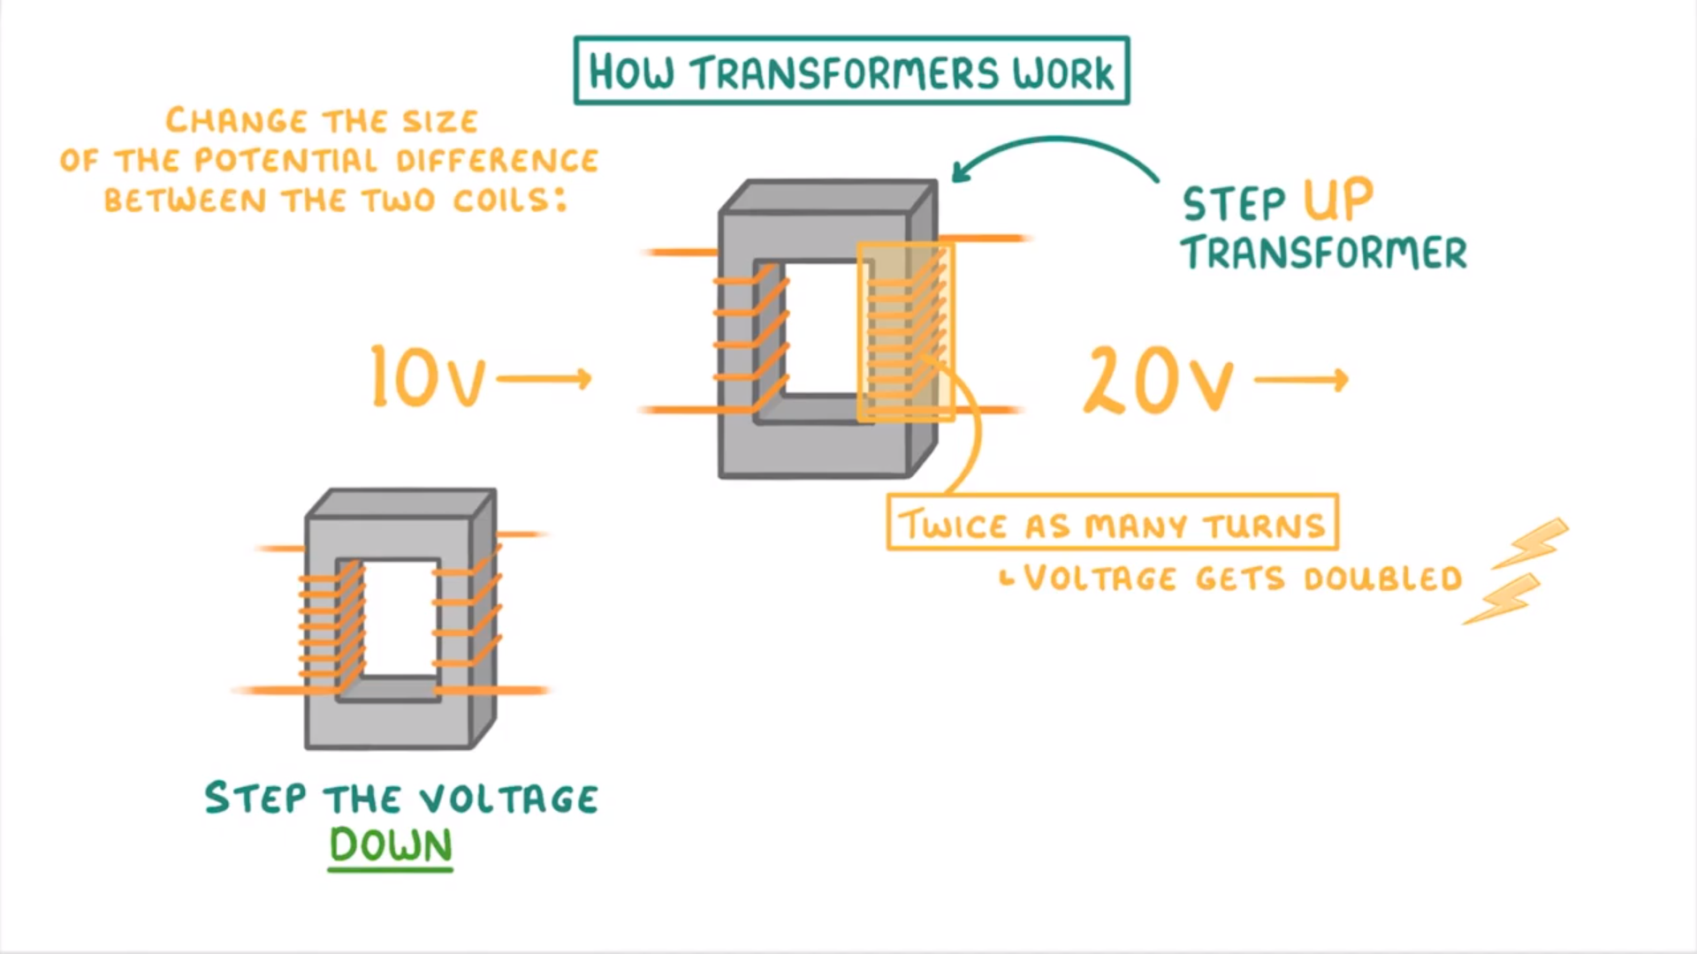
29-6 Transformers and Transmission of Power
https://www.youtube.com/watch?v=7RtBUEZbKmI

Slide 8
29-6 Transformers and Transmission of Power
A transformer is a device for increasing or decreasing an ac voltage
A transformer consists of two coils, either interwoven or linked by an iron core. A changing emf in one induces an emf in the other.
The ratio of the emfs is equal to the ratio of the number of turns in each coil:
This is the transformer equation
p: Primary
s: Secondary

Slide 9
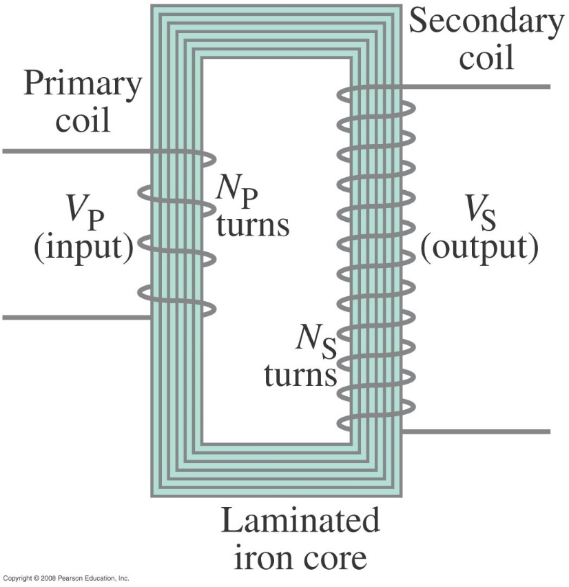
29-6 Transformers and Transmission of Power
This is a step-up transformer It is designed so that all the current produced by the magnetic flux is in the primary coil.
The emf in the secondary coil is larger than the emf in the primary and N_{s}> N_{p}
Notes:
Figure 29-24. Step-up transformer (N_{P} = 4, N_{S} = 12).

Slide 10
29-6 Transformers and Transmission of Power
Energy must be conserved; therefore, in the absence of losses, the ratio of the currents must be the inverse of the ratio of turns:
Because of conservation of energy, the power output cannot be greater than the power input

Slide 11
29-6 Transformers and Transmission of Power
Example 29-12: Cell phone charger.
The charger for a cell phone contains a transformer that reduces 120-V ac to 5.0-V ac to charge the 3.7-V battery. (It also contains diodes to change the 5.0-V ac to 5.0-V dc.) Suppose the secondary coil contains 30 turns and the charger supplies 700 mA. Calculate (a) the number of turns in the primary coil, (b) the current in the primary, and (c) the power transformed.
Notes:
Solution: a. N_{P} = N_{S} V_{P}/V_{S} = 720 turns.
b. I_{P} = I_{S} N_{S}/N_{P} = 29 mA.
c. P = I_{S}V_{S} = 3.5 W.

Slide 12
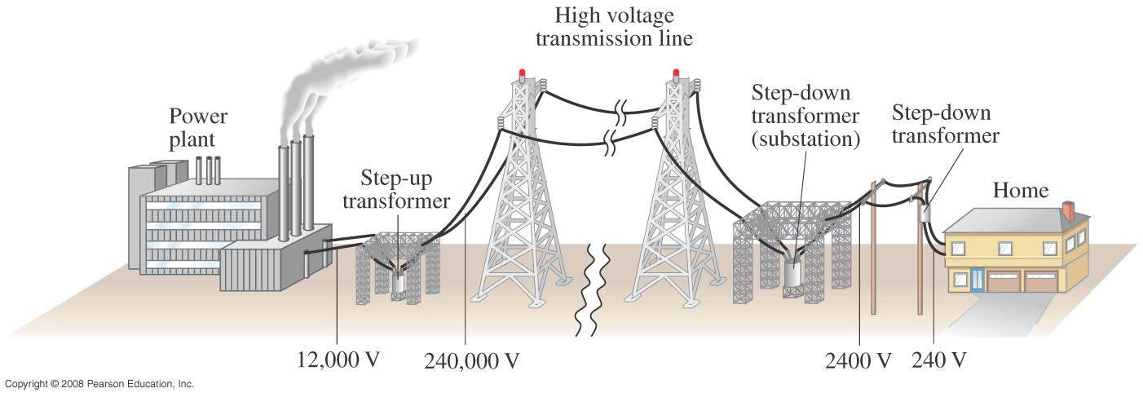
29-6 Transformers and Transmission of Power
Transformers work only if the current is changing-AC current (due to change of flux that induce an emf); this is one reason why electricity is transmitted as ac.
Power is transmitted at high voltages, so the transformers are used to reduce power.
Notes:
Figure 29-26. The transmission of electric power from power plants to homes makes use of transformers at various stages.

Slide 13
Problem 48
48. (II) A model-train transformer plugs into 120-V ac and draws 0.35 A while supplying 7.5 A to the train. (a) What voltage is present across the tracks? (b) Is the transformer step-up or step-down?

Slide 14
29-7 A Changing Magnetic Flux Produces an Electric Field
A changing magnetic flux induces an electric field; this is a generalization of Faraday’s law. The electric field will exist regardless of whether there are any conductors around:
$$V=$$
$$=𝓔=V$$
so
.
and
We know that the voltage is proportional to the electric field
And that an emf is voltage

Slide 15
Chapter 30 Inductance, Electromagnetic Oscillations, and AC Circuits
Notes:
Chapter 30 Opener. A spark plug in a car receives a high voltage, which produces a high enough electric field in the air across its gap to pull electrons off the atoms in the air–gasoline mixture and form a spark. The high voltage is produced, from the basic 12 V of the car battery, by an induction coil which is basically a transformer or mutual inductance. Any coil of wire has a self-inductance, and a changing current in it causes an emf to be induced. Such inductors are useful in many circuits.

Slide 16
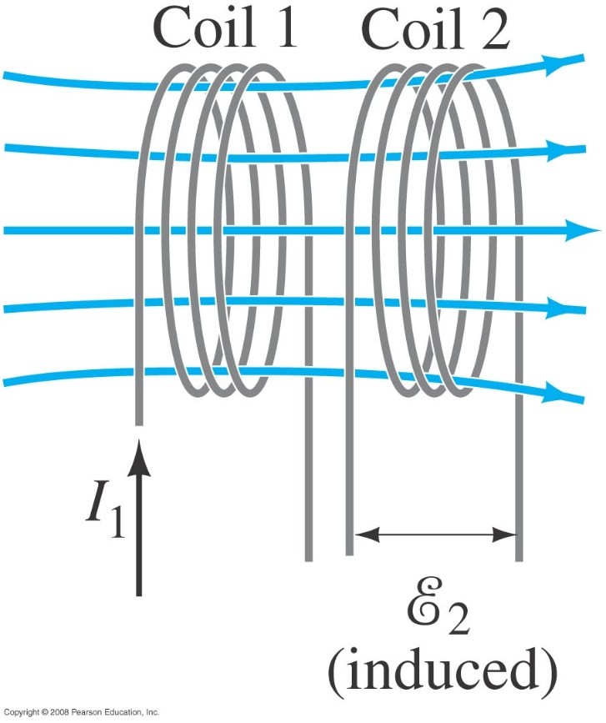
30-1 Mutual Inductance
Mutual inductance: a changing current in one coil will induce an emf in a second coil (flux due to current of the first coil)
And vice versa; note that the constant M (the mutual inductance) depends on the size, shape and the number of turns, and is known as the mutual inductance, is the same:

Slide 17
30-1 Mutual Inductance
Unit of inductance: the henry, H:
1 H = 1 V·s/A = 1 Ω·s.
M₁₂=M₂₁ =M
A transformer is an example of mutual inductance.
Notes:
Figure 30-1. A changing current in one coil will induce a current in the second coil.

Slide 18
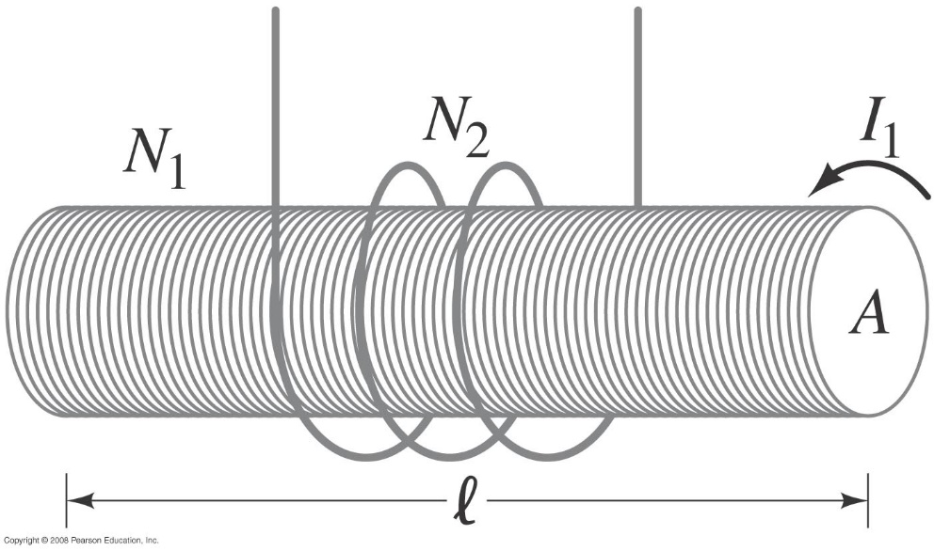
30-1 Mutual Inductance
Example 30-1: Solenoid and coil.
A long thin solenoid of length l and cross-sectional area A contains N₁ closely packed turns of wire. Wrapped around it is an insulated coil of N₂ turns. Assume all the flux from coil 1 (the solenoid) passes through coil 2, and calculate the mutual inductance.
Notes:
Solution$: Assuming all the flux from the solenoid stays within the secondary coil, the flux is BA = μ0 (N1/l) I1A, and M = μ0 (N1N2/l) A.$

