Slide 1
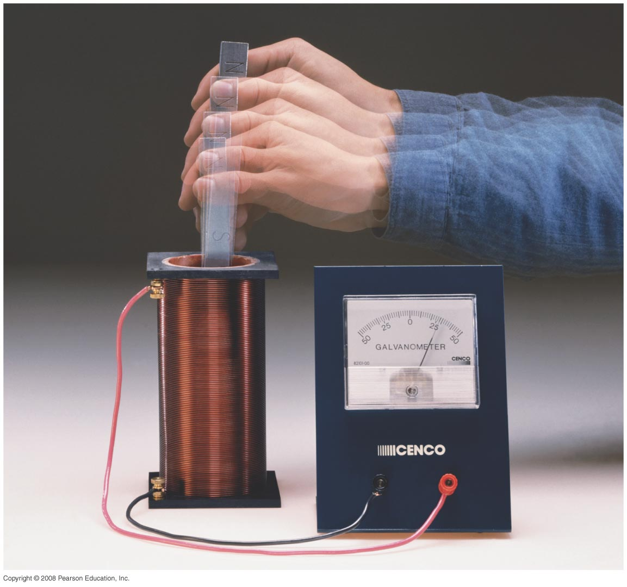
Chapter 29:Electromagnetic Induction and Faraday’s Law
Study Guide posted, exam on Friday April 11th
Notes:
Chapter 29 opener. One of the great laws of physics is Faraday’s law of induction, which says that a changing magnetic flux produces an induced emf. This photo shows a bar magnet moving inside a coil of wire, and the galvanometer registers an induced current. This phenomenon of electromagnetic induction is the basis for many practical devices, including generators, alternators, transformers, tape recording, and computer memory.

Slide 2
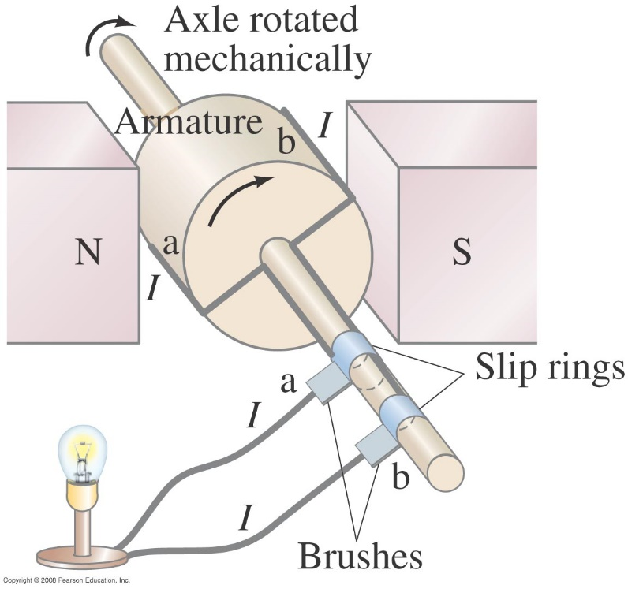
29-4 Electric Generators
One of the application of the induced emf is a generator. A generator is the opposite of a motor – it transforms mechanical energy into electrical energy. This is an ac generator:
The axle is rotated by an external force such as falling water or steam. The brushes are in constant electrical contact with the slip rings.
Notes:
Figure 29-15. An ac generator.

Slide 3
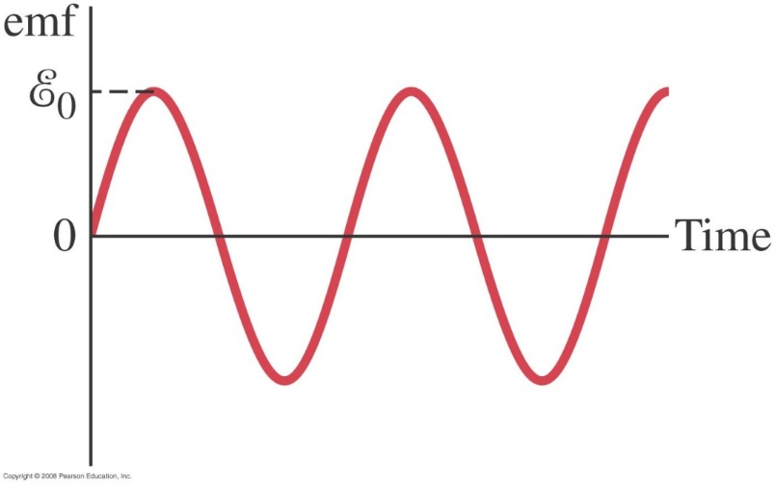
29-4 Electric Generators
If the loop is rotating with constant angular velocity ω, the induced emf is sinusoidal:
For a coil of N loops,
Notes:
Figure 29-16. An ac generator produces an alternating current. The output emf E = E₀ sin ωt, where E₀ = NABω.

Slide 4
29-4 Electric Generators
Example 29-9: An ac generator.
The armature of a 60-Hz ac generator rotates in a 0.15-T magnetic field. If the area of the coil is 2.0 x 10⁻² m², how many loops must the coil contain if the peak output is to be E₀ = 170 V?
Notes:
Solution: N = E₀/BAω = 150 turns. Remember to convert 60 Hz to angular units.

Slide 5
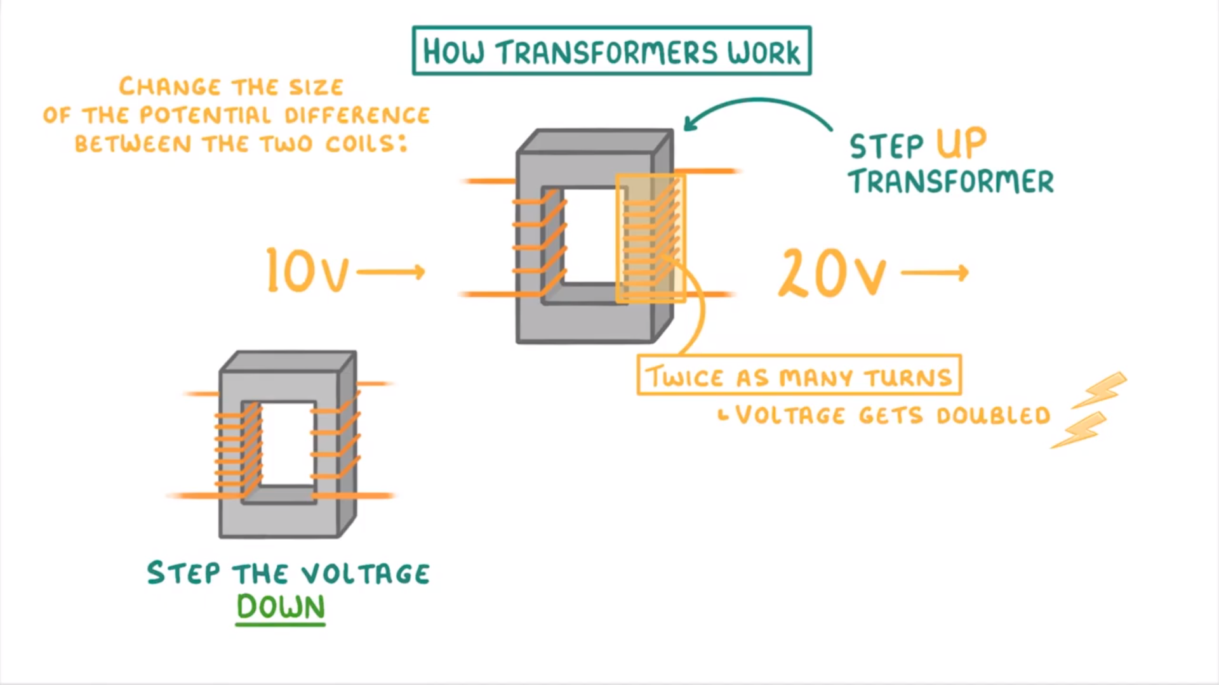
29-6 Transformers and Transmission of Power
https://www.youtube.com/watch?v=7RtBUEZbKmI

Slide 6
29-6 Transformers and Transmission of Power
A transformer is a device for increasing or decreasing an ac voltage
A transformer consists of two coils, either interwoven or linked by an iron core. A changing emf in one induces an emf in the other.
The ratio of the emfs is equal to the ratio of the number of turns in each coil:
This is the transformer equation
p: Primary
s: Secondary

Slide 7
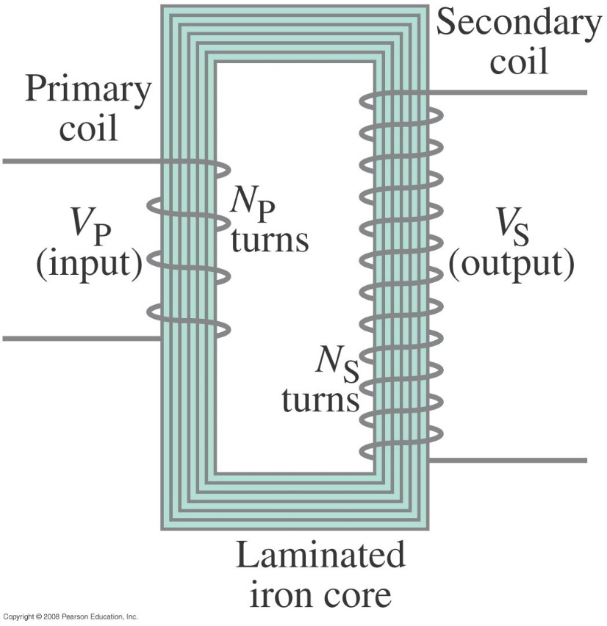
29-6 Transformers and Transmission of Power
This is a step-up transformer It is designed so that all the current produced by the magnetic flux is in the primary coil.
The emf in the secondary coil is larger than the emf in the primary and N_{s}> N_{p}
Notes:
Figure 29-24. Step-up transformer (N_{P} = 4, N_{S} = 12).

Slide 8
29-6 Transformers and Transmission of Power
Energy must be conserved; therefore, in the absence of losses, the ratio of the currents must be the inverse of the ratio of turns:
Because of conservation of energy, the power output cannot be greater than the power input

