Slide 1
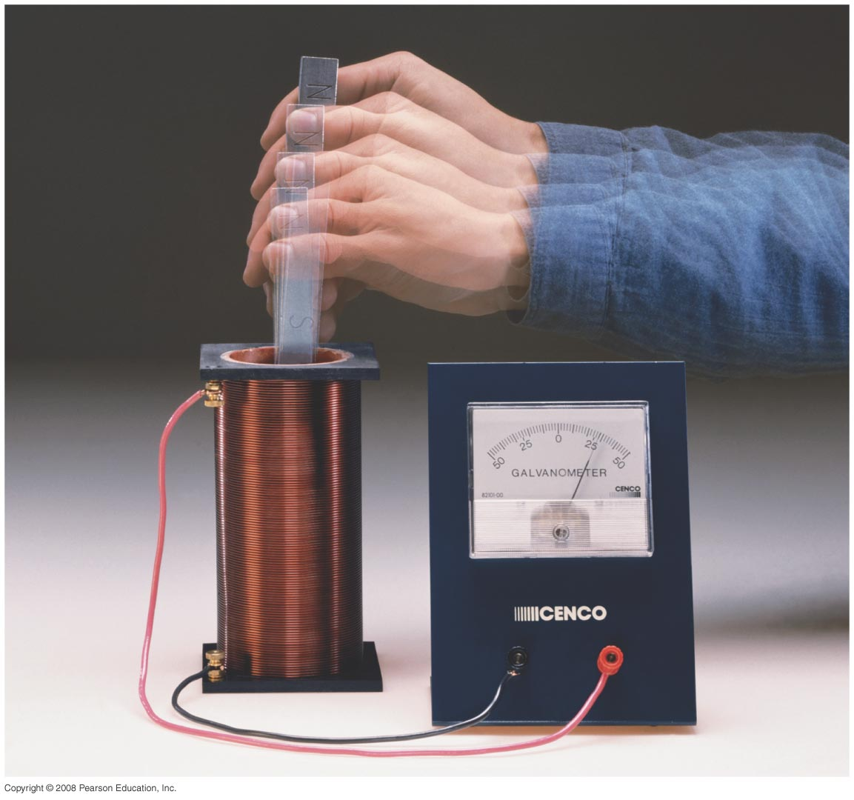
Chapter 29:Electromagnetic Induction and Faraday’s Law
HW 4: Chapter 26, Pb.11,Pb.18, Pb.28, Pb.32, Pb.50, Pb.51 due on Wednesday, March 20
Study Guide posted, exam on Friday April 5th
Quiz on Friday
Notes:
Chapter 29 opener. One of the great laws of physics is Faraday’s law of induction, which says that a changing magnetic flux produces an induced emf. This photo shows a bar magnet moving inside a coil of wire, and the galvanometer registers an induced current. This phenomenon of electromagnetic induction is the basis for many practical devices, including generators, alternators, transformers, tape recording, and computer memory.

Slide 2
Induced emf: Faraday’s law
https://www.youtube.com/watch?v=pQp6bmJPU_0

Slide 3
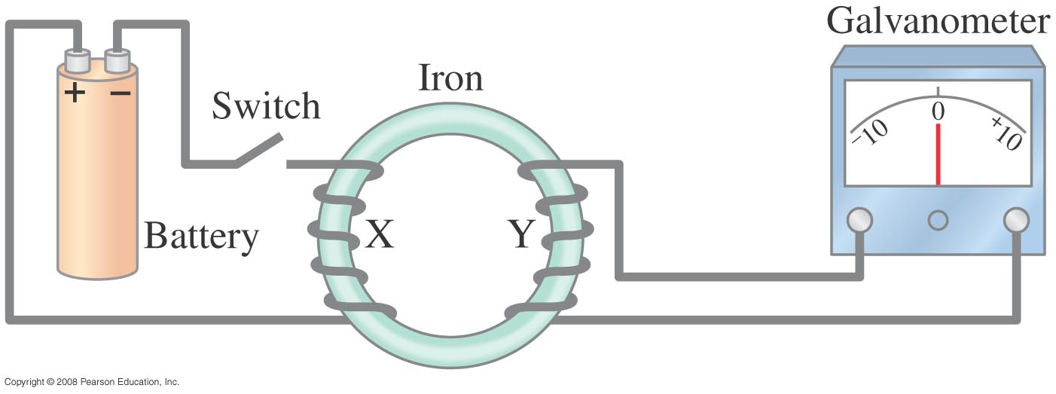
29-1 Induced EMF
Almost 200 years ago, Faraday looked for evidence that a change in a magnetic field would induce an electric current with this apparatus:
Notes:
Figure 29-1. Faraday’s experiment to induce an emf.

Slide 4
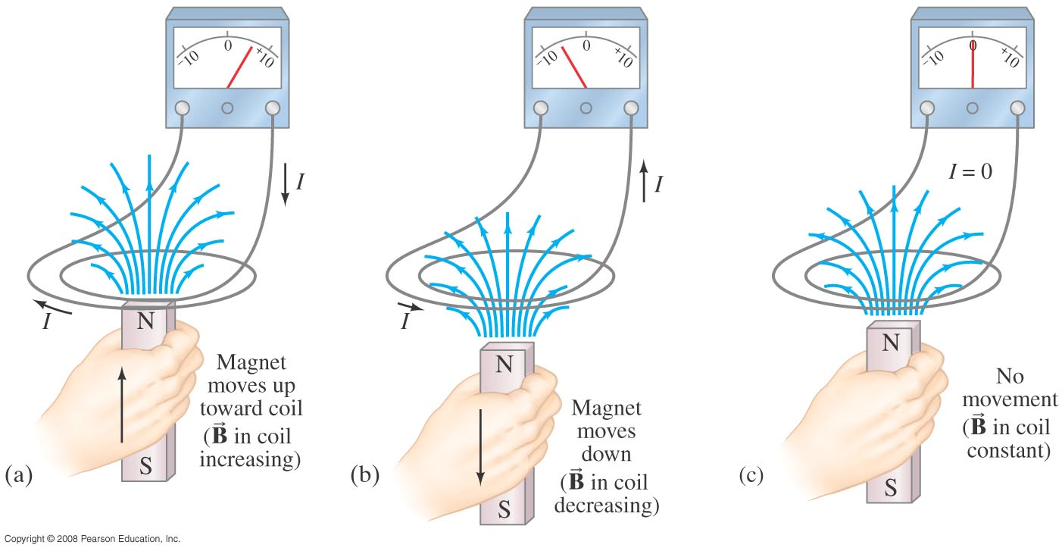
29-1 Induced EMF
He found no evidence of current when the B was steady, but did see a current induced when the switch was turned on or off.
Notes:
Figure 29-2. (a) A current is induced when a magnet is moved toward a coil, momentarily increasing the magnetic field through the coil. (b) The induced current is opposite when the magnet is moved away from the coil ( decreases). Note that the galvanometer zero is at the center of the scale and the needle deflects left or right, depending on the direction of the current. In (c), no current is induced if the magnet does not move relative to the coil. It is the relative motion that counts here: the magnet can be held steady and the coil moved, which also induces an emf.

Slide 5
29-1 Induced EMF
Therefore, a changing magnetic field induces an emf (or a current).
Faraday’s experiment used a magnetic field that was changing because the current producing it was changing;
the previous graphic shows a magnetic field that is changing because the magnet is moving.

Slide 6
29-2 Faraday’s Law of Induction; Lenz’s Law
The induced emf in a wire loop is proportional to the rate of change of magnetic flux through the loop.
Magnetic flux:
Unit of magnetic flux: weber,Wb: 1 Wb = 1 T·m².

Slide 7
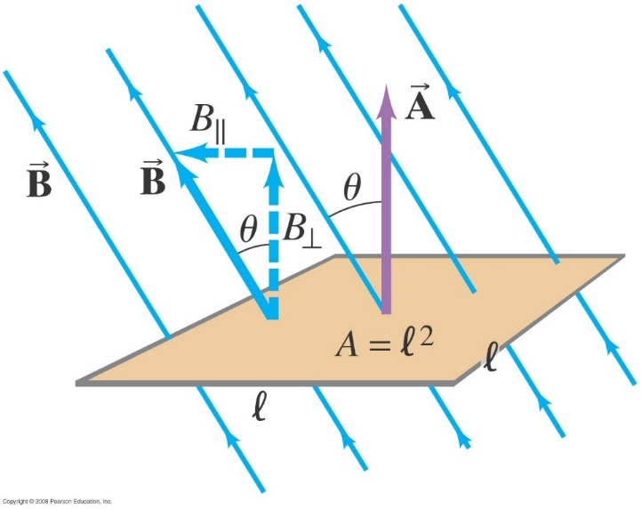
29-2 Faraday’s Law of Induction; Lenz’s Law
This drawing shows the variables in the flux equation:
$∅_{B}=BAcosθ$
Notes:
Figure 29-3. Determining the flux through a flat loop of wire. This loop is square, of side l and area A = l².

Slide 8
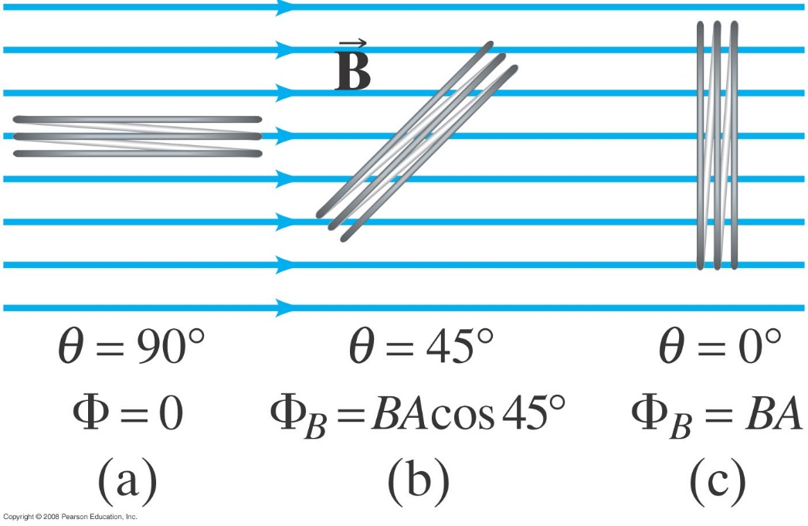
29-2 Faraday’s Law of Induction; Lenz’s Law
The magnetic flux is analogous to the electric flux – it is proportional to the total number of magnetic field lines passing through the loop.
Notes:
Figure 29-4. Magnetic flux Φ_{B} is proportional to the number of lines of B that pass through the loop.

Slide 9
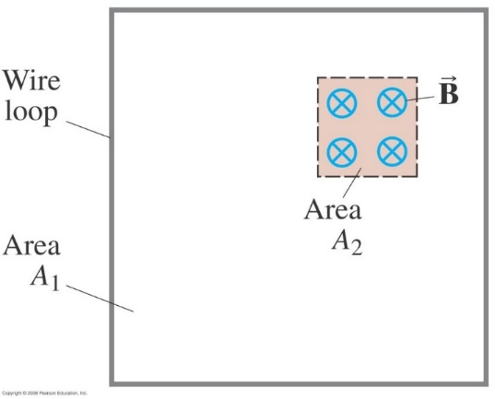
29-2 Faraday’s Law of Induction; Lenz’s Law
Conceptual Example 29-1: Determining flux.
A square loop of wire encloses area A₁. A uniform magnetic field B perpendicular to the loop extends over the area A₂. What is the magnetic flux through the loop A₁?
Notes:
Solution: Assuming the field is zero outside A₂, the flux is BA₂.

Slide 10
29-2 Faraday’s Law of Induction; Lenz’s Law
Faraday’s law of induction: the emf induced in a circuit is equal to the rate of change of magnetic flux through the circuit:
or

Slide 11
Problem 6
6. (II) A 10.8-cm-diameter wire coil is initially oriented so that its plane is perpendicular to a magnetic field of 0.68 T pointing up. During the course of 0.16 s, the field is changed to one of 0.25 T pointing down. What is the average induced emf in the coil?

Slide 12
29-2 Faraday’s Law of Induction; Lenz’s Law
Example 29-2: A loop of wire in a magnetic field.
A square loop of wire of side l = 5.0 cm is in a uniform magnetic field B = 0.16 T. What is the magnetic flux in the loop (a) when B is perpendicular to the face of the loop and (b) when B is at an angle of 30 to the area A of the loop? (c) What is the magnitude of the average current in the loop if it has a resistance of 0.012 Ω and it is rotated from position (b) to position (a) in 0.14 s?
Notes:
Solution: a. The flux is BA = 4.0 x 10⁻⁴ Wb.
b. The flux is BA cos θ = 3.5 x 10⁻⁴ Wb.
c. The emf is ΔΦ_{B}/Δt = 3.6 x 10⁻⁴ V; then I = emf/R = 30 mA.

Slide 13
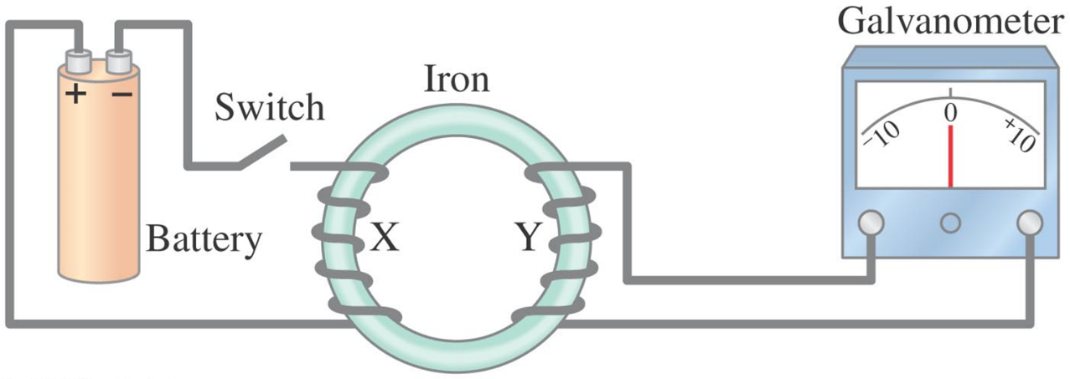
29-2 Faraday’s Law of Induction; Lenz’s Law
The minus sign gives the direction of the induced emf:
A current produced by an induced emf moves in a direction so that the magnetic field it produces tends to restore the changed field.
THIS IS LENZ’S LAW
Change in I₁ produces B₁, when closing and opening the switch
emf is produced in this part (second wire),
it will produce another current I₂ that will produce B₂ opposite to B₁

Slide 14
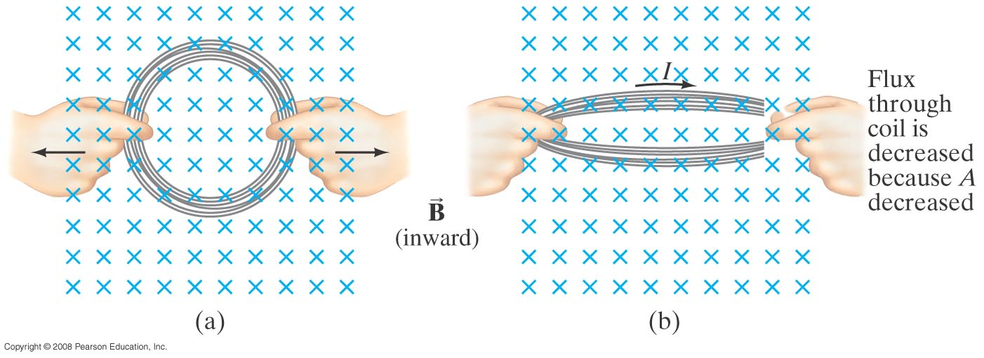
29-2 Faraday’s Law of Induction; Lenz’s Law
Magnetic flux will change if the area of the loop changes.
Notes:
Figure 29-6. A current can be induced by changing the area of the coil, even though B doesn’t change. Here the area is reduced by pulling on its sides: the flux through the coil is reduced as we go from (a) to (b). Here the brief induced current acts in the direction shown so as to try to maintain the original flux (Φ = BA) by producing its own magnetic field into the page. That is, as the area A decreases, the current acts to increase B in the original (inward) direction.

Slide 15
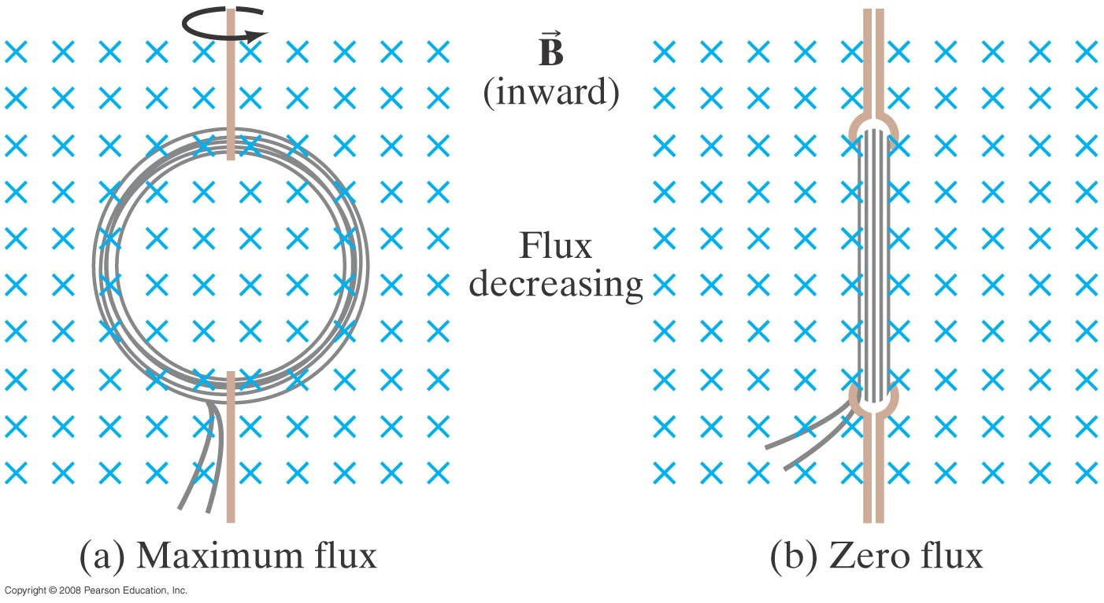
29-2 Faraday’s Law of Induction; Lenz’s Law
Magnetic flux will change if the angle between the loop and the field changes.
Notes:
Figure 29-7. A current can be induced by rotating a coil in a magnetic field. The flux through the coil changes from (a) to (b) because θ (in Eq. 29–1a, Φ = BA cos θ) went from 0° (cos θ = 1) to 90° (cos θ = 0).

Slide 16
29-2 Faraday’s Law of Induction; Lenz’s Law
Problem Solving: Lenz’s Law
Determine whether the magnetic flux is increasing, decreasing, or unchanged.
The magnetic field due to the induced current points in the opposite direction to the original field if the flux is increasing; in the same direction if it is decreasing; and is zero if the flux is not changing.(read Example 29-4)
Use the right-hand rule to determine the direction of the field.
Remember that the external magnetic field and the field due to the induced current are different.

Slide 17
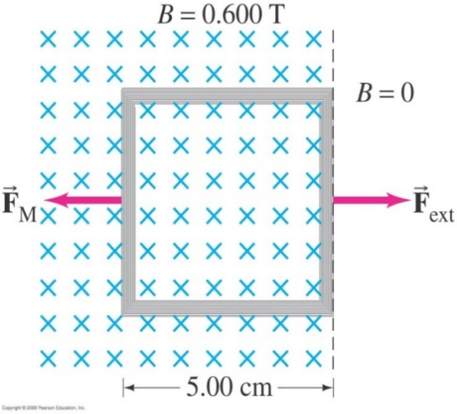
29-2 Faraday’s Law of Induction; Lenz’s Law
Example 29-5: Pulling a coil from a magnetic field.
A 100-loop square coil of wire, with side l = 5.00 cm and total resistance 100 Ω, is positioned perpendicular to a uniform 0.600-T magnetic field. It is quickly pulled from the field at constant speed (moving perpendicular to B) to a region where B drops abruptly to zero. At t = 0s, the right edge of the coil is at the edge of the field. It takes 0.100 s for the whole coil to reach the field-free region. Find (a) the rate of change in flux through the coil, and (b) the emf and current induced. (c) How much energy is dissipated in the coil? (d) What was the average force required (F_{ext})?
Notes:
Solution: a. The flux goes from BA to zero in 0.100 s, so Δ Φ_{B}/Δ t = BA/t = -1.50 x 10⁻² Wb/s.
b. The emf is –N Δ Φ_{B}/Δ dt = 1.50 V. The current is emf/R = 15.0 mA.
c. E = Pt = I²Rt = 2.25 x 10⁻³ J.
d. F = W/d = 0.0450 N.

Slide 18
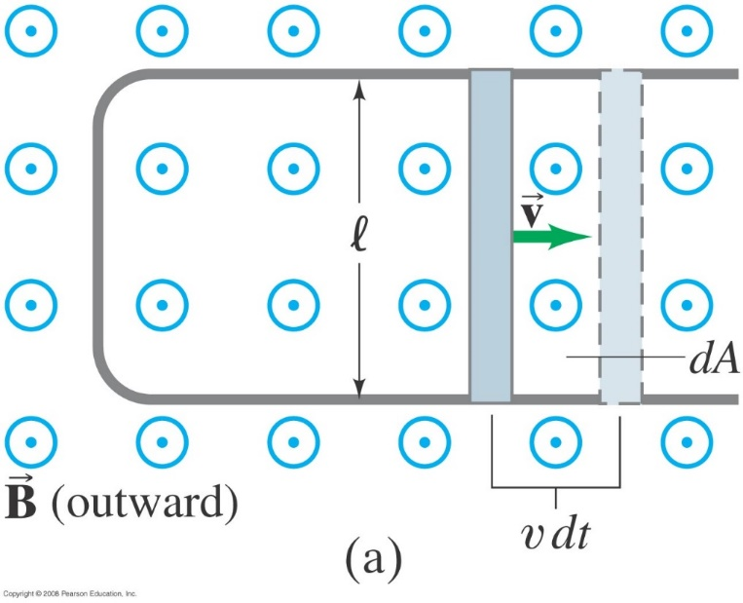
29-3 EMF Induced in a Moving Conductor
A conducting rod is moved to the right on a U-shaped conductor in a uniform magnetic field B that points out of the page (magnetic flux changes)
This image shows another way the magnetic flux can change:
Notes:
Figure 29-12a. A conducting rod is moved to the right on a U-shaped conductor in a uniform magnetic field B that points out of the page. The induced current is clockwise.

Slide 19
29-3 EMF Induced in a Moving Conductor
The induced emf has magnitude
This equation is valid as long as B, ,and v are mutually perpendicular (if not, it is true for their perpendicular components).

