Slide 1
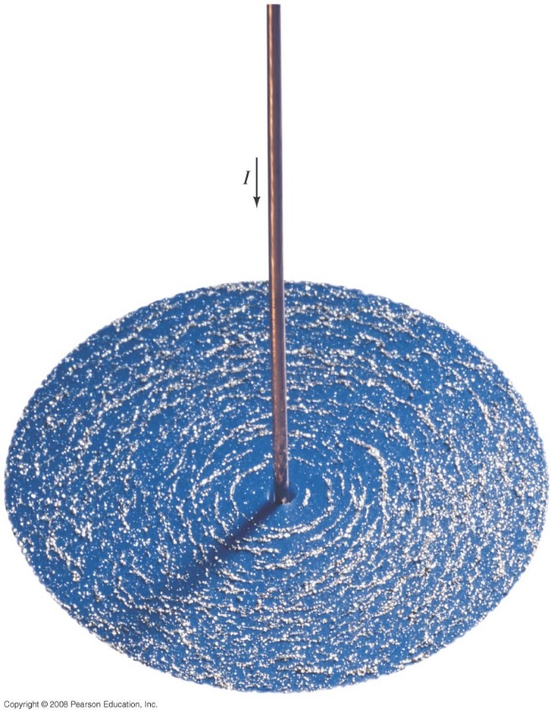
Chapter 27
Magnetism
HW 4: Chapter 26, Pb.11,Pb.18, Pb.28, Pb.32, Pb.50, Pb.51 due on Wednesday, March 20
Notes:
Chapter 27 opener. Magnets produce magnetic fields, but so do electric currents. An electric current flowing in this straight wire produces a magnetic field which causes the tiny pieces of iron (iron “filings”) to align in the field. We shall see in this Chapter how magnetic field is defined, and that the magnetic field direction is along the iron filings. The magnetic field lines due to the electric current in this long wire are in the shape of circles around the wire. We also discuss how magnetic fields exert forces on electric currents and on charged particles, as well as useful applications of the interaction between magnetic fields and electric currents and moving electric charges.

Slide 2
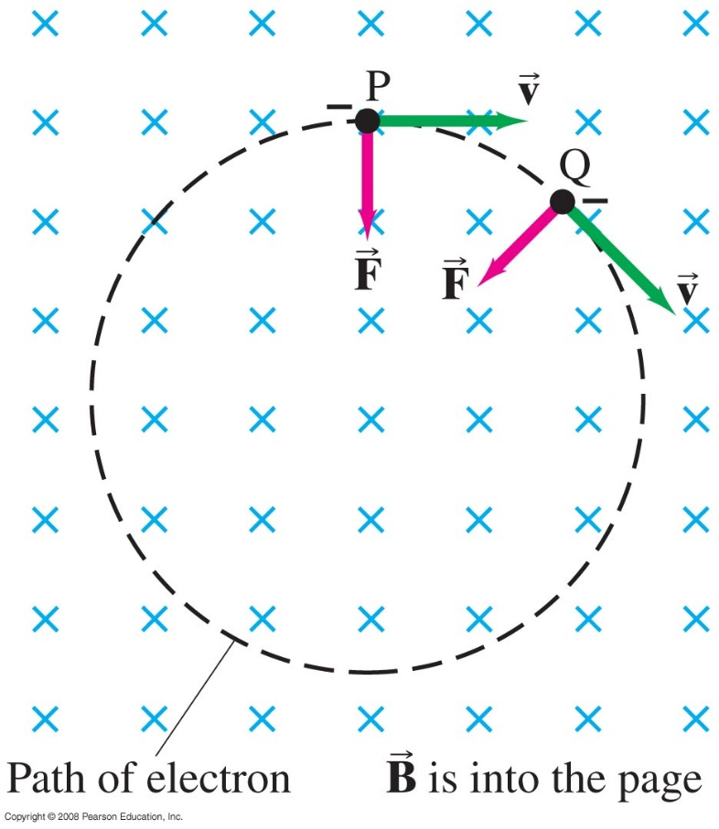
27-4 Force on an Electric Charge Moving in a Magnetic Field
If a charged particle (electron) is moving perpendicular to a uniform magnetic field, its path will be a circle, and the magnetic force is towards the center.
What will be the direction of the force if you have a proton?
Notes:
Figure 27-17. Force exerted by a uniform magnetic field on a moving charged particle (in this case, an electron) produces a circular path.

Slide 3
27-4 Force on an Electric Charge Moving in a Magnetic Field
Example 27-7: Electron’s path in a uniform magnetic field.
An electron travels at 2.0 x 10⁷ m/s in a plane perpendicular to a uniform 0.010-T magnetic field. Describe its path quantitatively.
Notes:
Solution: The magnetic force keeps the particle moving in a circle, so mv²/r = qvB. Solving for r gives r = mv/qB = 1.1 cm.

Slide 4
27-4 Force on an Electric Charge Moving in a Magnetic Field
Problem solving: Magnetic fields – things to remember:
The magnetic force is perpendicular to the plane formed by magnetic field and velocity.
The right-hand rule is useful for determining directions. The right-hand rule gives the direction.
Equations in this chapter give magnitudes only.

Slide 5
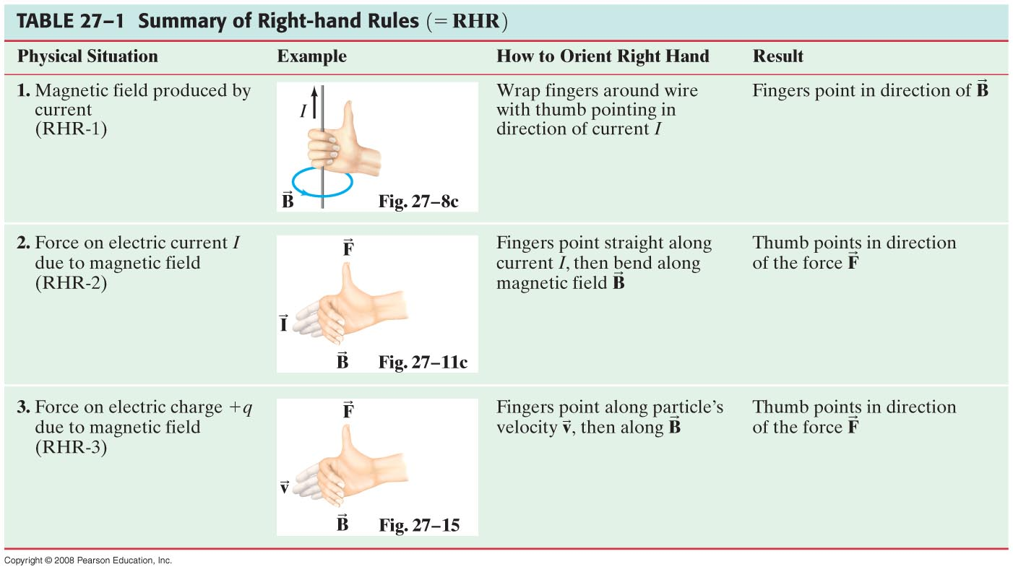
27-4 Force on an Electric Charge Moving in a Magnetic Field

Slide 6
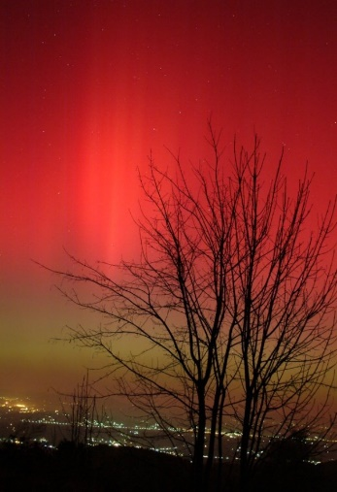
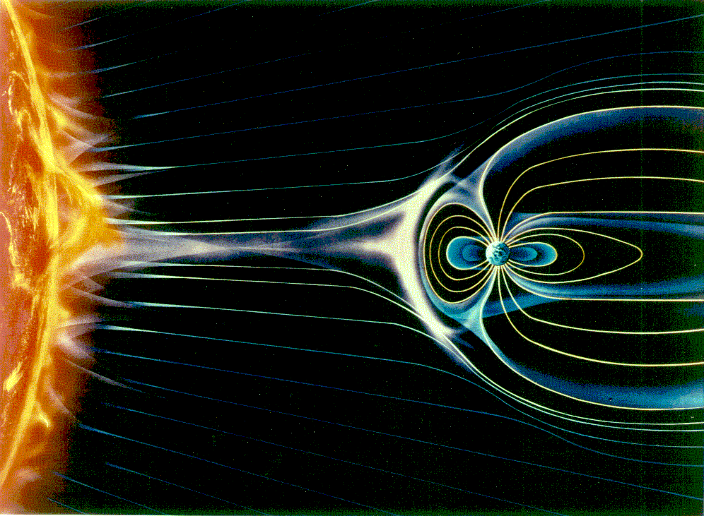
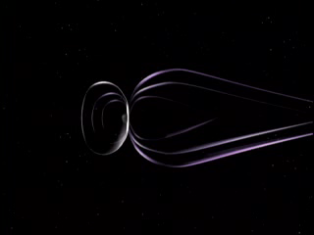
Charged particles in B-fields
Aurora Borealis: Northern Lights
Aurora Australis: Southern Lights
Due to ions (e⁻ & p⁺) from the Sun
    Travel from Sun to Earth in ~ 3 days
    93 million miles in 3 days ~ 30 million miles/day
www.spaceweather.com
Aurora on 11/20/03, Zagreb, Croatia. Photo by Hrvoje Horvat
http://www.nasa.gov/mpg/143772main_SolarCycleCME_Reconnection.mpg

Slide 7
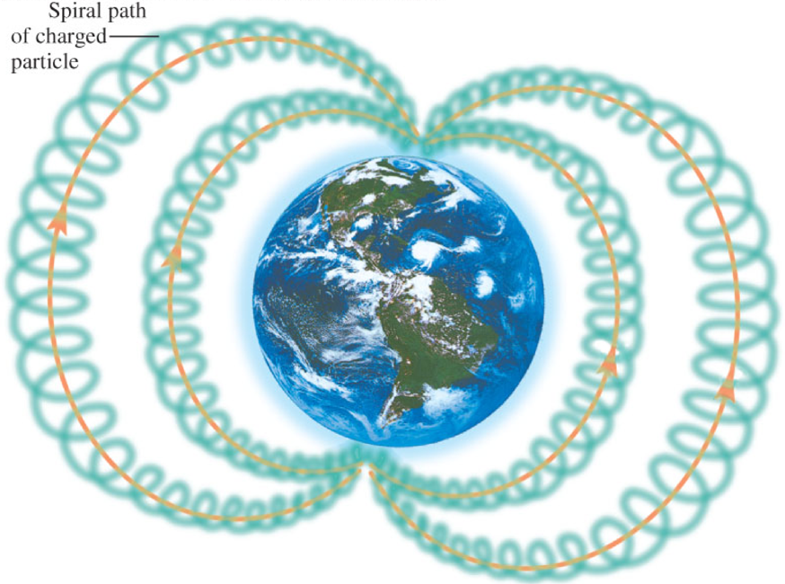
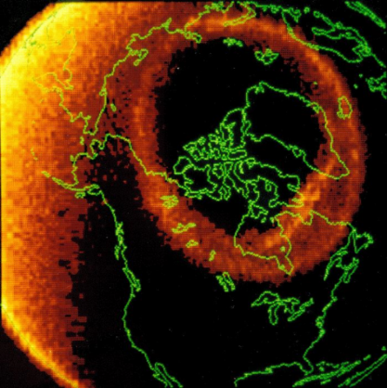
Aurora
Ions steered to poles by Earth’s magnetic field
  Sun particles collide with molecules in atmosphere at the poles
    ionize particles, recombination of the electrons with the ions from neutral atoms produces light: Aurora
  More energetic particles get closer to Earth
http://www.swpc.noaa.gov/pmap/

Slide 8
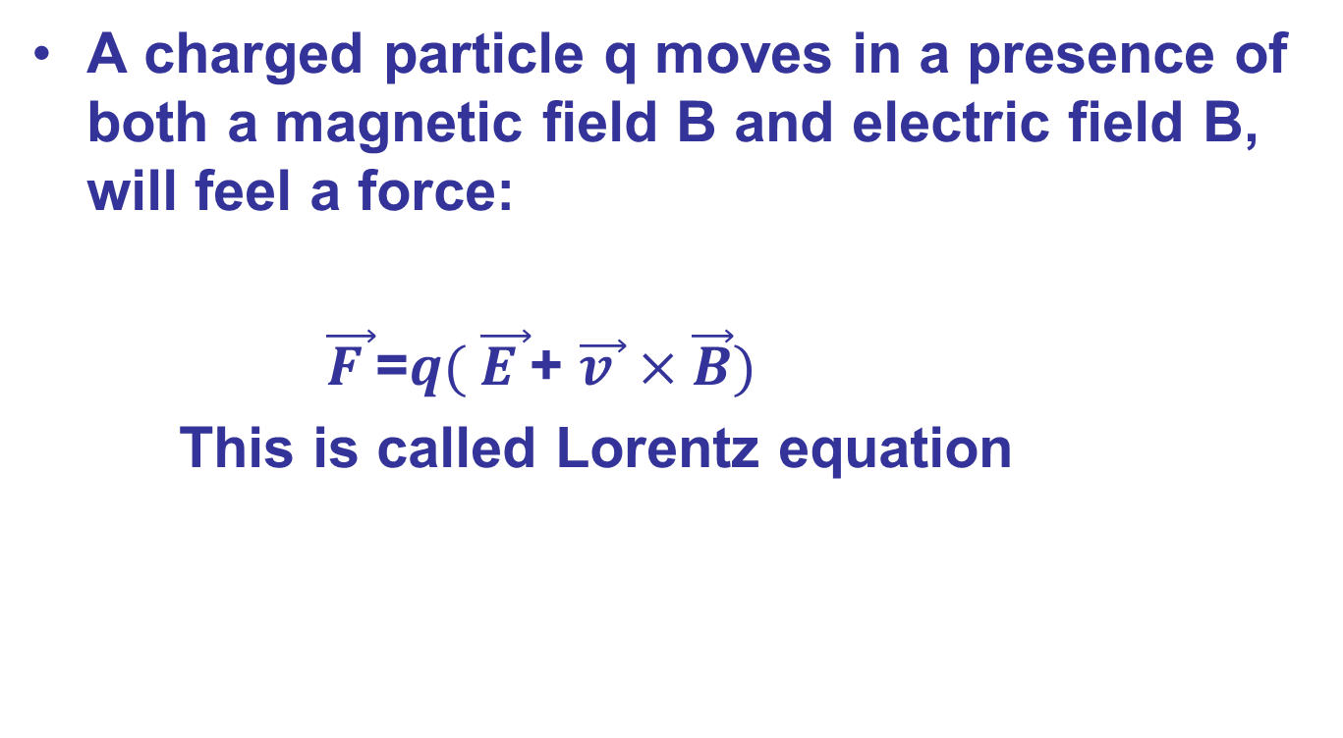
Lorentz Equation

Slide 9
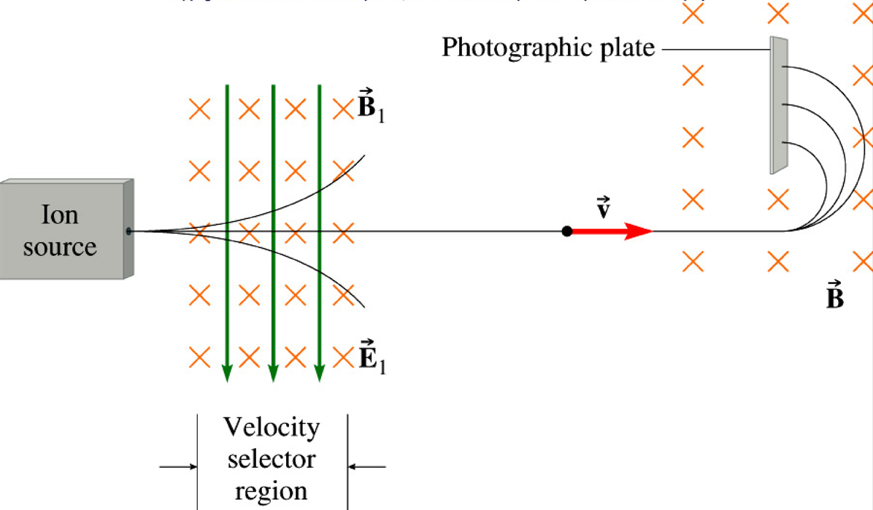
Mass Spectrometer
For selected speeds
The mass spectrometer is an instrument that measures
the masses and relative concentrations of atoms and molecules.

Slide 10
Electromagnetic Flowmeter
A flowmeter read the blood flow in
organs, and determine the oxygen flow, nutrients, hormones and so on, and is connected to the body through a catheter and a voltage is applied.
- - - - - - -
d
+
v
∆V
B
-
E
+ + + + + + +
B
Charges build until forces balance!
F_{E} = F_{B}
qE = qvB
We know B since we applied it.
E is determined from ΔV and the width of the artery d
E=ΔV/d

Slide 11
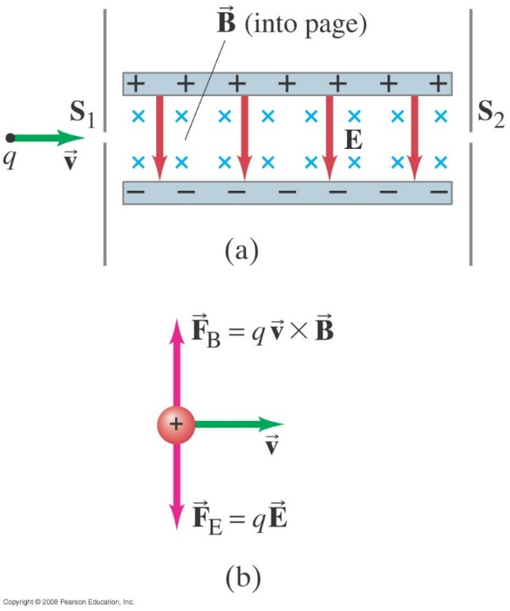
27-4 Force on an Electric Charge Moving in a Magnetic Field
Conceptual Example 27-10: Velocity selector, or filter: crossed E and B fields.
Some electronic devices and experiments need a beam of charged particles all moving at nearly the same velocity. This can be achieved using both a uniform electric field and a uniform magnetic field, arranged so they are at right angles to each other. Positive particles of charge q pass through slit S₁ and enter the region where B points into the page and E points down from the positive plate toward the negative plate. a) Draw the magnetic and electric forces Fb and Fe. b) If the particles enter with different velocities, show how this device “selects” a particular velocity, and determine what this velocity is.
Notes:
Figure 27-21: A velocity selector: if v = E/B, the particles passing through S₁ make it through S₂.
Solution: Only the particles whose velocities are such that the magnetic and electric forces exactly cancel will pass through both slits. We want qE = qvB, so v = E/B.

Slide 12
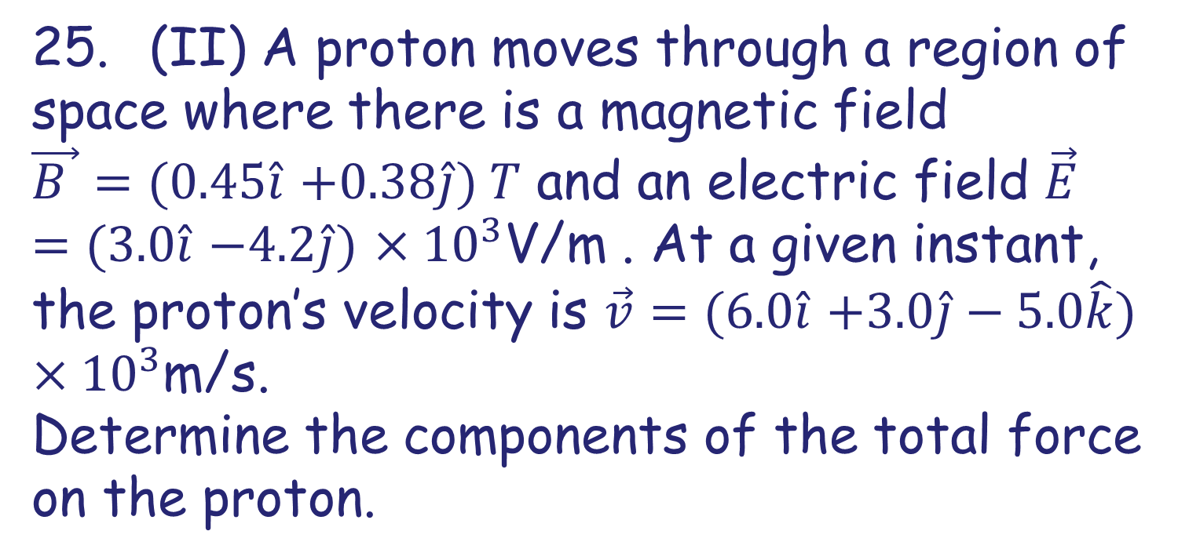
Problem 25

Slide 13
Problem 25 Solution

