Slide 1
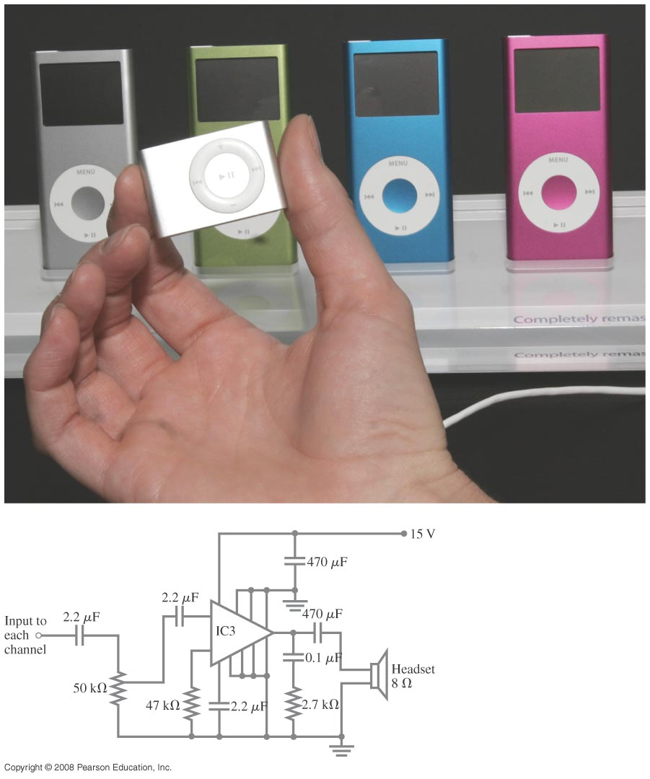
Chapter 26 DC Circuits
Study guide posted- Exam 2, March 1st.
Notes:
Chapter 26 Opener. These MP3 players contain circuits that are dc, at least in part. (The audio signal is ac.) The circuit diagram below shows a possible amplifier circuit for each stereo channel. Although the large triangle is an amplifier chip containing transistors (discussed in Chapter 40), the other circuit elements are ones we have met, resistors and capacitors, and we discuss them in circuits in this Chapter. We also discuss voltmeters and ammeters, and how they are built and used to make measurements.

Slide 2
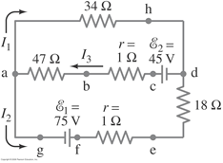
Problem 31
31. (II) (a) What is the potential difference between points a and d in Fig. 26–49 (similar to Fig. 26–13, Example 26–9), and (b) what is the terminal voltage of each battery?

Slide 3
Solved example 1
Please go through this Kirchhoff’s rule, solved example in the link below
https://www.youtube.com/watch?v=BnL_9BYHmVM

Slide 4
26-3 Kirchhoff’s Rules
Problem Solving: Kirchhoff’s Rules
Label each current, including its direction.
Identify unknowns.
Apply junction and loop rules; you will need as many independent equations as there are unknowns.
Solve the equations, being careful with signs. If the solution for a current is negative, that current is in the opposite direction from the one you have chosen.

Slide 5
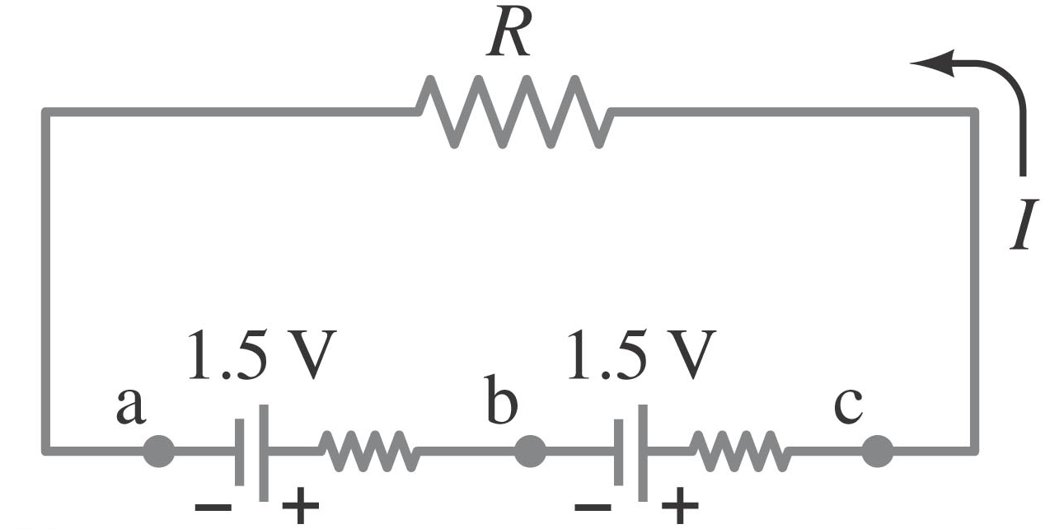
26-4 Series and Parallel EMFs; Battery Charging
EMFs in series in the same direction: total voltage is the sum of the separate voltages.
We can put emfs in series in series to increase the voltage.

Slide 6
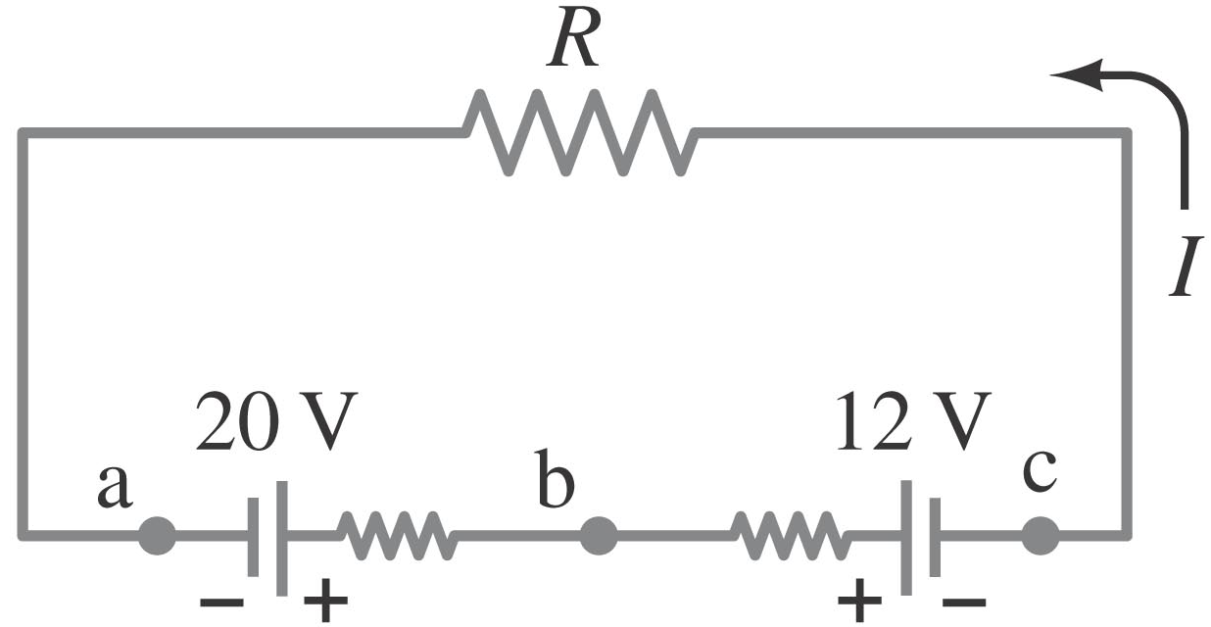
26-4 Series and Parallel EMFs; Battery Charging
EMFs in series, opposite direction: total voltage is the difference, but the lower-voltage battery is charged. Example :”car alternator”
Example: this is how a car alternator is connected, and how a car battery works,
The lower voltage battery will be charged by the higher voltage battery

Slide 7
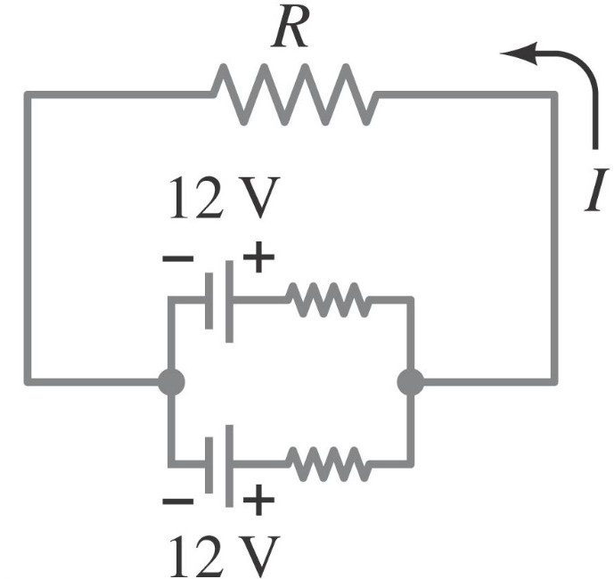
26-4 Series and Parallel EMFs; Battery Charging
EMFs in parallel only make sense if the voltages are the same; this arrangement can produce more current than a single emf.
This is not recommended since there is a loss due to the internal resistances.

Slide 8
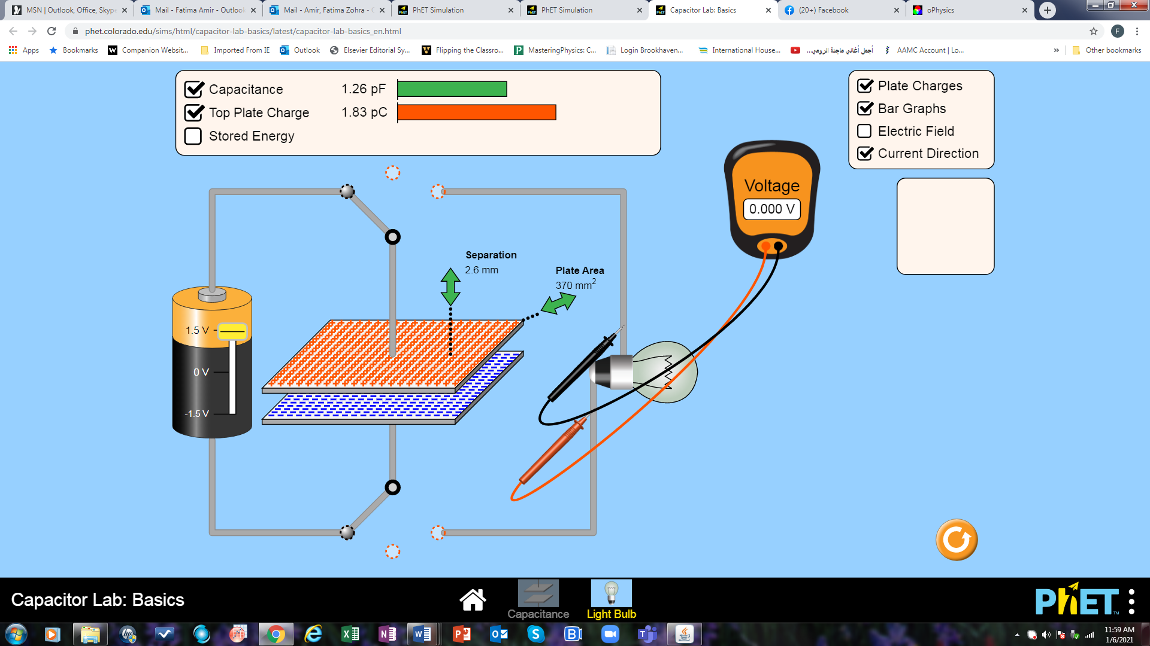
RC circuits charge
https://phet.colorado.edu/sims/html/capacitor-lab-basics/latest/capacitor-lab-basics_en.html

Slide 9
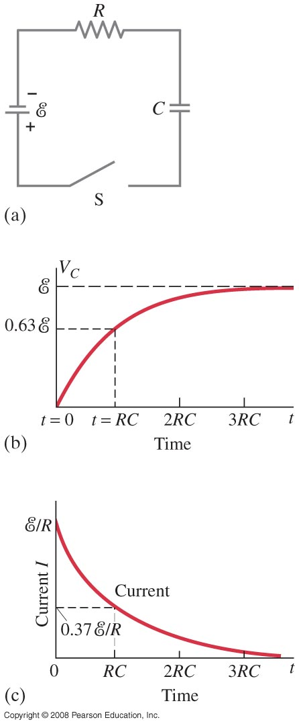
26-5 Circuits Containing Resistor and Capacitor (RC Circuits)
RC circuit consists of a resistor and a capacitor.
The circuit is connected to a power supply.
When the switch is closed, the capacitor will begin to charge. As it does, the voltage across it increases, and the current through the resistor decreases.
Notes:
Figure 26-17. After the switch S closes in the RC circuit shown in (a), the voltage across the capacitor increases with time as shown in (b), and the current through the resistor decreases with time as shown in (c).

Slide 10
26-5 Circuits Containing Resistor and Capacitor (RC Circuits)
To find the voltage as a function of time, we write the equation for the voltage changes around the loop:
Since I = dQ/dt, we can integrate to find the charge as a function of time:

Slide 11
26-5 Circuits Containing Resistor and Capacitor (RC Circuits)
The voltage across the capacitor is V_{C} = Q/C:
The quantity RC that appears in the exponent is called the time constant of the circuit:

Slide 12
26-5 Circuits Containing Resistor and Capacitor (RC Circuits)
The current at any time t can be found by differentiating the charge:
τ = RC
is the time constant
of the RC circuit, and is in seconds

Slide 13
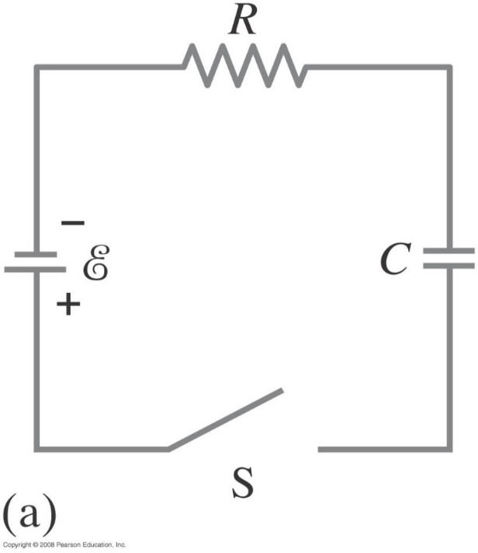
26-5 Circuits Containing Resistor and Capacitor (RC Circuits)
Example 26-11: RC circuit, with emf.
The capacitance in the circuit shown is C = 0.30 μF, the total resistance is 20 kΩ, and the battery emf is 12 V. Determine (a) the time constant, (b) the maximum charge the capacitor could acquire, (c) the time it takes for the charge to reach 99% of this value, (d) the current I when the charge Q is half its maximum value, (e) the maximum current, and (f) the charge Q when the current I is 0.20 its maximum value.
Notes:
Solution: a. The time constant is RC = 6.0 x 10⁻³ s.
b. The maximum charge is the emf x C = 3.6 μC.
c. Set Q(t) = 0.99 Q_{max} and solve for t: t = 28 ms.
d. When Q = 1.8 μC, I = 300 μA.
e. The maximum current is the emf/R = 600 μA.
f. When I = 120 μA, Q = 2.9 μC.

Slide 14
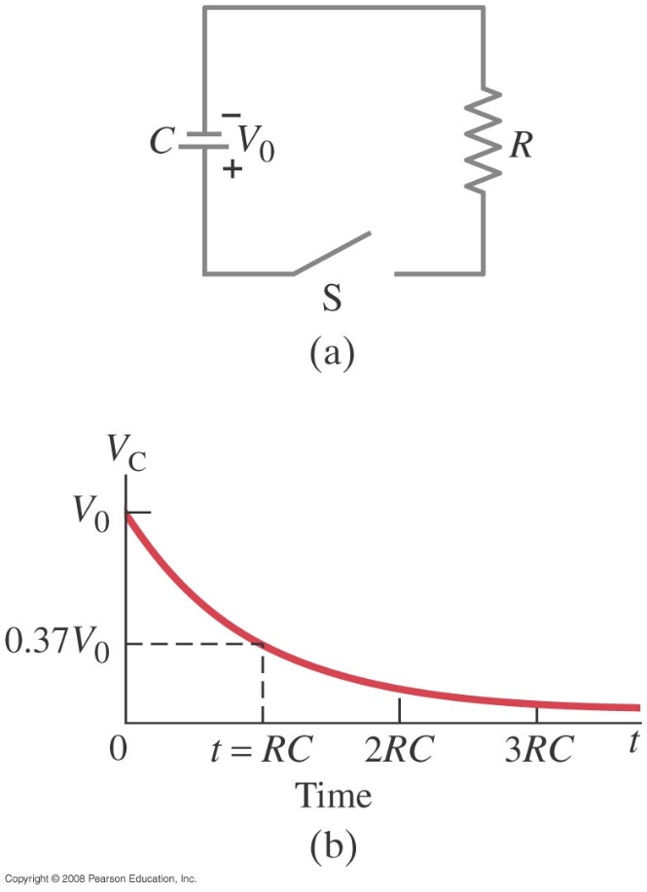
26-5 Circuits Containing Resistor and Capacitor (RC Circuits)
If an isolated charged capacitor is connected across a resistor, it discharges:
Q₀ is the maximum charge
Notes:
Figure 26-18. For the RC circuit shown in (a), the voltage V_{C} across the capacitor decreases with time, as shown in (b), after the switch S is closed at t = 0. The charge on the capacitor follows the same curve since V_{C} α Q.

Slide 15
26-5 Circuits Containing Resistor and Capacitor (RC Circuits)
Once again, the voltage and current as a function of time can be found from the charge:
and

Slide 16
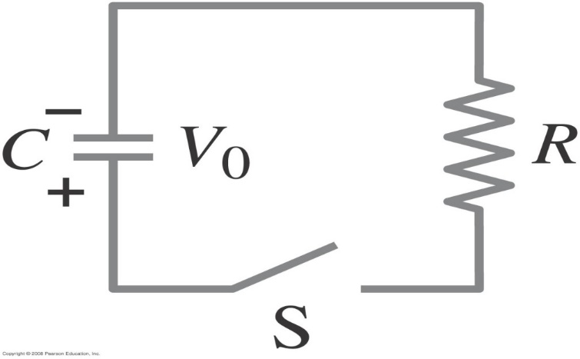
Problem 48
48.(II) The RC circuit of Fig. 26–59 (same as Fig. 26–18a) has R=8.7kΩ and C=3.0µF The capacitor is at voltage V₀ at t=0s when the switch is closed. How long does it take the capacitor to discharge to 0.10% of its initial voltage?

Slide 17
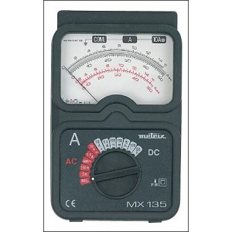
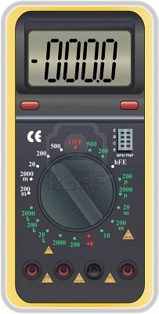
26-7 Ammeters and Voltmeters
An ammeter measures current; a voltmeter measures voltage. Both are based on galvanometers, unless they are digital.
Notes:
Figure 26-28. An ammeter is a galvanometer in parallel with a (shunt) resistor with low resistance, R_{sh}.

Slide 18
Ammeters and voltmeters
The current in a circuit passes through the ammeter; the ammeter should have low resistance so as not to affect the current.
A voltmeter should not affect the voltage across the circuit element it is measuring; therefore its resistance should be very large.

Slide 19
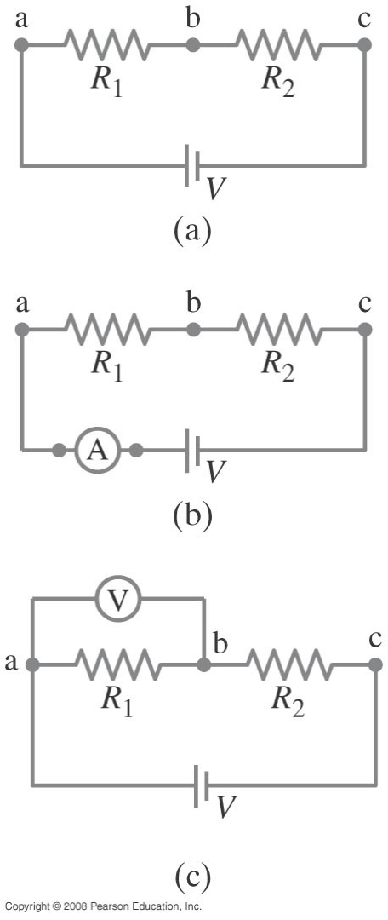
26-7 Ammeters and Voltmeters
Summary: How to connect Meters?
An ammeter must be in series with the current it is to measure;
A voltmeter must be in parallel with the voltage it is to measure.

