Slide 1
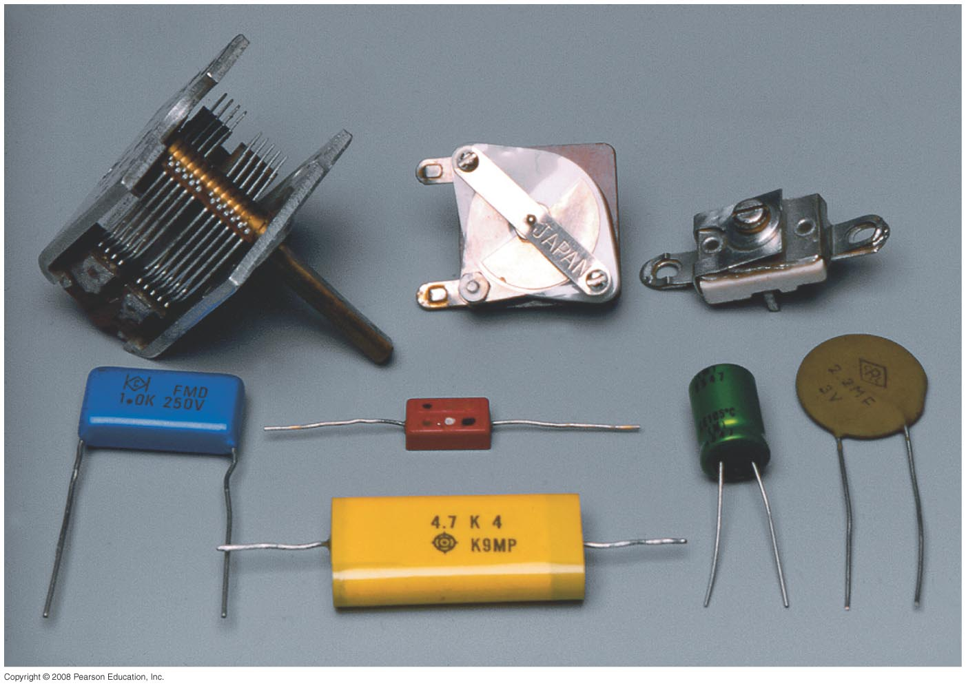
Chapter 24
Capacitance, Dielectrics, Electric Energy Storage
HW#3: Chapter 22: Pb.1, Pb.6,Pb.24 Pb.27, Pb.35 due on Friday, Feb. 16
There will be a quiz on Friday
Notes:
Chapter 24 opener. Capacitors come in a wide range of sizes and shapes, only a few of which are shown here. A capacitor is basically two conductors that do not touch, and which therefore can store charge of opposite sign on its two conductors. Capacitors are used in a wide variety of circuits, as we shall see in this and later Chapters.

Slide 2
Problem 28
28. (II) A 0.50μF and a 0.80 μF capacitor are connected in series to a 9.0-V battery. Calculate (a) the charge on each capacitor and (b) the potential difference across each capacitor . (c) Repeat parts (a) and (b) assuming the two capacitors are in parallel.

Slide 3
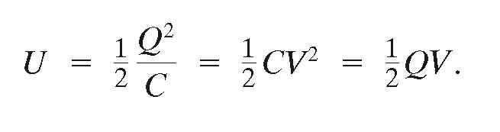
24-4 Electric Energy Storage
A charged capacitor stores electric energy; the energy stored is equal to the work done to charge the capacitor:

Slide 4
24-4 Electric Energy Storage
The energy density, defined as the energy per unit volume, is the same no matter the origin of the electric field and is in J/m³
The sudden discharge of electric energy can be harmful or fatal. Capacitors can retain their charge indefinitely even when disconnected from a voltage source – be careful!

Slide 5
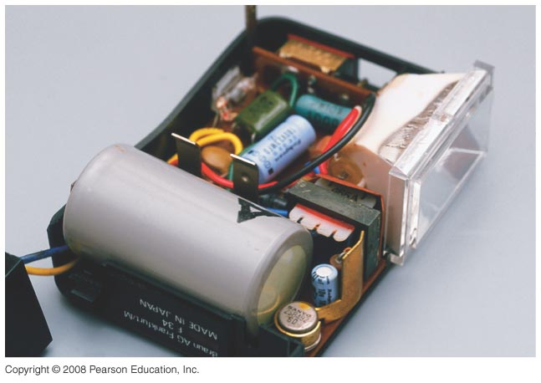
24-4 Electric Energy Storage
Example 24-8: Energy stored in a capacitor.
A camera flash unit stores energy in a 150-μF capacitor at 200 V. (a) How much electric energy can be stored? (b) What is the power output if nearly all this energy is released in 1.0 ms?
Notes:
Solution: a. U = ½ CV² = 3.0 J.
b. P = U/t = 3000 W.

Slide 6
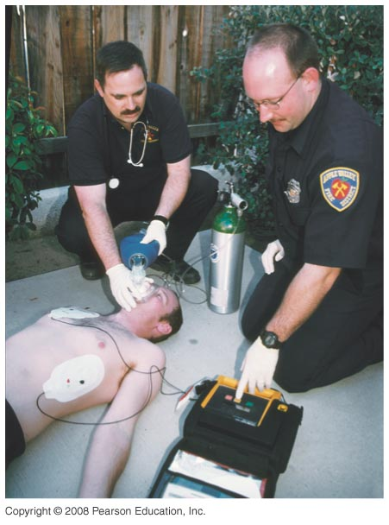
24-4 Electric Energy Storage
Heart defibrillators are capacitors that are charged to few thousand volts and they use electric discharge to “jump-start” the heart, and can save lives.
Notes:
Figure 24-14. Heart defibrillator.

Slide 7
24-5 Dielectrics
A dielectric is an insulator, and is characterized by a dielectric constant K.
Capacitance of a parallel-plate capacitor filled with dielectric:
Using the dielectric constant K, we define the permittivity:

Slide 8
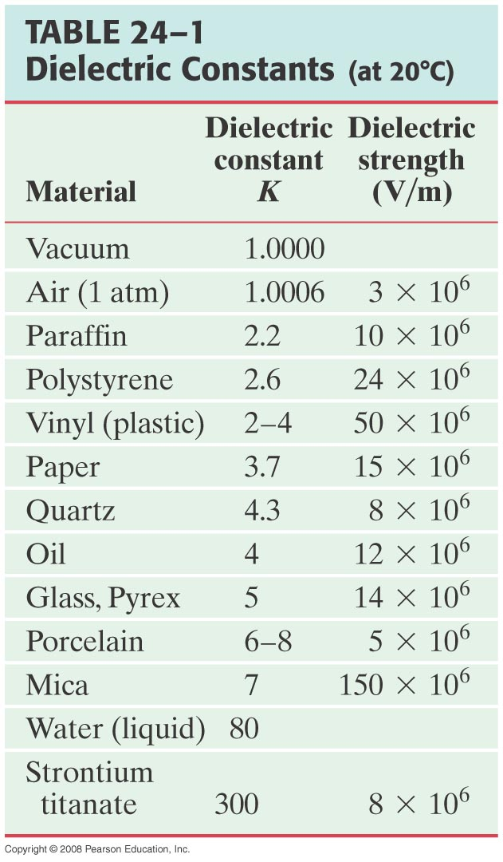
24-5 Dielectrics
Dielectric strength is the maximum electric field a dielectric can experience without breaking down.

Slide 9
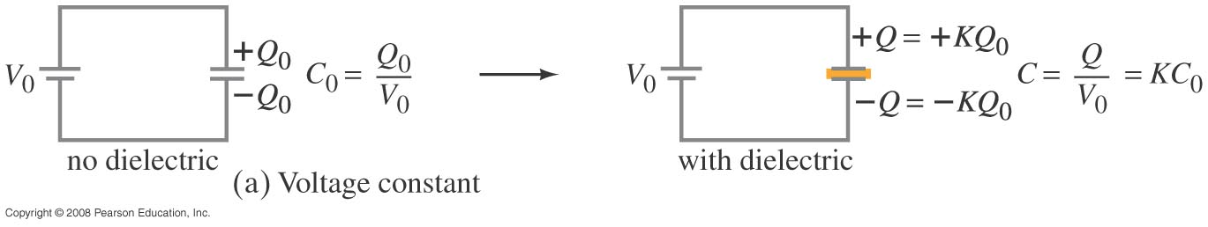
24-5 Dielectrics
Here are two experiments where we insert and remove a dielectric from a capacitor. In the first, the capacitor is connected to a battery, so the voltage remains constant. The capacitance increases, and therefore the charge on the plates increases as well.
Notes:
Figure 24-15a. Dielectric inserted into a capacitor, voltage held constant.

Slide 10
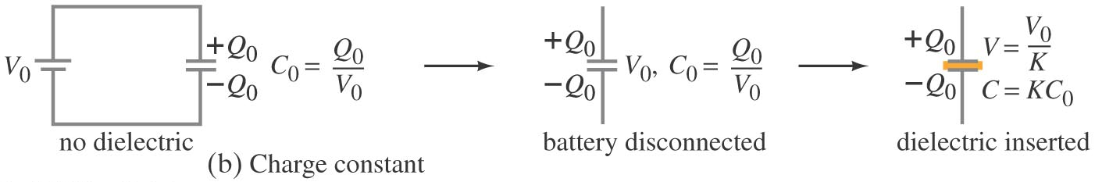
24-5 Dielectrics
In this second experiment, we charge a capacitor, disconnect it, and then insert the dielectric. In this case, the charge remains constant. Since the dielectric increases the capacitance, the potential across the capacitor drops.
Notes:
Figure 24-15b. Dielectric inserted into a capacitor, charge held constant.

Slide 11
Example
A parallel plate capacitor has a dielectric with . It is disconnected from the battery then the dielectric is removed. Describe what happens to the
capacitance
charge
potential difference
electric field
energy
decreases by a factor of
STAYS THE SAME, No place for the charge to go
increases by
increases by
increases by
∆V

Slide 12
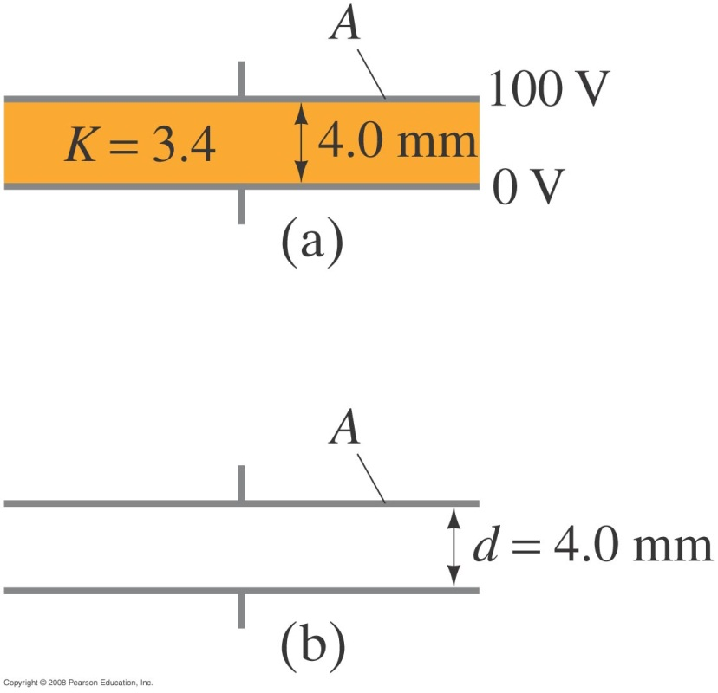
24-5 Dielectrics
Example 24-11: Dielectric removal.
A parallel-plate capacitor, filled with a dielectric with K =3.4, is connected to a 100-V battery. After the capacitor is fully charged, the battery is disconnected. The plates have area A = 4.0 m² and are separated by d = 4.0 mm.
(a) Find the capacitance, the charge on the capacitor, the electric field strength, and the energy stored in the capacitor.
(b) The dielectric is carefully removed, without changing
the plate separation nor does any charge leave the capacitor. Find the new values of capacitance, voltage between the plates, electric field strength, and the energy stored in the capacitor.
Notes:
Solution: a. C = Kε₀A/d = 3.0 x 10⁻⁸ F. Q = CV = 3.0 x 10⁻⁶ C. E = V/d = 25 kV/m. U = ½ CV² = 1.5 x 10⁻⁴ J.
B. Now C = 8.8 x 10⁻⁹ F, Q = 3.0 x 10⁻⁶ C (no change), V = 340 V, E = 85 kV/m, U = 5.1 x 10⁻⁴ J. The increase in energy comes from the work it takes to remove the dielectric.

Slide 13
24-6 Molecular Description of Dielectrics
+Q
E_{o}
-Q
+Q
E
-Q
1. Dielectric is inserted
+
-
+
-
2. Dielectric is polarized
+
-
+
-
3. Dielectric has internal Electric field
-
+
+
-
+
-
4. Electric Field is reduced by the dielectric constant, κ
+
-
+
-
+
-
+
-
+
-
+
-
+
-
+
-
+
-
+
-
+
-
+
-
+
-
E weaker, ΔV is smaller, but C is bigger

Slide 14
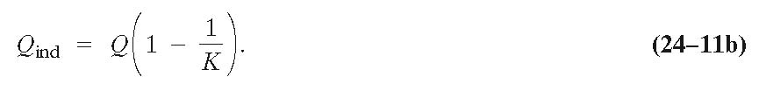
24-6 Molecular Description of Dielectrics
This means that the electric field within the dielectric is less than it would be in air, allowing more charge to be stored for the same potential. This reorientation of the molecules results in an induced charge – there is no net charge on the dielectric, but the charge is asymmetrically distributed.
The magnitude of the induced charge depends on the dielectric constant:

Slide 15
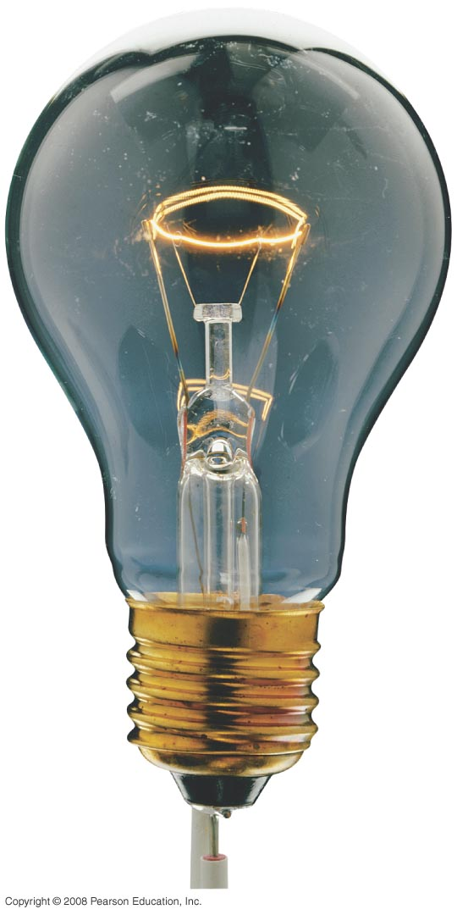
Chapter 25
Electric Currents and Resistance
Notes:
Chapter 25 opener. The glow of the thin wire filament of a light bulb is caused by the electric current passing through it. Electric energy is transformed to thermal energy (via collisions between moving electrons and atoms of the wire), which causes the wire’s temperature to become so high that it glows. Electric current and electric power in electric circuits are of basic importance in everyday life. We examine both dc and ac in this Chapter, and include the microscopic analysis of electric current.

Slide 16
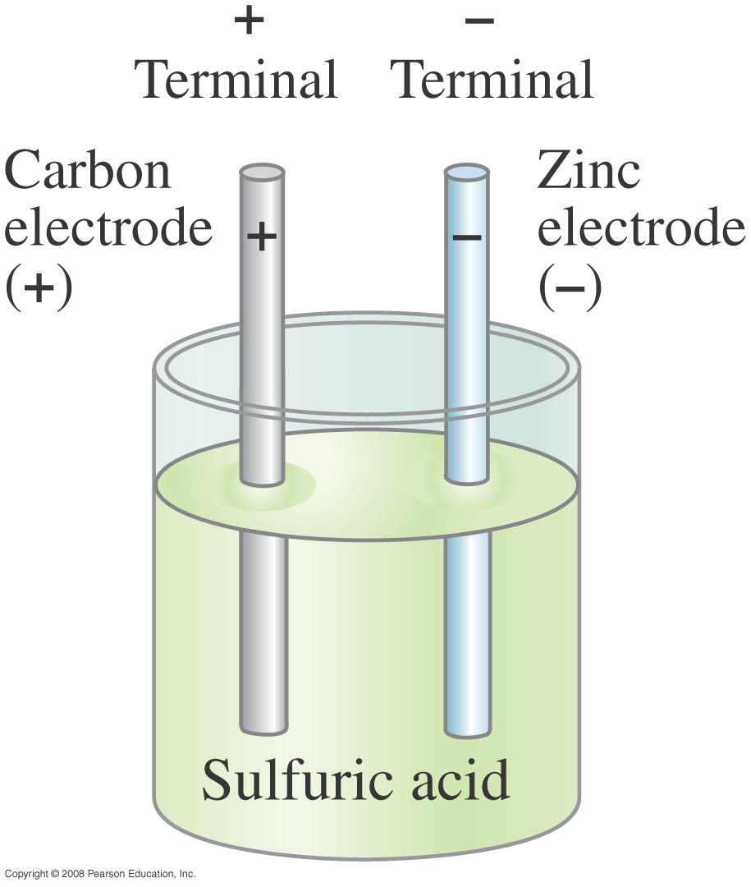
25-1 The Electric Battery
Volta discovered that electricity could be created if dissimilar metals were connected by a conductive solution called an electrolyte.
This is a simple electric cell.
Notes:
Figure 25-3. Simple electric cell.

Slide 17
25-1 The Electric Battery
A battery transforms chemical energy into electrical energy.
Chemical reactions within the cell create a potential difference between the terminals by slowly dissolving them. This potential difference can be maintained even if a current is kept flowing, until one or the other terminal is completely dissolved.

Slide 18
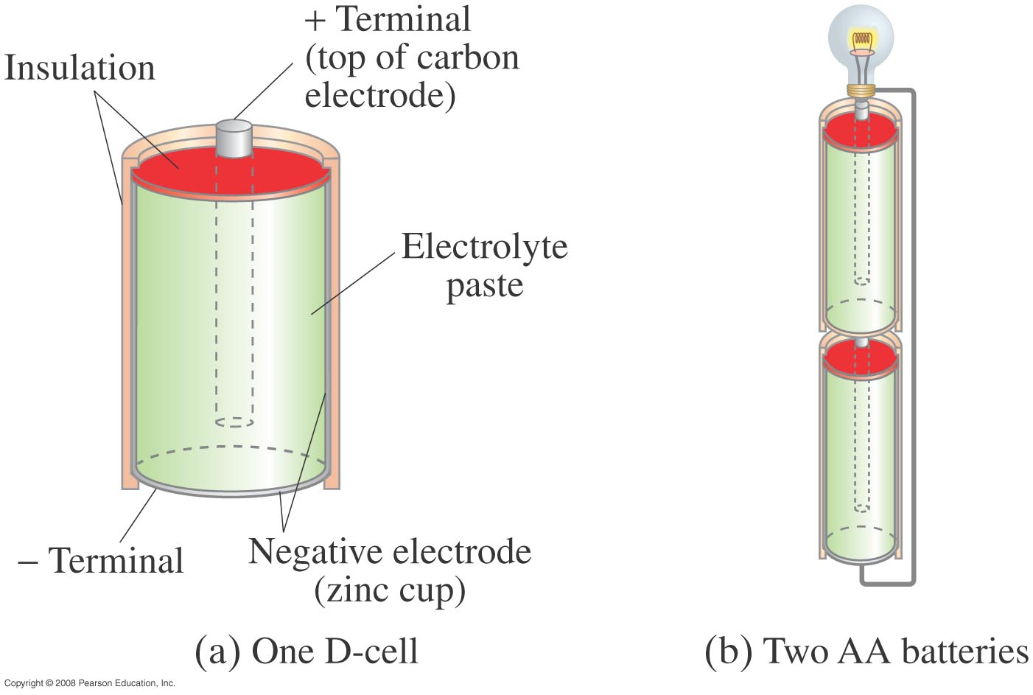
25-1 The Electric Battery
Several cells connected together make a battery, although now we refer to a single cell as a battery as well.
Notes:
Figure 25-4. (a) Diagram of an ordinary dry cell (like a D-cell or AA). The cylindrical zinc cup is covered on the sides; its flat bottom is the negative terminal. (b) Two dry cells (AA type) connected in series. Note that the positive terminal of one cell pushes against the negative terminal of the other.

Slide 19


25-2 Electric Current
Electric current is the rate of flow of charge through a conductor:
The instantaneous current is given by:
Unit of electric current: the ampere, A:
1 A = 1 C/s.

Slide 20
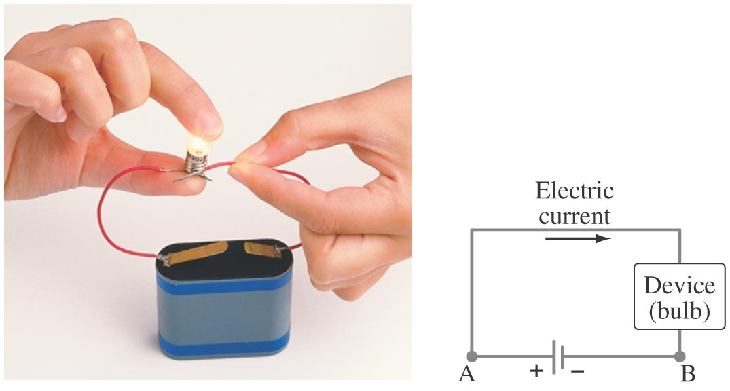
25-2 Electric Current
A complete circuit is one where current can flow all the way around. Note that the schematic drawing doesn’t look much like the physical circuit!
Notes:
Figure 25-6. (a) A simple electric circuit. (b) Schematic drawing of the same circuit, consisting of a battery, connecting wires (thick gray lines), and a lightbulb or other device.

Slide 21
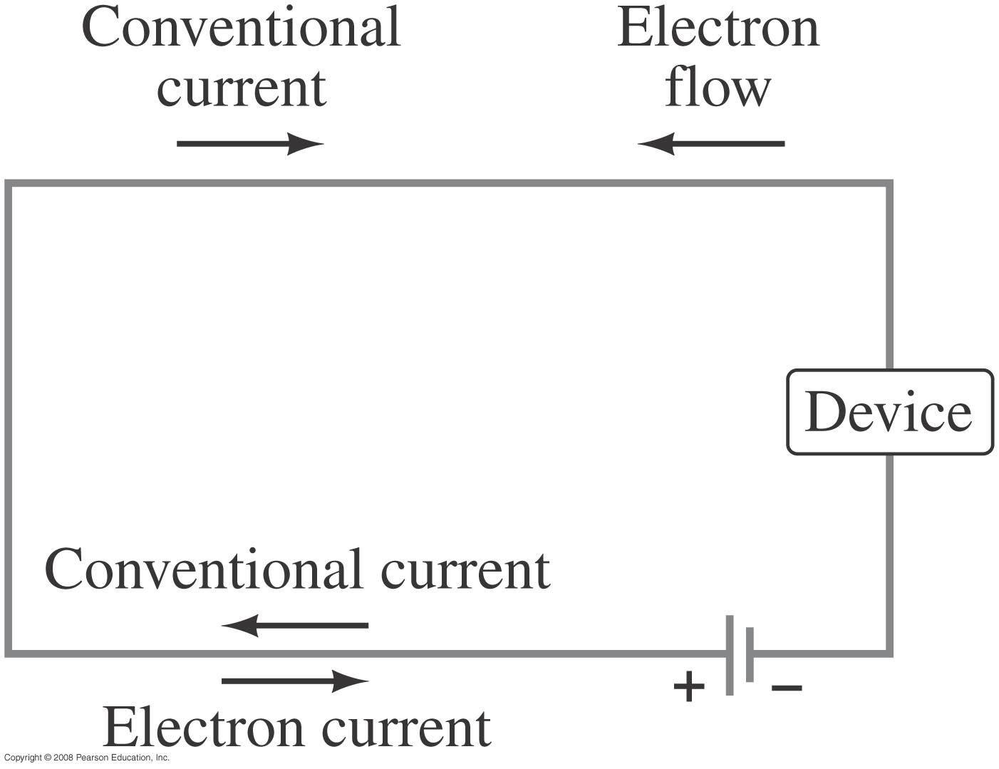
25-2 Electric Current
By convention, current is defined as flowing from + to -. Electrons actually flow in the opposite direction, but not all currents consist of electrons.
Notes:
Figure 25-8. Conventional current from + to - is equivalent to a negative electron flow from – to +.

Slide 22
25-2 Electric Current
Example 25-1: Current is flow of charge.
A steady current of 2.5 A exists in a wire for 4.0 min. (a) How much total charge passed by a given point in the circuit during those 4.0 min? (b) How many electrons would this be?
Notes:
Solution: a. Charge = current x time; convert minutes to seconds. Q = 600 C.
b. Divide by electron charge: n = 3.8 x 10²¹ electrons.

Slide 23

25-3 Ohm’s Law: Resistance and Resistors
Experimentally, it is found that the current in a wire is proportional to the potential difference between its ends:

Slide 24


25-3 Ohm’s Law: Resistance and Resistors
The ratio of voltage to current is called the resistance:
This is Ohm’s Law

Slide 25
Problem 5
5. (II) An electric clothes dryer has a heating element with a resistance of 8.6Ω (a) What is the current in the element when it is connected to 240 V? (b) How much charge passes through the element in 50 min? (Assume direct current.)

Slide 26
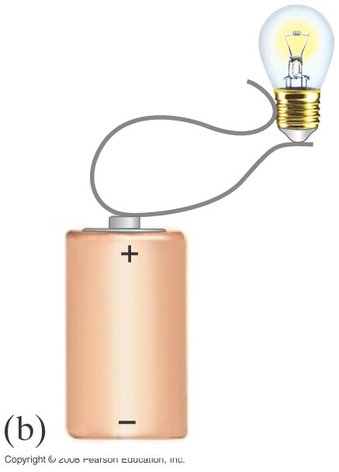
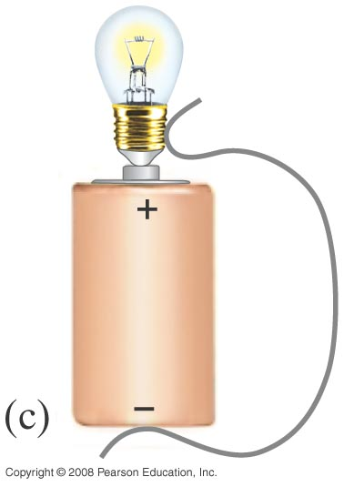
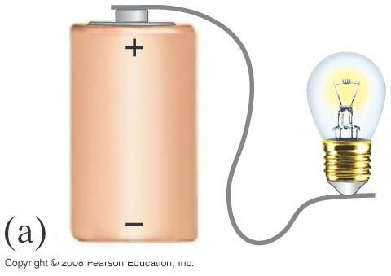
25-2 Electric Current
Conceptual Example 25-2: How to connect a battery.
What is wrong with each of the schemes shown for lighting a flashlight bulb with a flashlight battery and a single wire?
Notes:
Solution: a. Not a complete circuit.
b. Circuit does not include both terminals of battery (so no potential difference, and no current)
c. This will work. Just make sure the wire at the top touches only the bulb and not the battery!

Slide 27
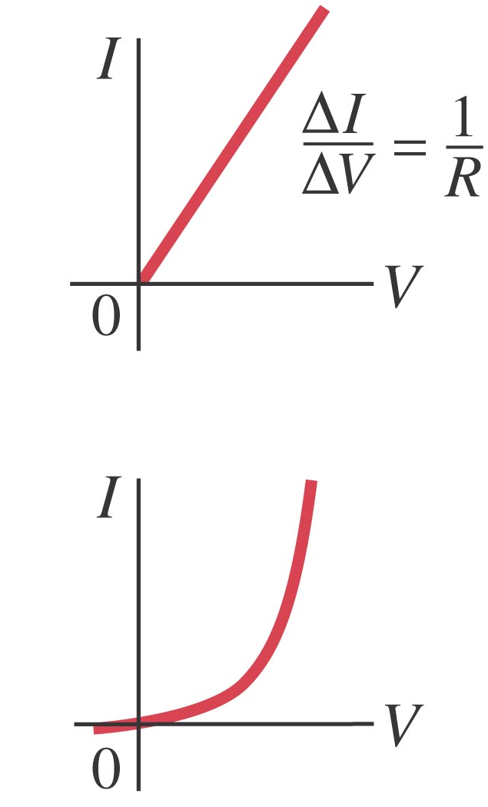
25-3 Ohm’s Law: Resistance and Resistors
In many conductors, the resistance is independent of the voltage; this relationship is called Ohm’s law (Ohmic Materials). Materials that do not follow Ohm’s law are called nonohmic.
Unit of resistance: the ohm, Ω:
1 Ω = 1 V/A.
Notes:
Figure 25-9. Graphs of current vs. voltage for (a) a metal conductor which obeys Ohm’s law, and (b) for a nonohmic device, in this case a semiconductor diode.

