Slide 1
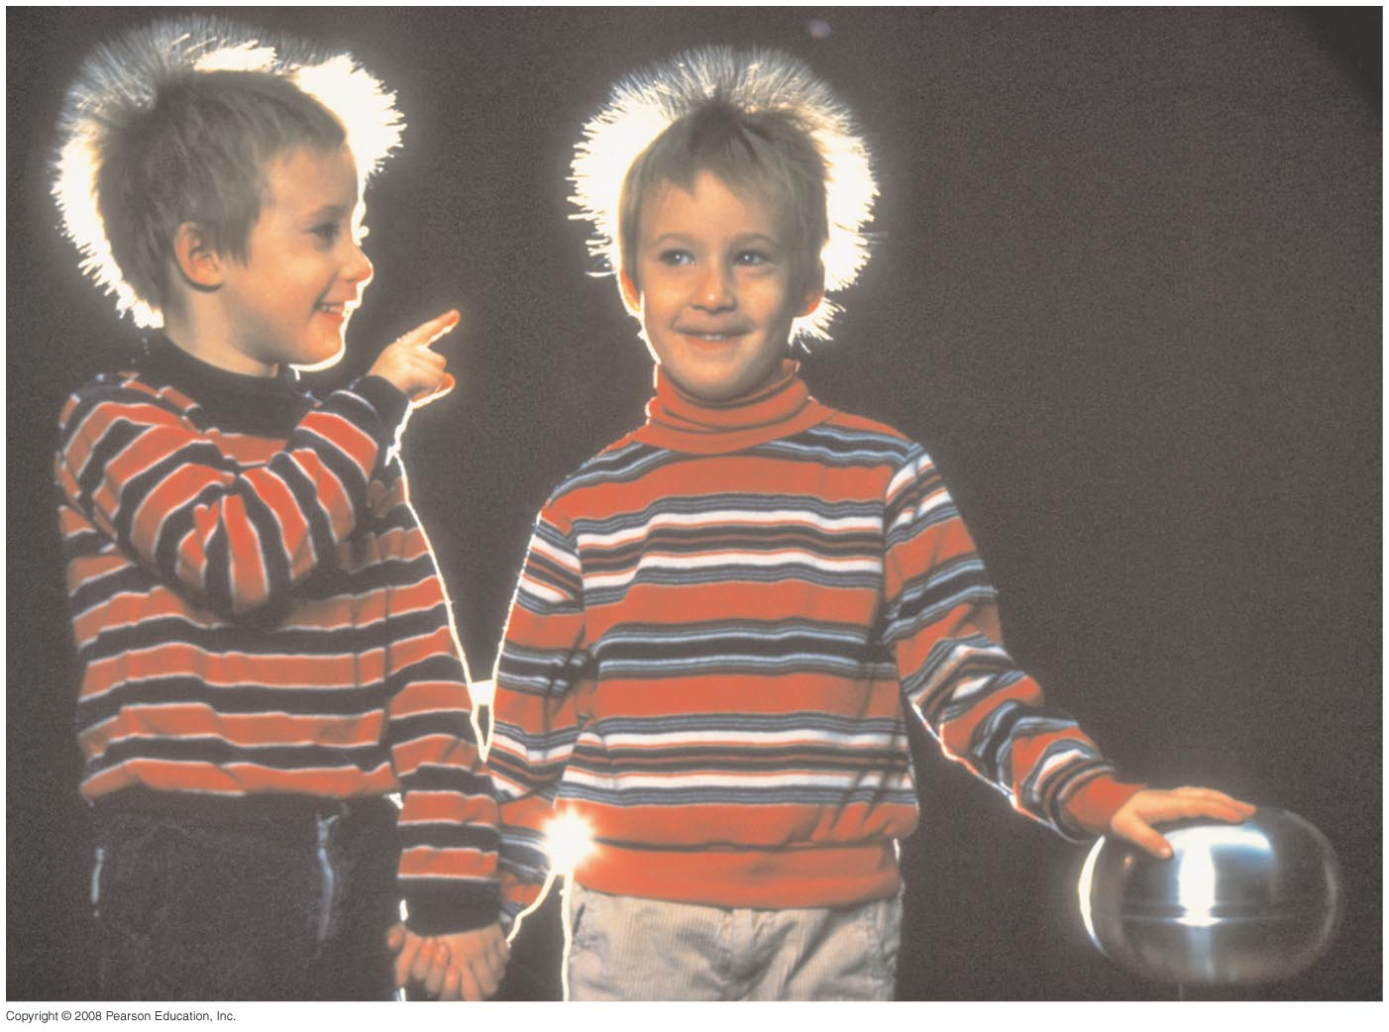
Chapter 23 Electric Potential
HW#2: Chapter 21: Pb.25, Pb.31,Pb.35 Pb.36, Pb.38, Pb.46 due Wednesday, Feb.7
Notes:
Chapter 23 opener. We are used to voltage in our lives—a 12-volt car battery, 110 V or 220 V at home, 1.5 volt flashlight batteries, and so on. Here we see a Van de Graaff generator, whose voltage may reach 50,000 V or more. Voltage is the same as electric potential difference between two points. Electric potential is defined as the potential energy per unit charge. The children here, whose hair stands on end because each hair has received the same sign of charge, are not harmed by the voltage because the Van de Graaff cannot provide much current before the voltage drops. (It is current through the body that is harmful, as we will see later.)

Slide 2
22-3 Applications of Gauss’s Law
Procedure for Gauss’s law problems:
Identify the symmetry, and choose a Gaussian surface that takes advantage of it (with surfaces along surfaces of constant field).
Draw the surface.
Use the symmetry to find the direction of E.
Evaluate the flux by integrating.
Calculate the enclosed charge.
Solve for the field.

Slide 3
23.1 Electrostatic Potential Energy
•Gravitational Potential Energy
•Electric Potential Energy
•U_{g} is due to an attractive force
•U_{E} can result from either an attractive force or a repulsive force
r
r
r
•U_{g} →0 when r →∞
-
+
+
•U_{E} →0 when r →∞

Slide 4
23.1 Electrostatic Potential Energy
Gravitational U_{g}
Attractive force
Electric U_{E}
Attractive force
Electric U_{E}
Repulsive force
-
+
+
+
or
-
-
< 0
> 0
Bigger when farther
Bigger when farther
Bigger when closer
U
U
U
r
r
r

Slide 5
Work and Electrostatic Potential energy
-
F_{E}
+
F_{E}
+
+
∆U > 0
Work done BY conservative force
∆U < 0
U
U
r
r
positive work
negative work

Slide 6
23-1 Electrostatic Potential Energy and Potential Difference
Electric Potential
=
Electric potential energy per unit charge
Electric Potential Difference: ΔV
~ Volts
Since only changes in potential energy are important, typically we are most interested in potential difference

Slide 7
23-1 Electrostatic Potential Energy and Potential Difference
Only changes in potential can be measured,
U and V are scalars

Slide 8
Problem I

Slide 9
Problem II
2. (I) How much work does the electric field do in moving a proton from a point with a potential of +185V to a point where it is -55V?

Slide 10
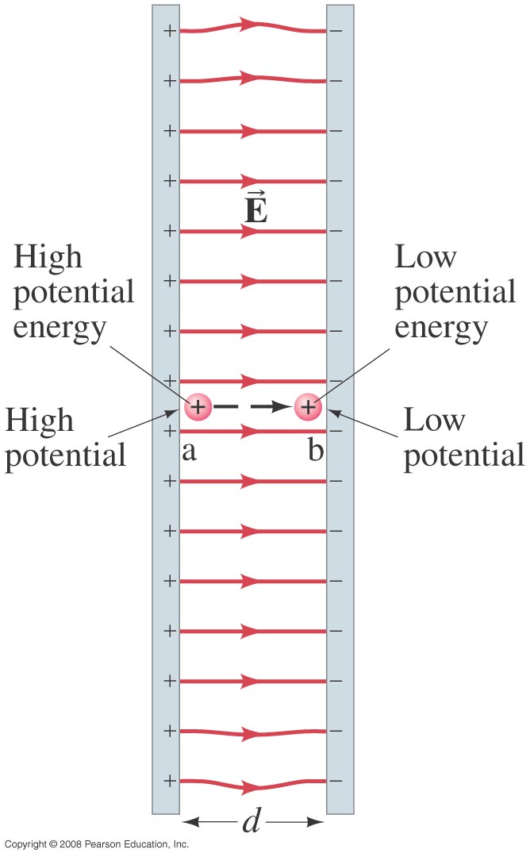
23-1 Electrostatic Potential Energy and Potential Difference
The electrostatic force is conservative – potential energy can be defined.
Change in electric potential energy is negative of work done by electric force:
Notes:
Figure 23-1. Work is done by the electric field in moving the positive charge q from position a to position b.

Slide 11
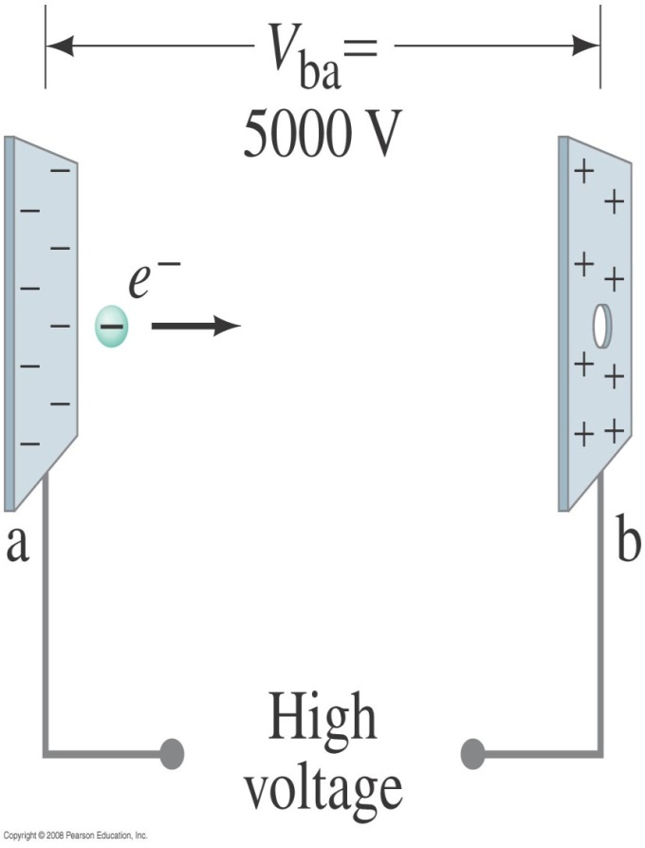
23-1 Electrostatic Potential Energy and Potential Difference
Example 23-2: Electron in CRT.
Suppose an electron in a cathode ray tube is accelerated from rest through a potential difference V_{b} – V_{a} = V_{ba} = +5000 V. (a) What is the change in electric potential energy of the electron? (b) What is the speed of the electron (m = 9.11 × 10⁻³¹ kg) as a result of this acceleration?
Notes:
Solution: a. The change in potential energy is qV = -8.0 x 10⁻¹⁶ J.
b. The change in potential energy is equal to the change in kinetic energy; solving for the final speed gives v = 4.2 x 10⁷ m/s.

Slide 12
Potential Difference and E-fields
Just as the Force points in the direction of LOWER Potential Energy, U_{E}
The Electric Field points in the direction of LOWER Potential, V
Low U_{E}
High U_{E}
High U_{E}
Low U_{E}
-
E
+
+
+
+
+
+
+
-
E
+
+
+
+
+
+
+
-
-
-
-
-
-
-
-
-
-
-
-
-
-
F
F
+
-
Low V
High V
Low V
High V

Slide 13
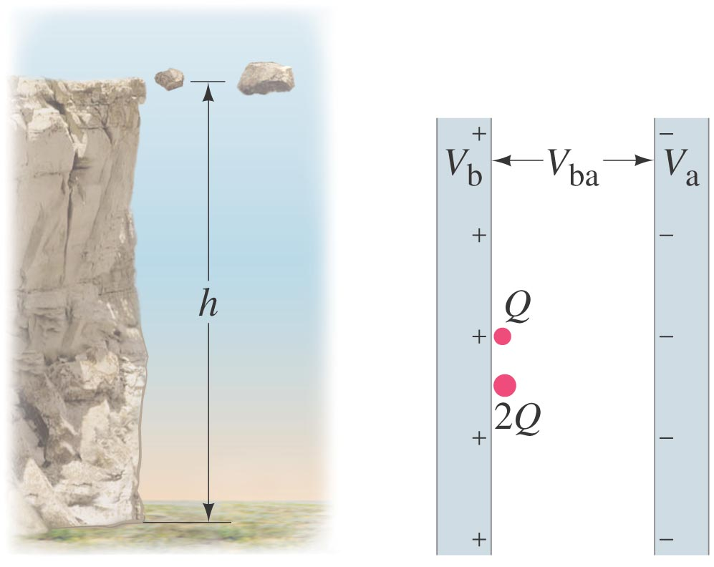
23-1 Electrostatic Potential Energy and Potential Difference
Analogy between gravitational and electrical potential energy:
Two charges have the same electric potential.
The 2Q charge has more potential energy
Notes:
Figure 23-3. (a) Two rocks are at the same height. The larger rock has more potential energy. (b) Two charges have the same electric potential. The 2Q charge has more potential energy.

Slide 14
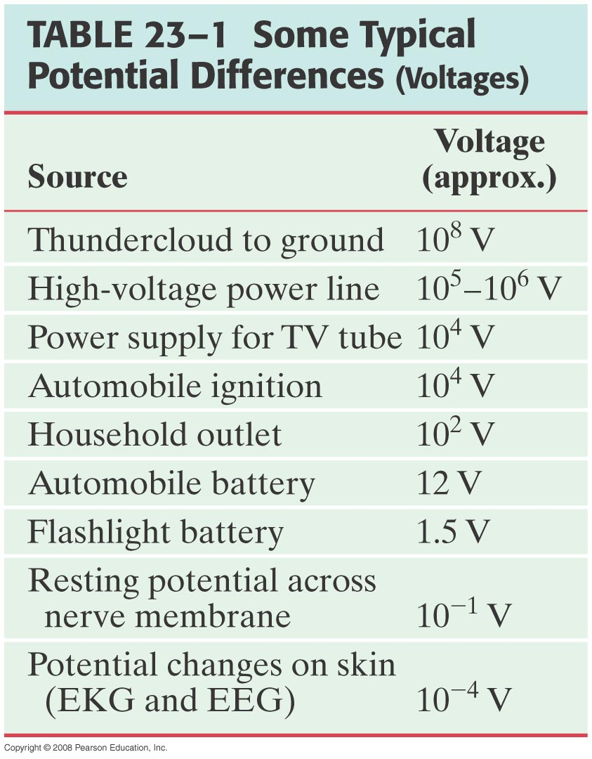
23-1 Electrostatic Potential Energy and Potential Difference
Electrical sources such as batteries and generators supply a constant potential difference. Here are some typical potential differences, both natural and manufactured:

Slide 15
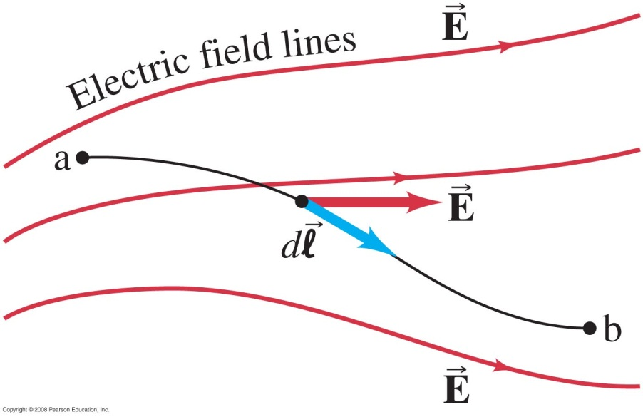
23-2 Relation between Electric Potential and Electric Field
The general relationship between a conservative force and potential energy:
Substituting the potential difference and the electric field:
Notes:
Figure 23-5. To find V_{ba} in a nonuniform electric field E, we integrate E·dl from point a to point b.

Slide 16
23-2 Relation between Electric Potential and Electric Field
The simplest case is a uniform field:

Slide 17
Points to remember
• Potential Energy U is NOT a vector
The potential energy is a scalar—no direction
Force always points in the direction of LOWER potential energy
The signs of the charges give the sign on the electric potential energy
• Only changes in electric potential are important

Slide 18
23-2 Relation between Electric Potential and Electric Field
Example 23-3: Electric field obtained from voltage.
Two parallel plates are charged to produce a potential difference of 50 V. If the separation between the plates is 0.050 m, calculate the magnitude of the electric field in the space between the plates.
Notes:
Solution: E = V/d = 1000 V/m.

Slide 19
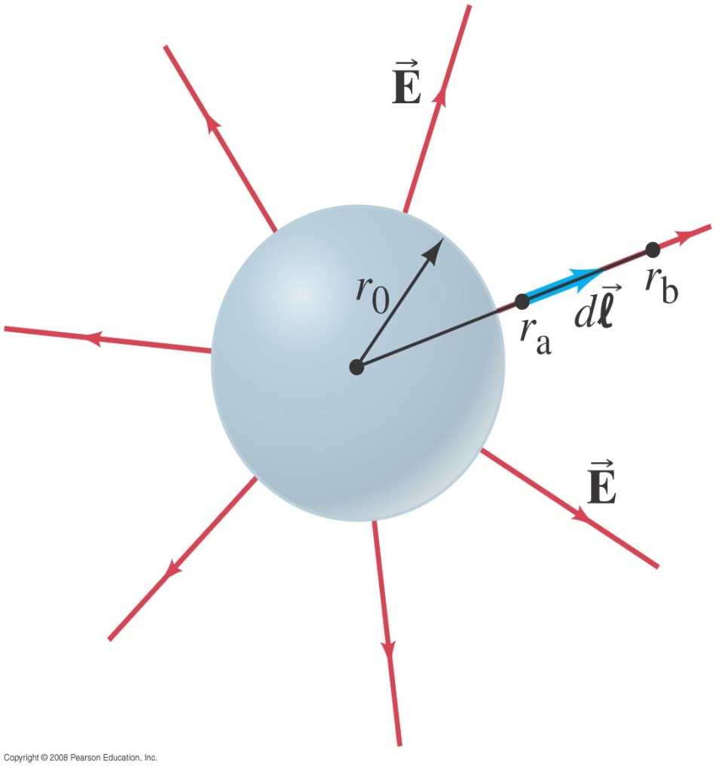
23-2 Relation between Electric Potential and Electric Field
Example 23-4: Charged conducting sphere.
Determine the potential at a distance r from the center of a uniformly charged conducting sphere of radius r₀ for (a) r > r₀, (b) r = r₀, (c) r < r₀. The total charge on the sphere is Q.
Notes:
Solution: The electric field outside a conducting sphere is Q/(4πε₀r²). Integrating to find the potential, and choosing V = 0 at r = ∞:
a. V = Q/4πε₀r.
b. V = Q/4πε₀r₀.
c. V = Q/4πε₀r₀ (the potential is constant, as there is no field inside the sphere).

Slide 20
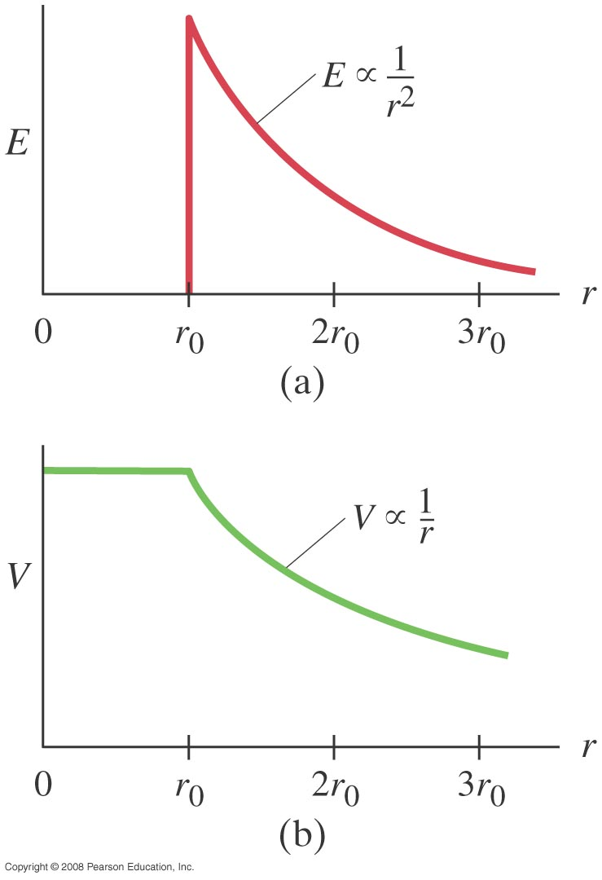
23-2 Relation between Electric Potential and Electric Field
The previous example gives the electric potential as a function of distance from the surface of a charged conducting sphere, which is plotted here, and compared with the electric field:
Notes:
Figure 23-8. (a) E versus r, and (b) V versus r, for a uniformly charged solid conducting sphere of radius r₀ (the charge distributes itself on the surface); r is the distance from the center of the sphere.

