Slide 1
Chapter 21, Electric Charge, and electric Field
No Homework this week
Exam Friday, Feb. 2
Study Guide posted

Slide 2
21-7 Electric Field Calculations for Continuous Charge Distributions
In Friday’s example of the disk, we showed if we are very close to the disk (that is, if z << R), the electric field is:
This is the field due to an infinite plane of charge.

Slide 3
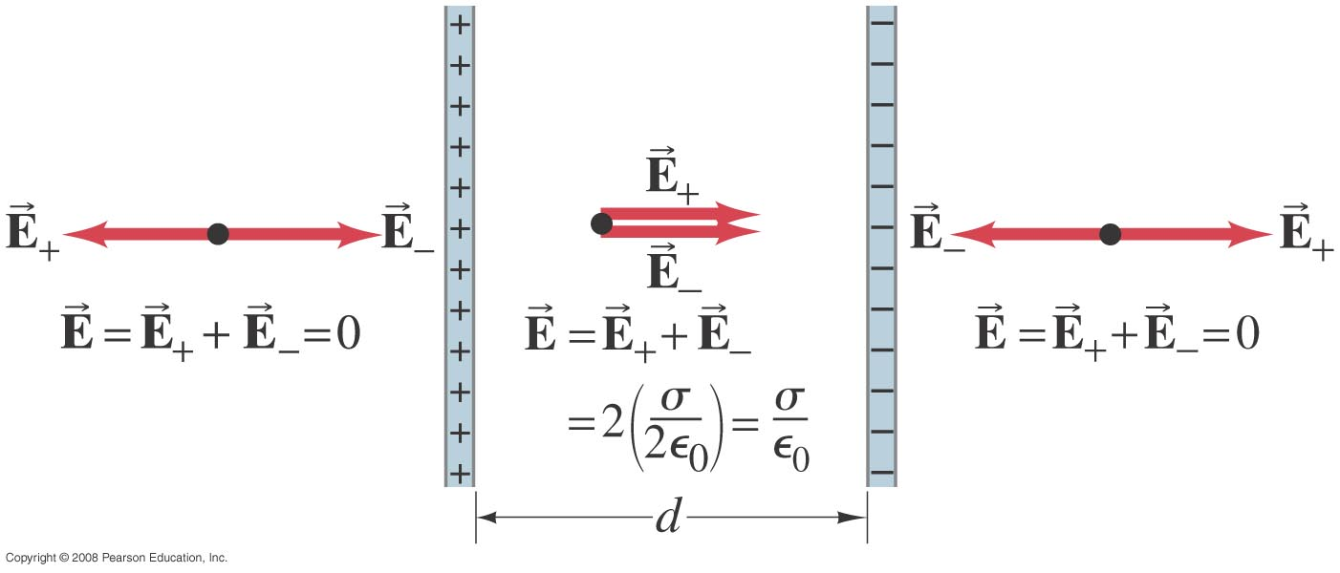
21-7 Electric Field Calculations for Continuous Charge Distributions
Example 21-13: Two parallel plates.
Determine the electric field between two large parallel plates or sheets, which are very thin and are separated by a distance d which is small compared to their height and width. One plate carries a uniform surface charge density σ and the other carries a uniform surface charge density -σ as shown (the plates extend upward and downward beyond the part shown).
Notes:
Solution: The field due to each plate is σ/2ε₀. Between the plates the fields add, giving E = σ/ε₀; outside the plates the fields cancel.

Slide 4
Example 21-13: Two parallel plates

Slide 5
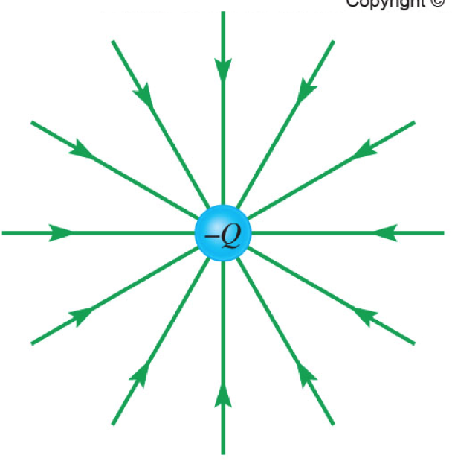
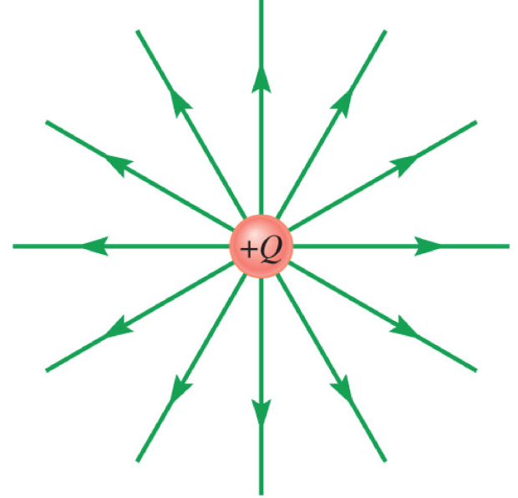
21-8 Electric Field Lines
Points in the direction of the electric field at any point
-
+
Rules:
Always start on + and end on -
Number of lines is proportional to the magnitude of the charge
Field Lines never cross
The electric field is stronger where the field lines are closer together.

Slide 6
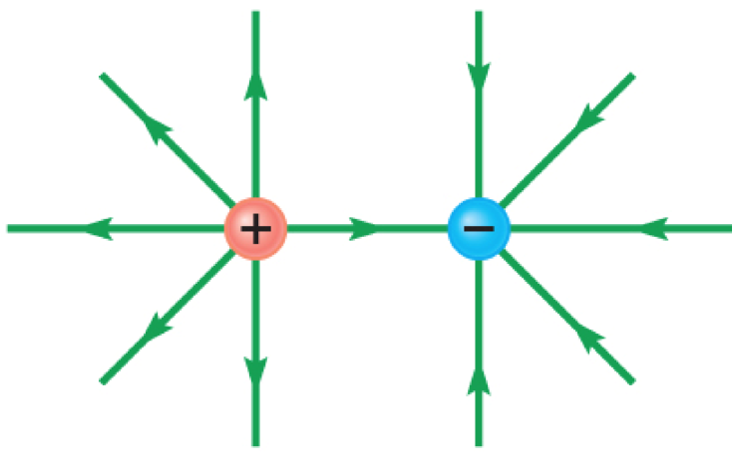
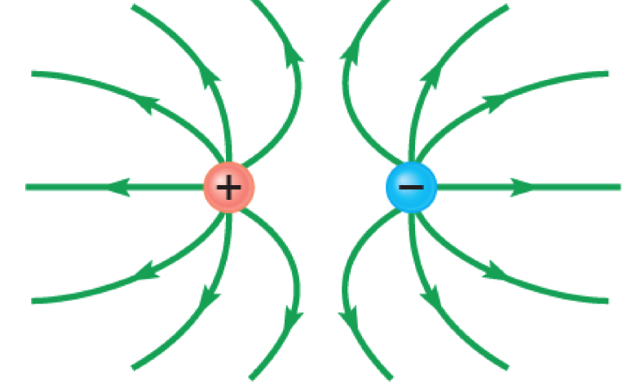
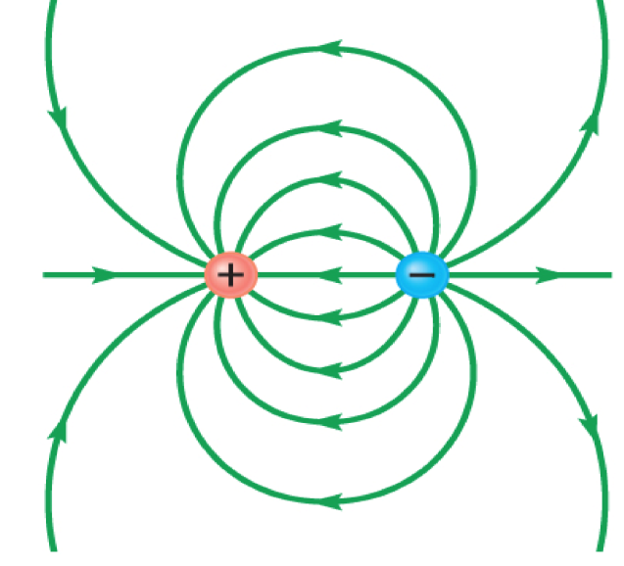
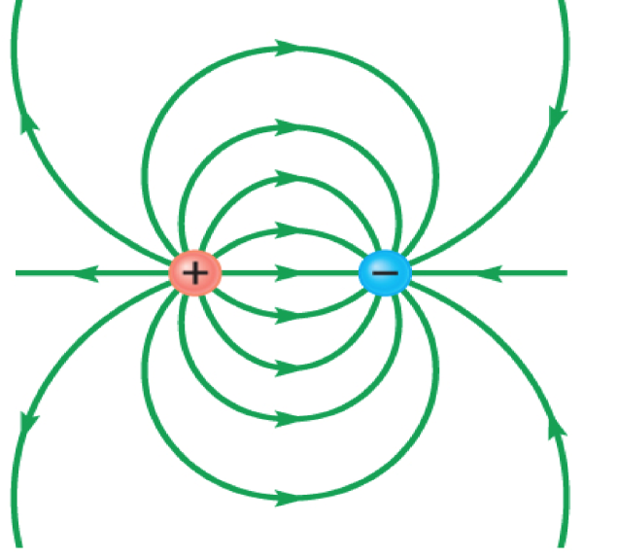
Question
Which figure best represents the Electric field lines
B)
A)
C)
D)

Slide 7
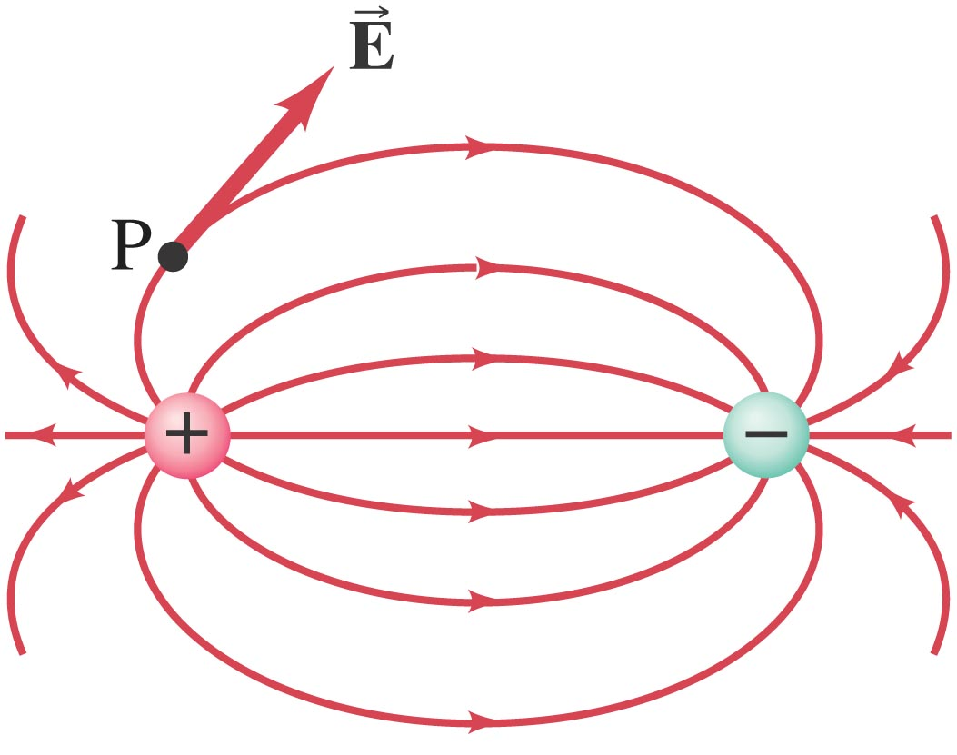
21-8 Field Lines
Electric dipole: two equal charges, opposite in sign:

Slide 8
Electric Field Lines – Like Charges
The charges are equal and positive
The same number of lines leave each charge since they are equal in magnitude

Slide 9
Electric Field Lines, Unequal Charges
The positive charge is twice the magnitude of the negative charge
The number of lines leaving 2q is twice the number on –q.

Slide 10
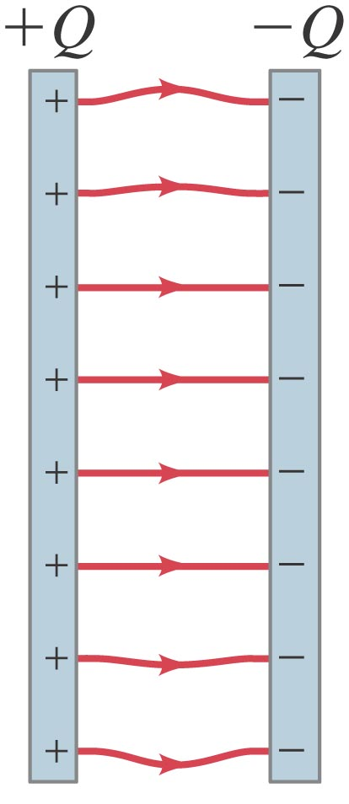
21-8 Field Lines
The electric field between two closely spaced, oppositely charged parallel plates is constant.

Slide 11
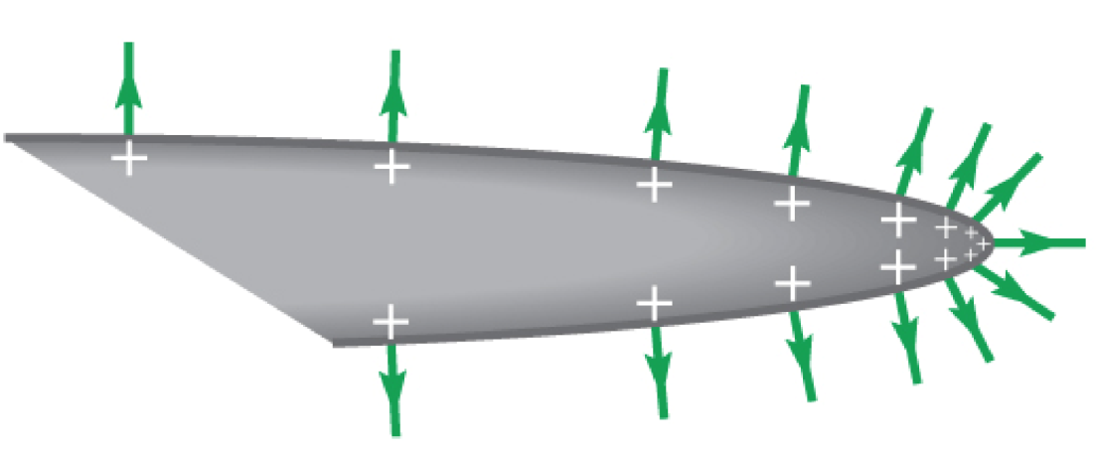
21.9 Conductors in Electrostatic Equilibrium
Have a zero electric field inside the conducting material when the charges are at rest.
Only the surface can have a net charge
The electric field is perpendicular to the surface
The surface charge density is highest at sharp points

Slide 12
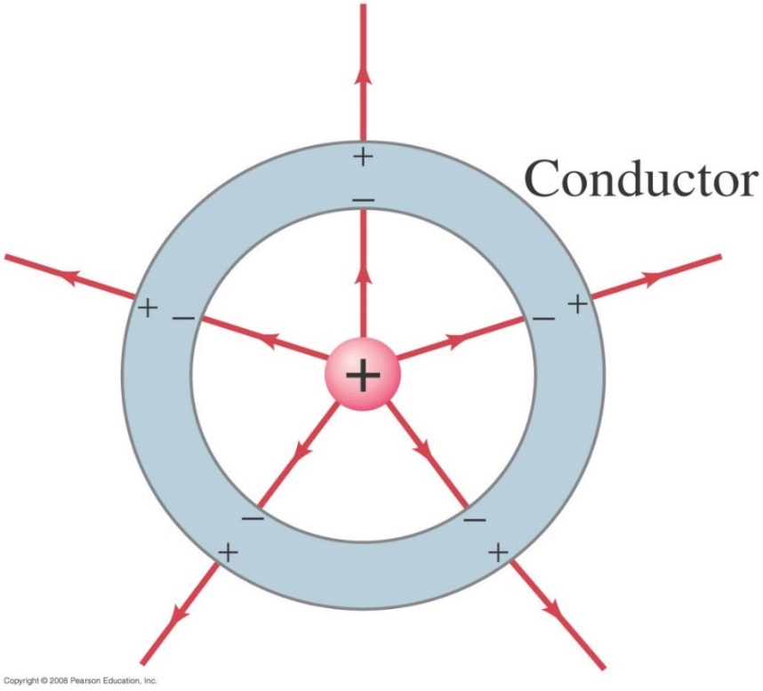
21-9 Electric Fields and Conductors
The static electric field inside a conductor is zero – if it were not, the charges would move.
The net charge on a conductor resides on its outer surface.
Notes:
Figure 21-36. A charge inside a neutral spherical metal shell induces charge on its surfaces. The electric field exists even beyond the shell, but not within the conductor itself.

Slide 13
21-10 Motion of a Charged Particle in an Electric Field
The force on an object of charge q in an electric field is given by:
= q
Therefore, if we know the mass and charge of a particle, we can describe its subsequent motion in an electric field.

Slide 14
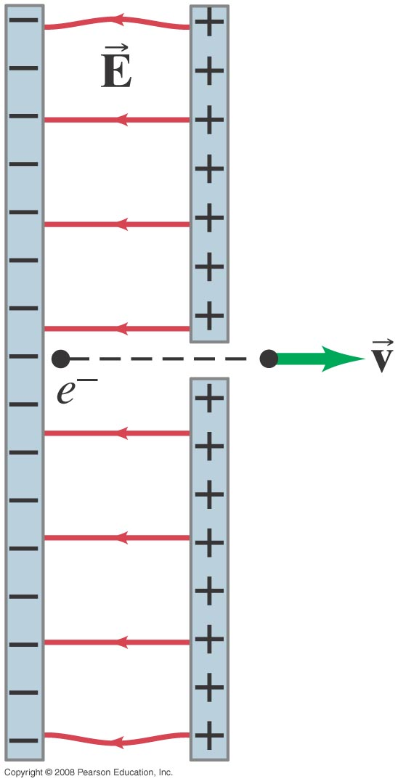
21-10 Motion of a Charged Particle in an Electric Field
Example 21-15: Electron accelerated by electric field.
An electron (mass m = 9.11 x 10⁻³¹ kg) is accelerated in the uniform field (E = 2.0 x 10⁴ N/C) between two parallel charged plates. The separation of the plates is 1.5 cm. The electron is accelerated from rest near the negative plate and passes through a tiny hole in the positive plate. (a) With what speed does it leave the hole? (b) Show that the gravitational force can be ignored. Assume the hole is so small that it does not affect the uniform field between the plates.
Notes:
Solution. a. The acceleration of the electron is qE/m = 3.5 x 10¹⁵ m/s². In 1.5 cm it therefore accelerates from a speed of zero to v = 1.0 x 10⁷ m/s.
b. The electric force on the electron is qE = 3.2 x 10⁻¹⁵ N; the gravitational force is mg = 8.9 x 10⁻³⁰ N. Therefore the gravitational force can safely be ignored.

Slide 15
21-11 Electric Dipoles
An electric dipole consists of two charges Q, equal in magnitude and opposite in sign, separated by a distance .The dipole moment, $\vec{p}$= Q $\vec{ℓ}$, points from the negative to the positive charge.
Notes:
Figure 21-42. A dipole consists of equal but opposite charges, +Q and –Q, separated by a distance l. The dipole moment p + Ql and points from the negative to the positive charge.

Slide 16
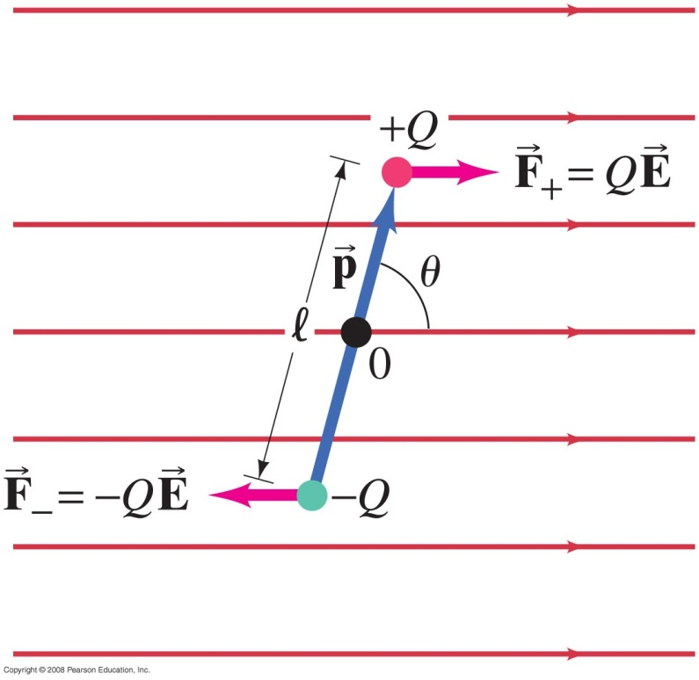
21-11 Electric Dipoles
An electric dipole in a uniform electric field will experience no net force, but it will, in general, experience a torque:
Notes:
Figure 21-44. An electric dipole in a uniform electric field.

Slide 17
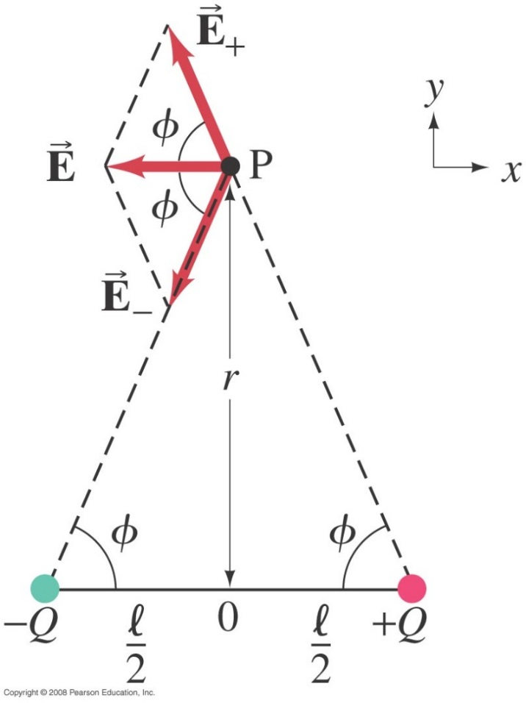
21-11 Electric Dipoles
The electric field created by a dipole is the sum of the fields created by the two charges; far from the dipole, the field shows a 1/r³ dependence:
Notes:
Figure 21-45. Electric field due to an electric dipole.

Slide 18
Problem 57

Slide 19
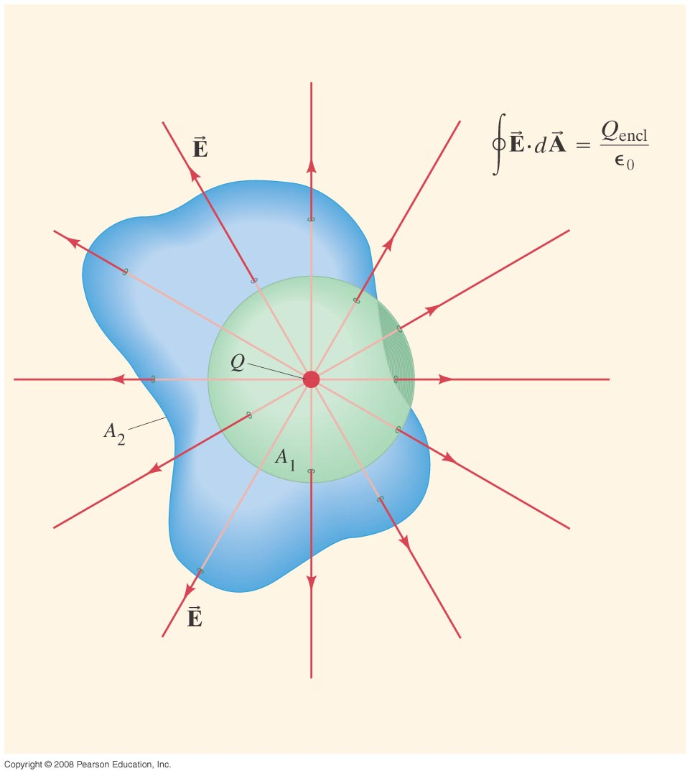
Chapter 22 Gauss’s Law
Notes:
Chapter 22 opener. Gauss’s law is an elegant relation between electric charge and electric field. It is more general than Coulomb’s law. Gauss’s law involves an integral of the electric field E at each point on a closed surface. The surface is only imaginary, and we choose the shape and placement of the surface so that we can figure out the integral. In this drawing, two different surfaces are shown, both enclosing a point charge Q. Gauss’s law states that the product E·dA, where dA is an infinitesimal area of the surface, integrated over the entire surface, equals the charge enclosed by the surface Q_{encl} divided by ε₀. Both surfaces here enclose the same charge Q. Hence ∫E·dA will give the same result for both surfaces.

Slide 20
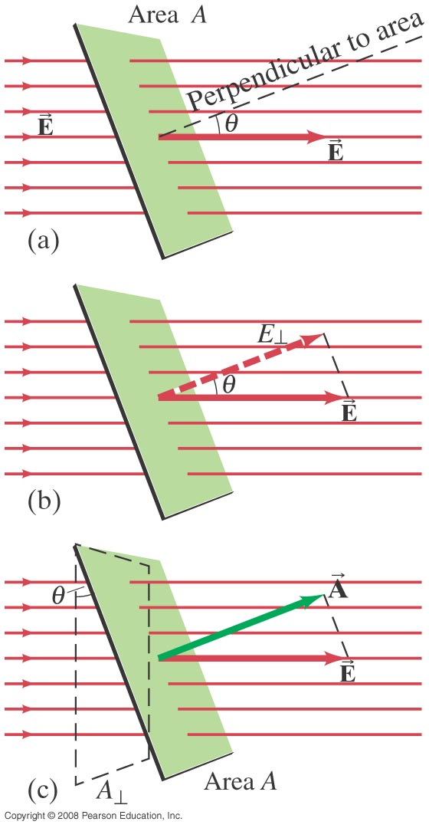
22-1 Electric Flux
Electric flux:
Units is Nm²/C
Electric flux through an area is proportional to the total number of field lines crossing the area.
Notes:
Figure 22-1. (a) A uniform electric field E passing through a flat area A. (b) E┴ = E cos θ is the component of E perpendicular to the plane of area A. (c) A┴ = A cos θ is the projection (dashed) of the area A perpendicular to the field E.

Slide 21
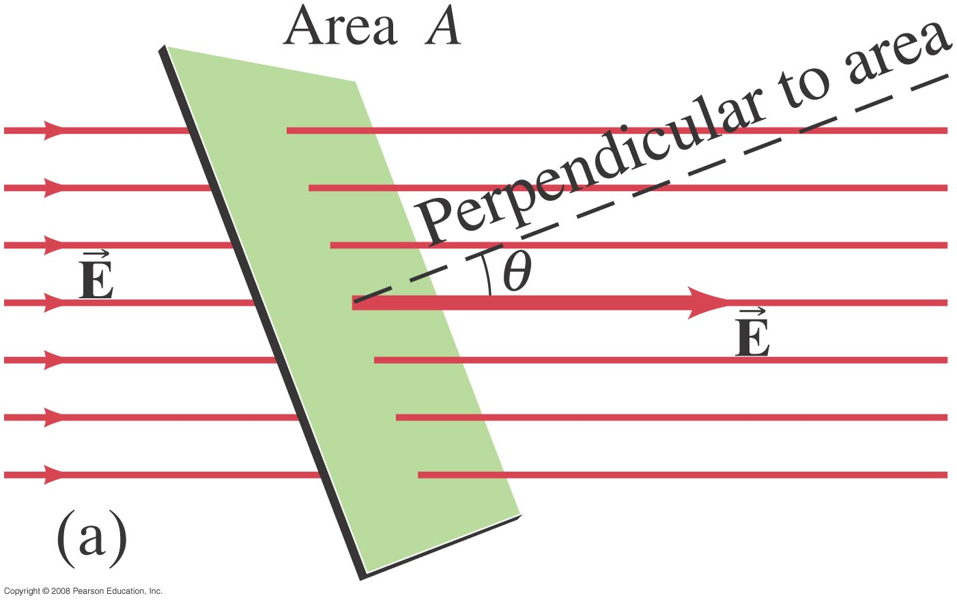
22-1 Electric Flux
Example 22-1: Electric flux.
Calculate the electric flux through the rectangle shown. The rectangle is 10 cm by 20 cm, the electric field is uniform at 200 N/C, and the angle θ is 30°.
Notes:
Solution. The flux is EA cos θ = 3.5 N·m²/C.

Slide 22
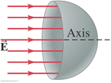
22-1 Electric Flux-Problem 4

