Slide 1
Chapter 21, Electric Charge, and electric Field
No Homework this week
Exam Friday, Feb. 2
Study Guide posted

Slide 2
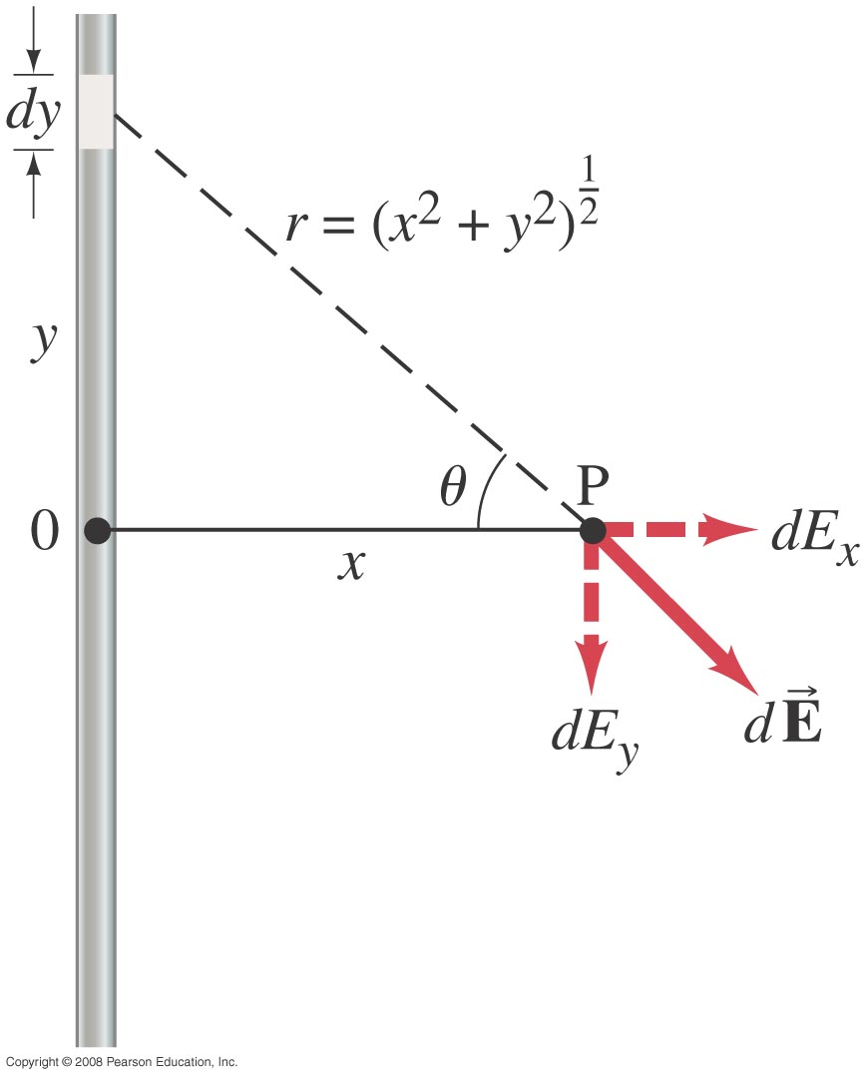
21-7 Electric Field Calculations for Continuous Charge Distributions
Example 21-11: Long line of charge.
Determine the magnitude of the electric field at any point P a distance x from a very long line (a wire, say) of uniformly distributed charge. Assume x is much smaller than the length of the wire, and let λ be the charge per unit length (C/m).
Use wolfram alpha for integration
https://www.wolframalpha.com/input/?i=integrate+dy%2F(x%5E2%2By%5E2)%5E(3%2F2)+from+-infinity+to+infinity
Notes:
Solution: By symmetry, there will be no component of the field parallel to the wire. Write dE = (λ/4πε₀) (cos θ dy)/x² + y²). This can be transformed into an integral over θ: dE = (λ/4πε₀x) cos θ dθ. Integrate θ from –π/2 to + π/2. Answer: E = (1/2πε₀) λ/x.

Slide 3
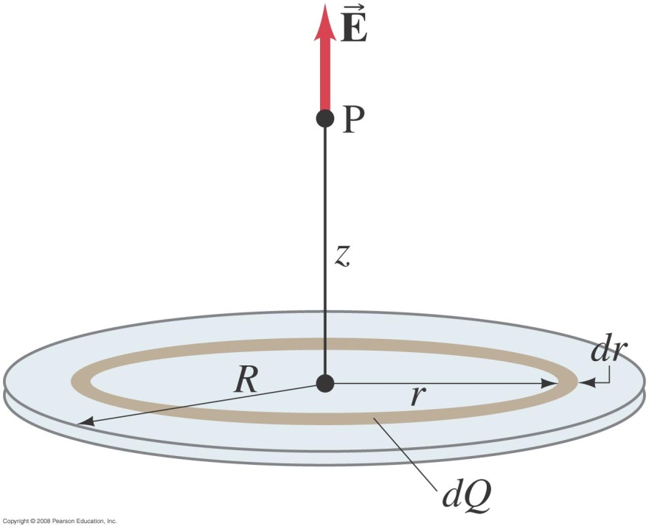
21-7 Electric Field Calculations for Continuous Charge Distributions
Example 21-12: Uniformly charged disk.
Charge is distributed uniformly over a thin circular disk of radius R. The charge per unit area (C/m²) is σ. Calculate the electric field at a point P on the axis of the disk, a distance z above its center.
https://www.wolframalpha.com/input/?i=integrate+x+*(x%5E2%2Ba)%5E(-3%2F2)+dx
Notes:
Solution: The disk is a set of concentric rings, and we know (from example 21-9) what the field due to a ring of charge is. Write dQ = σ 2πr dr. Integrate r from 0 to R. See text for answer.

