Slide 1
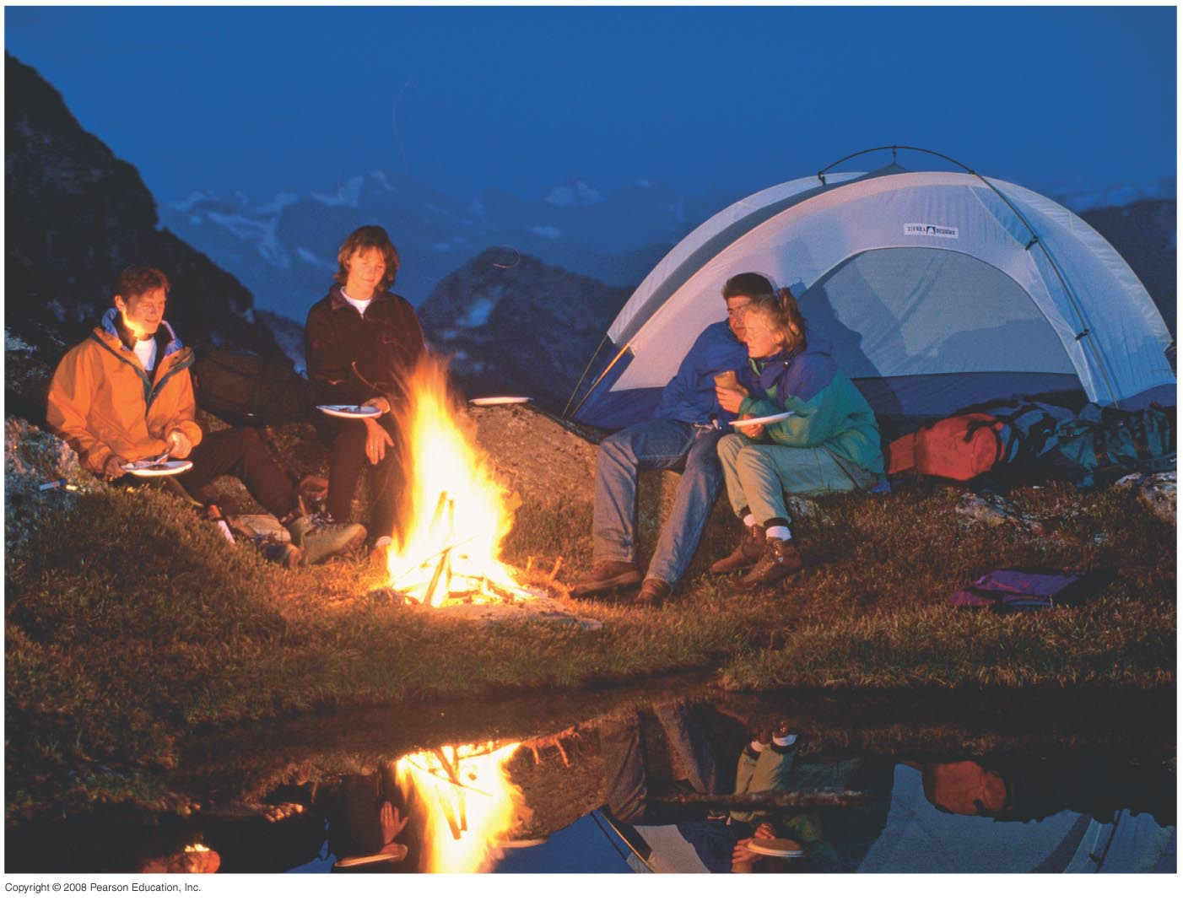
Chapter 19 Heat and the First Law of Thermodynamics
HW1 due on Wednesday, Jan 17
Chapt.17:Pb. 3, Pb.13, Pb. 18
Chapt.19: Pb.2, Pb.11, Pb.24
Notes:
Chapter opener. When it is cold, warm clothes act as insulators to reduce heat loss from the body to the environment by conduction and convection. Heat radiation from a campfire can warm you and your clothes. The fire can also transfer energy directly by heat convection and conduction to what you are cooking. Heat, like work, represents a transfer of energy. Heat is defined as a transfer of energy due to a difference of temperature. Work is a transfer of energy by mechanical means, not due to a temperature difference. The first law of thermodynamics links the two in a general statement of energy conservation: the heat Q added to a system minus the net work W done by the system equals the change in internal energy ΔE_{int} of the system: ΔE_{int} = Q – W. Internal energy E_{int} is the sum total of all the energy of the molecules of the system.

Slide 2
19-1 Heat as Energy Transfer
We often speak of heat as though it were a material that flows from one object to another; it is not. Rather, it is a form of energy.
Unit of heat: calorie (cal)
1 cal is the amount of heat necessary to raise the temperature of 1 g of water by 1 Celsius degree.
Don’t be fooled—the Calories on our food labels are really kilocalories (kcal or Calories), the heat necessary to raise 1 kg of water by 1 Celsius degree.

Slide 3
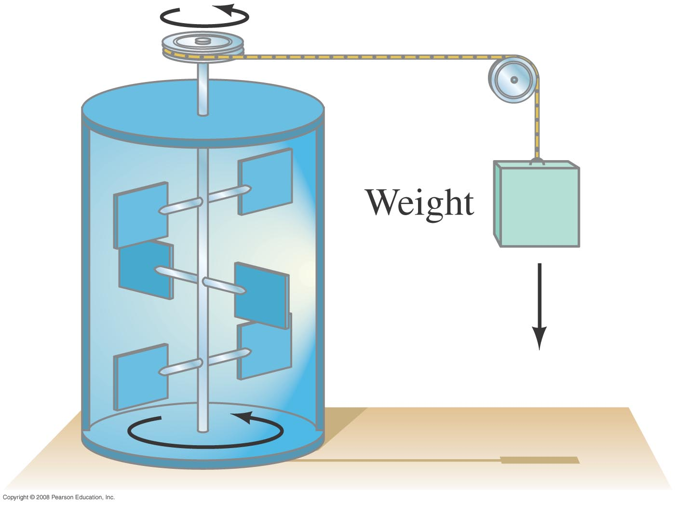
19-1 Heat as Energy Transfer
If heat is a form of energy, it ought to be possible to equate it to other forms. The experiment below found the mechanical equivalent of heat by using the falling weight to heat the water:
4.186 J = 1 cal
4.186 kJ = 1 kcal
Mechanical Joule experiment
Notes:
Figure 19-1. Joule’s experiment on the mechanical equivalent of heat.

Slide 4
19-1 Heat as Energy Transfer
Definition of heat:
Heat is energy transferred from one object to another because of a difference in temperature.
Remember that the temperature of a gas is a measure of the kinetic energy of its molecules.

Slide 5
19-1 Heat as Energy Transfer
Example 19-1: Working off the extra calories.
Suppose you throw caution to the wind and eat too much ice cream and cake on the order of 500 Calories. To compensate, you want to do an equivalent amount of work climbing stairs or a mountain. How much total height must you climb?
Notes:
Solution: Remember food calories are kcal; letting W = mgh, approximate your mass as 60 kg, then h = 3600 m.

Slide 6
Problem 5
5.(II) How many joules and kilocalories are generated when the brakes are used to bring a 1200-kg car to rest from a speed of 95km/h

Slide 7
19-2 Internal Energy
The total sum of all the energy of all the molecules in a substance is its internal (or thermal) energy.
Temperature: measures molecules’ average kinetic energy
Internal energy: total energy of all molecules
Heat: transfer of energy due to difference in temperature

Slide 8
19-2 Internal Energy
Internal energy of an ideal (atomic) gas:
Average kinetic energy
But since we know the average kinetic energy in terms of the temperature, we can write:
N is the number of molecules, and k is the Boltzman
constant=1.38X10⁻²³J/K

Slide 9
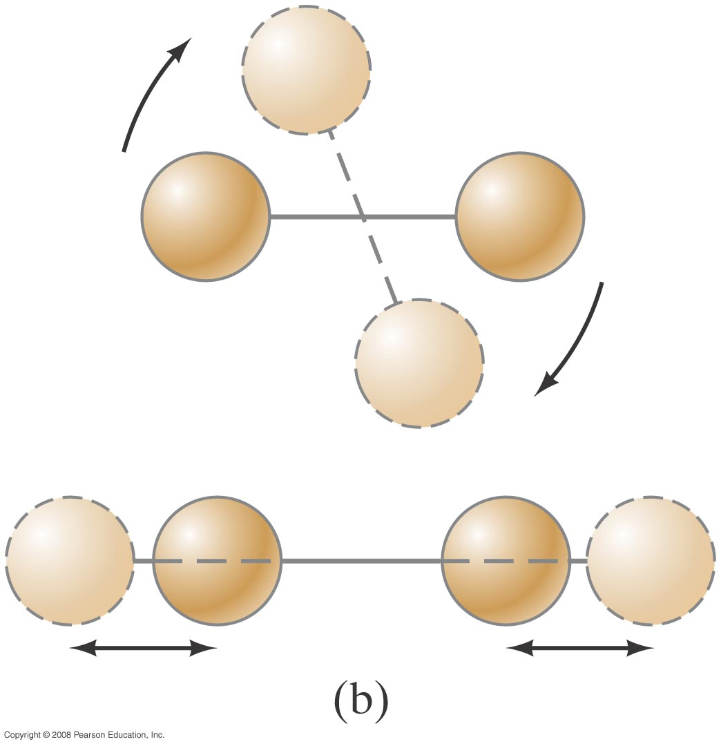
19-2 Internal Energy
If the gas is molecular rather than atomic, rotational and vibrational kinetic energy need to be taken into account as well.
Notes:
Figure 19-2. Besides translational kinetic energy, molecules can have (a) rotational kinetic energy, and (b) vibrational energy (both kinetic and potential).

Slide 10
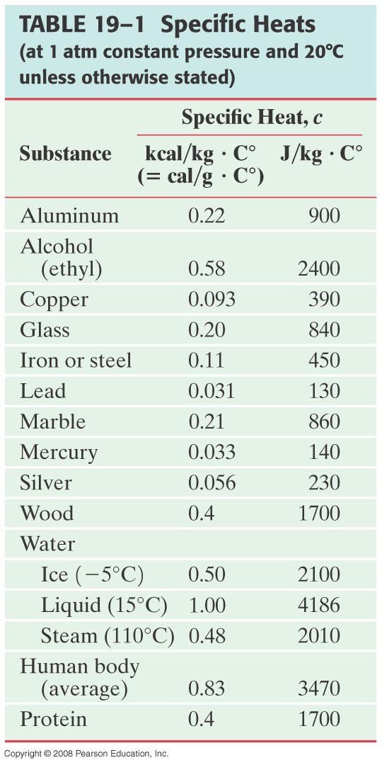
19-3 Specific Heat
The specific heat: The amount of heat required to change the temperature of a material and is proportional to the mass and to the temperature change:
The specific heat,c, is characteristic of the material. Some material values are listed on the left.

Slide 11
19-3 Specific Heat
Example 19-2: How heat transferred depends on specific heat.
How much heat input is needed to raise the temperature of an empty 20-kg vat made of iron from 10°C to 90°C?
(b) What if the vat is filled with 20 kg of water?
Notes:
Solution: a. Q = 720 kJ.
b. For the water alone, Q = 6700 kJ, so the total is 7400 kJ.

Slide 12
19-4 Calorimetry—Solving Problems
Closed system: no mass enters or leaves, but energy may be exchanged
Open system: mass may transfer as well
Isolated system: closed system in which no energy in any form is transferred
For an isolated system,
energy out of one part = energy into another part,
or: heat lost = heat gained.

Slide 13
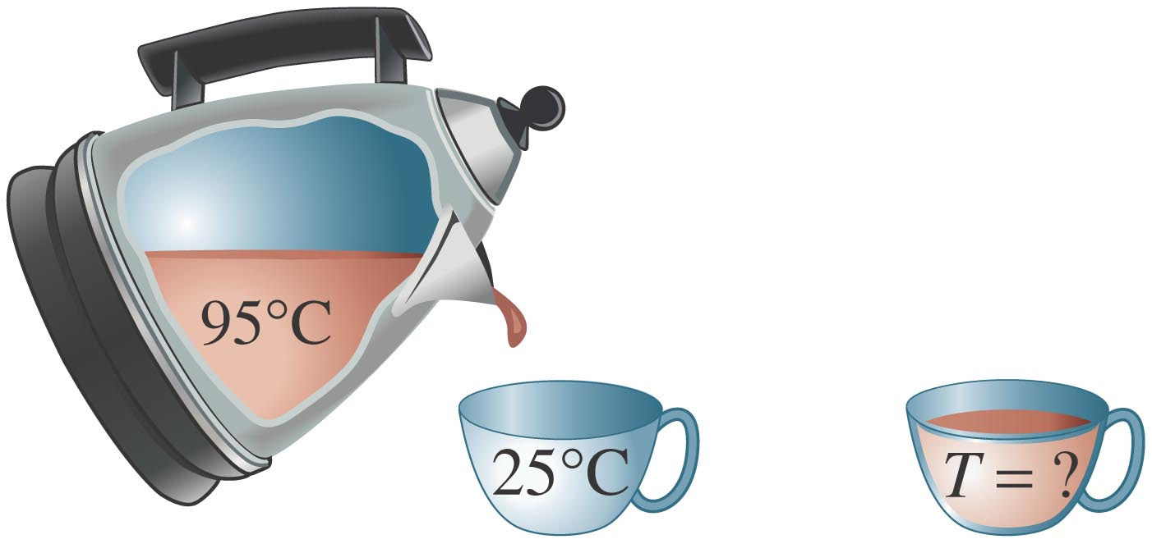
19-4 Calorimetry—Solving Problems
Example 19-3: The cup cools the tea.
If 200 cm³ of tea at 95°C is poured into a 150-g glass cup initially at 25°C, what will be the common final temperature T of the tea and cup when equilibrium is reached, assuming no heat flows to the surroundings?
Notes:
Solution: Assume all the heat that leaves the tea flows into the cup. Tea is mostly water; the common final temperature is 86 °C.

Slide 14
Problem 15
15.(II) When a 290-g piece of iron at 180°C is placed in a 95-g aluminum calorimeter cup containing 250 g of glycerin at 10°C, the final temperature is observed to be 38°C. ­Estimate the specific heat of glycerin.

Slide 15
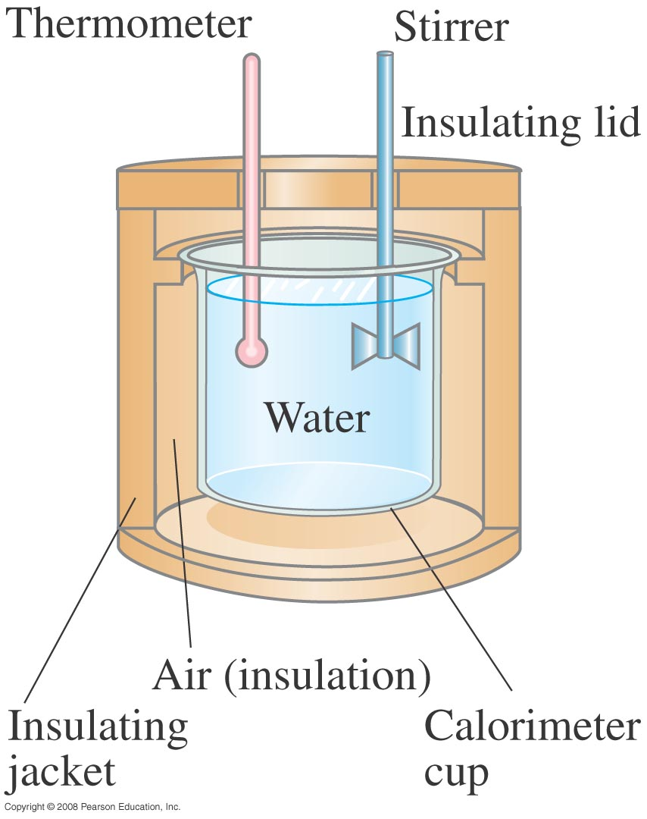
19-4 Calorimetry—Solving Problems
The instrument to the left is a calorimeter, which makes quantitative measurements of heat exchange. A sample is heated to a well-measured high temperature and plunged into the water, and the equilibrium temperature is measured. This gives the specific heat of the sample.
Notes:
Figure 19-4. Simple water calorimeter.

Slide 16
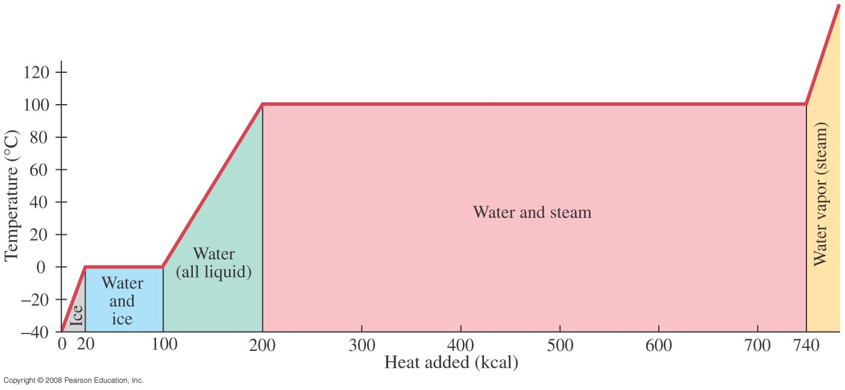
19-5 Latent Heat
Energy is required for a material to change phase, even though its temperature is not changing.
Latent heat is the heat (energy) required to change 1kg of substance from solid to liquid
Notes:
Figure 19-5. Temperature as a function of the heat added to bring 1.0 kg of ice at –40°C to steam above 100°C.

Slide 17
19-5 Latent Heat
The total heat required for a phase change depends on the total mass and the latent heat:
Notes:
Solution: First, figure out whether the final mixture will be ice or water (or a mix). The heat released when 3.0 kg of water is cooled from 20°C to 0°C is 250 kJ; the heat needed to raise 0.50 kg of ice to 0°C and then melt it is 177 kJ. Therefore, the final mixture will be liquid, at some temperature above zero. Now you can do conservation of energy; the heat required to heat the ice, melt it, and then raise its temperature to the final one is equal to the heat lost by the tea cooling from the original temperature to the final one. Solving for the temperature gives 5.0°C.

Slide 18
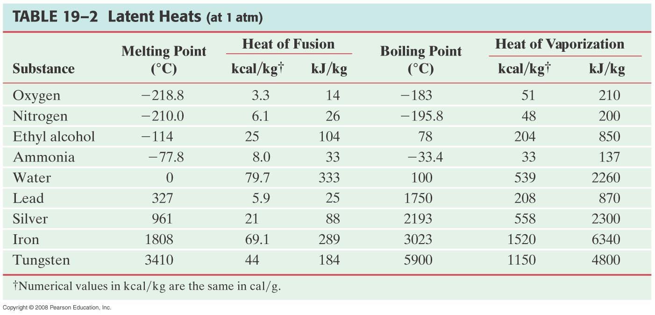
19-5 Latent Heat
Heat of fusion, L_{F}: heat required to change 1.0 kg of material from solid to liquid
Heat of vaporization, L_{V}: heat required to change 1.0 kg of material from liquid to vapor

Slide 19
19-5 Latent Heat
The latent heat of vaporization is relevant for evaporation as well as boiling. The heat of vaporization of water rises slightly as the temperature decreases.
On a molecular level, the heat added during a change of state does not increase the kinetic energy of individual molecules, but rather break the close bonds between them so the next phase can occur.

Slide 20
19-5 Latent Heat
Example 19-6: Determining a latent heat.
The specific heat of liquid mercury is 140 J/kg·°C. When 1.0 kg of solid mercury at its melting point of -39°C is placed in a 0.50-kg aluminum calorimeter filled with 1.2 kg of water at 20.0°C, the mercury melts and the final temperature of the combination is found to be 16.5°C. What is the heat of fusion of mercury in J/kg?
Notes:
Solution: Again, use conservation of energy; we know the final system is liquid, so the heat required to melt the mercury and then raise its temperature to 16.5 degrees equals the heat lost by the water. Solving gives L_{Hg} = 11 kJ/kg.

