Slide 1
Quiz 4

Slide 2
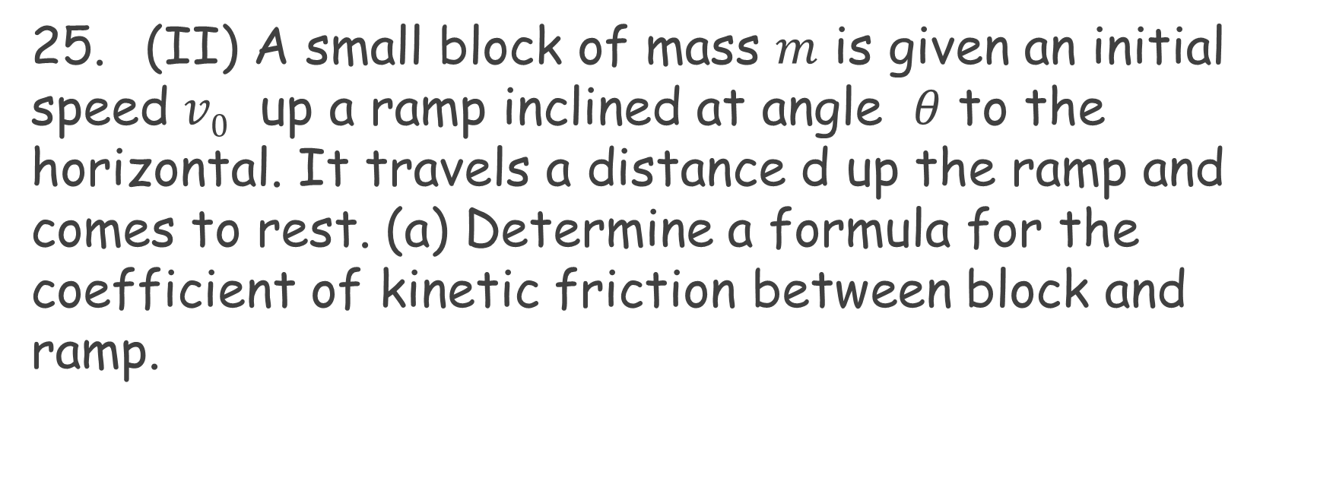
Chapter 5 Problem 25
25. (II) A small block of mass $m$ is given an initial speed $v0$ up a ramp inclined at angle $θ$ to the horizontal. It travels a distance d up the ramp and comes to rest. (a) Determine a formula for the coefficient of kinetic friction between block and ramp.

Slide 3
Chapter 5, Problem 35
35. (I) A child sitting 1.20 m from the center of a merry-go-around moves with a speed of 1.30 m /s. Calculate (a) the centripetal acceleration of the child and (b) the net force exerted on the child (m=22.5kg).

Slide 4
Chapter 5 Problem 41
41. (II) A sports car crosses the bottom of a valley with a radius of curvature equal to 95 m. At the very bottom, the normal force on the driver is twice his weight. At what speed was the car traveling?

