Slide 1
Chapter 6
Gravitation and Newton’s Synthesis
HW3: Chapter 4:Pb.32, Pb.35, Pb.48, Pb.49, Pb. 52, Pb.54, Due on Wednesday, Oct. 8
Exam 2 on Wednesday Oct. 15 after the break.
Notes:
Chapter Opener. Caption: The astronauts in the upper left of this photo are working on the Space Shuttle. As they orbit the Earth—at a rather high speed—they experience apparent weightlessness. The Moon, in the background, also is orbiting the Earth at high speed. What keeps the Moon and the space shuttle (and its astronauts) from moving off in a straight line away from Earth? It is the force of gravity. Newton’s law of universal gravitation states that all objects attract all other objects with a force proportional to their masses and inversely proportional to the square of the distance between them.

Slide 2
Highway Curves: Banked and Unbanked
Example 5-14: Skidding on a curve.
A 1000-kg car rounds a curve on a flat road of radius 50 m at a speed of 15 m/s (54 km/h). Will the car follow the curve, or will it skid? Assume: (a) the pavement is dry and the coefficient of static friction is μ_{s} = 0.60; (b) the pavement is icy and μ_{s} = 0.25.
Notes:
Figure 5-23. Caption: Example 5–14. Forces on a car rounding a curve on a flat road. (a) Front view, (b) top view.
Solution: The normal force equals the weight, and the centripetal force is provided by the frictional force (if sufficient). The required centripetal force is 4500 N.
The maximum frictional force is 5880 N, so the car follows the curve.
The maximum frictional force is 2450 N, so the car will skid.

Slide 3
Velocity-Dependent Forces: Drag and Terminal Velocity
When an object moves through a fluid, it experiences a drag force that depends on the velocity V of the object.
F_{D}= -bv
b is a constant that depends on the viscosity, size and shape of the object
For small velocities, the force is approximately proportional to the velocity; for higher speeds, the force is approximately proportional to the square of the velocity.

Slide 4
6-1 Newton’s Law of Universal Gravitation
If the force of gravity is being exerted on objects on Earth, what is the origin of that force?
Newton’s realization was that the force must come from the Earth.
He further realized that this force must be what keeps the Moon in its orbit.
Notes:
Figure 6-1. Caption: Anywhere on Earth, whether in Alaska, Australia, or Peru, the force of gravity acts downward toward the center of the Earth.

Slide 5
Newton’s Law of Universal Gravitation
The gravitational force on you is : the Earth exerts a downward force on you, and you exert an upward force on the Earth.
When there is such a disparity in masses, the reaction force is undetectable, but for bodies more equal in mass it can be significant.
Notes:
Figure 6-2. Caption: The gravitational force one object exerts on a second object is directed toward the first object, and is equal and opposite to the force exerted by the second object on the first.

Slide 6
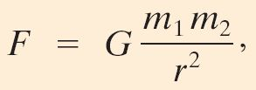

Newton’s Law of Universal Gravitation
Therefore, the gravitational force must be proportional to both masses.
By observing planetary orbits, Newton also concluded that the gravitational force must decrease as the inverse of the square of the distance between the masses.
In its final form, the law of universal gravitation reads:
Where G is the universal constant
r is the distance between the center of the objects

Slide 7
Question
What is the earth’s period about the sun?
24 hours
28 days
365 days

Slide 8
Newton’s Law of Universal Gravitation
Example 6-1: Can you attract another person gravitationally?
A 50-kg person and a 70-kg person are sitting on a bench close to each other. Estimate the magnitude of the gravitational force each exerts on the other.
Notes:
Answer: Assume the distance between the two people is about ½ m; then the gravitational force between them is about 10⁻⁶ N.

Slide 9
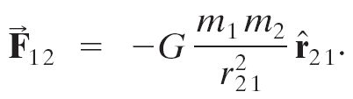
6.2 Vector Form of Newton’s Universal Gravitation
In vector form,
This figure gives the directions of the displacement and force vectors.
Notes:
Figure 6-6. Caption: The displacement vector r₂₁ points from particle of mass m₂ to particle of mass m₁. The unit vector shown, r₂₁, is in the same direction as r₂₁ but is defined as having length one.

Slide 10
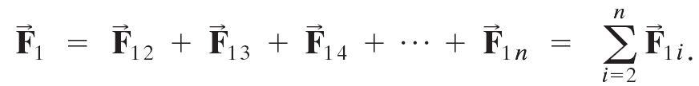
Vector Form of Newton’s Universal Gravitation
If there are many particles, the total force is the vector sum of the individual forces:
F1i is the force on particle 1 exerted by particle i, n is the number of particles.

Slide 11
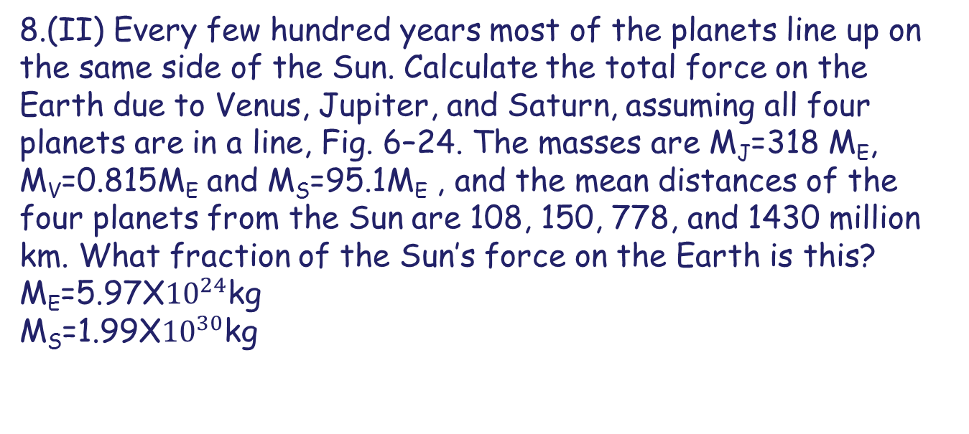
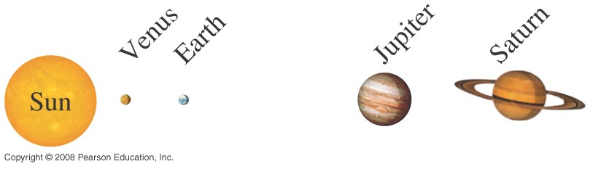
Problem 8

Slide 12
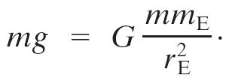
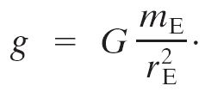
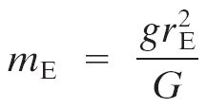

6-3 Gravity Near the Earth’s Surface; Geophysical Applications
Now we can relate the gravitational constant to the local acceleration of gravity. We know that, on the surface of the Earth:
Solving for g gives:
Now, knowing g and the radius of the Earth, the mass of the Earth can be calculated:

Slide 13
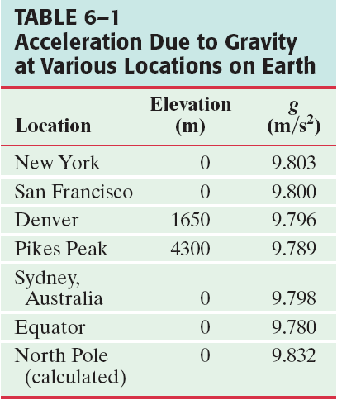
6-3 Gravity Near the Earth’s Surface; Geophysical Applications
The acceleration due to gravity varies over the Earth’s surface due to altitude, local geology, and the shape of the Earth, which is not quite spherical.

Slide 14
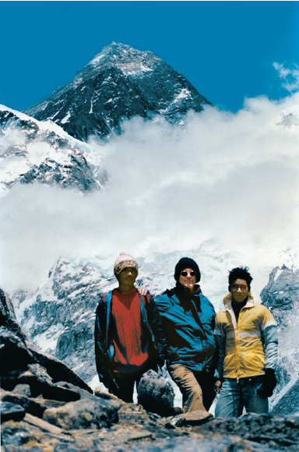
6-3 Gravity Near the Earth’s Surface; Geophysical Applications
Example 6-4: Gravity on Everest.
Estimate the effective value of g on the top of Mt. Everest, 8850 m (29,035 ft) above sea level. That is, what is the acceleration due to gravity of objects allowed to fall freely at this altitude?
Notes:
Figure 6-8. Caption: Example 6–4. Mount Everest, 8850 m (29,035 ft) above sea level; in the foreground, the author with sherpas at 5500 m (18,000 ft).
Answer: Add 8850 m to the radius of the Earth and recalculate; g = 9.77 m/s².

Slide 15
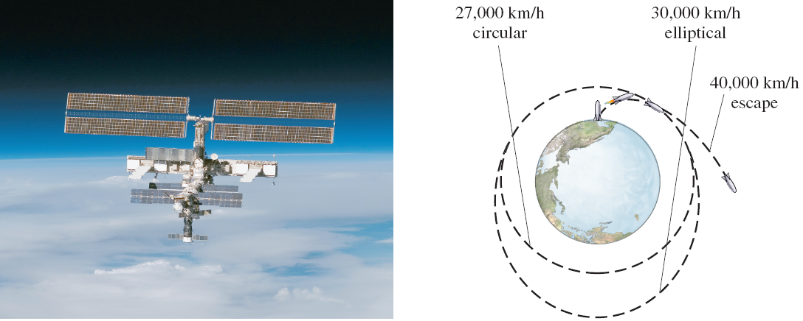
6-4 Satellites and “Weightlessness”
Satellites are routinely put into orbit around the Earth. The tangential speed must be high enough so that the satellite does not return to Earth, but not so high that it escapes Earth’s gravity altogether.
Notes:
Figure 6-10. Caption: A satellite, the International Space Station, circling the Earth.
Figure 6-11. Caption: Artificial satellites launched at different speeds.

Slide 16
6-4 Satellites and “Weightlessness”
The satellite is kept in orbit by its speed—it is continually falling, but the Earth curves from underneath it, and it continues in orbit because of gravity
Notes:
Figure 6-12. Caption: A moving satellite “falls” out of a straight-line path toward the Earth.

Slide 17

Newton’s Law of Universal Gravitation and satellites
So what is that velocity?
Satellites and planets are kept in orbit by gravitational force
r
We will treat the orbits as circular, so the acceleration is towards the center of the circle
r
r

Slide 18
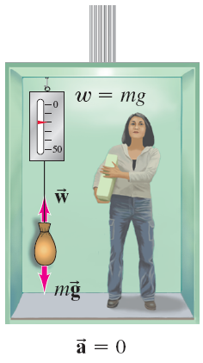
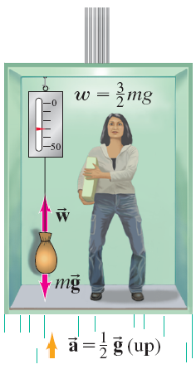
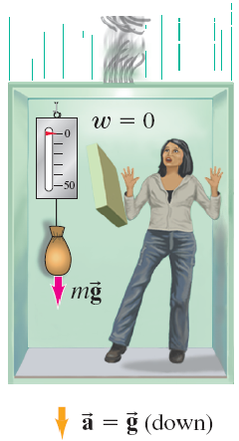
6-4 Satellites and “Weightlessness”
Objects in orbit are said to experience weightlessness. They do have a gravitational force acting on them, though!
The satellite and all its contents are in free fall, so there is no normal force. This is what leads to the experience of weightlessness.
Notes:
Figure 6-13. Caption: (a) An object in an elevator at rest exerts a force on a spring scale equal to its weight. (b) In an elevator accelerating upward at ½ g, the object’s apparent weight is 1 ½ times larger than its true weight. (c) In a freely falling elevator, the object experiences “weightlessness”: the scale reads zero.

Slide 19
Problem 29
29.(II) What will a spring scale read for the weight of a 53-kg woman in an elevator that moves (a) upward with constant speed 5.0 m/s, (b) downward with constant speed 5.0 m/s, (c) upward with acceleration 0.33 g, (d) downward with acceleration 0.33 g, and (e) in free fall?

Slide 20
6-4 Satellites and “Weightlessness”
More properly, this effect is called apparent weightlessness, because the gravitational force still exists. It can be experienced on Earth as well, but only briefly:
Notes:
Figure 6-15. Caption: Experiencing “weightlessness” on Earth.

