Slide 1
Chapter 3:Kinematics in 2 or 3 Dimensions; Vectors

Slide 2


Vector Addition: Components
We add vectors by adding their x and y components because we can add things in a line
y
y
x
A
B
A_{y}
B_{y}
A_{x}
x
B_{x}
A
B
A_{x}
B_{x}
A_{y}
B_{y}
C
C

Slide 3
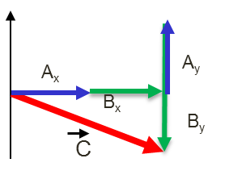
Vector Addition: Components
We add vectors by adding their x and y components.
A_{x}
A_{y}
B_{x}
B_{y}
C
A_{x}
B_{x}
C_{x}
C_{x}
A_{y}
C_{y}
C
C_{y}
B_{y}

Slide 4

Unit Vectors
Unit vectors have magnitude 1.
Using unit vectors, any vector can be written in terms of its components:
Components in each axis

Slide 5
Problem 6
-

Slide 6
Problem 6 Solution

Slide 7
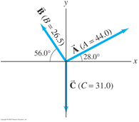
Problem 10
Three vectors are shown in figure below. Their magnitudes are given in arbitrary units. Determine the sum of the three vectors. Give the resultant in terms of (a) components, (b) magnitude and angle with x axis.
10.(II)

