Slide 1





Chapter 5
Circular Motion, the Planets, and Gravity
No Class on Thursday, and no Quiz
Exam on April 10, study guide posted

Slide 2
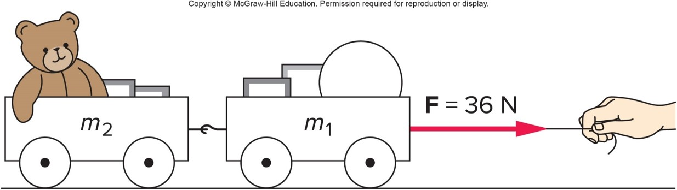
What happens when objects are connected? 1
Two connected carts being accelerated by a force F applied by a string:
  Both carts must have the same acceleration a which is equal to the net horizontal force divided by the total mass
  Each cart will have a net force equal to its mass times the acceleration

Slide 3
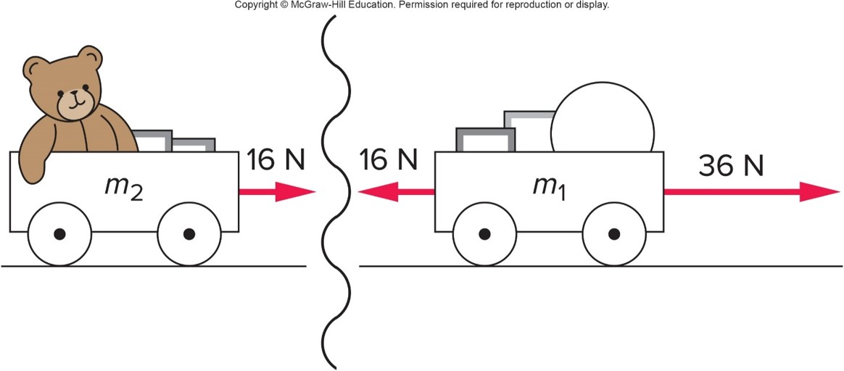
What happens when objects are connected? 2
The interaction between the two carts illustrates Newton’s third law:
exerts a pull of 16 N to the right on
exerts an equal and opposite pull of 16 N to the left on

Slide 4
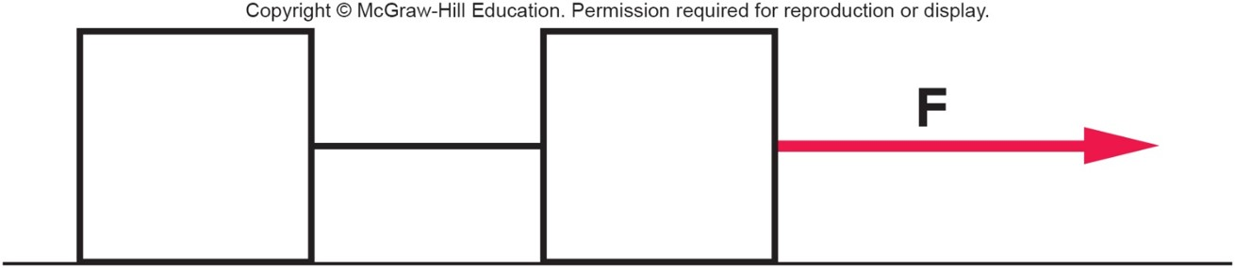
Two blocks with the same mass are connected by a string and are pulled across a frictionless surface by a constant force. Will the two blocks move with constant velocity? 1
a) Yes, both blocks move with constant velocity.
b) No, both blocks move with constant acceleration.
c) The two blocks will have different velocities and/or accelerations.

Slide 5
Two blocks with the same mass are connected by a string and are pulled across a frictionless surface by a constant force. Will the two blocks move with constant velocity? 2
a) Yes, both blocks move with constant velocity.
b) No, both blocks move with constant acceleration.
c) The two blocks will have different velocities and/or accelerations.
b) No. The front block will accelerate due to the constant force F. The rear block is also pulled by a constant force due to the connecting string, so it will accelerate with the same acceleration as the front block. The constant force implies a constant acceleration. Constant acceleration results in constantly changing velocity.

Slide 6
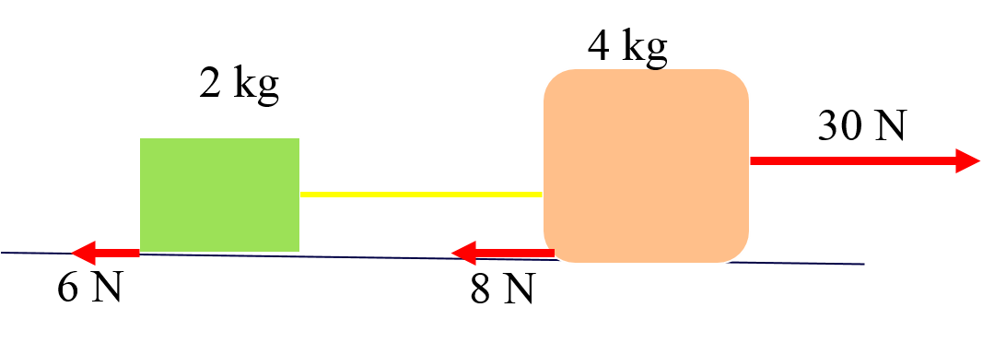
Two blocks tied together by a string are being pulled across the table by a horizontal force. The blocks have frictional forces exerted on them by the table as shown. What is the net force acting on the entire two-block system? 1
  a) 16 N
  b) 36 N
  c) 38 N
  d) 44 N
  e) 46 N

Slide 7
Two blocks tied together by a string are being pulled across the table by a horizontal force. The blocks have frictional forces exerted on them by the table as shown. What is the net force acting on the entire two-block system? 2
a) The net horizontal force is:
30 N - 6 N - 8 N = 16 N directed to the right.
  a) 16 N
  b) 36 N
  c) 38 N
  d) 44 N
  e) 46 N

Slide 8
What is the acceleration of this system?1

Slide 9
What is the acceleration of this system?2

Slide 10
What is the acceleration of this system?3
The total mass is: 2 kg + 4 kg = 6 kg
The acceleration of the system is:
directed to the right.

Slide 11
What force is exerted on the 2-kg block by the connecting string? 1
a) 16 N
b) 5.3 N
c) 2.7 N
d) 12.7 N
e) 11.3 N

Slide 12
What force is exerted on the 2-kg block by the connecting string? 2
a) 16 N
b) 5.3 N
c) 2.7 N
d) 12.7 N
e) 11.3 N
The net horizontal force on the 2-kg block is:
e) This net force is equal to the force of the string (to the right) minus the frictional force (to the left).
So the force due to the string is:
directed to the right.

Slide 13
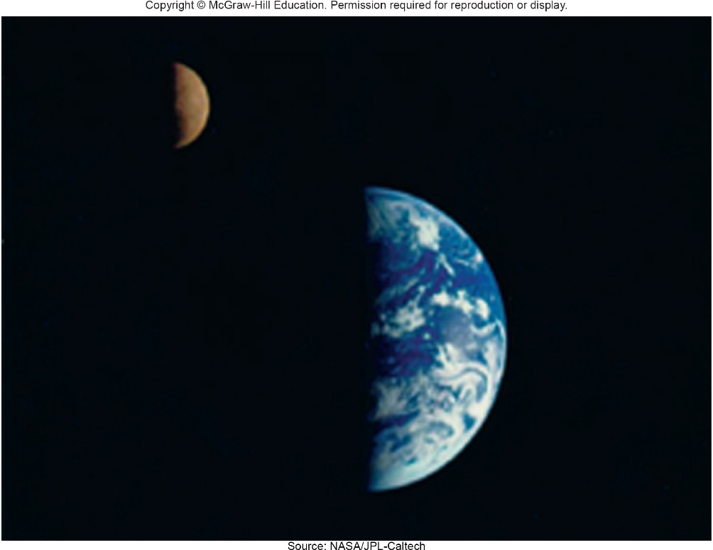
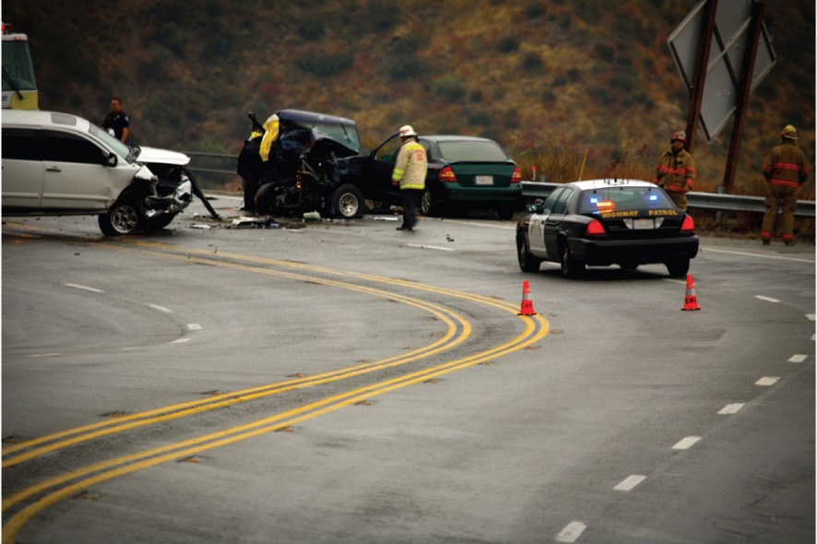
Circular Motion
Does the circular motion of the moon around the Earth ...
... have anything in common with circular motion on Earth?
Top Source: NASA/JPL-Caltech; Bottom ©eyecrave/iStockphoto/Getty Images RF

Slide 14
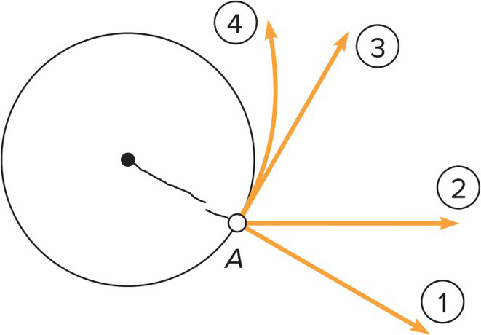
A ball is whirled on the end of a string with constant speed when the string breaks. Which path will the ball take? 1
Path 1
Path 2
Path 3
Path 4
Access the text alternative for slide images.

Slide 15
A ball is whirled on the end of a string with constant speed when the string breaks. Which path will the ball take? 2
Path 1
Path 2
Path 3
Path 4
Path 3, in the direction of the tangent to point A. Neglecting gravity, the body would move in the direction it was moving when the force disappeared, in accordance with the first law.
Access the text alternative for slide images.

Slide 16
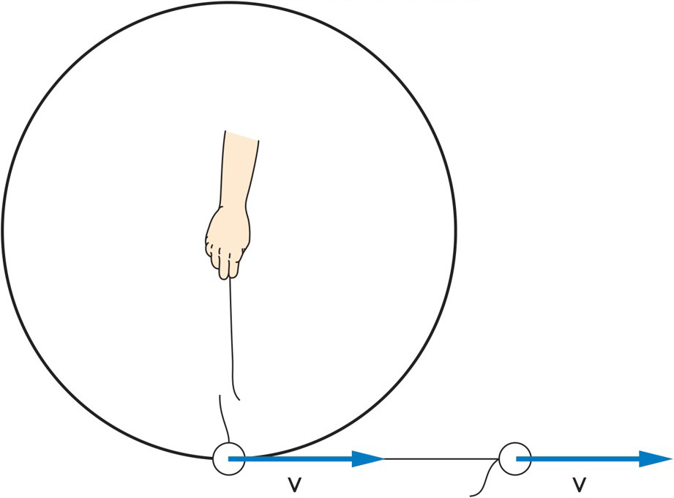
If the string breaks, the ball flies off in a straight-line path in the direction it was traveling at the instant the string broke.
If the string is no longer applying a force to the ball, Newton’s First Law tells us that the ball will continue to move in a straight line.
Circular motion is called centripetal motion, with the string providing a centripetal force.

Slide 17
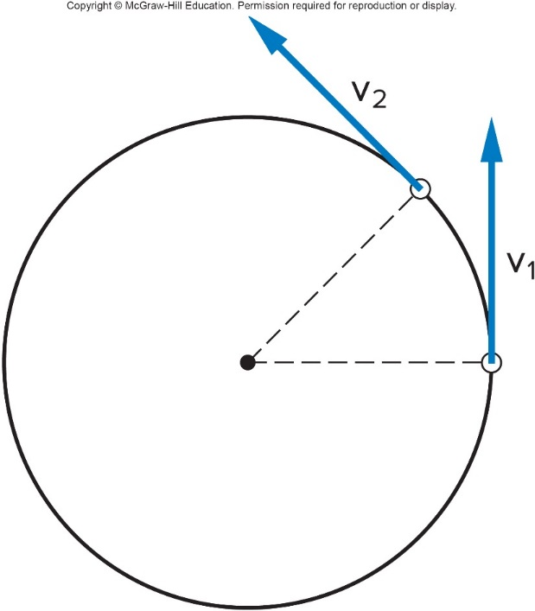
Question 5.1
An object is in uniform circular motion. Which of the following statements is true?
Velocity = constant
Speed = constant
Acceleration = constant

Slide 18
Answer 5.1
An object is in uniform circular motion. Which of the following statements is true?
Speed = constant. The ‘uniform’ in the term ‘uniform circular motion’ refers to the speed.
Since it is changing direction,
the velocity is changing, so
although speed is constant,
velocity is not.

Slide 19
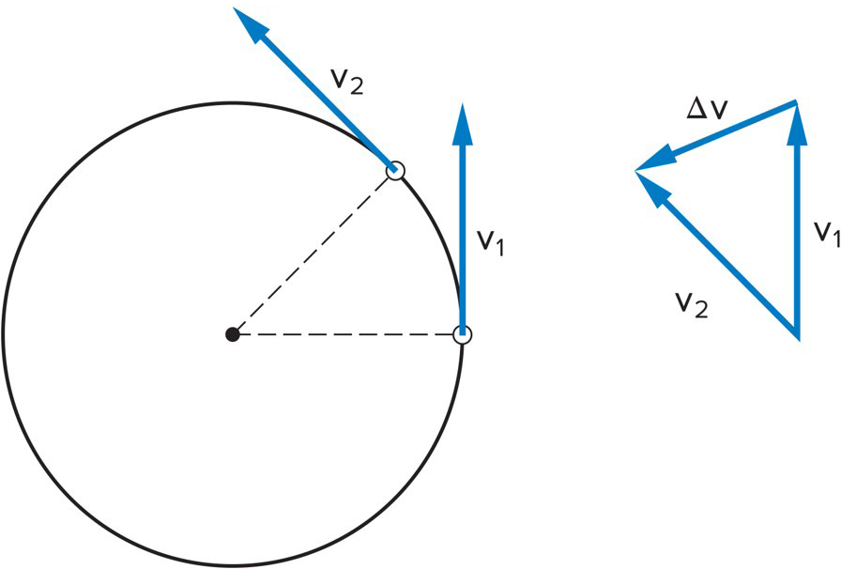
Centripetal Acceleration 1
Centripetal acceleration is the rate of change in velocity of an object that is associated with the change in direction of the velocity.
  Centripetal acceleration is always perpendicular to the velocity.
  Centripetal acceleration always points toward the center of the curve.

Slide 20
Centripetal Acceleration 2
Centripetal acceleration is the rate of change in velocity of an object that is associated with the change in direction of the velocity.
  Centripetal acceleration is always perpendicular to the velocity.
  Centripetal acceleration always points toward the center of the curve.
The centripetal force refers to any force or combination of forces that produces a centripetal acceleration.

Slide 21

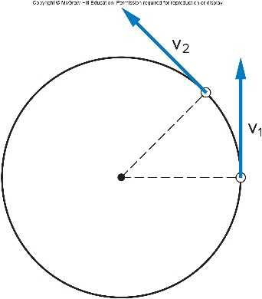
Question 5.3
If the radius in which an object moves in uniform circular motion is tripled while the
speed remains constant the centripetal
acceleration is multiplied by a factor of
9
3
1
1/3
1/9

Slide 22
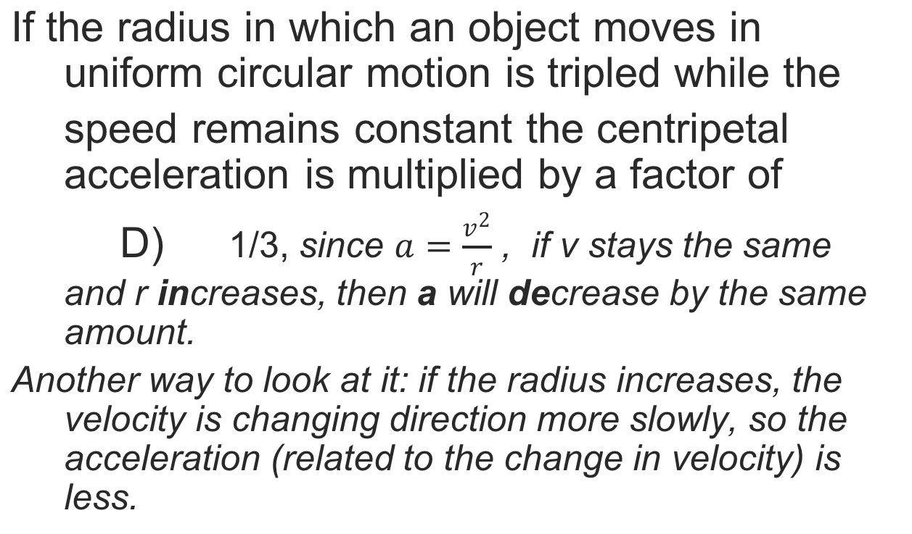
Answer 5.3

Slide 23
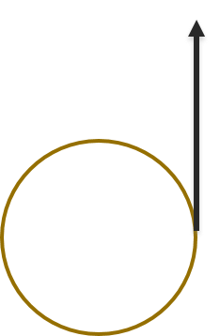
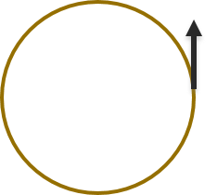
Question 5.4
If the speed of an object in uniform circular motion is tripled while the radius remains constant the centripetal acceleration is multiplied by a factor of
9
3
1
1/3
1/9

Slide 24
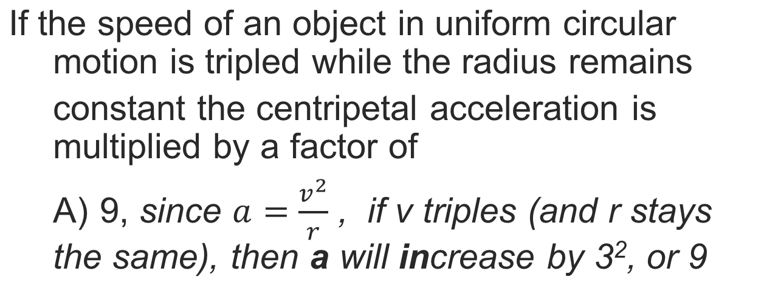
Answer 5.4

Slide 25
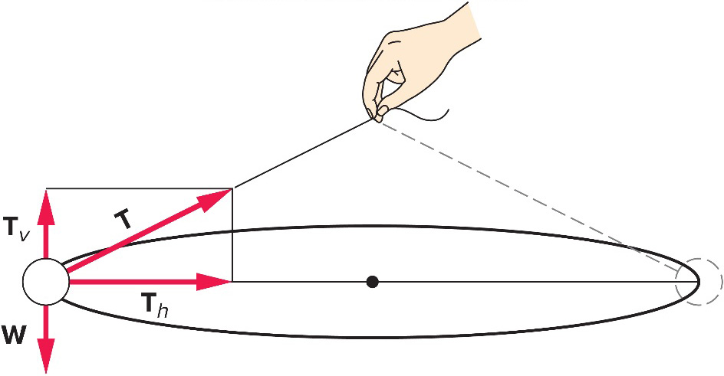
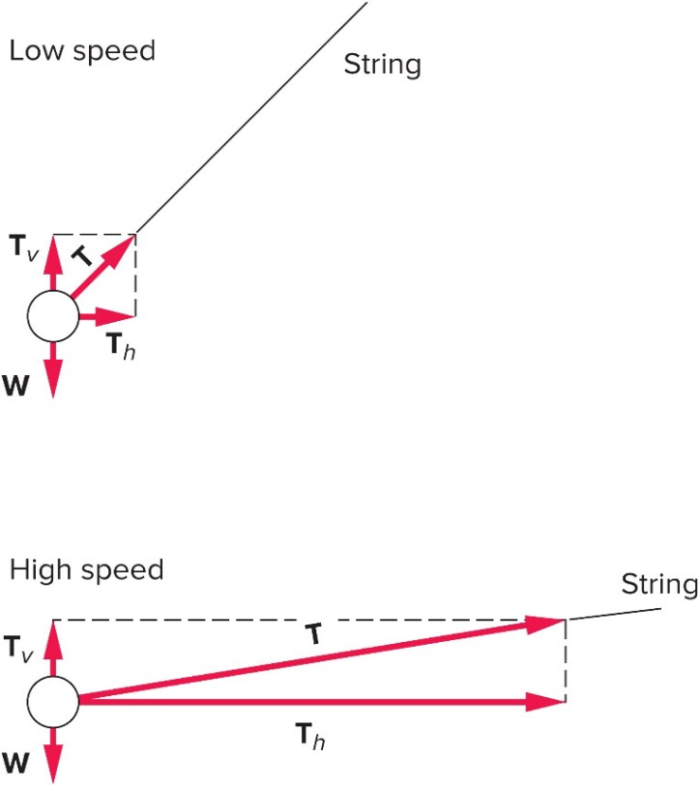
Force
The horizontal component of the tension, T, produces the centripetal acceleration.
The vertical component of T is equal to the weight of the ball.
At higher speeds, the string is closer to horizontal because a large horizontal component of T is needed to provide the required centripetal force.

Slide 26
Centripetal Forces 1
The centripetal force is the total force that produces a centripetal acceleration.
  The centripetal force may be due to one or more individual forces, such as a normal force and/or a force due to friction.
The Static force of friction is the frictional force acting when there is no motion along the surfaces.
  No skidding or sliding
The Kinetic force of friction is the frictional force acting when there is motion along the surfaces.

Slide 27
Question 5.7
As you make a right-hand turn in your car, you are pushed against the door to your left.
This is because
the centrifugal force pushed you to the left.
no force pushed you to the right.

Slide 28
Answer 5.7
As you make a right-hand turn in your car, you are pushed against the door to your left.
This is because
no force pushed you to the right.

Slide 29
Highway Curves: Banked and Unbanked
When a car goes around a curve, there must be a net force toward the center of the circle of which the curve is an arc. If the road is flat, that force is supplied by friction.
The road exerts an inward force on a car (friction against the tires) to make it move in a circle. The car exerts an inward force on the passenger.

Slide 30
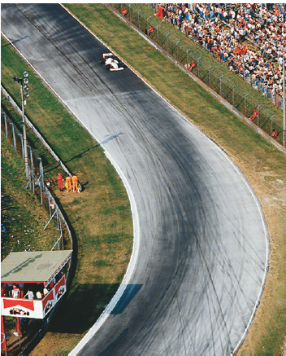
Highway Curves: Banked and Unbanked
If the frictional force is insufficient, the car will tend to move nearly in a straight line, as the skid marks show.
From the tire marks we see that most cars experienced a sufficient friction force to give them the needed centripetal acceleration for rounding the curve safely. But, we also see tire tracks of cars on which there was not sufficient force—and which unfortunately followed more nearly straight-line paths.

Slide 31
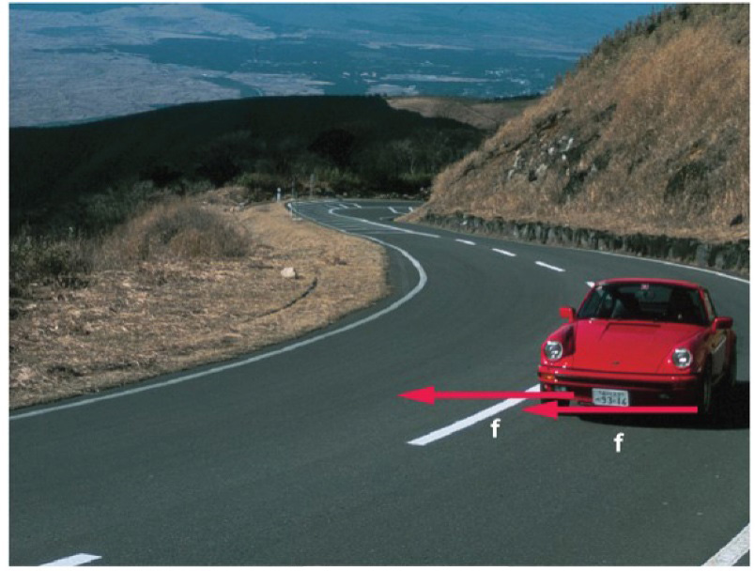
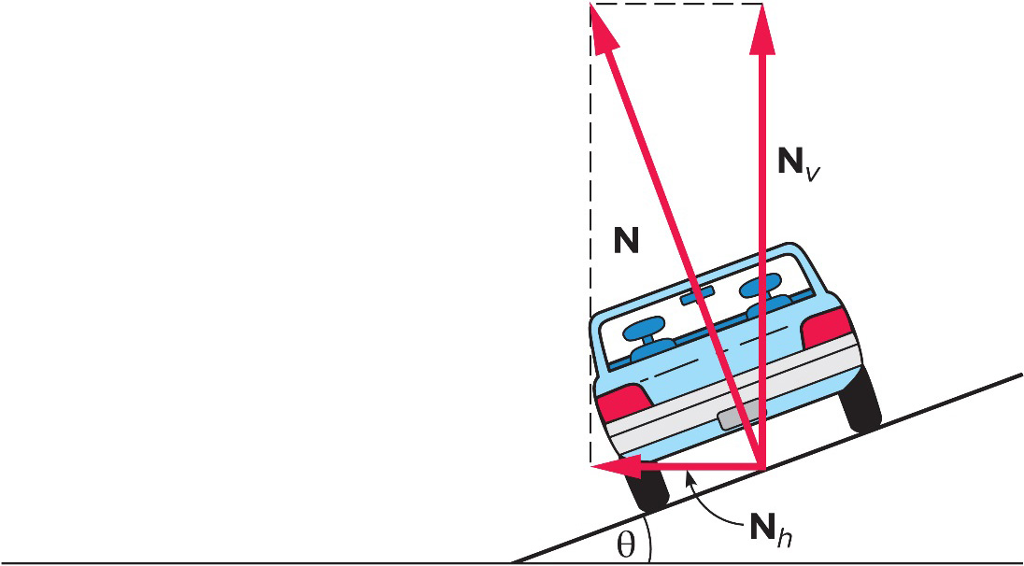
Centripetal Forces 2
The friction between the tires and road produces the centripetal acceleration on a level curve.
On a banked curve, the horizontal component of the normal force also contributes to the centripetal acceleration.
©Takeshi Takahara/Science Source

Slide 32
Planetary Motion 1
The ancient Greeks believed the sun, moon, stars and planets all revolved around the Earth.
  This is called a geocentric view (Earth-centered) of the universe.
  This view matched their observations of the sky, with the exception of the puzzling motion of the wandering planets.

Slide 33
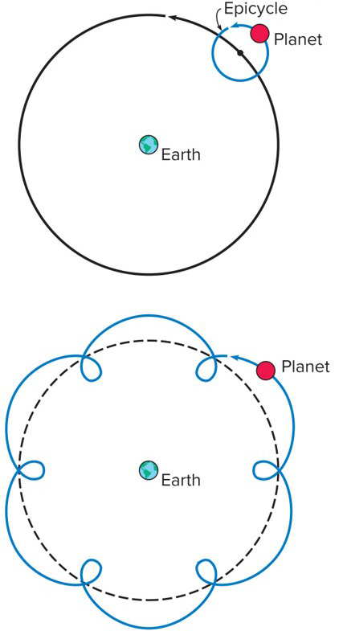
To explain the apparent retrograde motion of the planets, Ptolemy invented the idea of epicycles.
Retrograde motion occurs in a planet’s orbit when the planet appears to move against the background of stars.
Epicycles are imaginary circles the planets supposedly travel while also traveling along their main (larger) orbits around the Earth.
This would explain the occasional “backward motion” the planets seemed to follow.

Slide 34
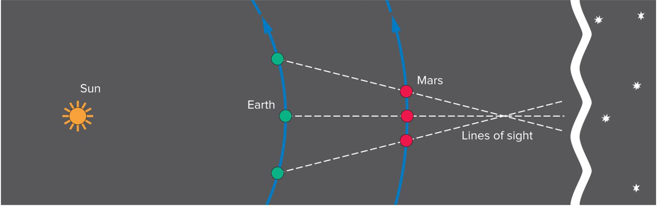
Planetary Motion 2
With the help of Copernicus, Brahe, and Kepler we now know the best explanation of retrograde motion is simply planetary alignment against an apparently motionless backdrop of stars as planets orbit the Sun.

Slide 35
Copernicus developed a model of the universe in which the planets (including Earth!) orbit the sun.
This is called a heliocentric view (sun-centered) of the universe.
Careful astronomical observations were needed to determine which view of the universe was more accurate.
Tycho Brahe spent several years painstakingly collecting data on the precise positions of the planets
  This was before the invention of the telescope!
  Note: Tycho Brahe was a Danish nobleman and Renaissance astronomer who made highly accurate observations of the stars, planets, moon, and sun. His work challenged ancient astronomical theories and inspired Kepler's theories of the solar system.

Slide 36
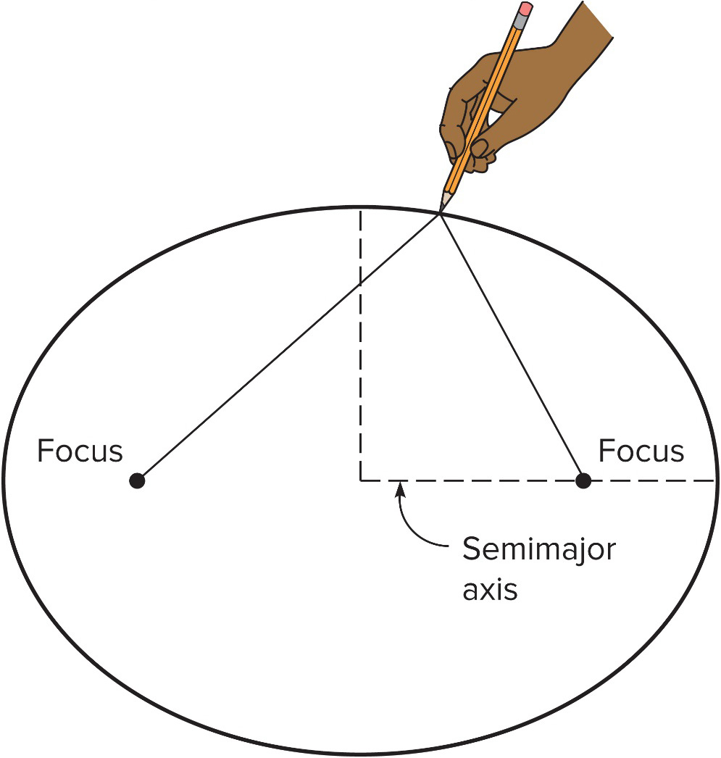
Kepler’s First Law of Planetary Motion
Tycho’s assistant, Kepler, analyzed the precise observation data.
Kepler was able to show that the orbits of the planets around the sun are ellipses, with the sun at one focus.
This is Kepler’s first law of planetary motion.

Slide 37
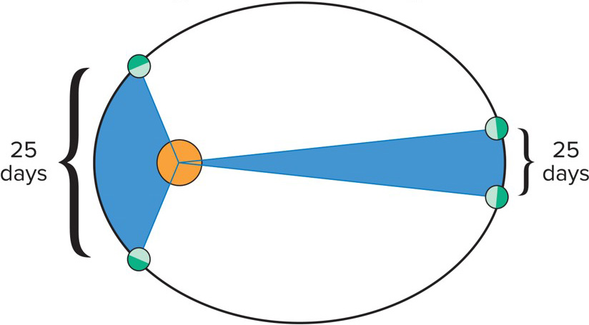
Kepler’s Second Law of Planetary Motion
Because planets move faster when nearer to the sun, the radius line for each planet sweeps out equal areas in equal times.
The two blue sections each cover the same span of time and have equal area.

Slide 38
Kepler’s Third Law of Planetary Motion
The period (T) of an orbit is the time it takes for one complete cycle around the sun.
The cube of the average radius (r) about the sun is proportional to the square of the period of the orbit.

Slide 39
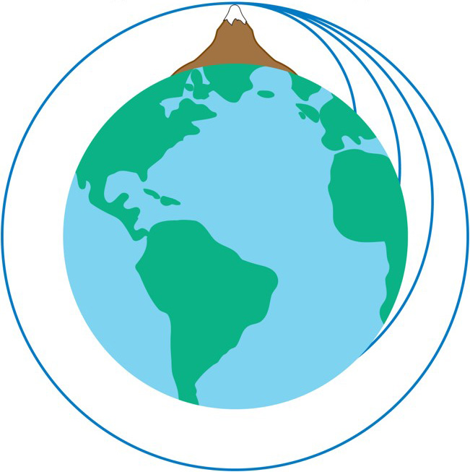
Orbital Motion
Newton recognized the similarity between the motion of a projectile on Earth and the orbit of the moon.
He imagined if a projectile was fired with enough velocity, it would fall towards Earth but never reach the surface.
This projectile would be in orbit.

Slide 40
Newton’s Law of Universal Gravitation
Newton was able to explain Kepler’s 1st and 3rd laws by assuming the gravitational force between planets and the sun falls off as the inverse square of the distance.
Newton’s law of universal gravitation says the gravitational force between two objects is proportional to the mass of each object, and inversely proportional to the square of the distance between the two objects.
G is the Universal gravitational constant G.
Let’s look at this conceptually:

Slide 41
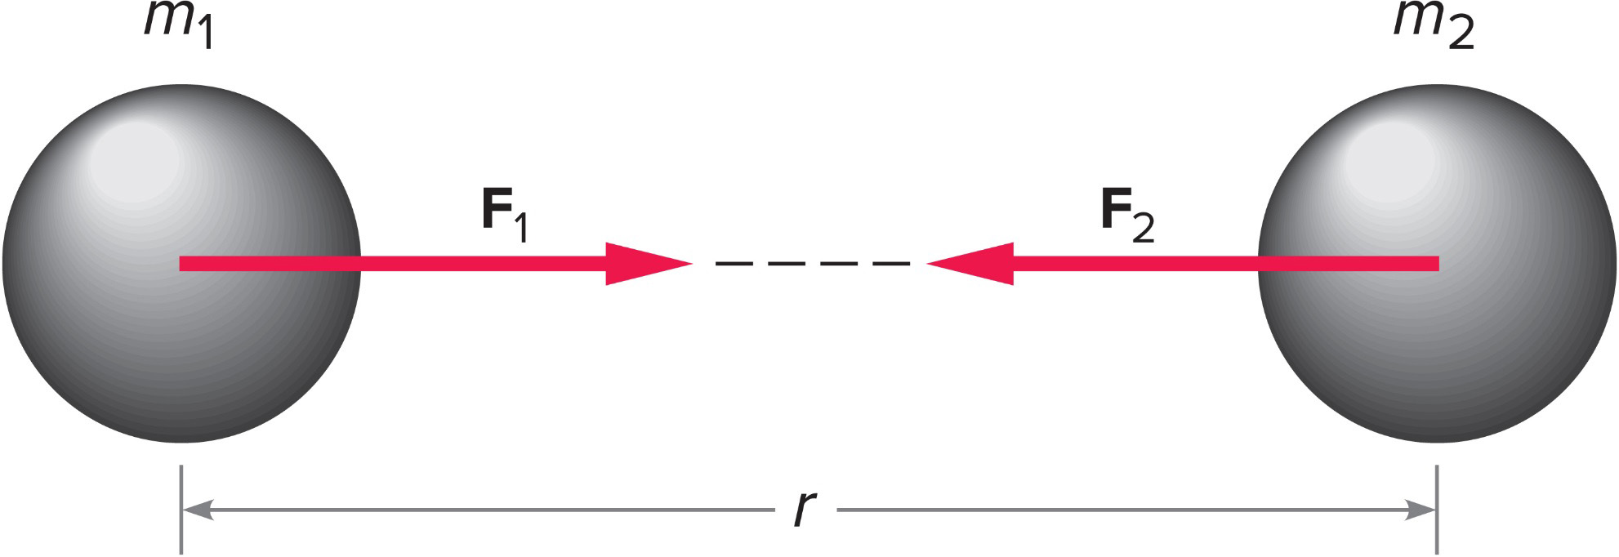
The gravitational force is attractive and acts along the line joining the center of the two masses.
It obeys Newton’s third law of motion.

Slide 42

Three equal masses are located as shown. What is the direction of the total force acting on m₂? 1
a) To the left.
b) To the right.
c) The forces cancel such that the total force is zero.
d) It is impossible to determine from the figure.

Slide 43
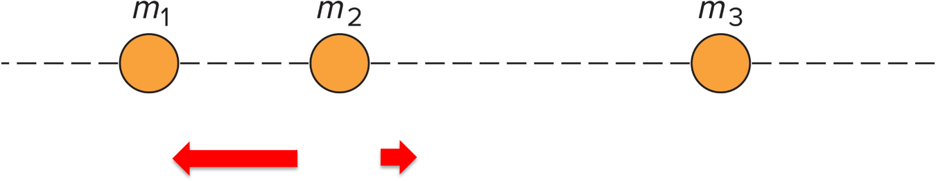
Three equal masses are located as shown. What is the direction of the total force acting on m₂? 2
a) To the left. There will be a net force acting on
toward
The third mass exerts a force of attraction to the right, but since
it is farther away that force is less than the force exerted by
to the left.

Slide 44
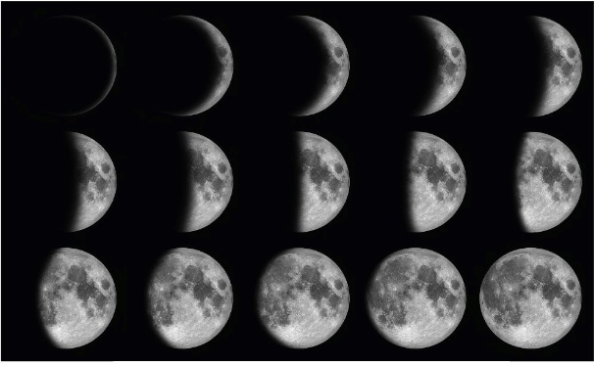
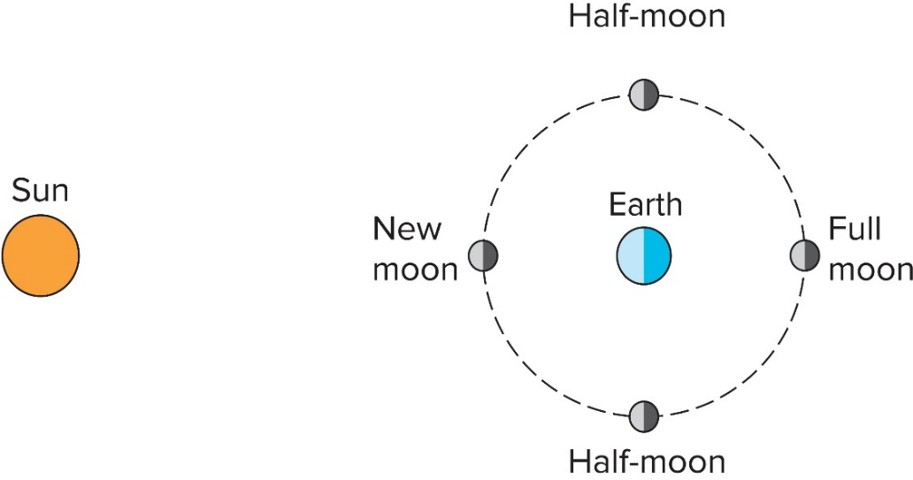
The Moon and Other Satellites
Phases of the moon result from the changes in the positions of the moon, Earth, and sun.
©somchaisom/Getty Images RF

Slide 45

An artist depicts a portion of the night sky as shown. Is this view possible? 1
a) Yes
b) No

Slide 46

An artist depicts a portion of the night sky as shown. Is this view possible? 2
a) Yes
b) No
b) No. There are no stars between the Earth and the moon. (Maybe blinking lights of a passing jet?)

Slide 47
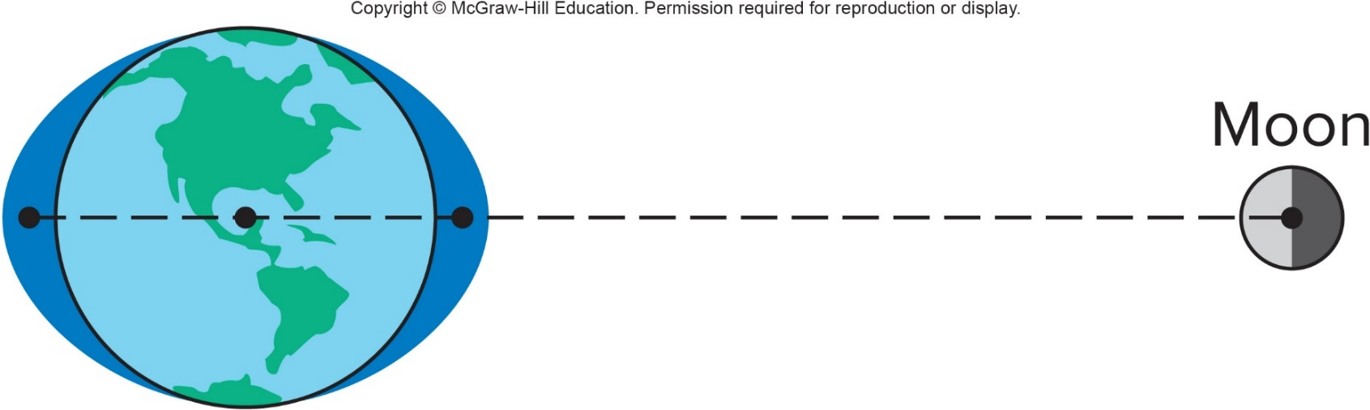
Question 5.17
Which is stronger, the earth's pull on the moon, or the moon's pull on the earth?
the earth's pull
the moon's pull
they're the same

Slide 48
Answer 5.17
Which is stronger, the earth's pull on the moon, or the moon's pull on the earth?
they're the same (Newton’s 3rd law)

