Slide 1
Chapter 4-Class2
Newton’s Laws: Explaining Motion
The Physics of Everyday Phenomena
Copyright 2022 © McGraw Hill LLC. All rights reserved. No reproduction or distribution without the prior written consent of McGraw Hill LLC.

Slide 2
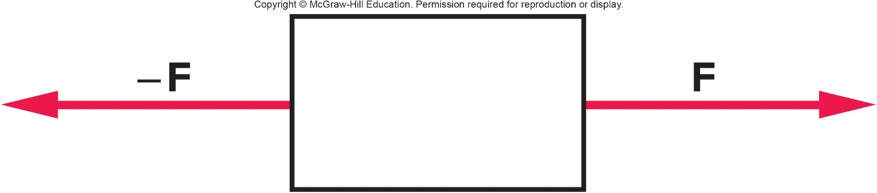
Is it possible that the box is moving, since the forces are equal in size but opposite in direction? 1
a) Yes, it is possible for the object to be moving.
b) No, it is impossible for the object to be moving.

Slide 3
Is it possible that the box is moving, since the forces are equal in size but opposite in direction? 2
a) Yes, it is possible for the object to be moving.
b) No, it is impossible for the object to be moving.
a) Yes. Even though there is no acceleration, it is possible (but not guaranteed) that the object is moving with a constant speed. (Newton’s 1st Law)

Slide 4
Question 4.1
If no force is acting on an object, the object is
at rest.
slowing down.
moving with a constant velocity.
at rest or moving with a constant velocity.

Slide 5
Answer 4.1
If no force is acting on an object, the object is
at rest or moving with a constant velocity.

Slide 6
Question 4.2
According to Newton’s 2nd Law
If the force is doubled and the mass remains the same the acceleration will halve.
If the force is doubled and the mass remains the same the acceleration will double.
If the force is doubled and the mass remains the same the acceleration will increase by a factor of 4.
If the force is doubled and the mass remains the same the acceleration will decrease by one-fourth.

Slide 7
Answer 4.2
According to Newton’s 2nd Law
If the force is doubled and the mass remains the same the acceleration will double. (a = F/m)

Slide 8
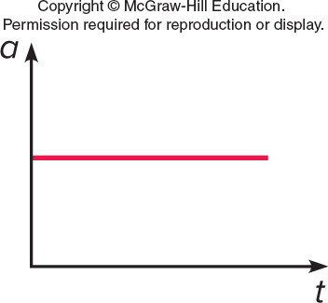
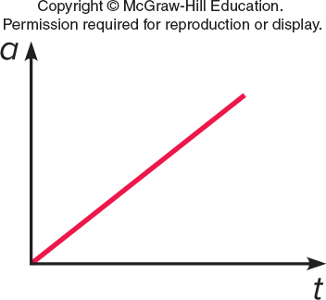
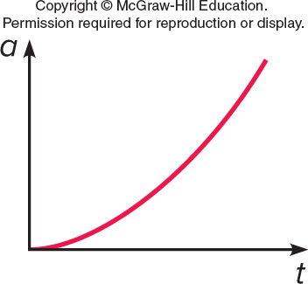
Question 4.4
A constant force is acting on an object. Which of these graphs best represents the acceleration of the object?

Slide 9
Answer 4.4
A constant force is acting on an object. Which of these graphs best represents the acceleration of the object?
Recall that a = F/m. If F is constant then a is constant.

Slide 10
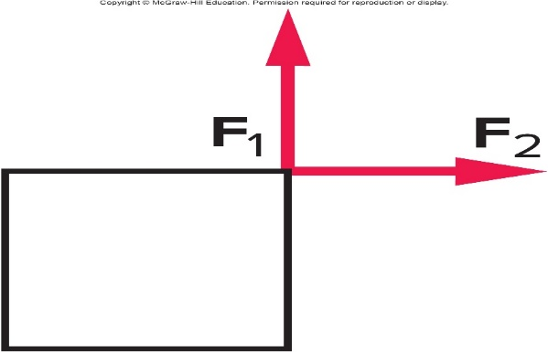
Two equal forces act on an object in the directions shown. If these are the only forces involved, will the object be accelerated? 1
a) Yes.
b) No.
c) It is impossible to determine from this figure.

Slide 11
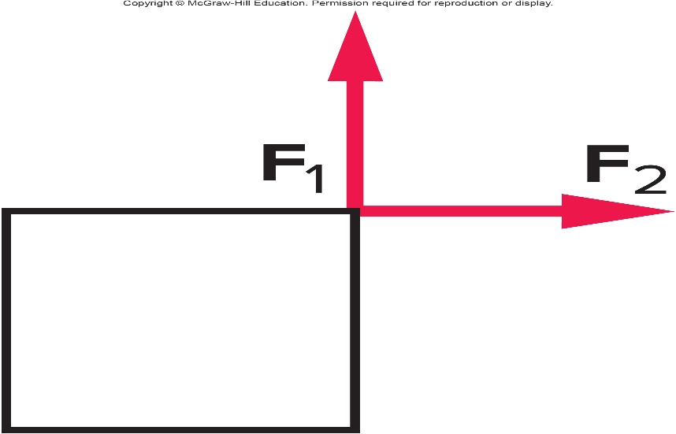
Two equal forces act on an object in the directions shown. If these are the only forces involved, will the object be accelerated? 2
a) Yes.
b) No.
c) It is impossible to determine from this figure.
a) Yes. The vector sum of the two forces results in a force directed toward the upper right corner. The object will be accelerated toward the upper right corner.

Slide 12

Two forces act in opposite directions on a box. What is the mass of the box if its acceleration is 4.0 m/s² ?
a) 5 kg
b) 7.5 kg
c) 12.5 kg
d) 80 kg
e) 120 kg

Slide 13
Two forces act in opposite directions on a box. What is the mass of the box if its acceleration is 4.0 m/s²? 1
a) 5 kg
b) 7.5 kg
c) 12.5 kg
d) 80 kg
e) 120 kg

Slide 14
Two forces act in opposite directions on a box. What is the mass of the box if its acceleration is 4.0 m/s²? 2
a) 5 kg
b) 7.5 kg
c) 12.5 kg
d) 80 kg
e) 120 kg
a) The net force is 50 N - 30 N = 20 N, directed to the right. From F=ma, the mass is given by:

Slide 15
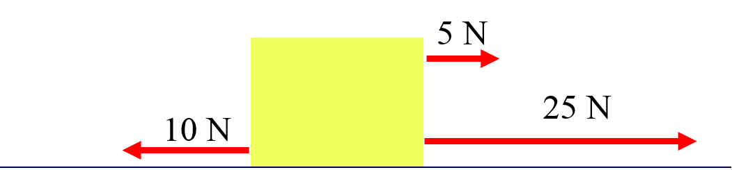
A 4-kg block is acted on by three horizontal forces. What is the net horizontal force acting on the block? 1
a) 10 N
b) 20 N
c) 25 N
d) 30 N
e) 40 N

Slide 16
A 4-kg block is acted on by three horizontal forces. What is the net horizontal force acting on the block? 2
a) 10 N
b) 20 N
c) 25 N
d) 30 N
e) 40 N
b) The net horizontal force is: 5 N + 25 N – 10 N = 20N
directed to the right.

Slide 17
A 4-kg block is acted on by the three horizontal forces shown. What is the horizontal acceleration of the block?

Slide 18
A 4-kg block is acted on by the three horizontal forces shown. What is the horizontal acceleration of the block? 2
Define your variables:
F_{net} = 20 N
m = 4 kg
a = ?
F_{net} = ma

Slide 19
A 4-kg block is acted on by the three horizontal forces shown. What is the horizontal acceleration of the block? 1
From F=ma, the acceleration is given by:
directed to the right.

Slide 20
Mass and Weight
What exactly is mass?
Is there a difference between mass and weight?
If something is weightless in space, does it still have mass?

Slide 21
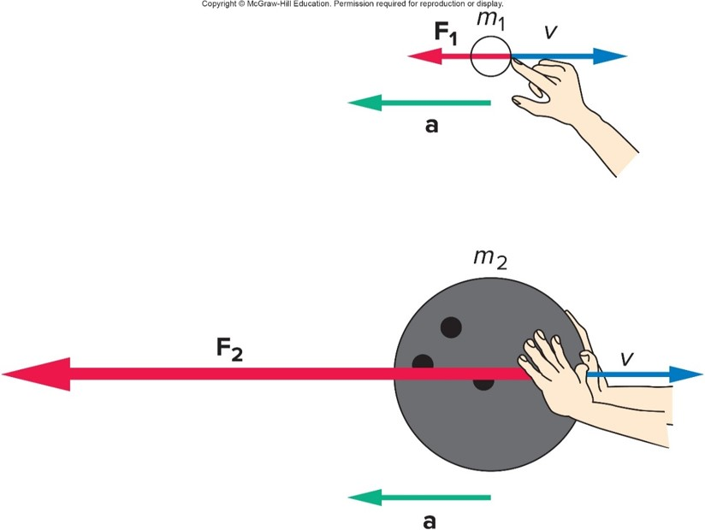
Mass, Weight, and Inertia 1
A much larger force is required to produce the same acceleration for the larger mass.
Inertia is an object’s resistance to a change in its motion.
Mass is a measure of an object’s inertia.
The unit of mass is kilograms (kg).

Slide 22
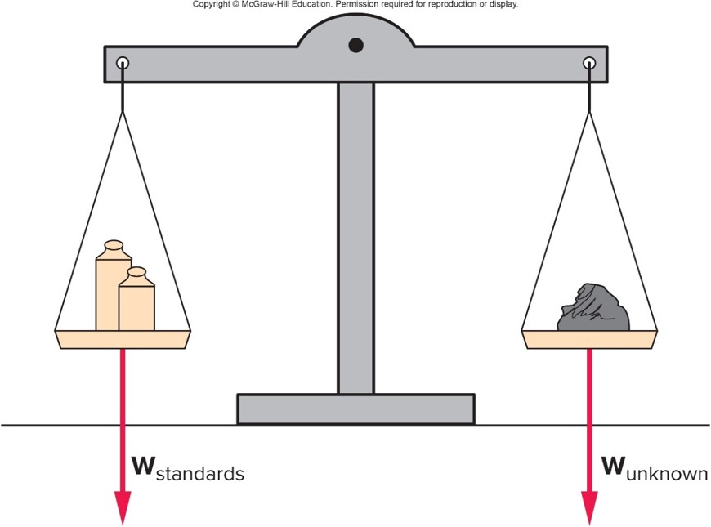
Mass, Weight, and Inertia 2
An object’s weight is the gravitational force acting on the object.
Weight is a force, measured in units of newtons (N).
In the absence of gravity, an object has no weight but still has the same mass.

Slide 23
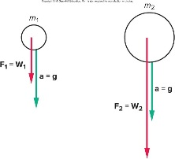
Mass, Weight, and Inertia 3
Objects of different mass experience the same gravitational acceleration on Earth:
By Newton’s 2nd Law,
F = ma, the weight is
W = mg.
Different gravitational forces (weights) act on falling objects of different masses, but the objects have the SAME acceleration.

Slide 24
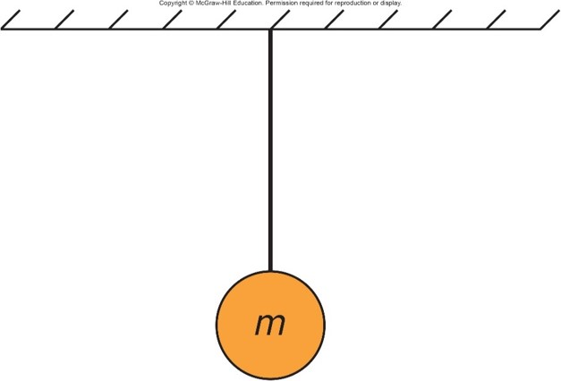
A ball hangs from a string attached to the ceiling. What is the net force acting on the ball? 1
a) The net force is downward.
b) The net force is upward.
c) The net force is zero.

Slide 25
A ball hangs from a string attached to the ceiling. What is the net force acting on the ball? 2
a) The net force is downward.
b) The net force is upward.
c) The net force is zero.
c) Zero. Since the ball is hanging from the ceiling at rest, it is not accelerating so the net force is zero. There are two forces acting on the ball: tension from the string and force due to gravitation. They cancel each other.

Slide 26
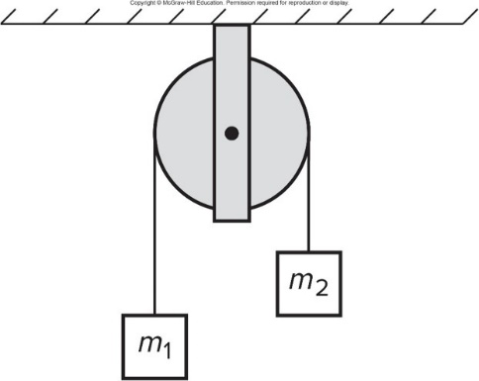
Two masses connected by a string are placed on a fixed frictionless pulley. If m₂ is larger than m₁, will the two masses accelerate? 1
a) Yes.
b) No.
c) You can’t tell from this diagram.

Slide 27
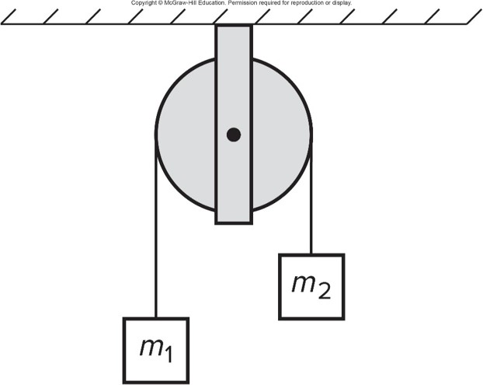
Two masses connected by a string are placed on a fixed frictionless pulley. If m₂ is larger than m₁, will the two masses accelerate? 2
a) Yes.
b) No.
c) You can’t tell from this diagram.
a) Yes. Mass m₂, being heavier, will fall and mass m₁, tied to mass m₂ with a string, will rise. Both will increase speed with time and have the same magnitude of acceleration.

Slide 28
Newton’s Third Law
Where do forces come from?
If we push on an object like a chair, does the chair also push back on us?
If objects do push back, who experiences the greater push, us or the chair?
Does our answer change if we are pushing against a wall?
How does Newton’s third law of motion help us to define force, and how is it applied?

Slide 29
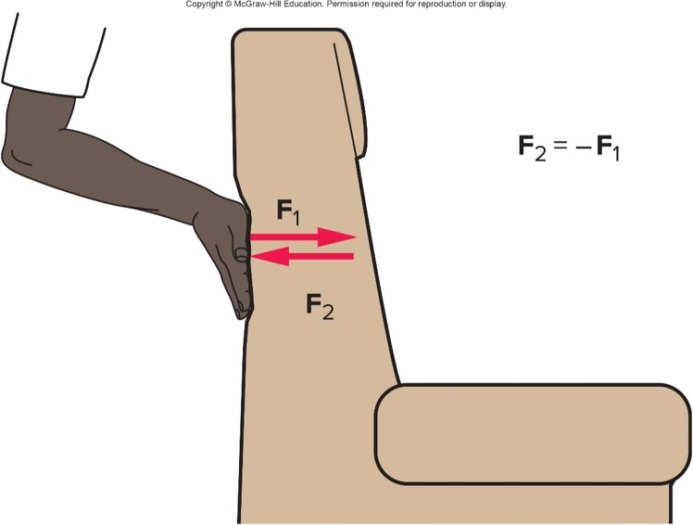
Newton’s Third Law
(“action/reaction”)
For every action (force), there is an equal but opposite reaction (force).
OR: If body A exerts a force on body B, body B exerts an equal and opposite force on body A.

Slide 30
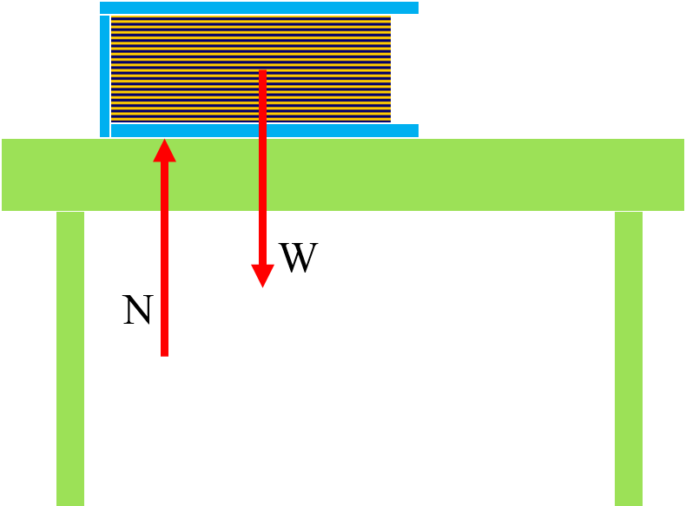
It is important to identify the forces acting ON an object (as opposed to BY an object).
The forces acting ON the book are W (gravitational force from Earth) and N (normal force from table).
Normal force refers to the perpendicular force a surface exerts on an object.

Slide 31
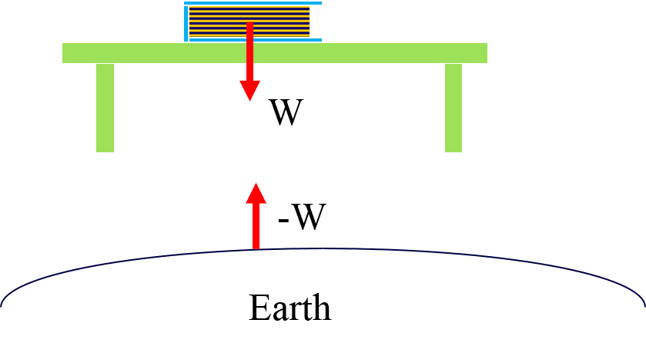
It is important to identify the forces acting on an object. It is also important to identify the action-reaction pairs. 1
The reaction force to the Earth’s attractive force W on the book, is an equal attractive force -W the book exerts on the Earth.

Slide 32
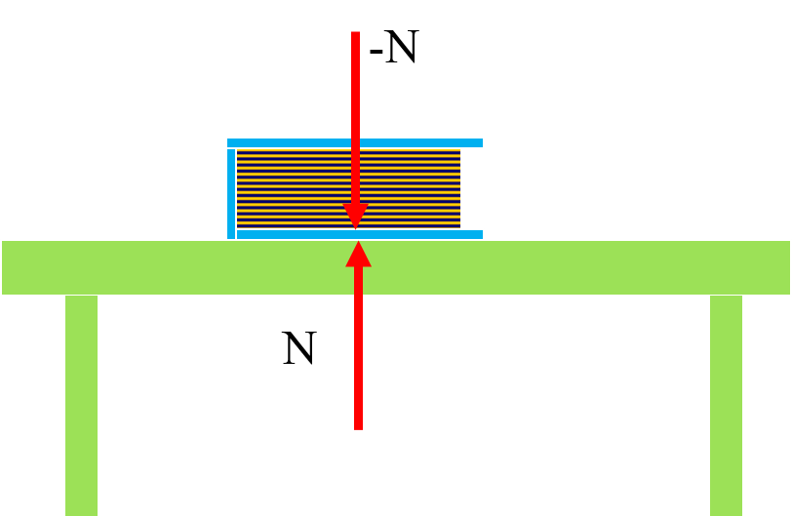
It is important to identify the forces acting on an object. It is also important to identify the action-reaction pairs. 2
The reaction force to the table’s normal force N exerted upward on the book, is an equal force -N the book exerts downward on the table.

Slide 33
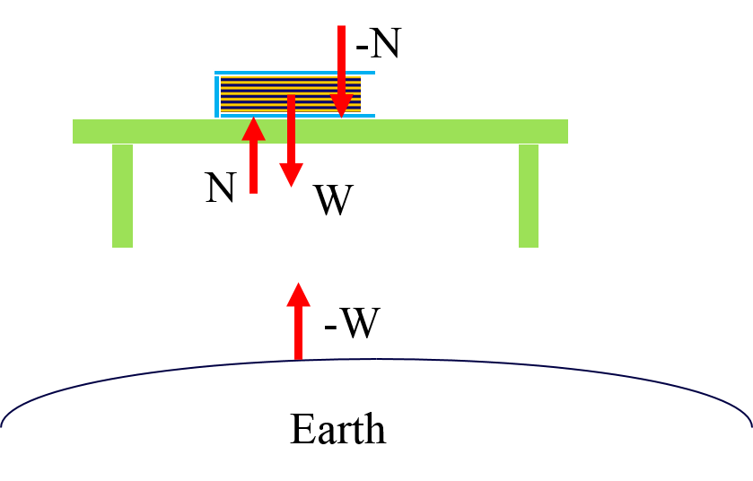
It is important to identify the forces acting on an object. It is also important to identify the action-reaction pairs. 3
Notice that the table’s normal force N exerted upward on the book and the Earth’s attractive force W on the book, are equal and opposite forces but are NOT action-reaction forces, since they act on the same object (the book).

Slide 34
It is important to identify the forces acting on an object. It is also important to identify the action-reaction pairs. 4
Action-reaction forces (or 3rd law pairs) ALWAYS act on different bodies. Think “If action force is body A acting on body B, then reaction force is body B acting on body A.”

Slide 35
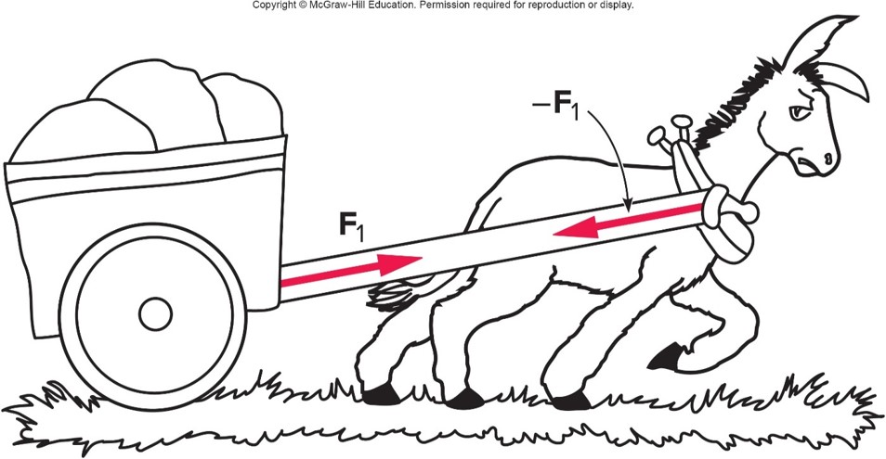
Third-Law Action/Reaction Pair 1
If the cart pulls back on the mule equal and opposite to the mule’s pull on the cart, how does the cart ever move?

Slide 36
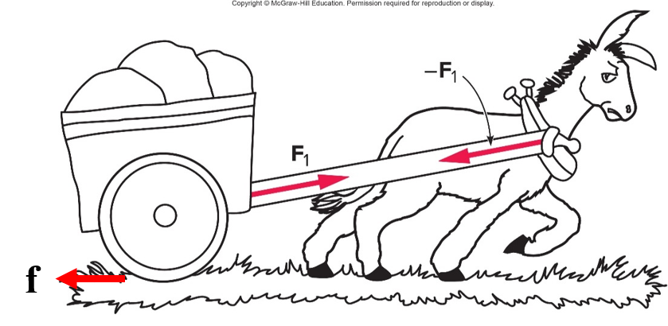
Third-Law Action/Reaction Pair 2
If the cart pulls back on the mule equal and opposite to the mule’s pull on the cart, how does the cart ever move? You need to look at the NET force ON the cart. If the force of the mule on the cart is greater than the frictional force of the ground on the cart, the cart will have a net force on it, and thus an acceleration.

Slide 37
Applications of Newton’s Laws
How can Newton’s laws be applied in different situations such as pushing a chair, sky diving, throwing a ball, and pulling two connected carts across the floor?

Slide 38
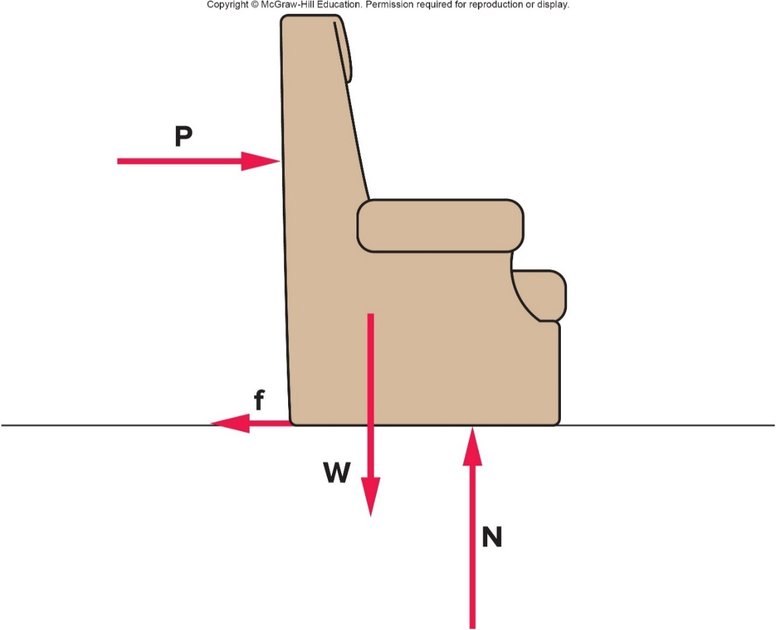
What forces are involved in moving a chair? 1
The weight W (gravitational force from Earth)
The upward force N (normal force from floor).
The push P (normal force from hand of person)
The frictional force f exerted by the floor

Slide 39
What forces are involved in moving a chair? 2
What is the NET force on the chair? Which direction is the net force?

Slide 40
What forces are involved in moving a chair? 3
What is the NET force on the chair? Which direction is the net force?
The two vertical forces cancel each other (no motion on the vertical direction)
(Note that they are NOT an action/reaction pair).
The net force is horizontal and is equal to P – f.

Slide 41
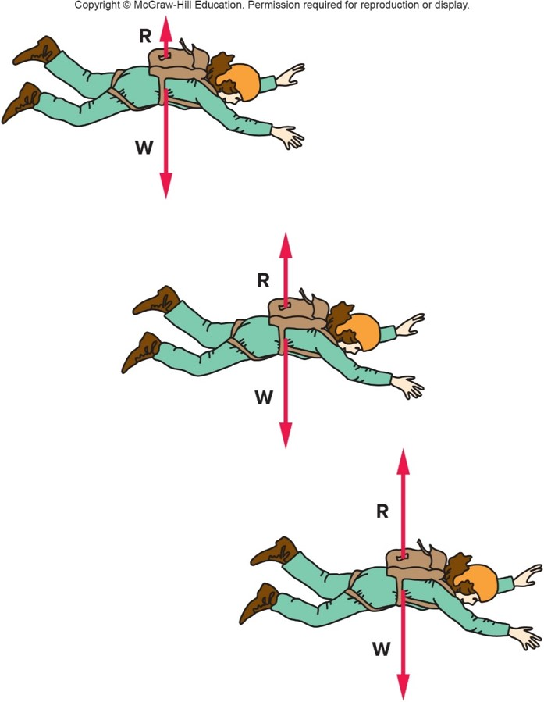
Does a sky diver continue to accelerate?
Air resistance R is a force directed upward, that opposes the gravitational force W
R increases as the sky diver’s velocity increases
When R has increased to the magnitude of W, the net force is zero so the acceleration is zero (and thus the velocity is constant)
The velocity is then at its maximum value, the terminal velocity

Slide 42
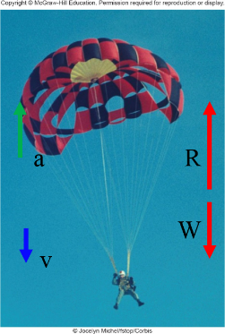
How does a sky diver slow down?
When the diver opens the parachute this increases air resistance (Since R is also proportional to surface area)
Since R is now greater than W, the net force is upward so the acceleration is upward
Since the upward acceleration is opposite in direction to the downward velocity, the skydiver slows down (but is still moving downward)
©Jocelyn Michel/fstop/Corbis

Slide 43
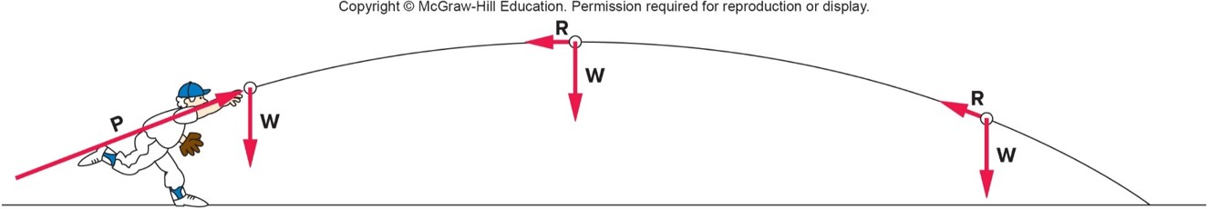
What happens when a ball is thrown?
Three forces act on a thrown ball:
The initial push P
    Only acts at the beginning; once the ball leaves the hand, P is no longer acting on the ball.
The weight W
    Is a constant (does not change) throughout the trajectory
The air resistance R
    Is always directed against the motion
    Is proportional to the speed

Slide 44
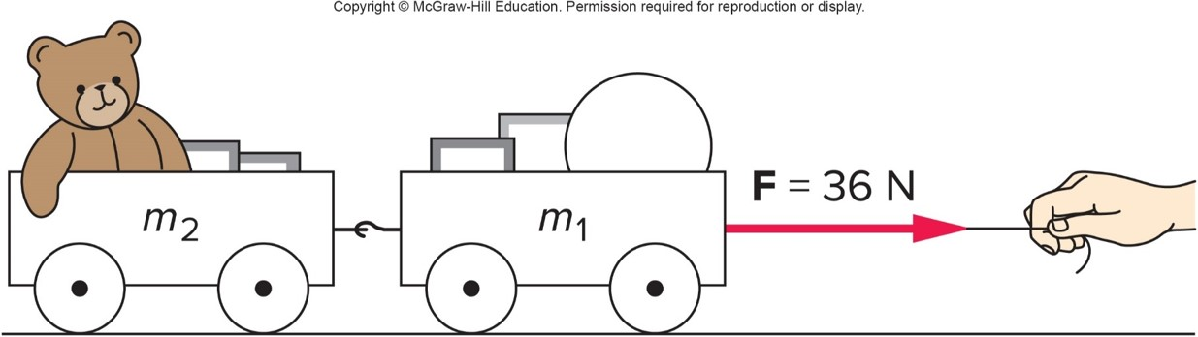
What happens when objects are connected? 1
Two connected carts being accelerated by a force F applied by a string:
  Both carts must have the same acceleration a which is equal to the net horizontal force divided by the total mass
  Each cart will have a net force equal to its mass times the acceleration

