Slide 1
Chapter 4-Class1
Newton’s Laws: Explaining Motion
The Physics of Everyday Phenomena
Copyright 2022 © McGraw Hill LLC. All rights reserved. No reproduction or distribution without the prior written consent of McGraw Hill LLC.

Slide 2
Newton’s Laws of Motion
The concepts of force, mass, and weight play critical roles.
©Boonyarak Voranimmanont/Shutterstock RF

Slide 3
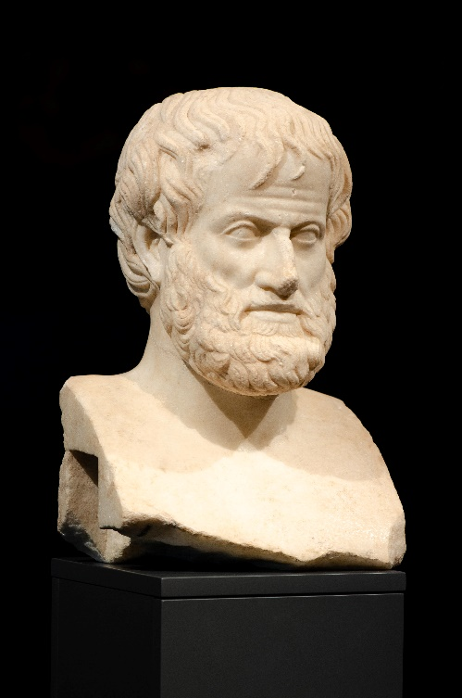
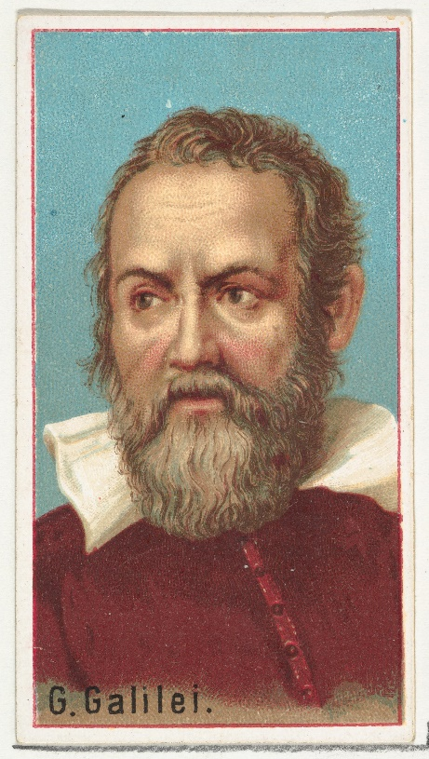
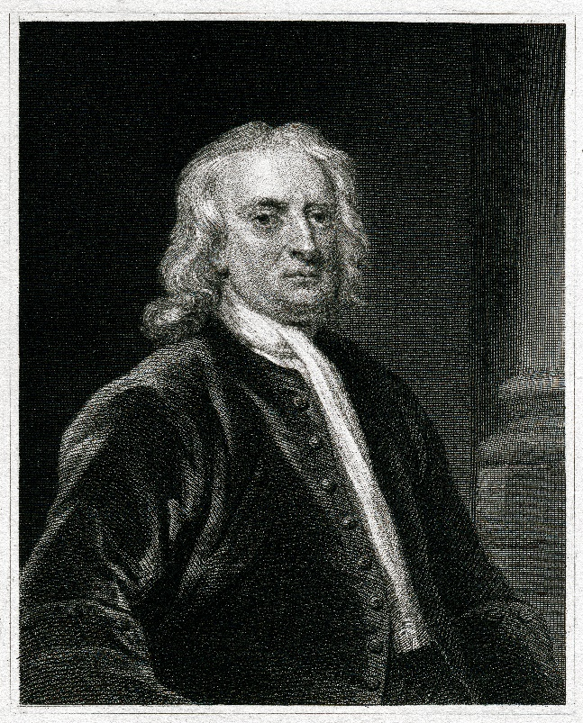
A Brief History
Where do our ideas and theories about motion come from?
What roles were played by Aristotle, Galileo, and Newton?

Slide 4
Will the chair continue to move when the person stops pushing?
How did Newton’s theory come about?
What does it tell us about motion?
Can we trust our intuition?
©Keith Eng 2008 RF

Slide 5
Aristotle’s View
A force is needed to keep an object moving.
Air rushing around a thrown object continues to push the object forward.

Slide 6
Galileo’s Contribution
Galileo challenged Aristotle’s ideas that had been widely accepted for many centuries.
He argued that the natural tendency of a moving object is to continue moving.
No force is needed to keep an object moving.
This goes against what we seem to experience.

Slide 7
Newton’s Contribution
Newton built on Galileo’s work, expanding it.
He developed a comprehensive theory of motion that replaced Aristotle’s ideas.
Newton’s theory is still widely used to explain ordinary motions.

Slide 8
Newton’s First and Second Laws
How do forces affect the motion of an object?
What exactly do we mean by force? Is there a difference between, say, force, energy, momentum, impulse?
What do Newton’s first and second laws of motion tell us, and how are they related to one another?

Slide 9
Newton’s First Law of Motion
An object remains at rest, or in uniform motion in a straight line, unless it is compelled to change by an externally imposed force.

Slide 10
Newton’s Second Law of Motion 1
The acceleration of an object is directly proportional to the magnitude of the imposed force and inversely proportional to the mass of the object.
The acceleration is the same direction as that of the imposed force.

Slide 11
Newton’s Second Law of Motion 2
Note that a force is proportional to an object’s acceleration, not its velocity.
We need some precise definitions of some commonly used terms:
This resistance to a change in motion is called inertia.
The mass of an object is a quantity that tells us how much resistance (inertia) the object has to a change in its motion.
Newton’s second law, F and a are vectors

Slide 12
Newton’s Second Law of Motion 3
It is the total force or net force that determines an object’s acceleration.
If there is more than one force acting on an object, the forces are added together as vectors, taking into account their directions.

Slide 13
Two equal-magnitude horizontal forces act on a box. Is the object accelerated horizontally? 1
a) Yes.
b) No.
c) You can’t tell from this diagram.

Slide 14
Two equal-magnitude horizontal forces act on a box. Is the object accelerated horizontally? 2
a) Yes.
b) No.
c) You can’t tell from this diagram.
b) No. Since the two forces are equal in size, and are in opposite directions, they cancel each other out and there is no acceleration.

Slide 15
Is it possible that the box is moving, since the forces are equal in size but opposite in direction? 1
a) Yes, it is possible for the object to be moving.
b) No, it is impossible for the object to be moving.

Slide 16
Is it possible that the box is moving, since the forces are equal in size but opposite in direction? 2
a) Yes, it is possible for the object to be moving.
b) No, it is impossible for the object to be moving.
a) Yes. Even though there is no acceleration, it is possible (but not guaranteed) that the object is moving with a constant speed. (Newton’s 1st Law)

