Slide 1
Chapter 3-Class2
Falling Objects and Projectile Motion
The Physics of Everyday Phenomena

Slide 2
Tracking a Falling Object 2
Starting from rest, its velocity has increased to 10 m/s after the first second; to 20 m/s after 2 s; to 30 m/s after 3 s; etc.
In the first half second, it travels 1.25 m.

Slide 3
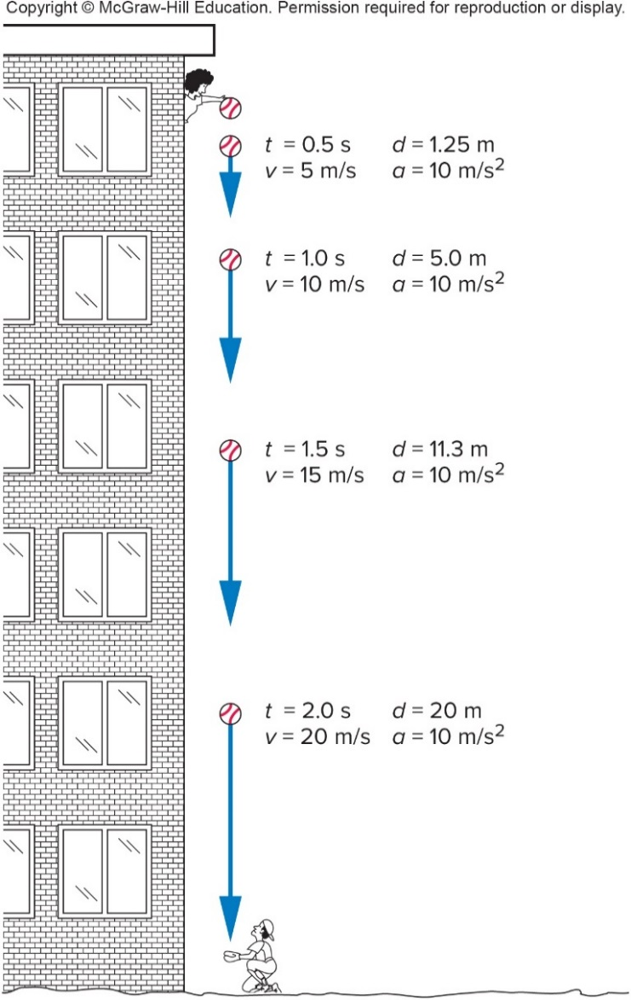
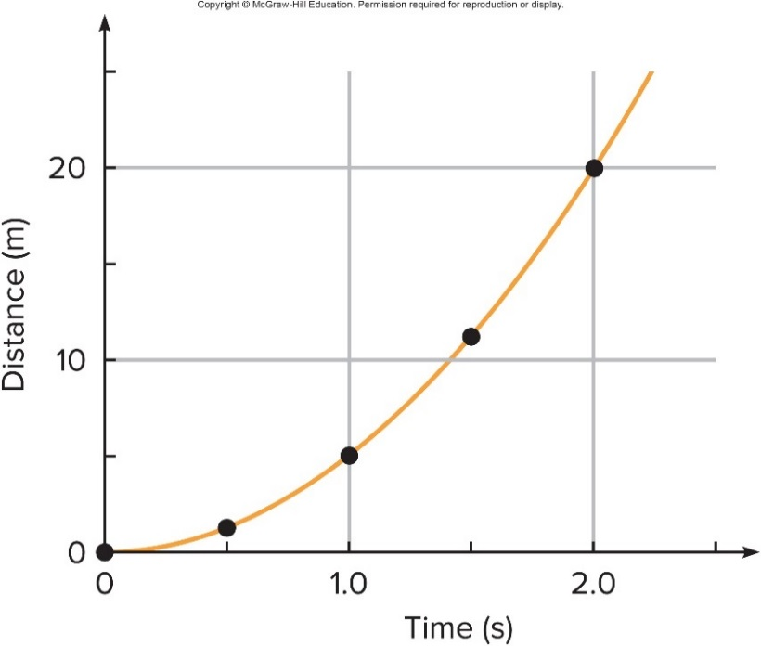
Tracking a Falling Object 3
The distance increases in proportion to the square of the time:

Slide 4
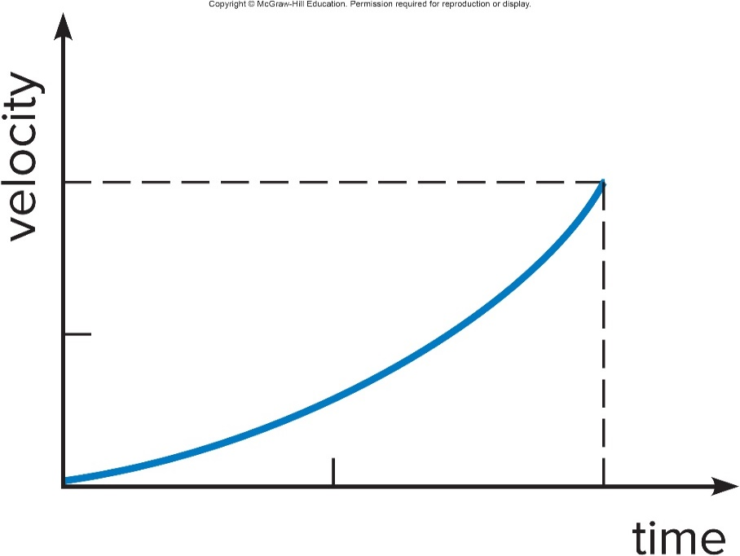
The velocity-versus-time graph for a certain falling object is shown. Is the acceleration of this object constant? 1
a) Yes.
b) No.
c) Impossible to tell from this graph.

Slide 5
The velocity-versus-time graph for a certain falling object is shown. Is the acceleration of this object constant? 2
a) Yes.
b) No.
c) Impossible to tell from this graph.
b) No. Constant acceleration would require the v vs. t curve to be a straight line. This graph is curving upward, so the slope (and the acceleration) is increasing.
5

Slide 6
Throwing a ball downward
Let the ball be thrown downward instead of being dropped.
It will have a starting velocity different from zero.
It will reach the ground more rapidly.
It will have a larger velocity when it reaches the ground.

Slide 7
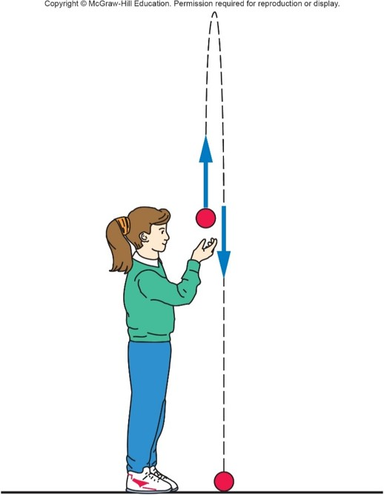
Beyond Free Fall: Throwing a Ball Upward 1
What if the ball is thrown upward?
Gravitational acceleration is always directed downward, toward the center of the Earth.
Here, the acceleration is in the opposite direction to the original upward velocity.

Slide 8
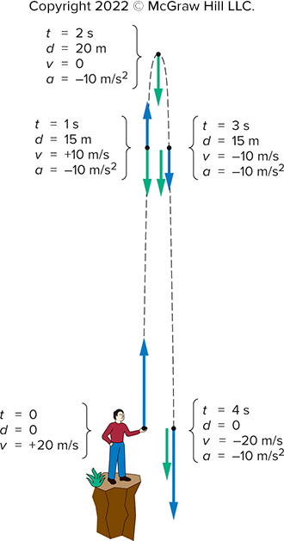
Beyond Free Fall: Throwing a Ball Upward 2
Let the initial velocity be 20 m/s upward.
It immediately starts experiencing a downward acceleration due to gravity, of approximately 10 m/s.
Every second, the velocity decreases by 10 m/s.
After 2 s, the ball has reached its highest point.
Its velocity changes direction, from upward to downward, passing through a value of 0 m/s.
Now, the constant downward acceleration increases the downward velocity.

Slide 9
What is the ball’s acceleration at the top of its path (at t = 2s)? 1
zero.

Slide 10
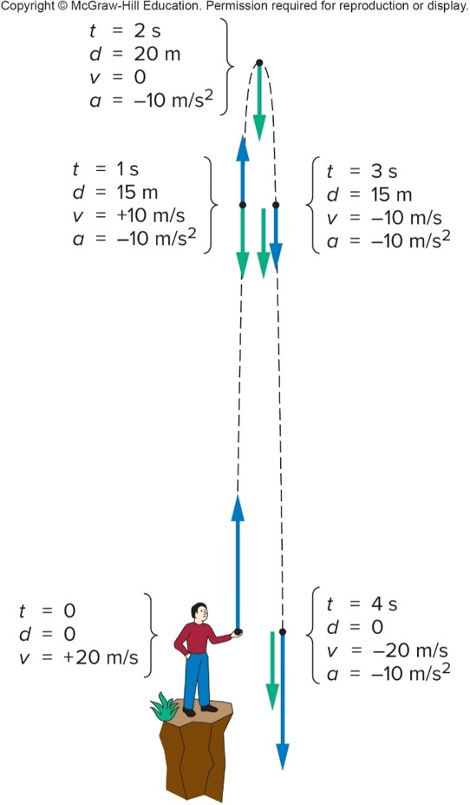
What is the ball’s acceleration at the top of its path (at t = 2s)? 2
zero.
e) Gravity does not “turn off” at the top! The ball’s velocity is still changing, as it changes from going up to going down. For a moment the velocity is zero, but the gravitational acceleration is a constant throughout the path.
Access the text alternative for slide images.

Slide 11
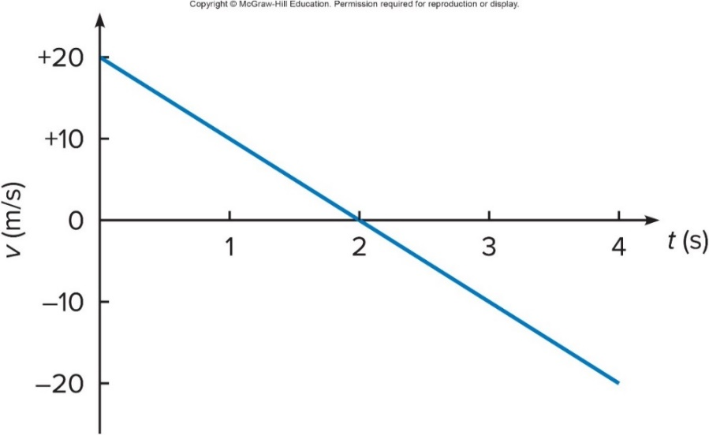
Graph of velocity vs time for a ball thrown upward
The velocity-vs-time plot starts with
(upward) at time
and changes at a steady
rate of
(decreasing
each second).
Positive velocities correspond to upward motion; negative velocities correspond to downward motion.
The slope is constant and negative (for constant downward acceleration).

Slide 12
Projectile Motion 1
The path that a moving object follows is called its trajectory.
An object thrown horizontally is accelerated downward under the influence of gravity.
Gravitational acceleration is only vertical, not horizontal.
The object’s horizontal velocity is unchanged, if we can neglect air resistance.
Projectile motion involves the trajectories and velocities of objects that have been launched, shot, or thrown.

Slide 13
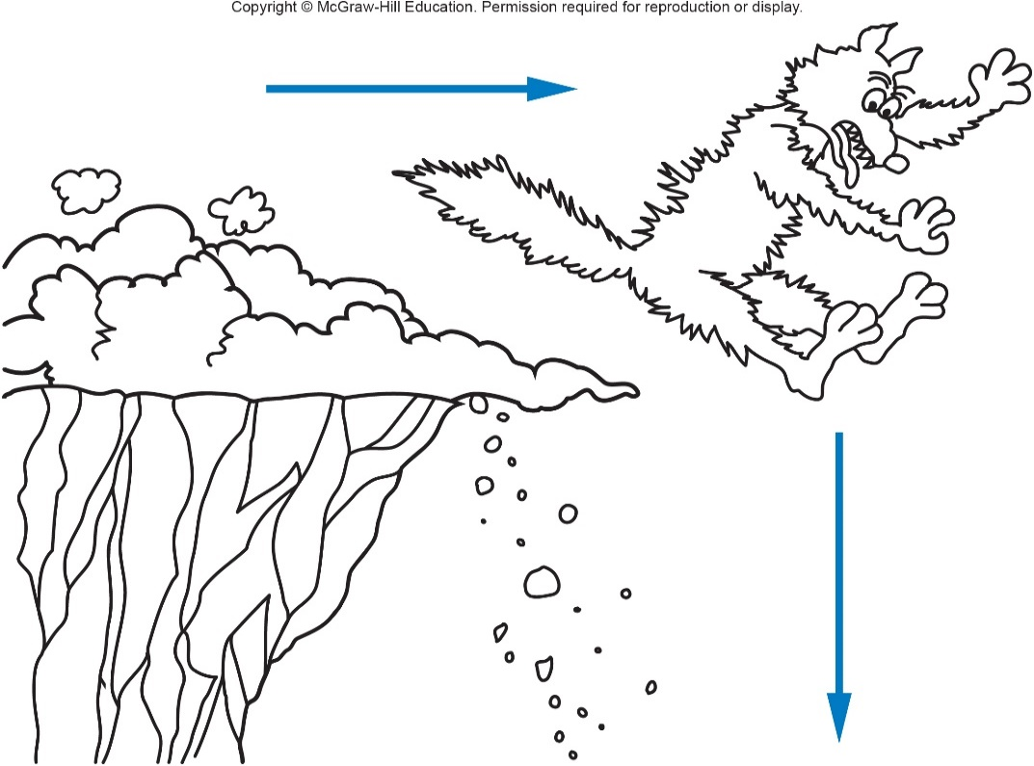
Does this represent a realistic trajectory? 1
a) Yes.
b) No.
c) Maybe.

Slide 14
Does this represent a realistic trajectory? 2
a) Yes.
b) No.
c) Maybe.
b) No. The coyote would not go straight horizontally, pause, and then fall straight down. There are many examples in movies and on television of unrealistic trajectories.
14

Slide 15
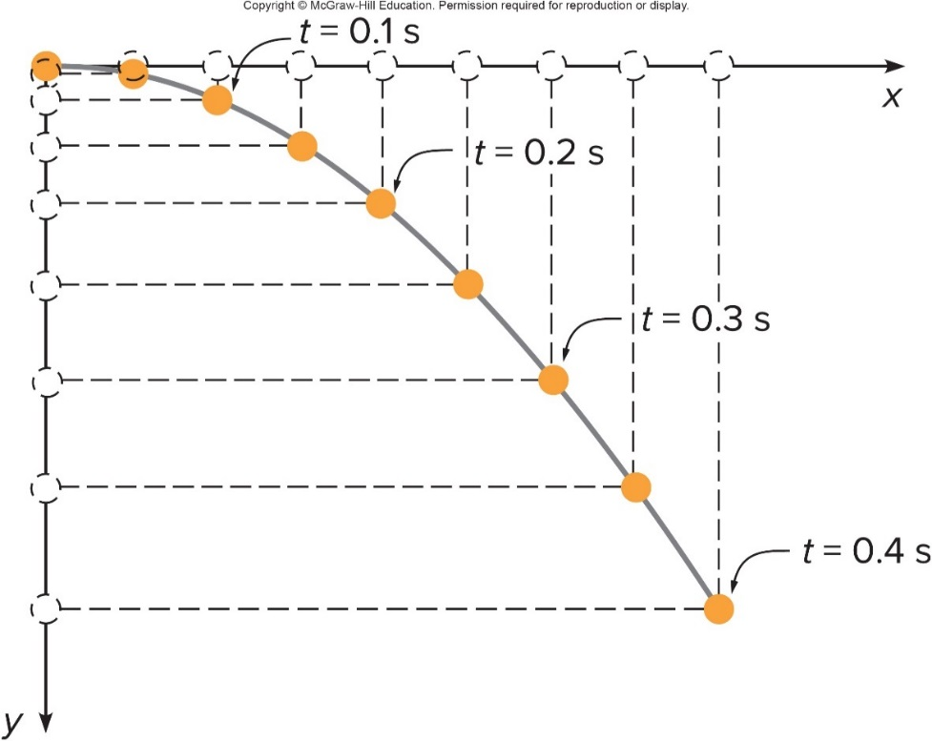
What does the trajectory look like? 1
The acceleration of the horizontal motion is zero (in the absence of air resistance).
The object moves with constant horizontal velocity.
It travels equal horizontal distances in equal time intervals.
The acceleration in the vertical direction is constant.
Its vertical velocity increases downward just like the falling ball.
In each successive time interval, it falls a greater distance than in the previous time interval.

Slide 16
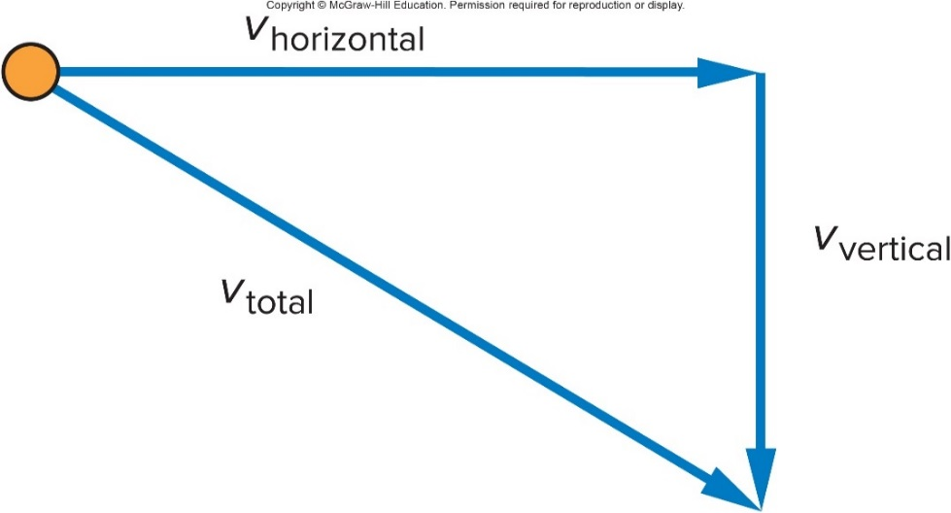
What does the trajectory look like? 2
The total velocity at any point is found by adding the vertical component of the velocity, at that point, to the horizontal component of the velocity at that point.
The horizontal velocity remains constant, because there is no acceleration in that direction.
The length of the horizontal velocity vector doesn’t change.
The downward (vertical) velocity gets larger and larger, due to the acceleration due to gravity.

Slide 17
What does the trajectory look like? 3
Trajectories for different initial velocities of a ball rolling off a table:
The largest initial velocity is
The smallest initial velocity is
The ball travels greater horizontal distances when projected with a larger initial horizontal velocity.
17

Slide 18
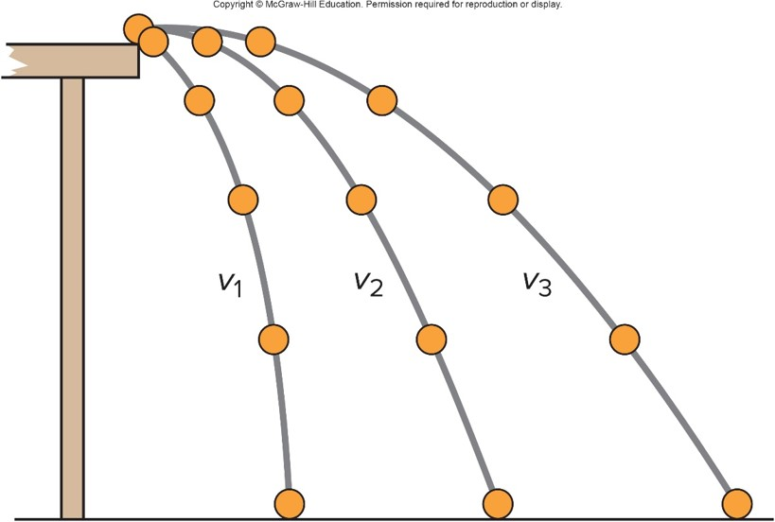
Which of these three balls would hit the floor first if all three left the tabletop at the same time? 1
a) The ball with initial velocity
b) The ball with initial velocity
c) The ball with initial velocity
d) They would all hit at the same time.
.
.
.

Slide 19
Which of these three balls would hit the floor first if all three left the tabletop at the same time? 2
.
a) The ball with initial velocity
b) The ball with initial velocity
c) The ball with initial velocity
d) They would all hit at the same time.
d) Since all three balls undergo the same downward acceleration, and they all start with a vertical velocity of zero, they would all fall the same distance in the same time!
.
.

Slide 20
Question 3.4
When throwing a ball straight up, which of the following is true about its velocity and acceleration at the highest point in its path?
both v = 0 and a = 0
v ≠ 0, a = 0
v = 0, a ≠ 0
v ≠ 0, a ≠ 0
not really sure

Slide 21
Answer 3.4
When throwing a ball straight up, which of the following is true about its velocity and acceleration at the highest point in its path?
v = 0, a ≠ 0, you can’t turn off gravity!

Slide 22
Question 3.6
Alec and Michelle release their snowballs from the same height, at the same time and with the same speed. Alec's is thrown upward while Michelle’s is thrown downward. Which one hits the ground with the greatest speed (ignore air resistance)?
the one thrown upward
the one thrown downward
they hit with the same speed
it depends on the initial height

Slide 23
Answer 3.6
Alec and Michelle release their snowballs from the same height, at the same time and with the same speed. Alec's is thrown upward while Michelle’s is thrown downward. Which one hits the ground with the greatest speed (ignore air resistance)?
they hit with the same speed
Alec’s snowball will slow down on its way upward, but speed up enough on the way down so that when it reaches the point of release, it will have the same speed as it had initially.

Slide 24
Projectile Motion 2
Treating the vertical motion independently of the horizontal motion, and then combining them to find the trajectory, is the secret.
A horizontal glide combines with a vertical plunge to produce a graceful curve.
The downward gravitational acceleration behaves the same as for any falling object.
There is no acceleration in the horizontal direction if air resistance can be ignored.
The projectile moves with constant horizontal velocity while it is accelerating downward.

Slide 25
Hitting a Target
The trajectory depends on the initial velocity.
The trajectory depends on the launch angle.

Slide 26
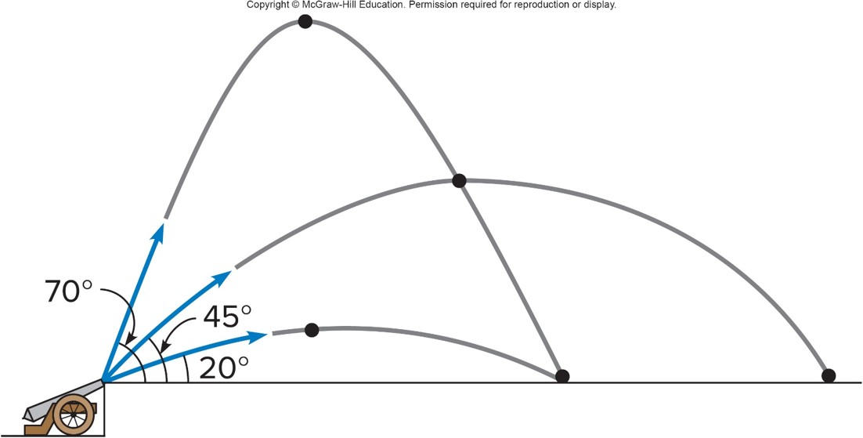
Hitting a Target
The greatest distance is achieved using an angle close to
if the effects of air resistance are negligible.

Slide 27
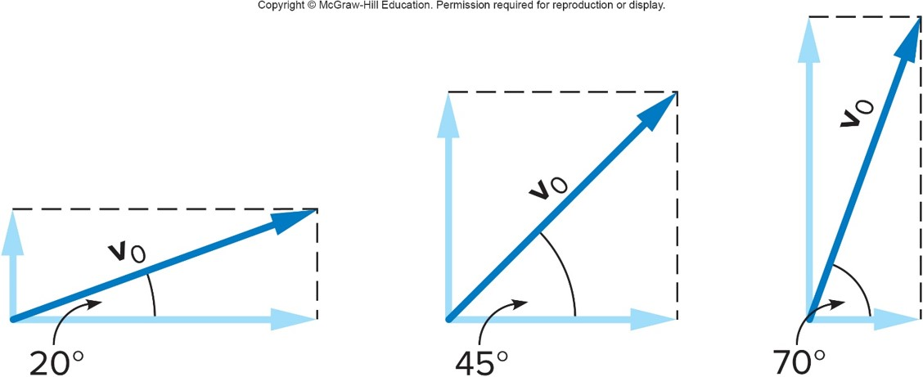
Hitting a Target
For the lowest angle, the horizontal velocity is much greater than the initial vertical velocity.
The ball does not go very high, so its time of flight is short.

Slide 28
Hitting a Target
For the highest angle, the initial vertical velocity is much greater than the horizontal velocity.
The ball goes higher, so its time of flight is longer, but it does not travel very far horizontally.

Slide 29
Hitting a Target
The intermediate angle of
divides the initial velocity
equally between the vertical and the horizontal.
The ball stays in the air longer than at low angles, but also travels with a greater horizontal velocity than at high angles.

Slide 30
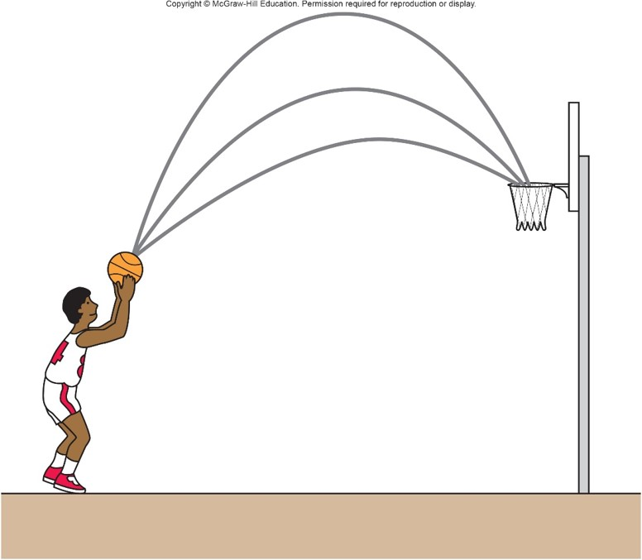
Which free-throw trajectory has the greatest chance of success? 1
a) upper.
b) middle.
c) lower.

Slide 31
Which free-throw trajectory has the greatest chance of success? 2
a) upper.
b) middle.
c) lower.
a) The upper path is more likely to go thru if the ball player has the same control for either path. What factors determine the best trajectory? Are these factors different for different situations?

Slide 32
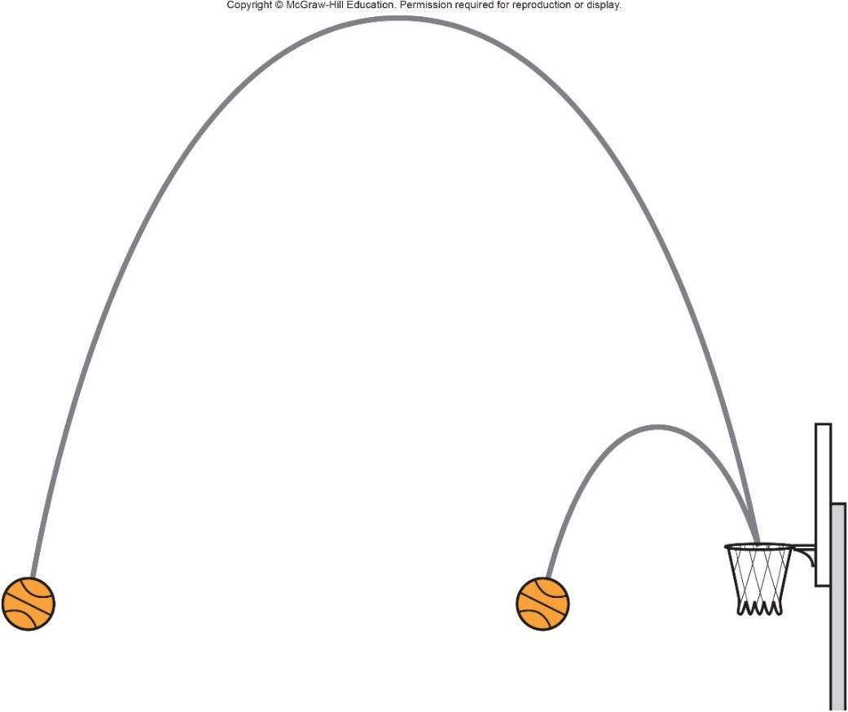
An arched shot from farther away stays in the air longer than an arched shot from closer to the basket.
Away from the basket, flatter trajectories allow more accurate control.
A highly arched shot is more effective when you are close the basket.
Spin of the basketball, height of release, and other factors also play a role.

Slide 33
Question 3.10
Alyssa throws a snowball horizontally from the top of a roof; Ryan throws a snowball straight down from the same point. Once in flight, the acceleration of Alyssa’s snowball is _____ the acceleration of Ryan’s snowball.
greater than
less than
equal to

Slide 34
Answer 3.10
Alyssa throws a snowball horizontally from the top of a roof; Ryan throws a snowball straight down from the same point. Once in flight, the acceleration of Alyssa’s snowball is _____ the acceleration of Ryan’s snowball.
C. equal to
Both have an acceleration due to gravity, and that is a constant.

Slide 35
Question 3.12
Projectile motion is characterized by
constant velocity in the x direction and constant acceleration in the y direction
constant acceleration in both the x and y directions
constant velocity in both the x and y directions
constant acceleration in the x direction and constant velocity in the y direction

Slide 36
Answer 3.12
Projectile motion is characterized by
constant velocity in the x direction and constant acceleration in the y direction

