Slide 1
Chapter 2
Describing Motion
Exam 1 study guide problems posted
The Physics of Everyday Phenomena
Copyright 2022 © McGraw Hill LLC. All rights reserved. No reproduction or distribution without the prior written consent of McGraw Hill LLC.

Slide 2
Newton’s Theory of Motion
To see well, we must stand on the shoulders of giants.
©Pixtal/age Fotostock RF

Slide 3
First Things First
Before we can accurately describe motion, we must provide clear definitions of our terms.
The meanings of some terms as used in physics are different from the meanings in everyday use.
Precise and specialized meanings make the terms more useful in describing motion.

Slide 4
Why do we need clear, precise definitions?
What’s the difference between:
average speed and instantaneous speed?
speed and velocity?
speed and acceleration?

Slide 5
Speed
Speed is how fast an object changes its location.
Speed is always some distance divided by some time.
The units of speed may be miles per hour, or meters per second, or kilometers per hour, or inches per minute, etc.
Average speed is total distance divided by total time.

Slide 6
Unit Conversion 1
Convert 70 kilometers per hour to miles per hour:
1 km = 0.6214 miles
1 mile = 1.609 km
It is easier to multiply by 0.6214 than divide by 1.609… either will work on a calculator equally well.

Slide 7
Unit Conversion 2
Convert 70 kilometers per hour to meters per second:
1 km = 1000 m
1 hour = 60 min
1 min = 60 sec

Slide 8
Problem 1
A car travels with an average speed of 55 miles/hr. What is this speed in
km/hr?
km/s?
m/s?

Slide 9
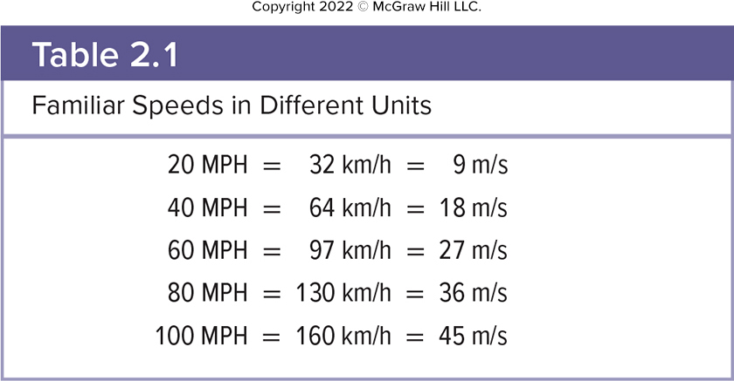
Table 2.1

Slide 10
Average Speed 1
Kingman to Flagstaff:
120 mi ÷ 2.4 hr = 50.0 mph
Flagstaff to Phoenix:
140 mi ÷ 2.6 hr = 53.8 mph
Total trip:
120 mi + 140 mi = 260 mi
2.4 hr + 2.6 hr = 5.0 hr
260 mi ÷ 5.0 hr = 52.0 mph

Slide 11
Average Speed 2
Kingman to Flagstaff:
120 mi ÷ 2.4 hr = 50.0 mph
Flagstaff to Phoenix:
140 mi ÷ 2.6 hr = 53.8 mph
Note: the average speed for the whole trip (52.0 mph) is not the average of the two speeds (51.9 mph). Why?

Slide 12
Average Speed 3
Rate is one quantity divided by another quantity.
For example: gallons per minute, pesos per dollar, points per game.
So average speed is the rate at which distance is covered over time.
Instantaneous speed is the speed at that precise instant in time.
It is the rate at which distance is being covered at a given instant in time.
It is found by calculating the average speed, over a short enough time that the speed does not change much.

Slide 13
What does a car’s speedometer measure? 1
a) Average speed
b) Instantaneous speed
c) Average velocity
d) Instantaneous velocity

Slide 14
What does a car’s speedometer measure? 2
a) Average speed
b) Instantaneous speed
c) Average velocity
d) Instantaneous velocity
b) A speedometer measures instantaneous speed.
(In a moment, we’ll discuss why a speedometer doesn’t measure velocity.)

Slide 15
Instantaneous Speed
The speedometer tells us how fast we are going at a given instant in time.

Slide 16
Which quantity is the highway patrol more interested in? 1
a) Average speed
b) Instantaneous speed

Slide 17
Which quantity is the highway patrol more interested in? 2
a) Average speed
b) Instantaneous speed
b) The speed limit indicates the maximum legal instantaneous speed.
In some cases, the highway patrol uses an average speed to prosecute for speeding. If your average speed ever exceeds the posted limit they can be 100% certain your instantaneous speed was over the posted limit.

Slide 18
Velocity
Velocity involves direction of motion as well as how fast the object is going.
Velocity is a vector quantity.
Vectors have both magnitude and direction.
Velocity has a magnitude (the speed) and also a direction (which way the object is moving).
A change in velocity can be a change in the object’s speed OR direction of motion OR both.
A speedometer doesn’t indicate direction, so it indicates instantaneous speed but not velocity.

Slide 19
A car goes around a curve at constant speed. Is the car’s velocity changing? 1
a) Yes
b) No

Slide 20
A car goes around a curve at constant speed. Is the car’s velocity changing? 2
a) YES. At position A, the car has the velocity indicated by the arrow (vector)
At position B, the car has the velocity indicated by the arrow(vector)
with the same magnitude (speed) but a different direction.

Slide 21
Changing Velocity
A force is required to produce a change in either the magnitude (speed) or direction of velocity.
For the car to round the curve, friction between the wheels and the road exerts a force to change the car’s direction.
For a ball bouncing from a wall, the wall exerts a force on the ball, causing the ball to change direction.

Slide 22
Instantaneous Velocity
Instantaneous velocity is a vector quantity having:
a size (magnitude) equal to the instantaneous speed at a given instant in time, and
a direction equal to the direction of motion at that instant.

Slide 23
Problem 2
A person covers a distance of 320 miles in a travel time of 8 hours. What is the speed for this trip?

Slide 24
Question 2.2
What is the difference between velocity and speed?
There is no difference, they are both vectors.
Speed is a scalar and velocity is a vector.
Speed is a vector and velocity is a scalar.
There is no difference, they are both scalars.

Slide 25
Answer 2.2
What is the difference between velocity and speed?
Speed is a scalar and velocity is a vector.

Slide 26
Example 2
Mary walks 4 meters East, 2 meters South, 4 meters West, and finally 2 meters North. The entire motion lasted for 24 seconds. Determine the average speed and the average velocity.

Slide 27
Mary walked a distance of 12 meters in 24 seconds; thus, her average speed was 0.50 m/s.
However, since her change of position is 0 meters, her average velocity is 0 m/s.
Average velocity is the rate a which position change.
. In this case of the Mary’s motion, there is a position change of 0 meters and thus an average velocity of 0 m/s.

Slide 28
Acceleration 1
Acceleration is the rate at which velocity changes.
Our bodies don’t feel velocity, if the velocity is constant.
Our bodies feel acceleration.
A car changing speed or direction.
An elevator speeding up or slowing down.
Acceleration can be either a change in the object’s speed or direction of motion.

Slide 29
Acceleration 2
It isn’t the fall that hurts; it’s the sudden stop at the end!

Slide 30
Acceleration 3
Acceleration is also a vector quantity, with magnitude and direction.
The direction of the acceleration vector is that of the change in velocity,
Acceleration refers to any change in velocity.
In Physics we even refer to a decrease in velocity (a slowing down) as an acceleration.

Slide 31
Acceleration 4
The direction of the acceleration vector is that of the change in velocity,
If velocity is increasing, the acceleration is in the same direction as the velocity.

Slide 32
Acceleration 5
The direction of the acceleration vector is that of the change in velocity,
If velocity is decreasing, the acceleration is in the opposite direction as the velocity.

Slide 33
Acceleration 6
The direction of the acceleration vector is that of the change in velocity,
If speed is constant but velocity direction is changing, the acceleration is at right angles to the velocity.

Slide 34
Average Acceleration 1
Average acceleration is the change in velocity divided by the time required to produce that change.
The units of velocity are units of distance divided by units of time.
The units of acceleration are units of velocity divided by units of time.
So, the units of acceleration are units of distance divided by time (e.g m/s) divided by units of
time (e.g. s):

Slide 35
Average Acceleration 2
A car starting from rest, accelerates to a velocity of 20 m/s due east in a time of 5 s.

Slide 36
Instantaneous Acceleration
Instantaneous acceleration is the acceleration at that precise instant in time.
It is the rate at which velocity is changing at a given instant in time.
It is found by calculating the average speed, over a short enough time that the speed does not change much, and then dividing by that short period of time.

Slide 37
Graphing Motion
To describe the car’s motion, we could note the car’s position every 5 seconds.
Time | Position
0 s | 0.0 cm
5 s | 4.1 cm
10 s | 7.9 cm
15 s | 12.1 cm
20 s | 16.0 cm
25 s | 16.0 cm
30 s | 16.0 cm
35 s | 18.0 cm
Table divided into 2 columns summarizes position of the toy car along the meter stick at different times. The column headers are marked from left to right as: Time and position.

Slide 38
To graph the data in the table, let the horizontal axis represent time, and the vertical axis represent distance.
Each interval on an axis represents a fixed quantity of distance or time.
The first data point is at 0 seconds and 0 cm.
The second data point is at 5 seconds and 4.1 cm. Etc.

