Slide 1
Chapter 10
Your study guide will include problems from all 3 study guides, I will add few problems on this last chapter.
You final exam is on Wednesday, April 30 at 11:30 am in this room
Temperature and Heat
The Physics of Everyday Phenomena

Slide 2
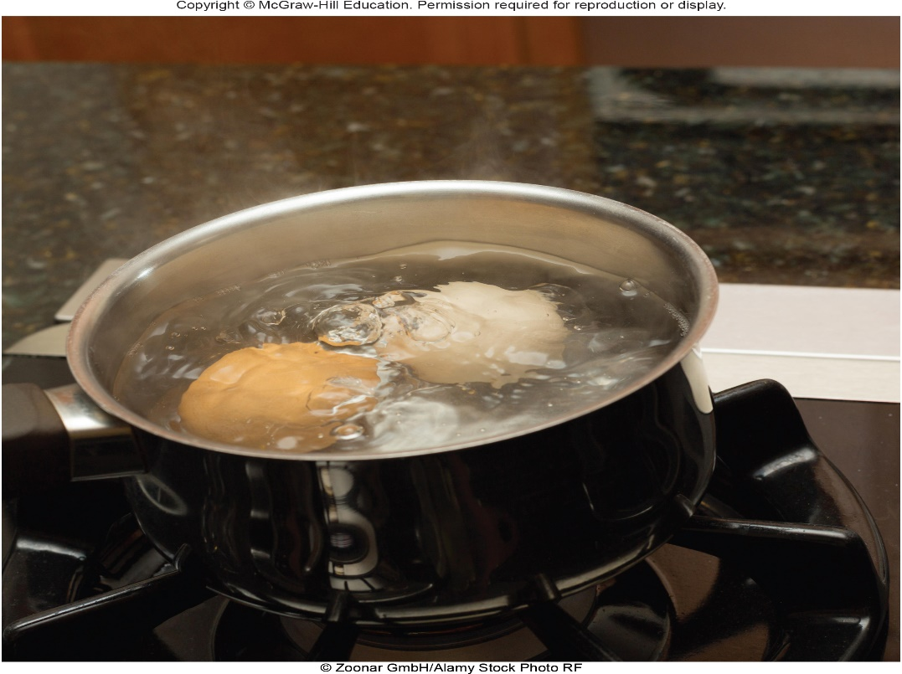
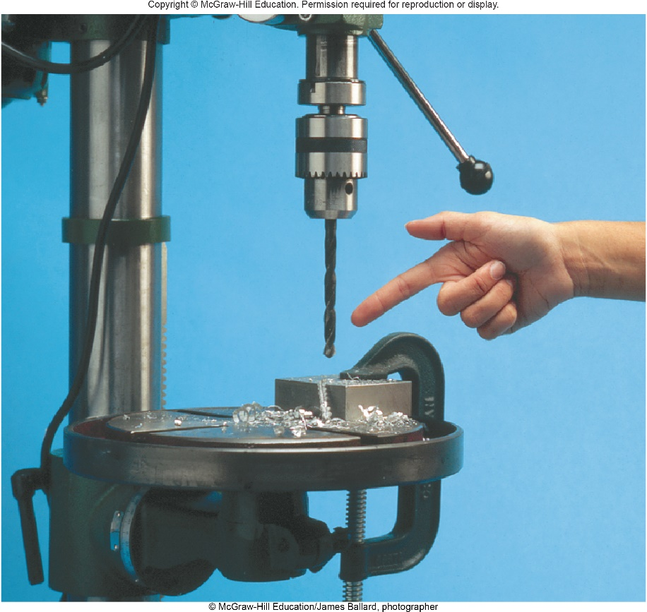
Temperature and Heat
What are temperature and heat?
Are they the same?
What causes heat?

Slide 3
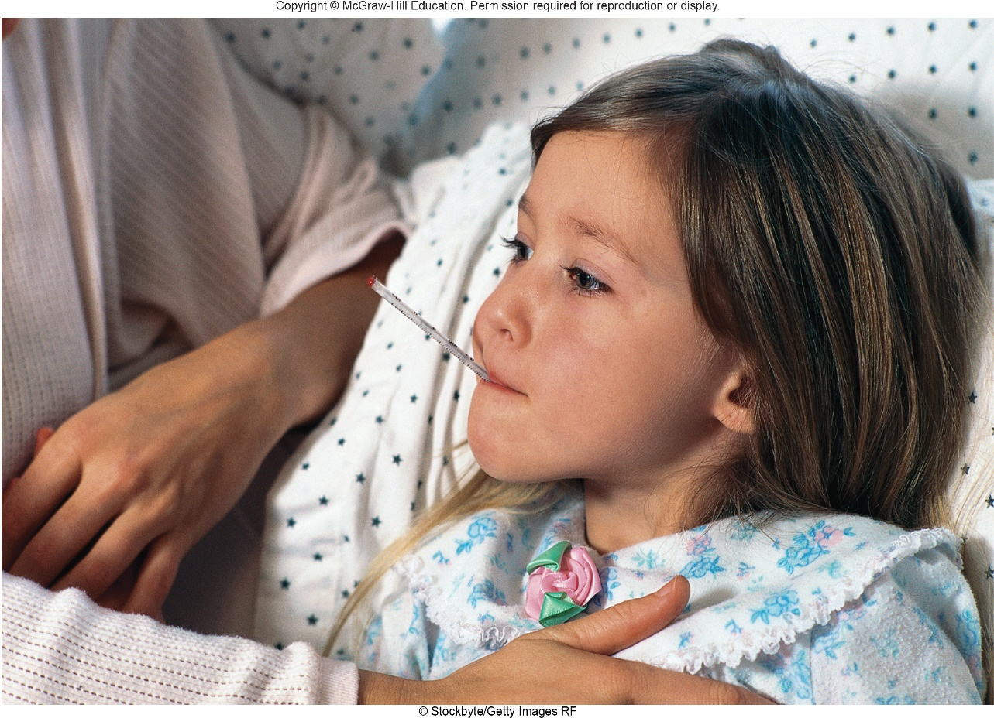
What Is Temperature?
How do we measure temperature?
What are we actually measuring?
©Stockbyte/Getty Images RFz

Slide 4
Temperature and Its Measurement 1
If two objects are in contact with one another long enough, the two objects have the same temperature.
This begins to define temperature, by defining when two objects have the same temperature.
  When the physical properties are no longer changing, the objects are said to be in thermal equilibrium.
  Two or more objects in thermal equilibrium have the same temperature.
  This is the zeroth law of thermodynamics.

Slide 5
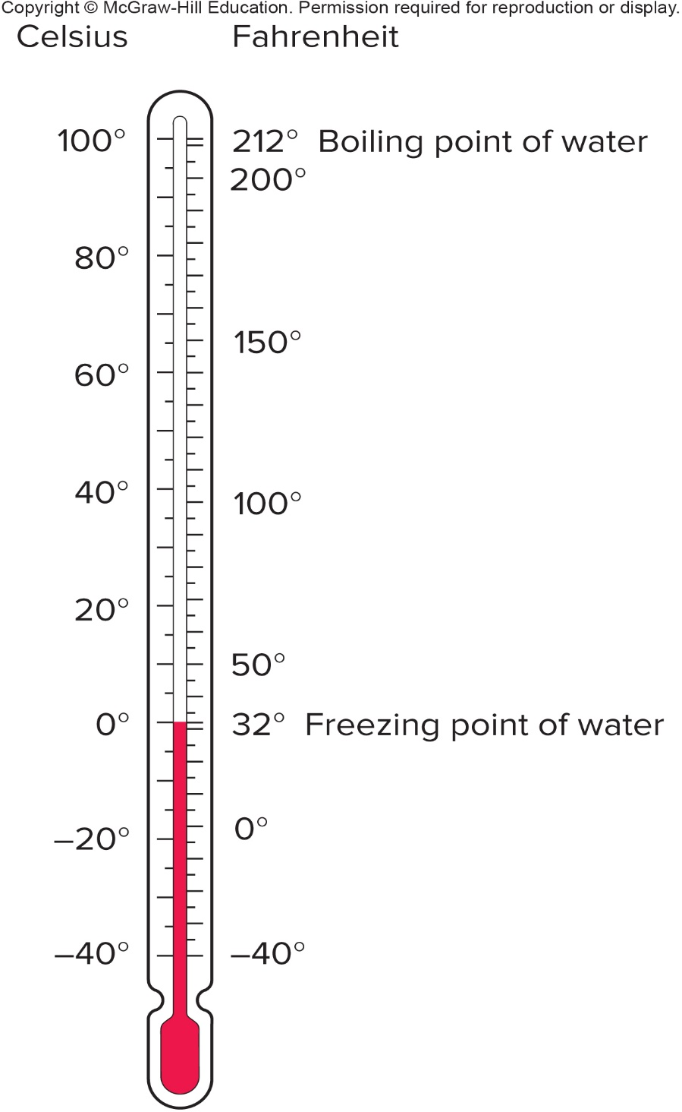
Temperature and Its Measurement 2
The first widely used temperature scale was devised by Gabriel Fahrenheit.
Another widely used scale was devised by Anders Celsius.
The Celsius degree is larger than the Fahrenheit degree: the ratio of Fahrenheit degrees to Celsius degrees is 180/100, or 9/5.

Slide 6
Temperature and Its Measurement 3
The zero point on the Fahrenheit scale was based on the temperature of a mixture of salt and ice in a saturated salt solution.
The zero point on the Celsius scale is the freezing point of water.
Both scales go below zero.
Is there such a thing as absolute zero?

Slide 7
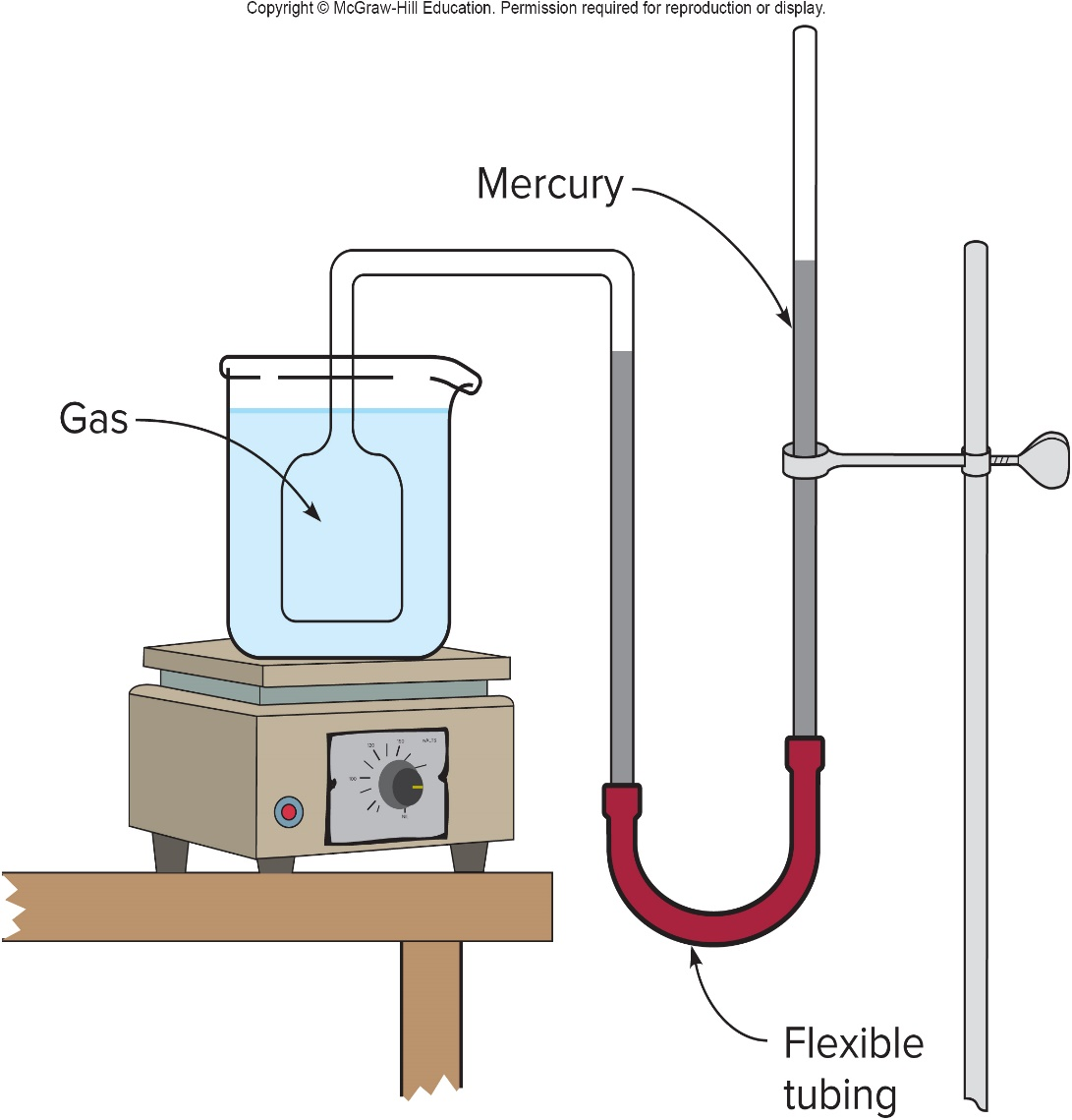
What is absolute zero? 1
If the volume of a gas is kept constant while the temperature is increased, the pressure will increase.
This can be used as a means of measuring temperature.
A constant-volume gas thermometer allows the pressure to change with temperature while the volume is held constant.
The difference in height of the two mercury columns is proportional to the pressure.

Slide 8
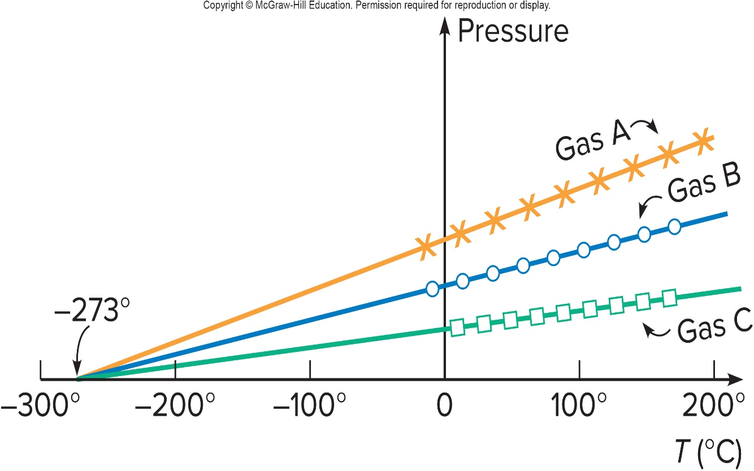
What is absolute zero? 2
We can then plot the pressure of a gas as a function of the temperature.
The curves for different gases or amounts are all straight lines.
When these lines are extended backward to zero pressure, they all
intersect at the same temperature,
Since negative pressure has no meaning, this suggests that the temperature can never get lower than
, or 0 K (kelvin).

Slide 9
What is absolute zero? 3
Can anything ever get colder than 0 K?
Can absolute zero ever be reached?

Slide 10
What is absolute zero? 4
Can anything ever get colder than 0 K?
  No.( Absolute zero represents a limiting value)
Can absolute zero ever be reached?
  No. ( we can never reach absolute zero, we can approach though)
This is the absolute zero

Slide 11
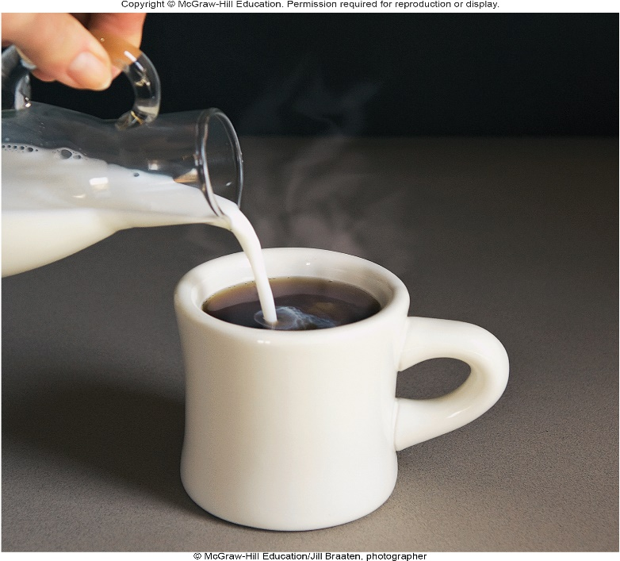
Heat and Specific Heat Capacity 1
What happens when objects or fluids at different temperatures come in contact with one another?
The colder object gets hotter, and the hotter object gets colder, until they both reach the same temperature.
What is it that flows between the objects to account for this?
We use the term heat for this quantity.

Slide 12
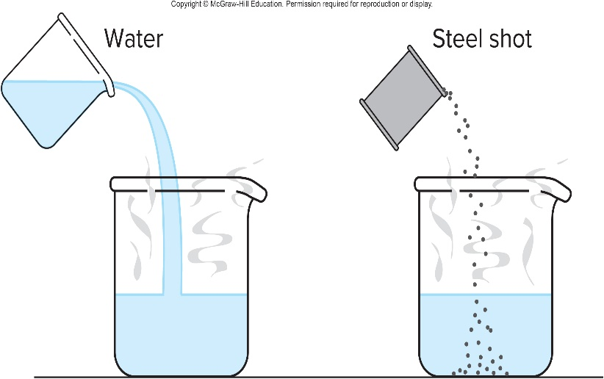
Heat and Specific Heat Capacity 2
Heat flow is a form of energy transfer between objects.
One-hundred grams of room-temperature water is more effective than 100 grams of room-temperature steel shot in cooling a hot cup of water.
Steel has a lower specific heat capacity than water.
The specific heat capacity of a material is the relative amount of heat needed to raise its temperature.

Slide 13
The specific heat capacity 1
The specific heat capacity c of a material is the quantity of heat needed to change a unit mass of the material by a unit amount in temperature.
  For example, to change 1 gram by 1 Celsius degree.
  It is a property of the material, determined by experiment.
The specific heat capacity of water is
: it takes 1 calorie of heat to
raise the temperature of 1 gram of water by
We can then calculate how much heat must be absorbed by a material to change its temperature by a given amount:

Slide 14
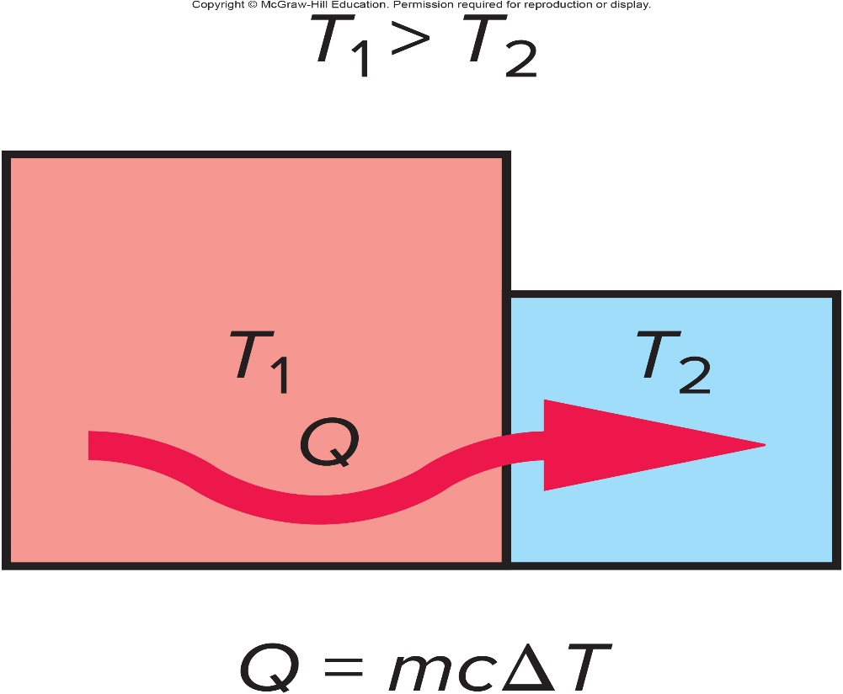
The specific heat capacity 2
When two objects at different temperatures are placed in contact, heat will flow from the object with the higher temperature to the object with the lower temperature.
Heat added increases temperature, and heat removed decreases temperature. Heat and temperature are NOT the same. Temperature is a quantity that tells us which direction the heat will flow.

Slide 15
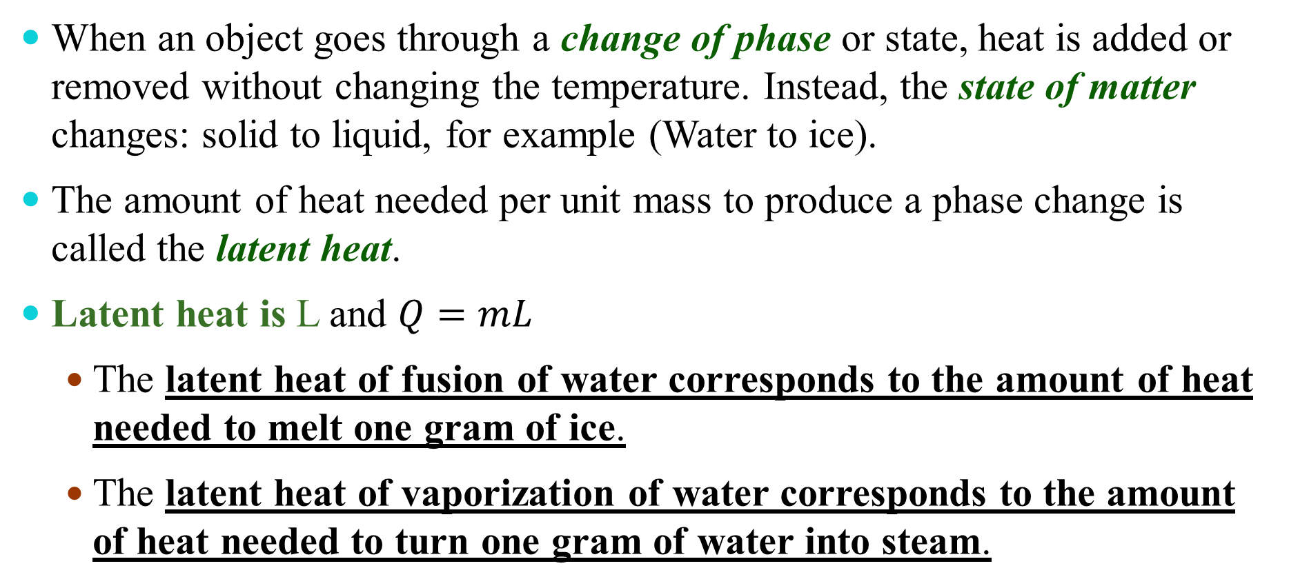
Phase Changes and Latent Heat
When an object goes through a change of phase or state, heat is added or removed without changing the temperature. Instead, the state of matter changes: solid to liquid, for example (Water to ice).
The amount of heat needed per unit mass to produce a phase change is called the latent heat.
Latent heat is L and $Q=mL$
  The latent heat of fusion of water corresponds to the amount of heat needed to melt one gram of ice.
  The latent heat of vaporization of water corresponds to the amount of heat needed to turn one gram of water into steam.

Slide 16
If the specific heat capacity of ice is 0.5 cal/g⋅ °C, how much heat would have to be added to 200 g of ice, initially at a temperature of -10°C, to raise the ice to the melting point? 1
1,000 cal
2,000 cal
4,000 cal
0 cal

Slide 17
If the specific heat capacity of ice is 0.5 cal/g⋅ °C, how much heat would have to be added to 200 g of ice, initially at a temperature of -10°C, to raise the ice to the melting point? 2
1,000 cal
2,000 cal
4,000 cal
0 cal
Define your variables!

Slide 18
If the specific heat capacity of ice is 0.5 cal/g⋅ °C, how much heat would have to be added to 200 g of ice, initially at a temperature of -10°C, to raise the ice to the melting point? 3
1,000 cal
2,000 cal
4,000 cal
0 cal

Slide 19
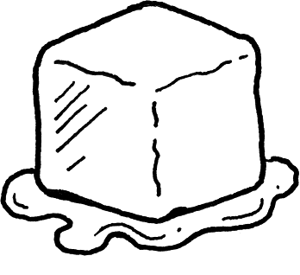
If the latent heat of fusion of ice is 80 cal/g, how much heat would have to be added to 200 g of ice, now at the melting point of ice, to completely melt the ice? 1
1,000 cal
14,000 cal
16,000 cal
17,000 cal

Slide 20
If the latent heat of fusion of ice is 80 cal/g, how much heat would have to be added to 200 g of ice, now at the melting point of ice, to completely melt the ice? 2
1,000 cal
14,000 cal
16,000 cal
17,000 cal
Define your variables!

Slide 21
If the latent heat of fusion of ice is 80 cal/g, how much heat would have to be added to 200 g of ice, now at the melting point of ice, to completely melt the ice? 3
1,000 cal
14,000 cal
16,000 cal
17,000 cal

Slide 22
How much heat would have to be added to 200 g of ice, initially at a temperature of -10°C, to completely melt the ice? 1
1,000 cal
14,000 cal
16,000 cal
17,000 cal

Slide 23
How much heat would have to be added to 200 g of ice, initially at a temperature of -10°C, to completely melt the ice? 2
1,000 cal
14,000 cal
16,000 cal
17,000 cal
Total heat required to raise the ice to
and then to
melt the ice is:
1,000 cal + 16,000 cal = 17,000 cal = 17 kcal

Slide 24
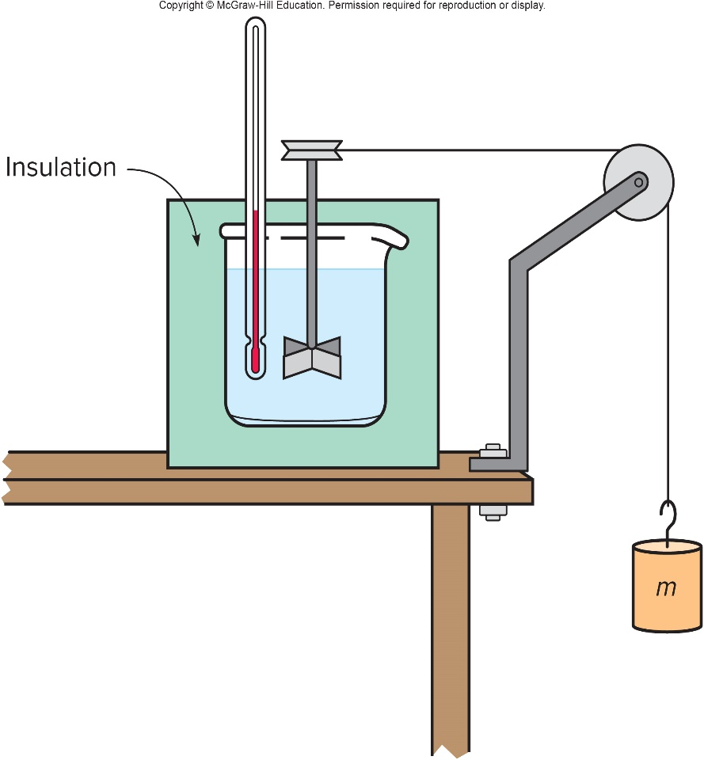
Joule’s Experiment and the First Law of Thermodynamics 1
Rumford noticed that cannon barrels became hot during drilling.
Joule performed a series of experiments showing that mechanical work could raise the temperature of a system.
In one such experiment, a falling mass turns a paddle in an insulated beaker of water, producing an increase in temperature.

Slide 25
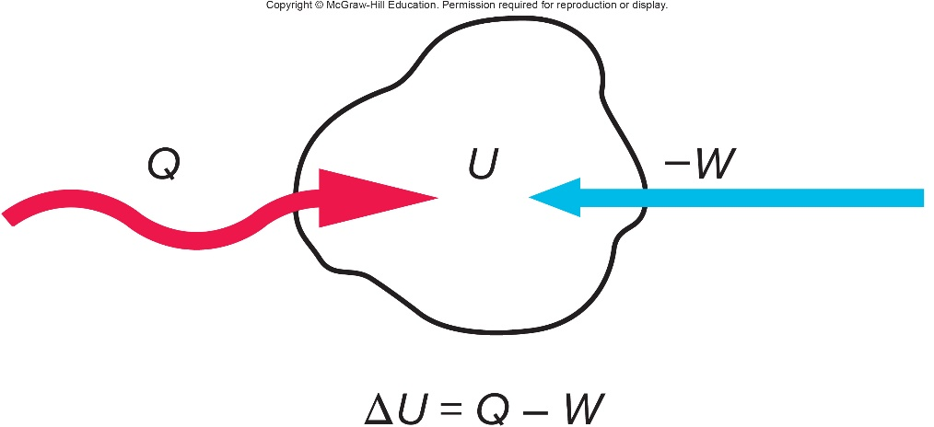
Joule’s Experiment and the First Law of Thermodynamics 2
Joule’s experiments led to Kelvin’s statement of the first law of thermodynamics.
  Both work and heat represent transfers of energy into or out of a system.
  If energy is added to a system either as work or heat, the internal energy of the system increases accordingly.
The increase in the internal energy of a system is equal to the amount of heat added to a system minus the amount of work done by the system.

Slide 26
Joule’s Experiment and the First Law of Thermodynamics 3
This introduced the concept of the internal energy of a system.
  An increase in internal energy may show up as an increase in temperature, or as a change in phase, or any other increase in the kinetic and/or potential energy of the atoms or molecules making up the system.
  Internal energy is a property of the system uniquely determined by the state of the system.
The internal energy of the system is the sum of the kinetic and potential energies of the atoms and molecules making up the system.

Slide 27
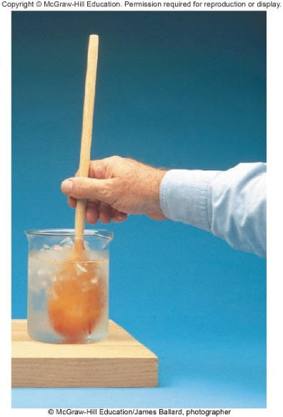
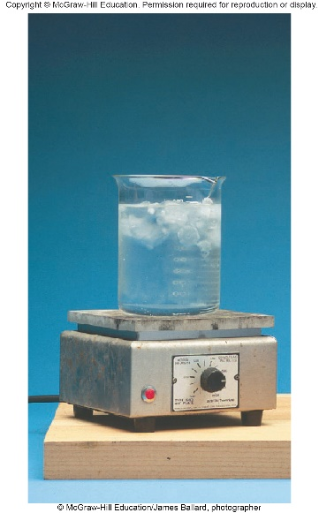
A hot plate is used to transfer 400 cal of heat to a beaker containing ice and water; 500 J of work are also done on the contents of the beaker by stirring. What is the increase in internal energy of the ice-water mixture (watch your units)? 1
900 J
1180 J
1680 J
2180 J

Slide 28
A hot plate is used to transfer 400 cal of heat to a beaker containing ice and water; 500 J of work are also done on the contents of the beaker by stirring. What is the increase in internal energy of the ice-water mixture (watch your units)? 2
Define your variables, convert your units

Slide 29
A hot plate is used to transfer 400 cal of heat to a beaker containing ice and water; 500 J of work are also done on the contents of the beaker by stirring. What is the increase in internal energy of the ice-water mixture (watch your units)? 3
Thus d is the correct answer.

Slide 30
A hot plate is used to transfer 400 cal of heat to a beaker containing ice and water; 500 J of work are also done on the contents of the beaker by stirring. How much ice melts in this process? 1
0.037 g
0.154 g
6.5 g
27.25 g

Slide 31
A hot plate is used to transfer 400 cal of heat to a beaker containing ice and water; 500 J of work are also done on the contents of the beaker by stirring. How much ice melts in this process? 2
Define your variables, convert your units

Slide 32
A hot plate is used to transfer 400 cal of heat to a beaker containing ice and water; 500 J of work are also done on the contents of the beaker by stirring. How much ice melts in this process? 3
Thus, the correct answer is c.

Slide 33
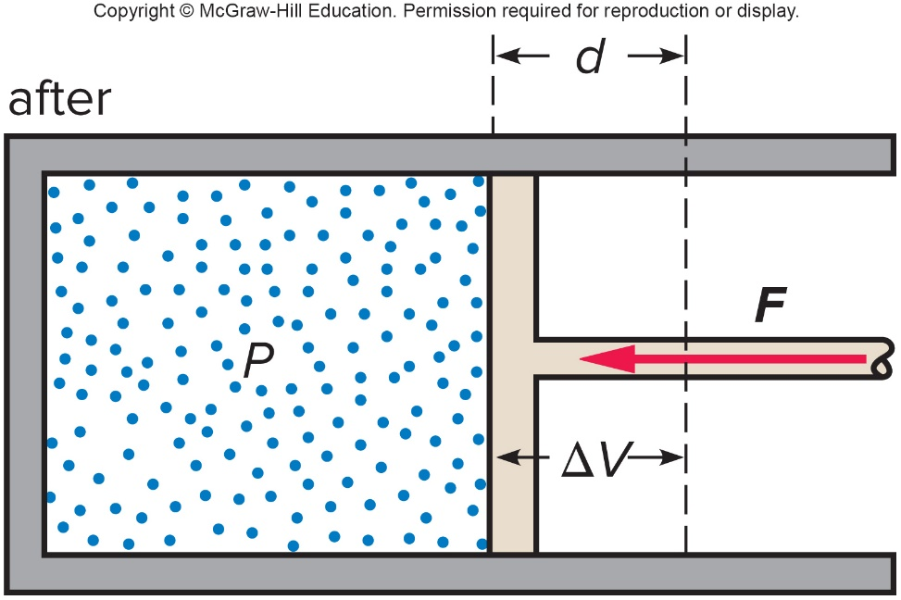
Gas Behavior and The First Law 1
Consider a gas in a cylinder with a movable piston.
If the piston is pushed inward by an external force, work is done on the gas, adding energy to the system.
The force exerted on the piston by the gas equals the pressure of the gas times the area of the piston:
The work done equals the force exerted by the piston times the distance the piston moves:

Slide 34

Gas Behavior and The First Law 2
If the gas is being compressed, the change in volume is negative, and the work done is negative.
  Work done on the system is negative.
  Negative work increases the energy of the system.
If the gas is expanding, positive work is done by the gas on its surroundings, and the internal energy of the gas decreases.

Slide 35
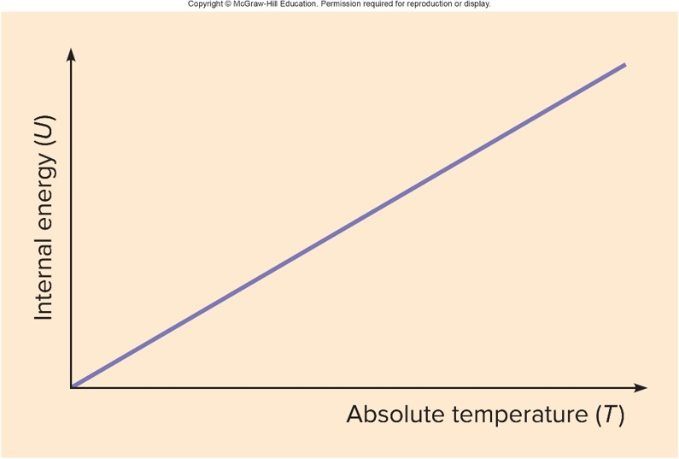
Gas Behavior and The First Law 3
An ideal gas is a gas for which the forces between atoms are small enough to be ignored.
  For an ideal gas, absolute temperature is directly related to the average kinetic energy of the molecules of the system.
  Most gases behave approximately as ideal gases.
If the process is adiabatic, no heat flows into or out of the gas.
Even though no heat is added, the temperature of a gas will increase in an adiabatic compression, since the internal energy increases.

Slide 36
Gas Behavior and The First Law 4
If the process is adiabatic, no heat flows into or out of the gas.
Even though no heat is added, the temperature of a gas will increase in an adiabatic compression, since the internal energy increases.
Be very careful. This is an example where NO heat is transferred (Q equals zero) yet the temperature increases. Temperature and heat are NOT the same thing.
An example of an adiabatic process is one that occurs in a perfectly insulated container.
Another example is an process that occurs so fast that there is not time for heat to be transferred.

Slide 37
Gas Behavior and The First Law 5
In an isothermal process, the temperature does not change.
  The internal energy must be constant.
The change in internal energy,
, is zero.
If an amount of heat Q is added to the gas, an equal amount of work W will be done by the gas on its surroundings, from
In an isobaric process, the pressure of the gas remains constant.
  The internal energy increases as the gas is heated, and so does the temperature.
  The gas also expands, removing some of the internal energy.

Slide 38
Ideal Gas Law
  Experiments have determined that the pressure, volume, and absolute temperature of an ideal gas are related by the equation of state:
  PV = NkT where N is the number of molecules and k is Boltzmann’s constant.
  This is also known as the ideal gas law.
  Another form of this equation is PV = nRT, where n is the number of moles and R is the gas constant.

Slide 39
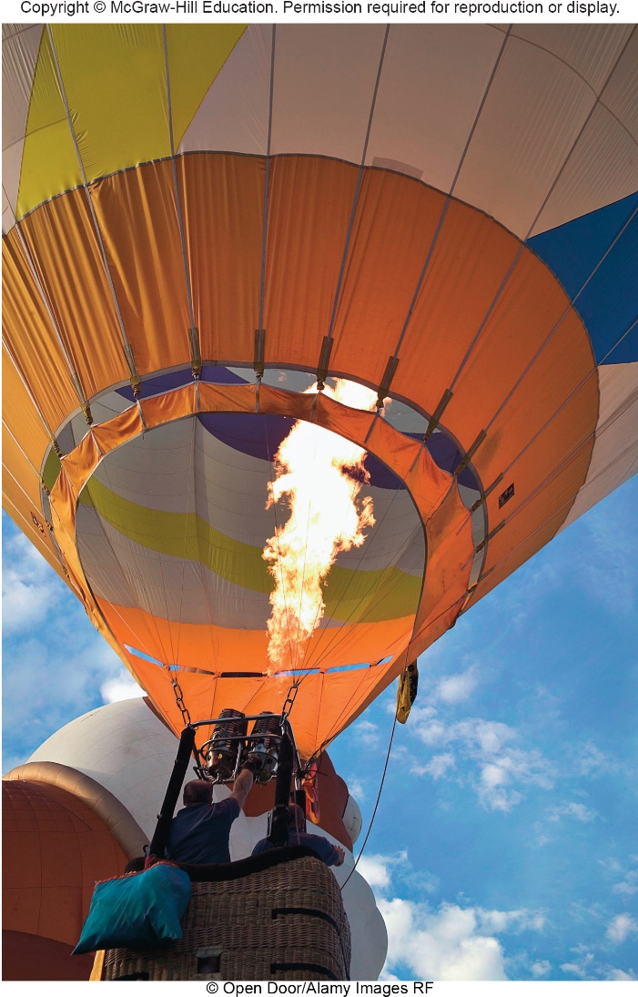
What process makes a hot-air balloon rise?
When gas is heated in a hot-air balloon, the pressure, not the temperature, remains constant.
The gas undergoes an isobaric expansion.
Since the gas has expanded, the density has decreased.
The balloon experiences a buoyant force because the gas inside the balloon is less dense than the surrounding atmosphere.

Slide 40
The Flow of Heat 1
There are three basic processes for heat flow:
  Conduction
  Convection
  Radiation

Slide 41
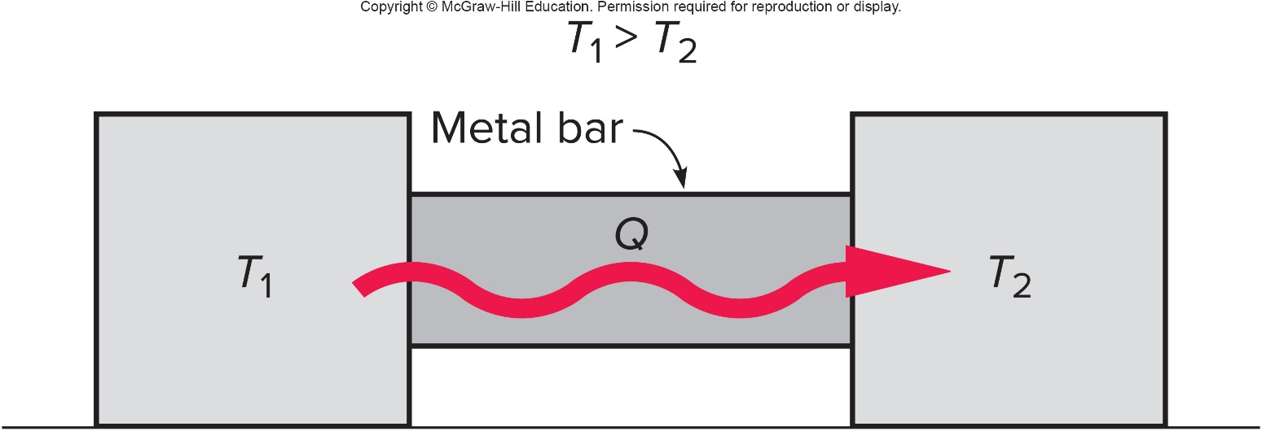
The Flow of Heat 2
In conduction, heat flows through a material when objects at different temperatures are placed in contact with one another.

Slide 42
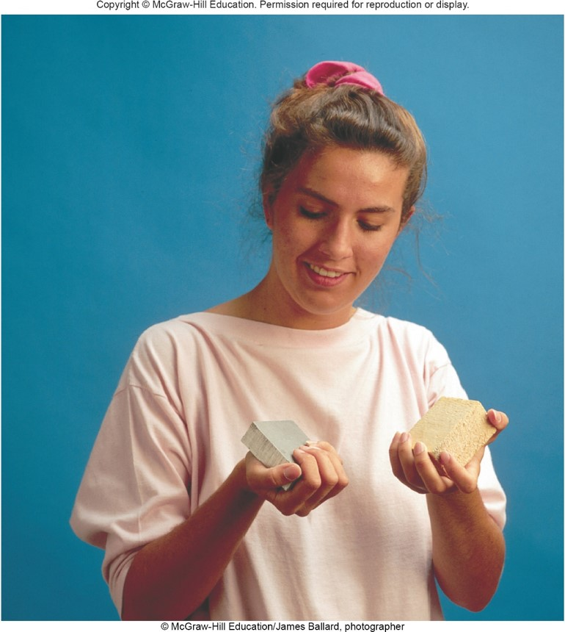
The Flow of Heat 3
  Conduction
  The rate of heat flow depends on the temperature difference between the objects.
  It also depends on the thermal conductivity of the materials, a measure of how well the materials conduct heat.
  For example, a metal block at room temperature will feel colder than a wood block of the exact same temperature.
  The metal block is a better thermal conductor, so heat flows more readily from your hand into the metal.
  Since contact with the metal cools your hand more rapidly, the metal feels colder.

Slide 43
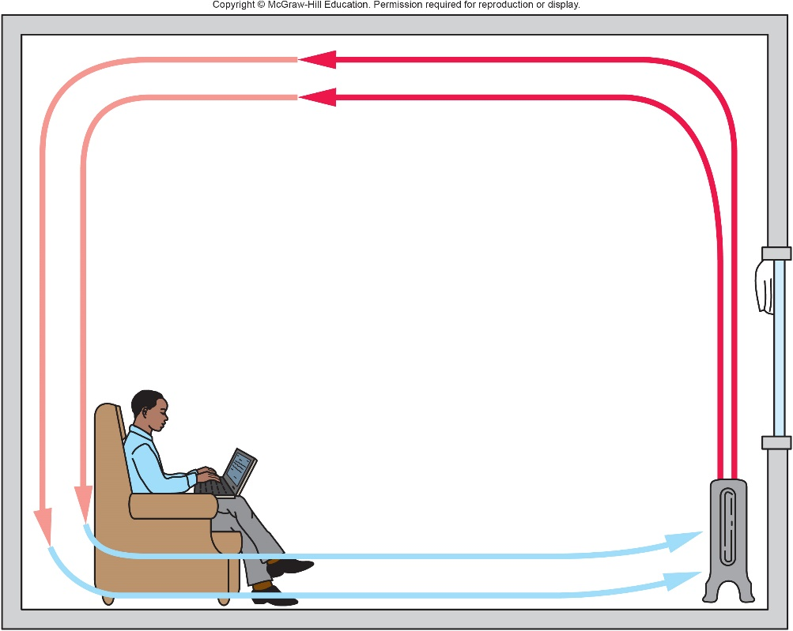
The Flow of Heat 4
  In convection, heat is transferred by the motion of a fluid containing thermal energy.
    Convection is the main method of heating a house.
    It is also the main method heat is lost from buildings.

Slide 44
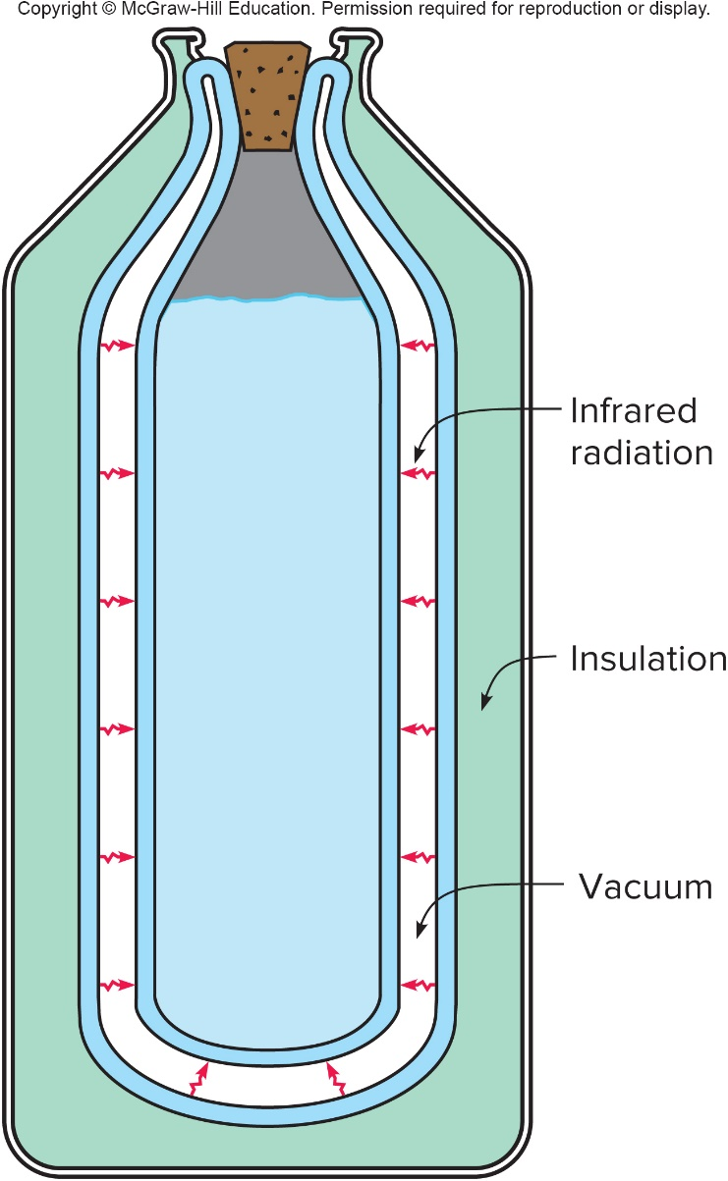
The Flow of Heat 5
  In radiation, heat energy is transferred by electromagnetic waves.
    The electromagnetic waves involved in the transfer of heat lie primarily in the infrared portion of the spectrum.
    Unlike conduction and convection, which both require a medium to travel through, radiation can take place across a vacuum.
    For example, the evacuated space in a thermos bottle.
    The radiation is reduced to a minimum by silvering the facing walls of the evacuated space.

Slide 45
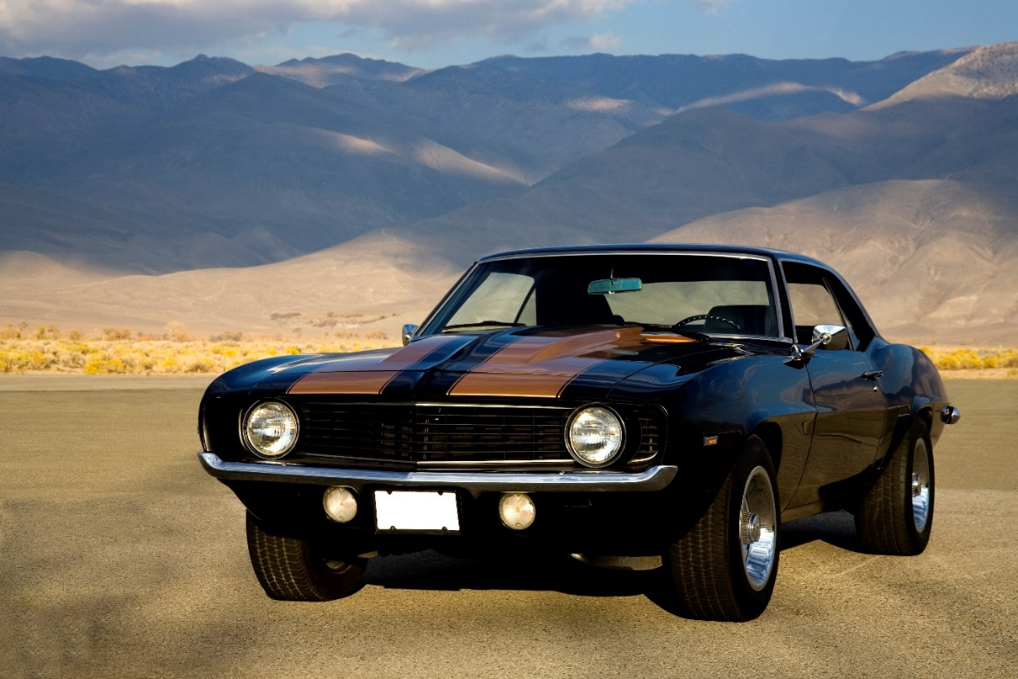
The Flow of Heat 6
Which process makes a car’s interior heat up when parked in the sun?
a) Radiation
b) Convection
c) Conduction

Slide 46
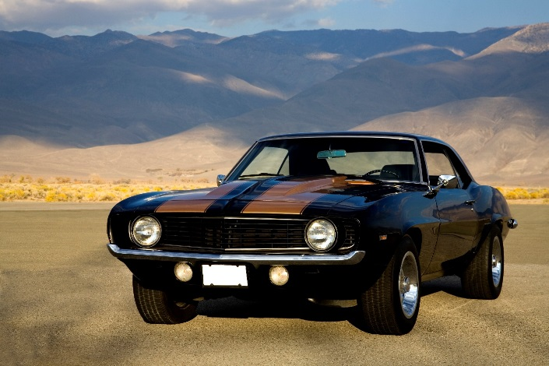
The Flow of Heat 7
Which process makes a car’s interior heat up when parked in the sun?
a) Radiation
Radiation involves the flow of energy by electromagnetic waves, such as those coming from the sun.

Slide 47
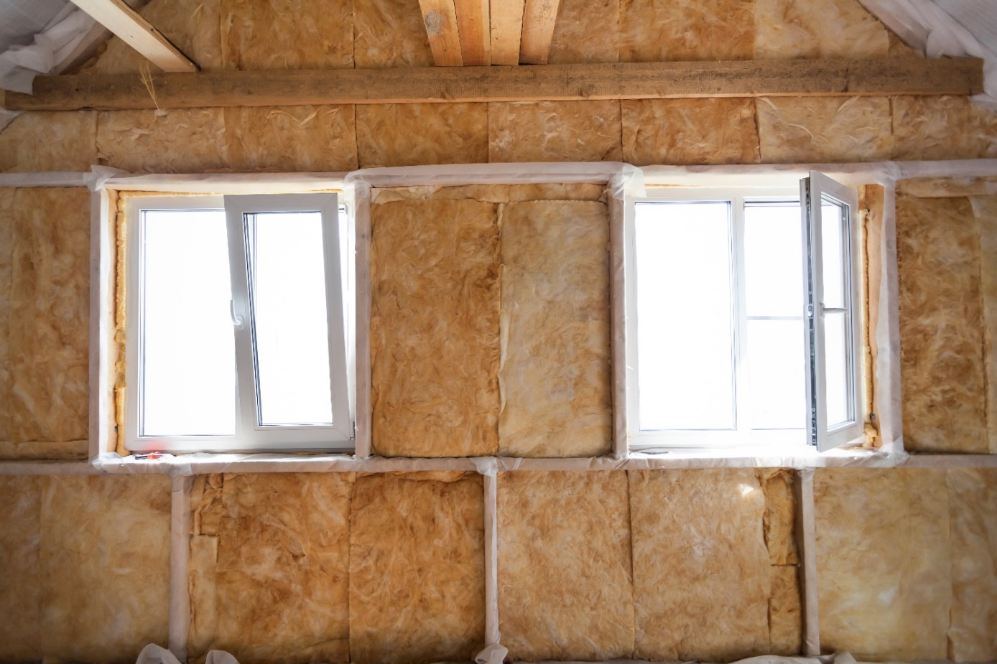
The Flow of Heat 8
Why are houses insulated with material in the walls instead of just empty space?

Slide 48
The Flow of Heat 9
Why are houses insulated with material in the walls instead of just empty space?
To reduce loss of heat from radiation and conduction.
Some of the heat flow across the dead-air space within a wall is due to radiation and some to conduction through the air.

Slide 49
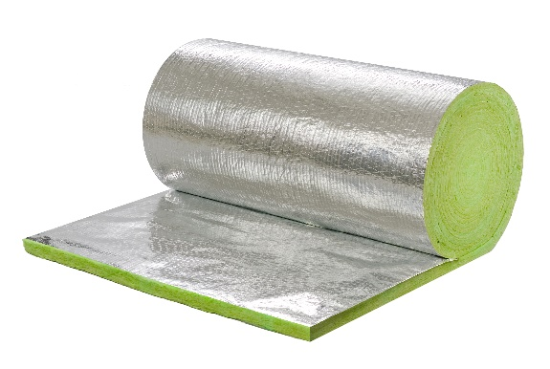
The Flow of Heat 10
Why is this insulated material often foil-backed?
To limit loss of energy through radiation
Using foil-backed insulation reduces heat flow from radiation.
It causes the electromagnetic waves to be reflected rather than absorbed and reduces the energy flow through the walls
Thin sheets of foil-backed insulation may have R values equal to those of thicker sheets of insulation without the foil backing.

Slide 50
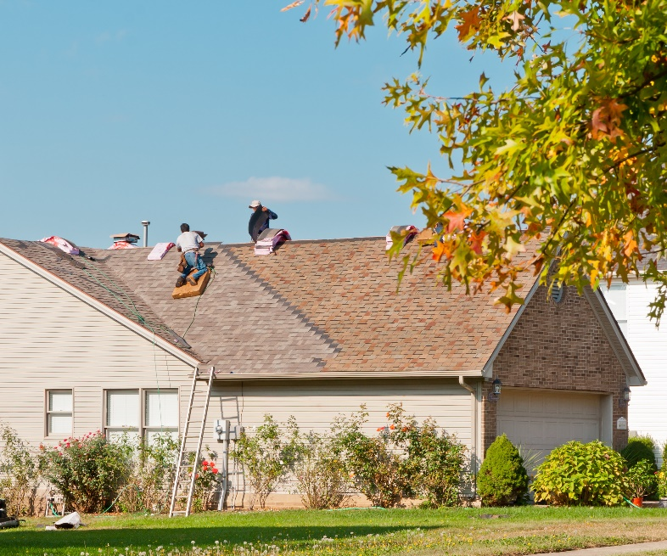
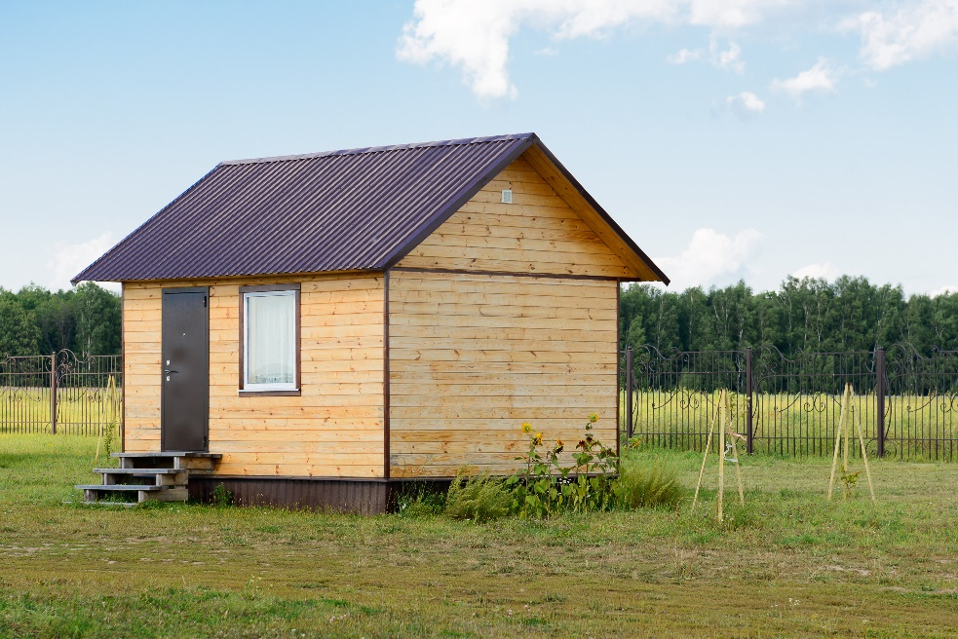
The Flow of Heat 11
Is a light-colored roof or a dark-colored roof more energy efficient?

Slide 51
The Flow of Heat 12
Is a light-colored roof or a dark-colored roof more energy efficient?
Light colored roofs keep a house cooler reducing cooling costs.
Radiation is also involved in the loss of energy from roofs. Black surfaces in general, are effective radiators of electromagnetic waves. Good absorbers of electromagnetic radiation are also good emitters: Black materials both absorb more solar energy in the summer and lose more heat in the winter. A black roof may look nice, but it is not the best color for energy conservation. A lighter color is more effective in keeping your home both cool in the summer and warm in the winter.

